Slide 1



The impact of Buddhism
on life today (part 2).
Key Question…
What is the evidence that Buddhism is an influential religion in the 21st Century?
To begin…
Note down up to five examples of where you have seen examples of Buddhist symbolism, teachings or beliefs you have noticed outside of your RE lessons.

Slide 2
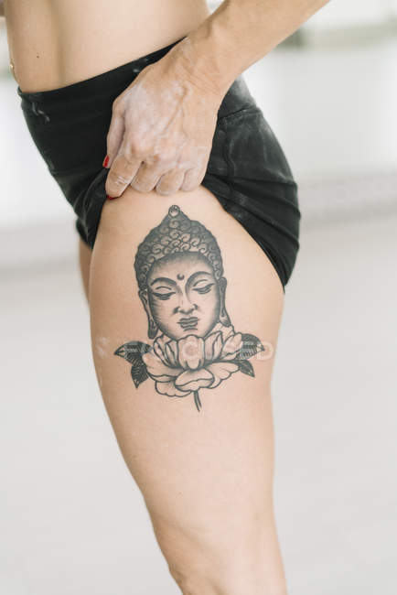


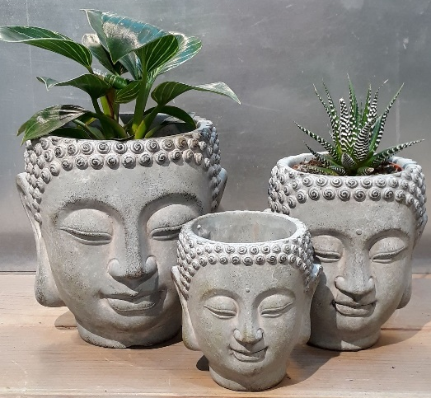


The impact of Buddhism on life today
(part 2).
Read and complete…
Read the information you will be given and answer the questions about the images on the sheet.

Slide 3
The impact of Buddhism on life today
(part 2).
What do you think?
After reading all the information what is your opinion about the requests about the use of images of Buddha?
Are the requests reasonable?
Are they a bit over the top?
Give examples of how symbols of other faiths are used.
How do you think other faiths think about the use of their religious symbols? Explain with examples.
{
Explain you answers.

Slide 4
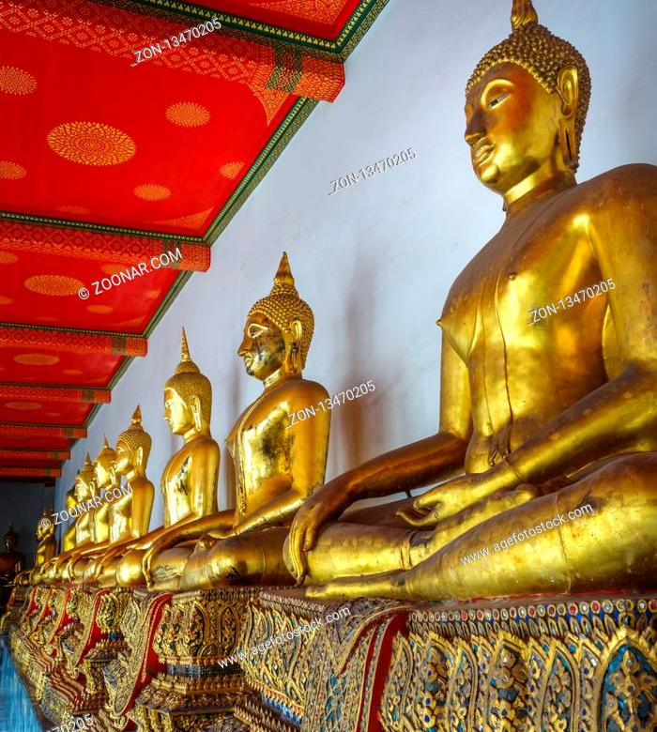

The impact of Buddhism on life today (part 2).
Review.
Note down three advantages and three disadvantages of the non-religious use of religious images.
Advantages | Disadvantages

