Slide 1
The Impact of Buddhism
on Life Today.
Key Question…
What is Buddhism all about?
To begin…
Note down five things you
already know about Buddhism.

Slide 2
The impact of Buddhism on life today
What is Buddhism all about?
Read the information and then design an information poster (no more than 2 sheets of A4) that informs other people of the essentials of Buddhism.
Make sure your poster includes the basics on each of the following:
The foundations and founder of Buddhism
Key Beliefs
Different types of Buddhism
The Dharma, key teachings and holy books
The Dalai Lama
Festivals

Slide 3
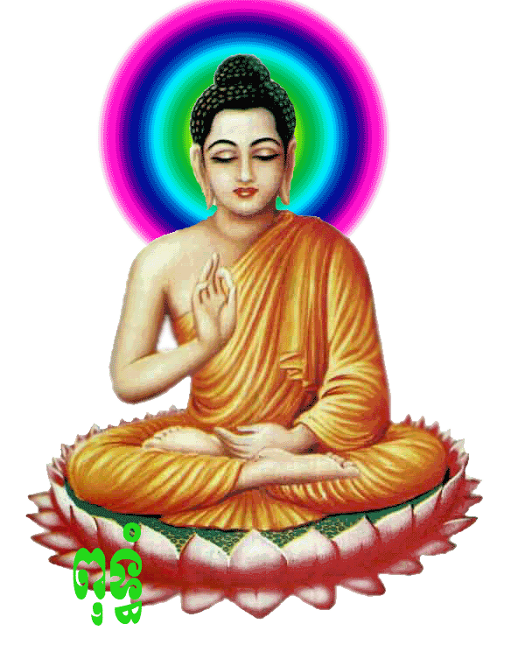
The impact of Buddhism on life today
Review…
Answer the following questions…
1. What did you find most interesting about Buddhism?
2. What did you find most surprising about Buddhism?
Reflect…
Note down five qualities you would expect a practicing Buddhist should have.

