Slide 1
Religion in the 21st Century
Key Question…
How popular is religion today?
Selling Freezers to Inuits
In pairs, sell religion to your partner – one person to take on the role of the ‘seller’ and the other, the ‘customer’.
The ‘seller’
Give reasons why your partner should belong a religion (any religion). Explain some of the benefits of religion.
The ‘customer’
In response, give reasons why you don’t think being in a religion is for you. Consider carefully your responses to the sellers points.

Slide 2
Religion in the 21st Century
Think and answer…
What would the world be like if there was no religion?
Note down 5 differences there might be in the world if religion was banned.
Bearing in mind your responses to the above task, would the world be a better or worse place without religion?

Slide 3
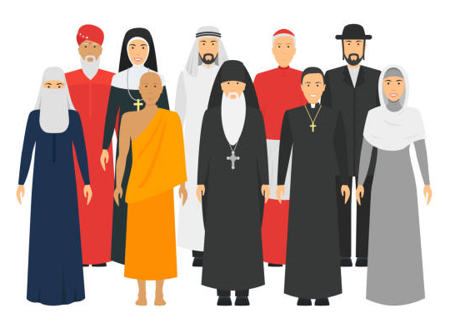
Religion in the 21st Century
What do you think?
Is membership of religions on the rise, or is it falling?
Explain your answer.
What do you think?
Read the article from the Guardian newspaper.
Complete the tasks outlined at the end of the article.
Chromebooks would be handy here.

Slide 4
Religion in the 21st Century
What do you think?
You should now have an understanding of what a theocracy is. Explain what you think the advantages and disadvantages there might be living in a theocratic country.
Consider and explain some of the advantages and disadvantages of belonging to a religion.

Slide 5
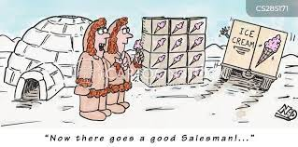
Religion in the 21st Century
Review…
Selling Freezers to Inuits – again!
In your exercise books, using information you have learnt from the article, note down at least three reasons to belong to a religion and reasons why someone would not want to be a religious believer.

