Slide 1
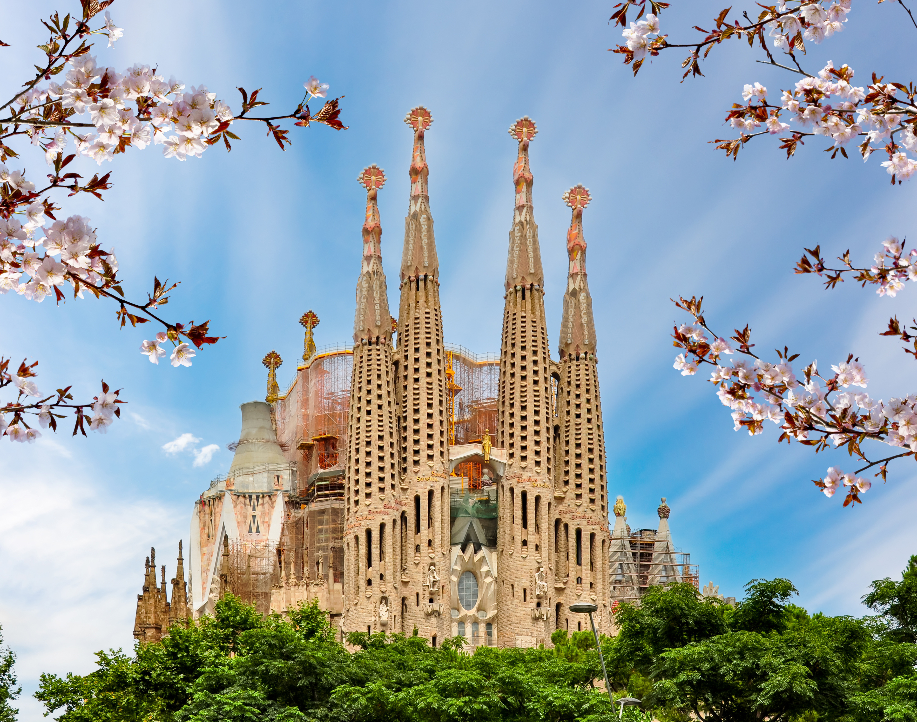
The Global Dimension
Key Question…
What do religions have to offer the world?
To begin…
Note down 5 ways in which religion has influenced the world.
Add specific examples of each idea.
 | Ideas | Specific examples
1 | Art | Sagrada Familia
2
3 | Food
4
5

Slide 2
The Global Dimension
My World View…
On your ‘lens’ outline, answer the following questions. Remember the answers should be from your own views, thoughts and ideas.
How might religion influence your life?
How much of an influence does religion have in the world?
Which religion has the most influence in the world? Explain your answer.
… and now, read through the unit booklet to discover what you will be learning about this term.

Slide 3
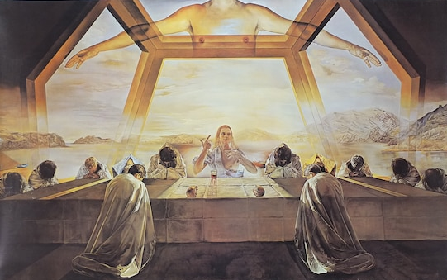
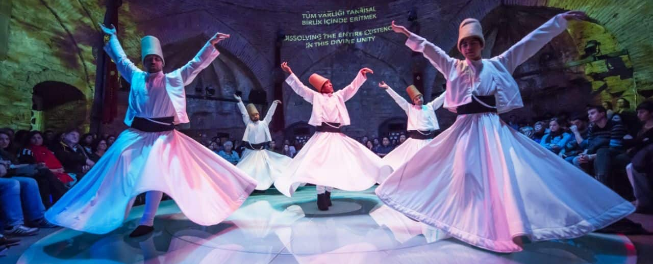
The Global Dimension
Research and Report…
In groups you will be given one area of life where religion may have an influence. You will need to find examples and pictures, explain how your examples influence this area and evaluate how far religion influences this area.

Slide 4
The Global Dimension
Research and Report…
This is group work and everyone needs to contribute.
Each person needs to look up at least one example of religion in their area, find a picture and explain a little about the example.
All need to discuss and note down answers to tasks 3 & 4.
Your work should be presented as a power point to be shown to the rest of the class indicating which group members have researched which example.

Slide 5
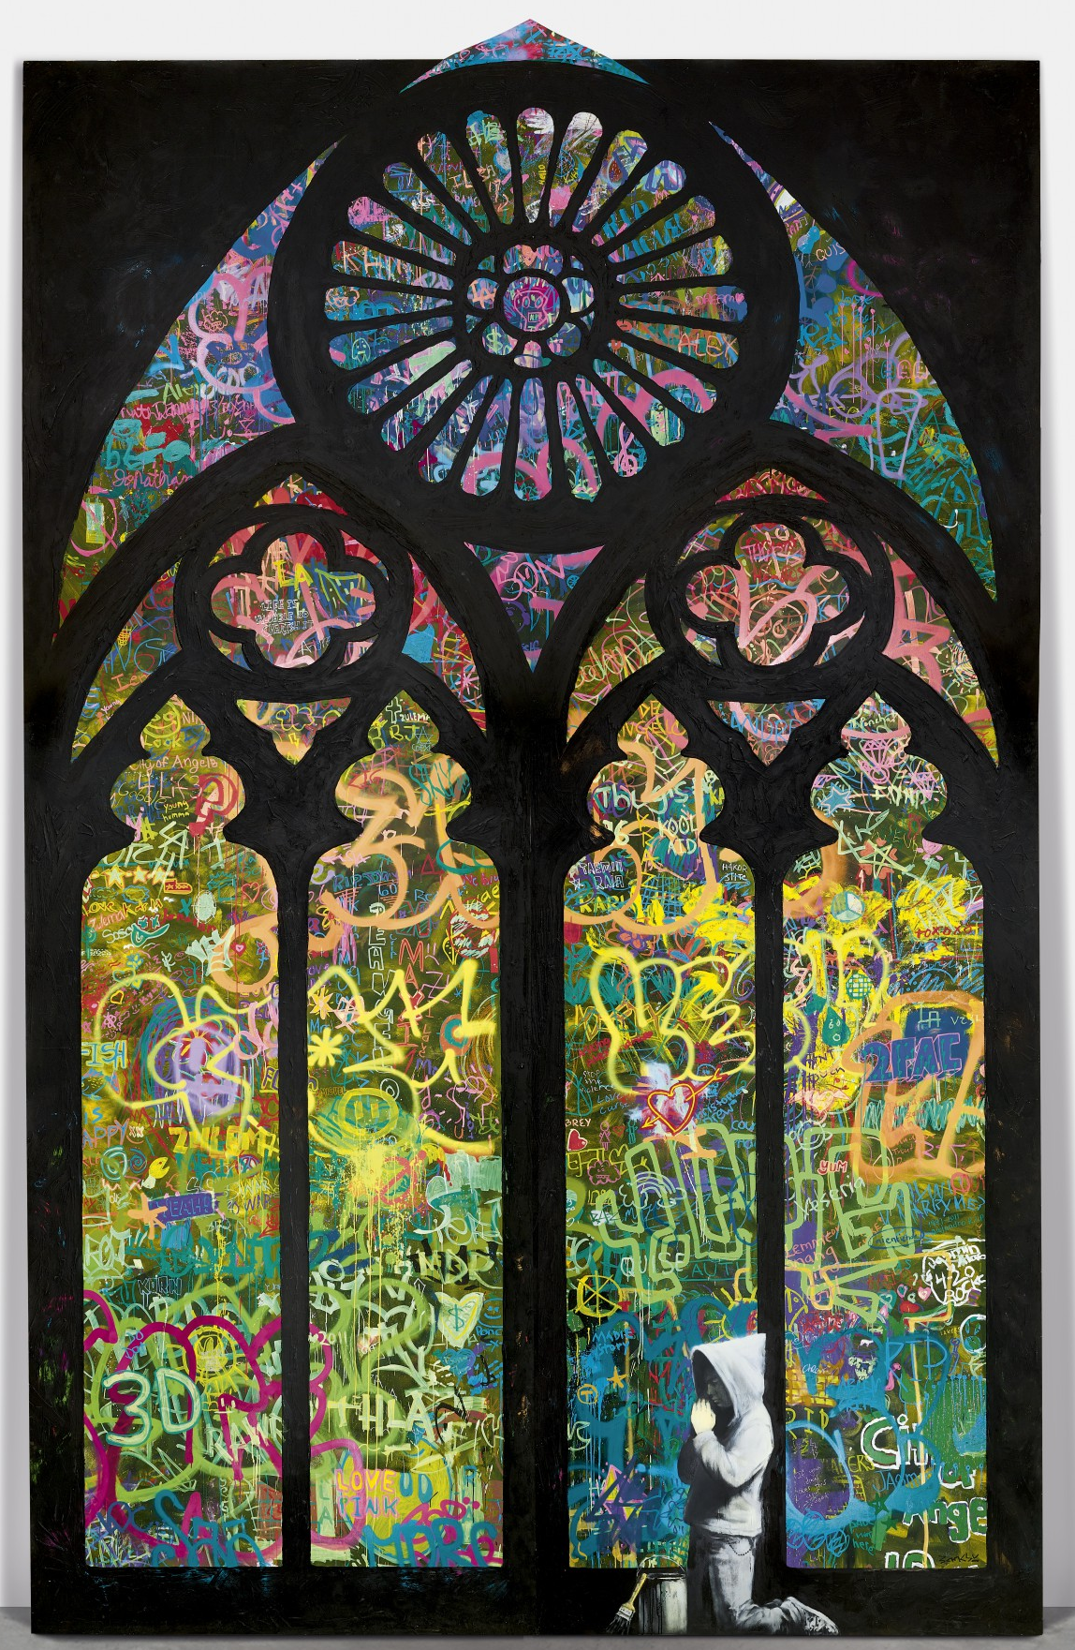
The Global Dimension
Research and Report… Areas to research;
Group 1 – Music and dance
Group 2 – Art
Group 3 – Science
Group 4 – the UK
Groups 5 - Food
Group 6 – Popular media (e.g. TV, Internet, film)
Group 7 – Charities

Slide 6
The Global Dimension
Instructions…
For each area of research complete the following tasks.
Find an example of religion/religious person associated with your groups area. Include pictures.
Explain the links to religion, which religion(s), how might this example impact on people’s lives?
Discuss your findings as a group and explain how your examples may influence your area, how religion may be influenced by this area and evaluate how much of an influence religion has in your area. Put your information together to present to the rest of the class as a power point.

Slide 7
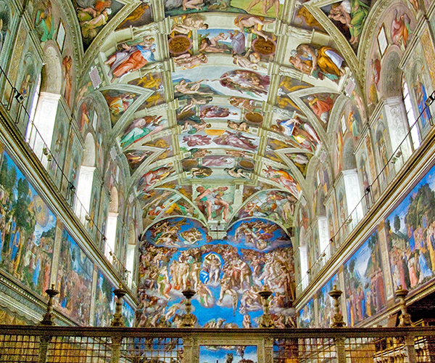
Example… Science…
Name… Georges Lemaitre.
Famous for (achievements etc…)
His religion was…
His faith influenced him by…
The Global Dimension
Example… Art…
Name… Sistine Chapel Ceiling.
Famous for…
Religious links…
Influences …

Slide 8
The Global Dimension
Review…
Write up your group’s evaluation in your exercise book.
Write an answer to the statement below making sure you consider different points of view.
‘Religion has little influence in the 21st century’.
Assess this view.
I agree with this statement because…
I disagree with this statement because…

