Slide 1
Wise Words – Reflections on the topic.
Key Question…
Why are wise words important?
To begin…
Use the clues to find the words in the wordsearch.
…and then – 5 Questions.
Answer the, ‘what, who, where, when and why’ questions based on the pictures on the sheet.

Slide 2
Wise Words – Reflections on the topic.
Make links…
Make links between each of the following lists;
Jesus Bible MLK ‘Wise Words’
Bhagavad Gita Gandhi ‘Wise Words’
Sikh Gurus Harmandir Sahib Langar ‘Wise Words’

Slide 3
Wise Words – Reflections on the topic.
Question…
During this topic we have looked at wise words of Jesus and the Bible, Martin Luther King Jr, The Bhagavad Gita, Gandhi and the Sikh Gurus.
… and the question is, ‘What was the point’?
Write an answer to this question making sure you include evidence (e.g. a quotation or reference to someone or something you have learnt about).

Slide 4
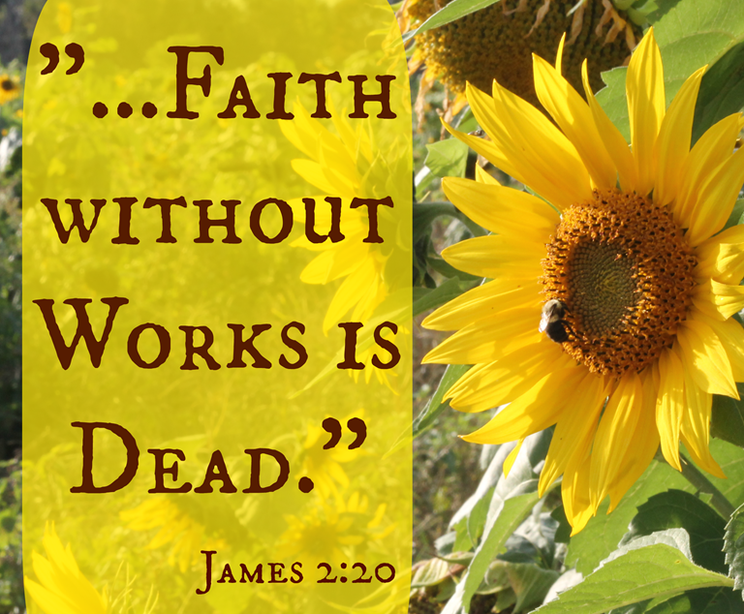
Wise Words – Reflections on the topic.
The answer…
There is no one correct answer to the question, ‘What was the point?’ – there are many!
Perhaps, though, we need to think about how these ‘wise words’ are put into action.
Think and note down…
Write down the quotation on this slide. Explain what you think it means to religious people.

Slide 5
Wise Words – Reflections on the topic.
Your Worldview…
Considering what you have learnt since beginning this topic answer the questions from your own point of view…
What do you think belief is?
What do you think religion is for?
Why do you think people belong to religions?
How do you think religion benefits society?

Slide 6
Wise Words – Reflections on the topic.
Revision…
Next lesson you will be completing an assessment on this topic. Revise what you have learnt about this term.
Revision…
Complete the revision tasks on the sheet.

