Slide 1
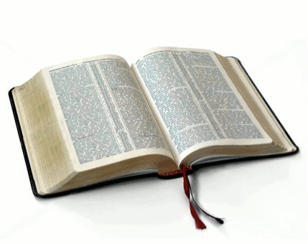
Putting Wise Words into Action.
Key Question…
What is the point of wise words?
Equality
Global Warming
To begin…
Think back to some of the inspiring ‘wise words’ you have learnt about in this topic.
Choose two of the following topics and note down ‘wise words’ of your own about these issues.
Poverty
Peace
Happiness
God
Faith
Love

Slide 2
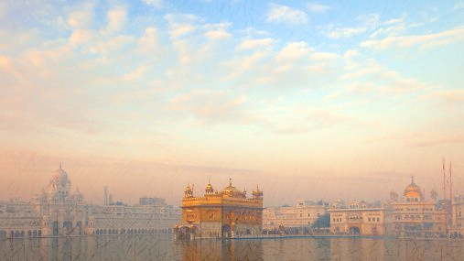
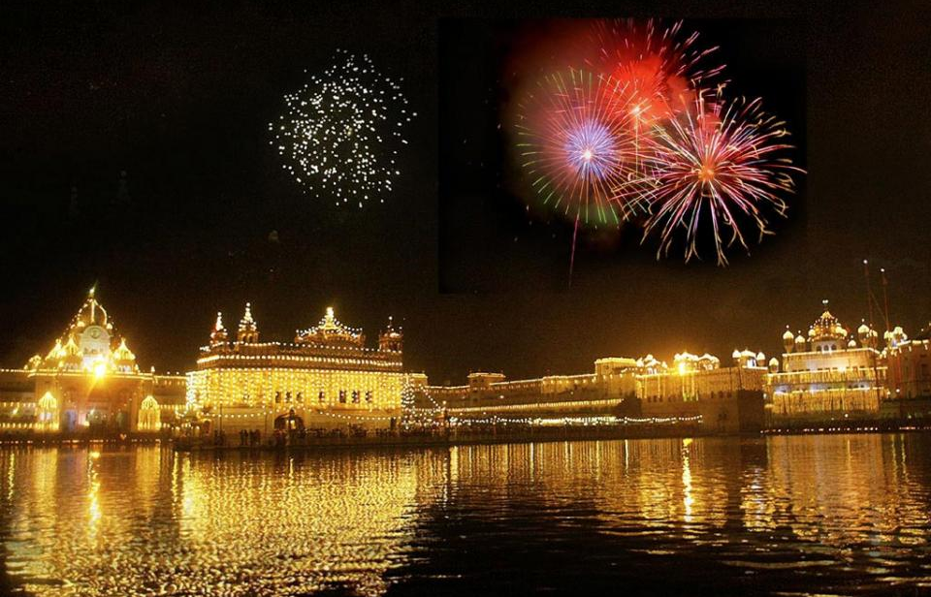
Putting Wise Words into Action.
Read and answer…
What is the Harmandir Sahib?
Read the information and answer the question above and then the questions following the information.
https://www.google.co.uk/maps/search/sri+harmandir+sahib/@31.6199802,74.8693478,1904m/data=!3m1!1e3?entry=ttu

Slide 3
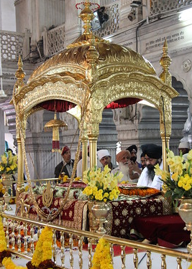
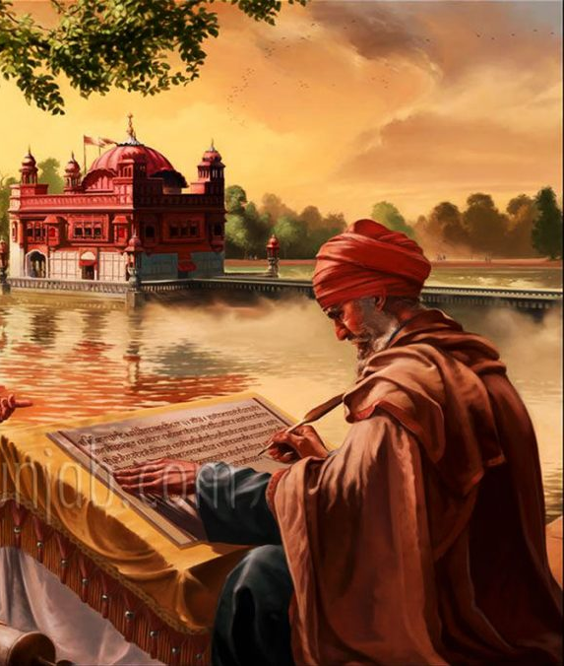
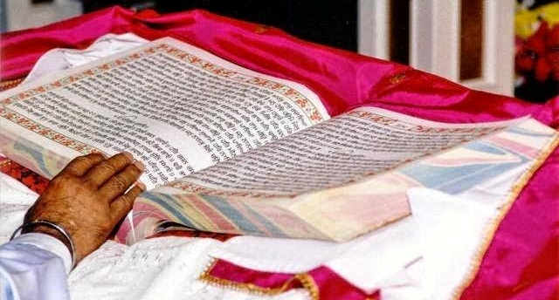
Putting Wise Words into Action.
Watch and answer…
Why, perhaps, was it surprising that the man felt very welcome in the Sikh Temple.
What did the Sikh man say he reads alongside his own holy book?
What do your answers suggest about what is important in Sikhism?
(662) Inside The Golden Temple (World's Largest Community Kitchen) – YouTu+be
Watch and answer…
Why is 1st September 1604 an important date in Sikh history?
What did Guru Gobind Singh say would be his successor?
What does the Guru Granth Sahib contain?
(662) 1st September 1604: The Adi Granth first installed at the Golden Temple - YouTube

Slide 4
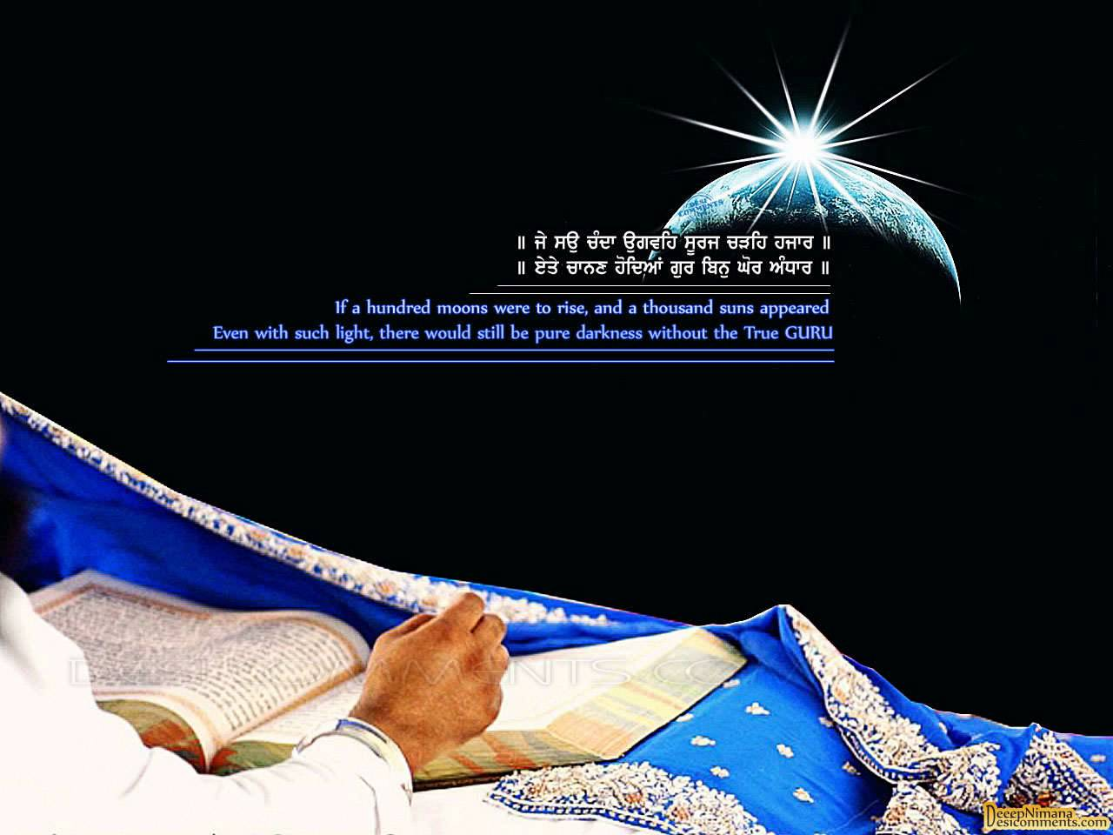
Putting Wise Words into Action.
And finally…
We have looked at some key aspects of Sikhism.
Explain how Sikhs put the words of their Gurus into
action. Include examples and reference to the
Harmandir Sahib.

