Slide 1
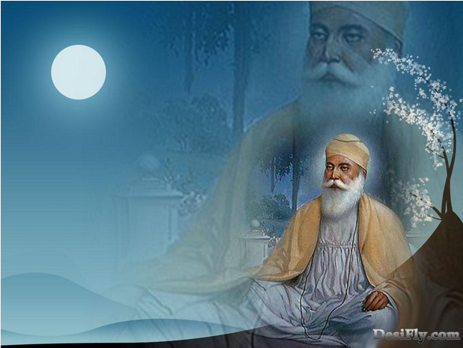
Wise words of the Ten Gurus
Key Question.
How did Sikhism develop after Guru Nanak?
Starter Task.
Write a sentence explaining a Sikh belief that matches the symbols below.

Slide 2
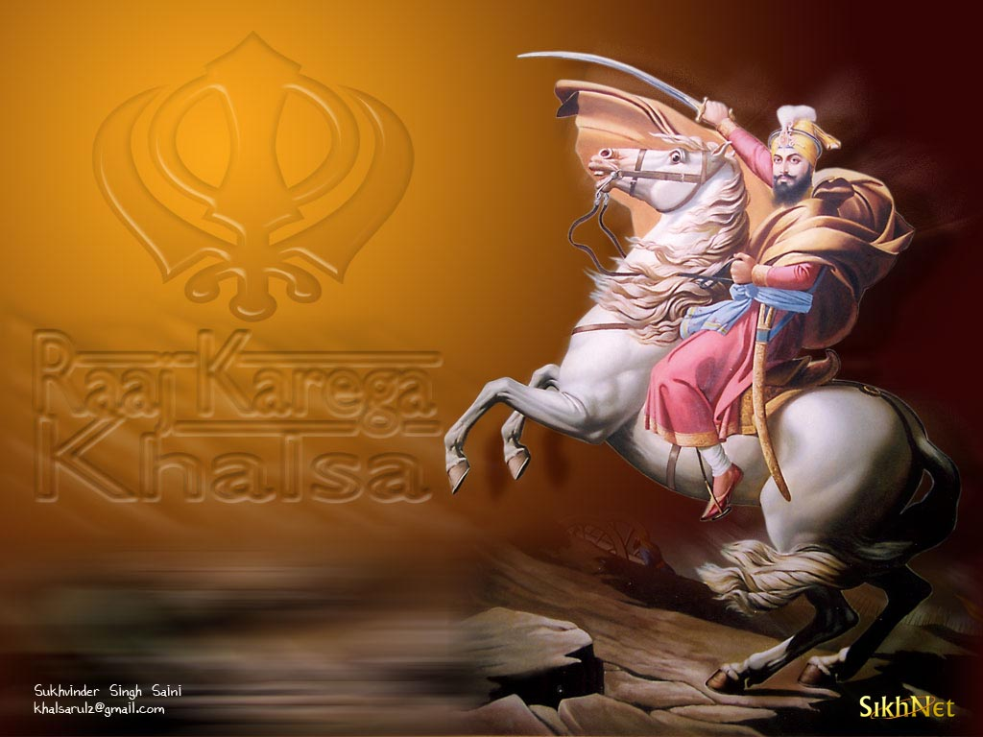
Wise words of theTen Gurus
Things to do.
1. Draw or use pictures you will be given to highlight the main achievements of each of the Gurus.
2. All the Gurus had ‘wise words’. Choose three Gurus and write down a word for each that describes a good quality they taught. Give reasons for your choices.

Slide 3
Wise words of theTen Gurus
3. Think back to the starter task – Match a Guru up to each of the beliefs you identified. Choose the Guru that is most closely identified with that belief and give your reasons.

Slide 4
Wise Words of the Ten Gurus
Review.
Write an equation to sum up the lesson. The beginning and end should be as follows;
Guru Nanak x ? + ? + ? + ? = Sikhism

