Slide 1
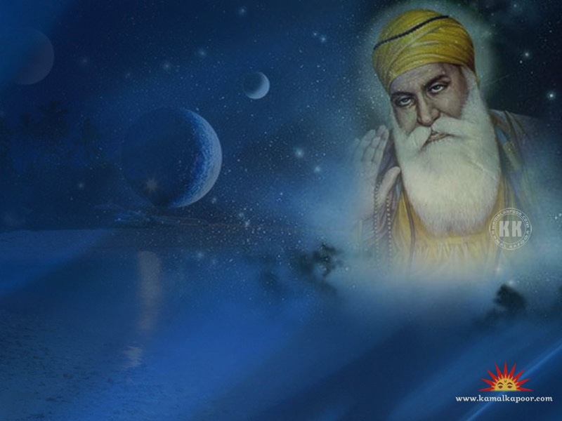
Wise Words in Sikhism
Key Question…
Where do Sikhs look for wisdom?
To begin…Odd one out…
The following have something in common
– what is it? Which is the odd one out?
Qur’an
Torah
Guru Granth Sahib

Slide 2
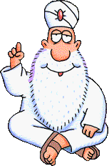
Wise Words in Sikhism.
Things to do.
Read through the script about Guru Nanak’s vision.
Use the pictures you will be given to retell the main parts of the story.
In the empty box draw and label a symbol to represent the message Guru Nanak wanted to teach.

Slide 3
Wise Words in Sikhism.
Beliefs and Symbols.
Read through the information on Guru Nanak and The Khanda.
Complete the tasks on the sheet.
Extension - Challenge.
Do you think that religions should ever use violence even if it is to defend their faith?

Slide 4
Wise Words in Sikhism.
Review and Reflect.
Answer the following questions to show what you have learnt about Sikh beliefs.
5 ways of thinking about the story of Guru Nanak;
Numbers How many days did Nanak disappear for?
People Which religions did Nanak’s friends follow?
Actions What did Nanak do after he reappeared?
4) Sights What images represent Sikh beliefs?
5) Words Which were the wisest of Guru Nanak’s
words?

