Slide 1
Was Gandhi Wise?
Key Question…
How was Gandhi influenced by Hindu teachings?
To begin… There has been an alien invasion! The new rulers from the planet Albionex and they are putting restrictions on your life in favour of the other Aliens. You are not allowed to gather together with your friends, you can only buy food from the Aliens at very high prices and you are only allowed very low paid jobs like cleaning the streets.
What do you do?
Nothing – you just have to accept the situation.
Fight the Aliens.
Run away to France
Peacefully protest.

Slide 2
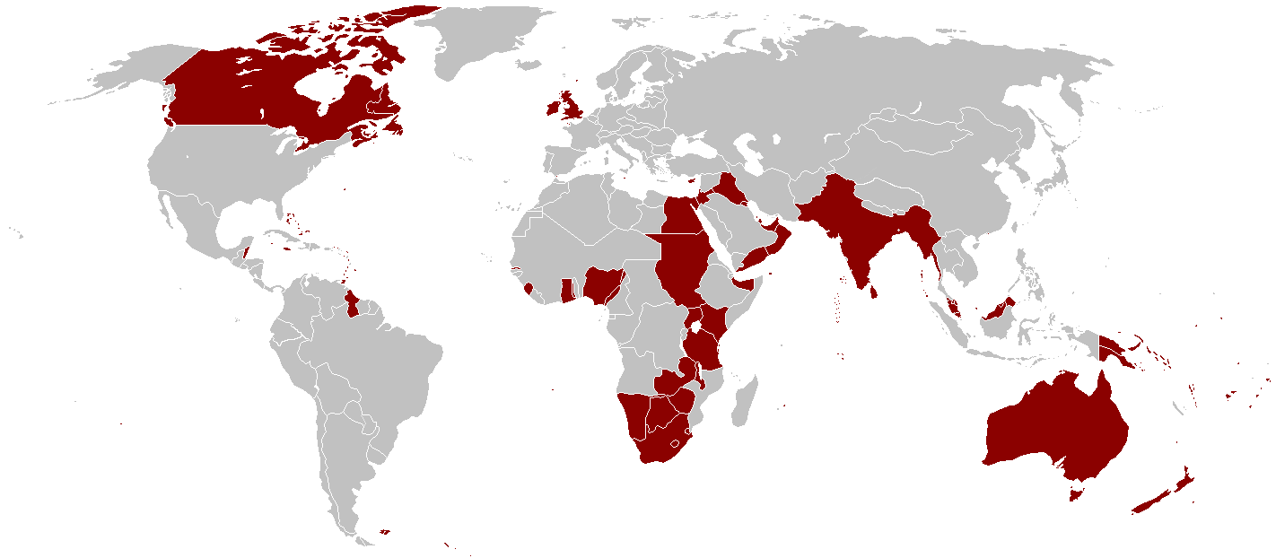
The British Empire at its Peak (1922)

Slide 3
Was Gandhi Wise?
Watch the video and answer the questions…
Mahatma Gandhi and India's Struggle for Independence - Bing video

Slide 4
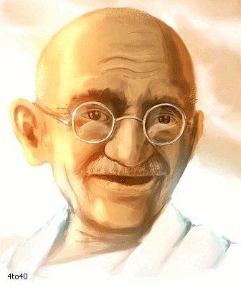
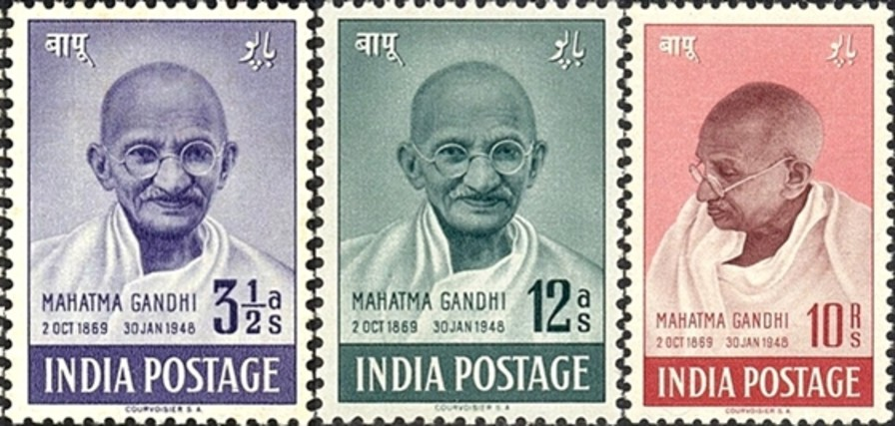
Was Gandhi Wise?
Explain…
Look at the quotations. Explain what each quotation is about and what they mean.
Do this on the sheet provided.

Slide 5
Was Gandhi Wise?
And finally…
“The future
depends on
what you do today.”
Explain what these words could mean for all people.
Explain how these words link to
Hindu beliefs and what these words could mean for Hindus.
Mahatma Gandhi.

