Slide 1
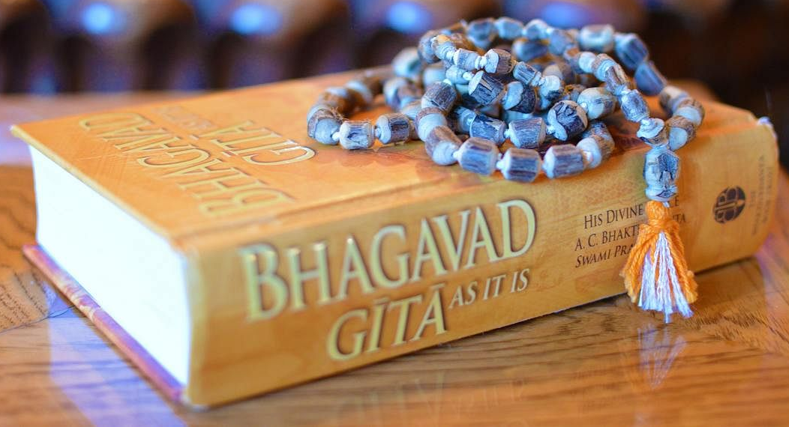
Wise Words in Hinduism
Key Question…
Where can wisdom
be found in Hinduism?
To begin…
Complete the ‘what have I learnt and understood section (after lesson 3) in your unit booklet.

Slide 2
Wise Words in Hinduism
Question…
What are the Hindu Holy Books?
Note down…
4 facts about Hinduism.
3 Hindu scriptures.
2 facts about the Vedas.
1 fact about the Upanishads.

Slide 3
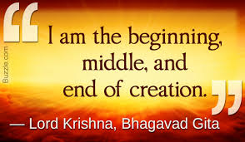
Wise Words in Hinduism

Slide 4
Wise Words in Hinduism
Things to do…
Identify the subject of the
quotations and then explain what each
of the quotations from the Bhagavad Gita mean.
And finally…
Are these ‘wise words’? Which quotation do you think is the most important for Hindus? Which quotation could be important for other people?
Explain your answers.

