Slide 1
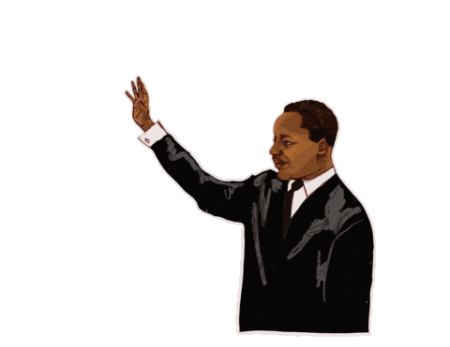
Wise Words influenced
by the Bible
Key Question…
How was Martin Luther King Jr influenced by the
wise words of the Bible and Jesus?
To begin…
Note down some reasons why people in the
world do not get on with each other.
You could do this as a spider diagram or list.

Slide 2
Wise Words influenced by the Bible
Question…What do you already know?
Fill in as much of the question grid as you can with your prior knowledge of Martin Luther King Jr.
At the end of the lesson fill in the remaining answers in a different colour.

Slide 3
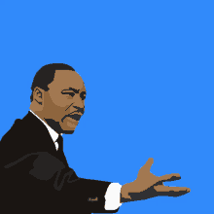
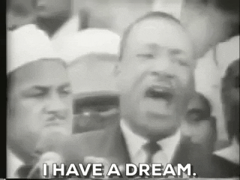
Wise Words influenced by the Bible
Things to do…
Read Martin Luther King’s ‘I have a dream’ speech.
Answer the questions.
More things to do…
Read Martin Luther King’s ‘Mountaintop’ speech.
Answer the questions.
4K DeOldify | Dr. Martin Luther King Jr. I have a Dream Speech - COLOR - Bing video

Slide 4
Wise Words influenced by the Bible
Even more things to do…
Identify and explain links between MLK’s speeches and the parables of Jesus you looked at last lesson. Consider the meaning of the parables, the moral ideas displayed in the parables and the speeches and the events at the time of MLK’s speeches and the attitudes of people in the parables.
Was MLK wise? What can we learn from MLK’s speeches? Consider what he believed about we should treat each other and how we should behave. Were these good ideas? Explain what you think.

Slide 5
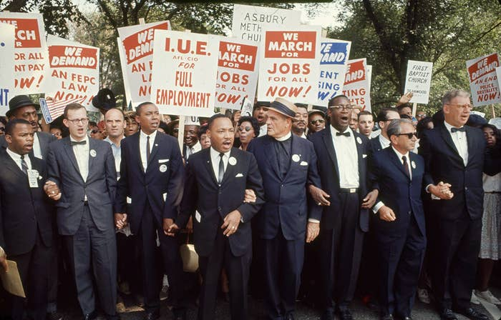
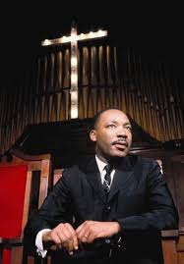
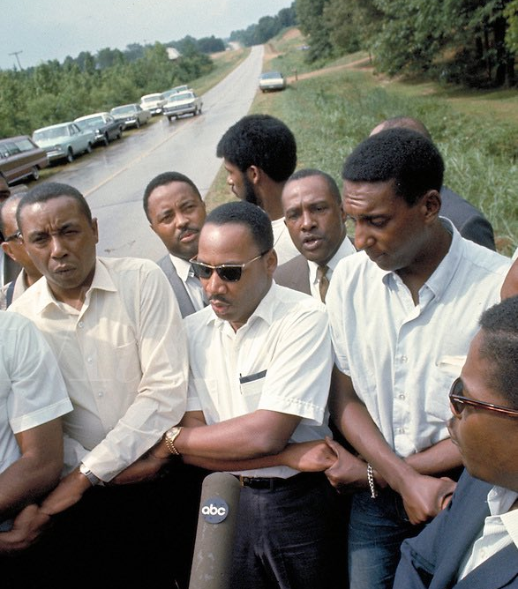
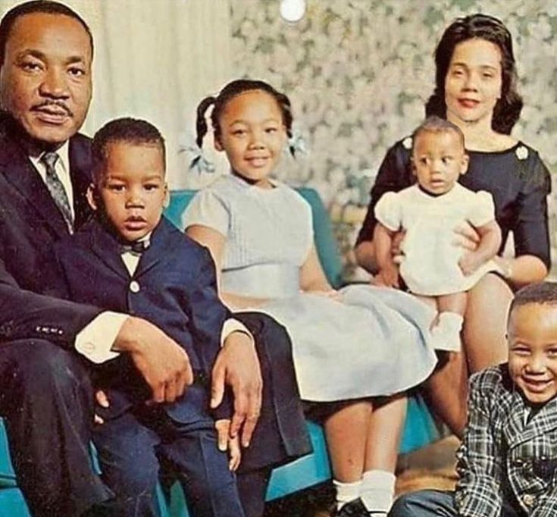
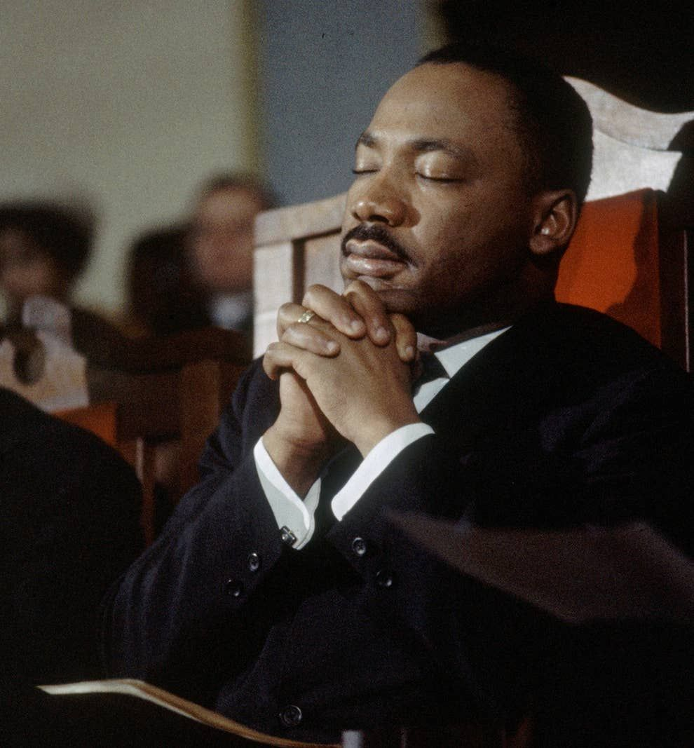
Wise Words influenced by the Bible
Making links…be artistic!
Create an artwork (of any kind) that shows how MLK was inspired by his Christian beliefs.
Use words and pictures in your design.

