Slide 1
Was Jesus Wise?
Key Question.
Were Jesus’ parables a good way of getting a message across?
Starter Task – Story telling.
In 4 groups you are going to write a story. Each group will be given the start of a story and each member of the group adds a sentence to the story. Go round your group twice. The story you are writing should have a positive moral message.
One person in each groups will read out the whole story.

Slide 2
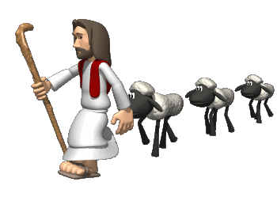
Was Jesus Wise?
Paired work.
You will be given two parables to read.
Answer the questions
for these parables in your exercise books.
…and then…
Note down good qualities encouraged in the parables you read.
Why do you think Jesus used parables to get across his messages?

Slide 3
Was Jesus Wise?
Question.
Jesus used metaphors
in his parables. Is this a good way to get a moral or meaning
across? Explain your answer.
Question.
Jesus told many parables through stories. Was this wise? Explain two opposing points of view.

Slide 4
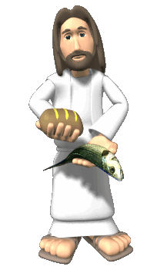
Was Jesus Wise?
... And finally
Using the pictures write your own short story with a message. The pictures can be used in any order.
Reflect…
How easy was it to write your story?
As Jesus told many parables does this mean he was wise?

