Slide 1
Year 7 – Spring Term
Wise Words
Key Question.
What does it mean to be wise?
Starter task – word association.
Write the word ‘wise’ in your books and around it write words that are associated with being wise?

Slide 2
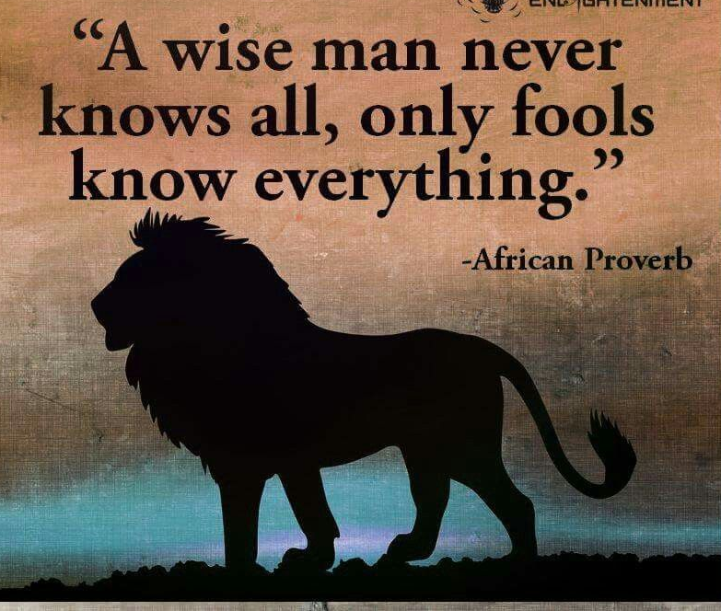
Wise Words
What are Wise Words? Where can wise words be found?
Things to do...
Read the ‘wise words’ above. Choose the one you like the most and write it down. Explain what the quotation means and why you like it.

Slide 3
Wise Words
Things to do...
The quotations on the previous slide were from different sources. Where to you look for wisdom?
Note down 3 examples of where a person might go for ‘wise words’. Choose one of your examples and explain why you would go to that source. Are there any problems with going to that source for wisdom? Explain.

Slide 4
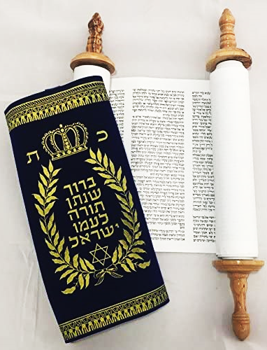
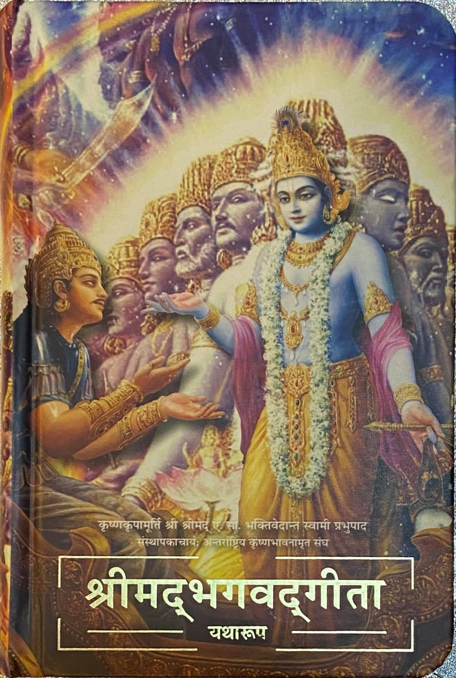
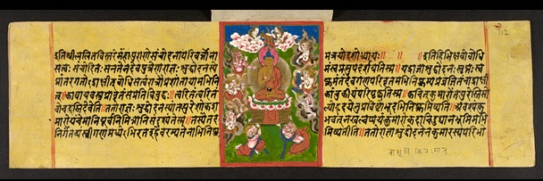
Wise Words
Where do religious believers get their ‘words of wisdom from’?
Dhammapada
Guru Granth Sahib
Torah
Match, stick and label...
Match the pictures of Holy books to their names and religions.
Stick them in your exercise books in the right order.
Qur’an
Bible
Bhagavad Gita

Slide 5
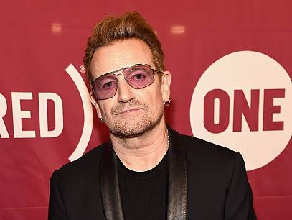
Wise Words
And finally...
In this topic we will be considering words of wisdom from holy books and important people.
Note down the title and author of your favourite book.
Why do you like this book? Would you take advice from anything you might read in this book?
Note down the name of a famous person you admire.
Why do you admire this person? Would you take advice from this person?

