Slide 1

1.4.4 Motivation in
Theory
AS Business Studies – Edexcel

Slide 2

Starter Activity - Categories
Think, pair, share
Categorise the following concepts and items by whether they motivate people or not
Money
Achievement
Fancy car
Fulfilling a goal
Consumer goods
Family and friends
Eating out
Success
Love
Owning a home
Power
Working as a team
Luxury holidays
Renting a home
Basic food
Freedom
Heating
Job security
Fair treatment
Designer clothing
Feeling good about oneself
Nice working environment
Notes:
$

Slide 3

To be able to:
Explain the importance of employee motivation to a business
Explain motivation theories: Taylor (scientific management, Mayo (human relations theory), Maslow (hierarchy of needs) and Herzberg (two-factor theory)
Apply motivational theories to business contexts
Evaluate motivational theories and their usefulness in business contexts
1.4.
People in
Business
Learning Objectives

Slide 4

What is Motivation?
Motivation is a force which ________ people to do or achieve something. Many different things will ________ people, for instance some will be motivated by ________ while others will get ___________ from knowing they have done a good job. Others will want opportunities for ___________, to know their job is _________ or might just enjoy _____________ with their colleagues at work. Employees all have different __________ and wants and so will be motivated by different factors.
Needs, Motivate, Promotion, Secure, Socialising, Satisfaction, Pushes, Money

Slide 5

Brainstorm
What are the benefits of a well-motivated workforce?

Slide 6

Benefits of Motivated Staff
Lower labour turnover
Lower rate of absenteeism
Higher productivity leading to lower costs per unit and higher profitability
Employees feel confident to make suggestions for improvements
Staff are prepared to take responsibility

Slide 7

Indicators of a poorly motivated workforce
Low motivation can be a contributing factor towards:
Absenteeism
Lateness
Poor performance
Accidents
Higher rate of labour turnover
Grievances
Poor response rate

Slide 8

The importance of motivation
Employees work 20% better when motivated
Highly engaged teams increase business profitability by 21%
Employee engagement and motivation reduces absenteeism by 41%
Motivated employees are 87% less likely to resign
Only 15% of employees worldwide feel motivated.
Unmotivated employees cost US companies up to $450 billion a year
The US employer loses over $5,000 on average each time an employer walks out on the job.
Partner Chat
Which of the statistics stated do you think are false?
Why?

Slide 9
The importance of motivation
According to a number of sources collated by Teamstage.io all of these statistics were drawn from workforce studies
Which stats surprised you the most?
Employees work 20% better when motivated
Highly engaged teams increase business profitability by 21%
Employee engagement and motivation reduces absenteeism by 41%
Motivated employees are 87% less likely to resign
Only 15% of employees worldwide feel motivated.
Unmotivated employees cost US companies up to $450 billion a year
The US employer loses over $5,000 on average each time an employer walks out on the job.
Partner Chat
Which of the statistics stated do you think are false?
Why?
Notes:
https://teamstage.io/motivation-statistics/#:~:text=Only%2015%25%20of%20employees%20worldwide%20feel%20motivated.&text=The%20employee%20motivation%20statistics%20for,noticeable%20decrease%20over%20the%20years

Slide 10




Which of the following is NOT an indicator of poor motivation in the workplace?
Grievances
Accidents
High rate of absenteeism
Low staff turnover
Knowledge Check

Slide 11
Click for answer
Which of the following is NOT an indicator of poor motivation in the workplace?
Grievances
Accidents
High rate of absenteeism
Low staff turnover
Knowledge Check

Slide 12
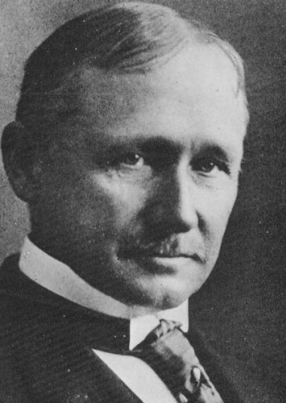
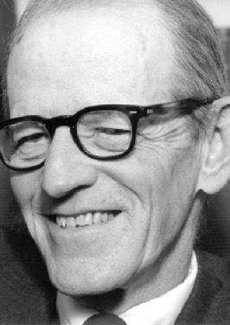
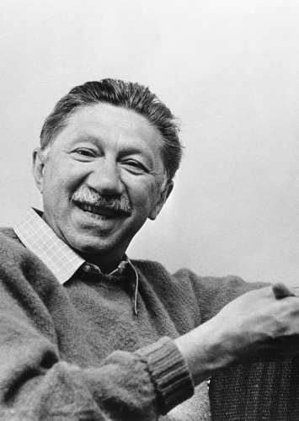
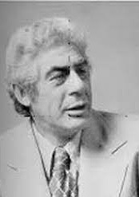
Four Theories of Motivation
Taylor’s Theory of Scientific Management
Mayo’s Theory of Human Relations
Maslow’s Hierarchy of Needs
Herzberg’s Two Factor Theory

Slide 13
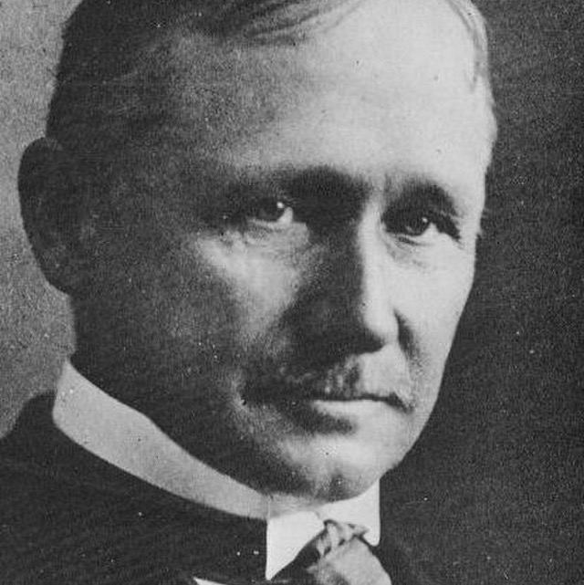
Taylor’s Theory of Scientific Management
Frederick Taylor (1856-1915) was a management consultant who was interested in maximising the value of people in organisations.
First theorist to attempt to analyse worker motivation to advise managers on the best way to improve productivity
Aimed to reduce inefficiency in US manufacturing industry
He had a significant Theory X view of workers.
Believed in ‘a fair day’s pay for a fair day’s work’ and that a worker not meeting targets should face a loss of earnings.
Key to remember:
Believed people’s motivation comes from pay, and if you link pay to performance, then you maximise performance

Slide 14
Taylor’s Theory of Scientific Management
Major assumptions:
Workers do not naturally enjoy work and so need close supervision and control
Economic man – only way to motivate ‘man’ is with money – payment by piece rate
Supervise and record performance of staff
Establish best method of doing a job – time the process – provide instructions on the most efficient method and ensure workers don’t deviate from this
Application to business:
Revolutionised the way work was organised in many industries – focus on efficiency and productivity
First forms of mass and flow production established in early 20th century

Slide 15
Advantages and Disadvantages of Taylor’s Theory
Benefits
Drawbacks
Did help to increase productivity and efficiency in the early 20th century
Higher productivity reduces average costs and increases profits
Workers came to resent boring and repetitive tasks
Some felt demotivated by close supervision and worker satisfaction decreased
Higher productivity led to job cuts and industrial action
Doesn’t account for individual worker differences
Doesn’t account for the fact most workers are motivated by factors other than money

Slide 16
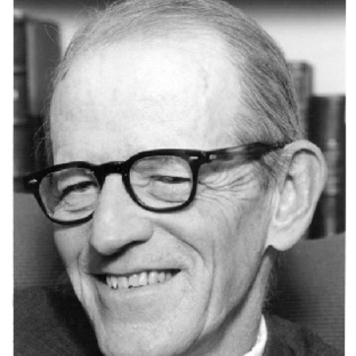

Mayo’s Theory of Human Relations
Hawthorne effect - the idea that workers are motivated by recognition given to them as a group
Elton Mayo reported on the Hawthorne Studies and is seen as a founding theorist of the ‘human relations school’ in psychology.
The Hawthorne Studies
Experiments over 5-year period at the Hawthorne factory of Western Electric in Chicago
Study was based on assumptions that working conditions e.g. lighting, heating, financial incentives and rest periods had an effect on productivity (based on Scientific management)
Experiments were undertaken to establish the optimum working conditions
Findings were unexpected – productivity rose in ALL groups, including the control group (no changes to conditions made)

Slide 17
Mayo’s Theory of Human Relations
Conclusions of the Hawthorne Studies
Changes in working conditions and financial rewards have little to no effect on productivity
When management consult with workers and take an interest, then motivation is improved
Working in teams and developing a team spirit can improve productivity
When some control over working lives is given to workers, such as deciding when to take breaks, there is a positive effect
Groups can establish their own targets or norms which are influenced by informal leaders
Key to remember:
The main finding of the Hawthorne Studies was that changes in working conditions or pay had little effect on productivity. Social cohesion and team work motivated workers.

Slide 18
Advantages and Disadvantages of Mayo’s Theory
Benefits
Drawbacks
Gave workers more of a role in decision-making
Personnel departments were established to try to put the Hawthorne effect into action in the workplace – businesses began to care about ‘personal satisfaction’ of workers
Businesses started to involve workers in decision-making
Team-working can be applied in modern organisations (e.g. Volvo implemented teamworking and saw a decrease in absenteeism)
Opened up research into people-centered motivation and took industry away from money-motivated views of Taylor
Study only took place in one workplace – results could be difficult to replicate and apply elsewhere
It could be argued that financial awards can motivate certain workers to be more productive – for example sales people – again, fails to take account of individual worker differences
Assumes workers and managers share same goals – not always true

Slide 19

CASE STUDY – Amazon could run out of workers in US in two years, internal memo suggests
Is Amazon about to run out of workers? According to a leaked internal memo, the retail logistics company fears so. “If we continue business as usual, Amazon will deplete the available labor supply in the US network by 2024,” the research, first reported by Recode, stated.
Amazon is right to be worried – its staff turnover rate is astronomical. The annual average turnover in transportation, warehousing and utilities was 49% in 2021 and in retail it was 64.6%, less than half of Amazon’s turnover.
Workers and labour groups have long decried Amazon’s working conditions and high employee turnover amid high injury rates.
Matt Littrell, 22, a picker at Amazon in Kentucky said Amazon’s hiring practices, productivity quotas, attendance policies and unequal enforcement of rules are contributors to the lack of job security that drives Amazon’s high turnover.
One issue is Amazon’s “time off task” metric, he said, where Amazon monitors employees’ productivity and issues write-ups, which can lead to termination if too much “time off task” is accrued.
“Each one of those instances where I was taking too long to find an item counted against me, and that is all added up, and then they count that as your total time off. And it doesn’t matter if you were doing your job – you were not meeting the expectation,” said Littrell.
If an Amazon worker receives so many attendance penalties that they go negative in their allotted time off, they face automatic termination if they cannot get the absence excused by the correct department.
A report based on Occupational Safety and Health Administration (Osha) data released by the Strategic Organizing Center in April found Amazon’s serious injury rate in 2021 was 6.8 per 100 workers, more than twice the average of 3.3 per 100 workers in the warehousing industry and a 20% increase from a year prior.
Discussion questions:
Explain which indicators demonstrate a lack of worker motivation at Amazon and why.
Explain which theorist’s teachings seem to have influenced Amazon’s warehouse management practices. Provide examples from the case study
Analyse the benefits and drawbacks of Amazon’s approach to employee motivation
Except from: https://www.theguardian.com/technology/2022/jun/22/amazon-workers-shortage-leaked-memo-warehouse

Slide 20
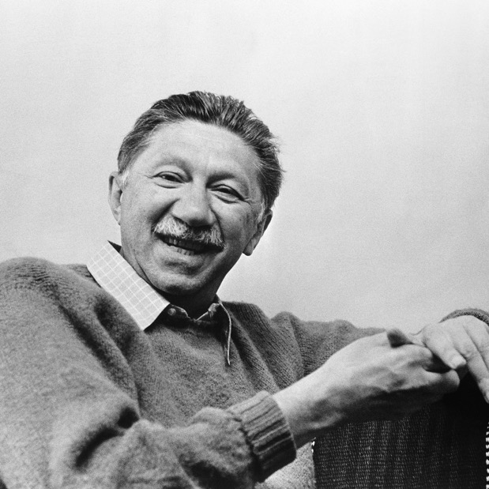
Maslow’s Hierarchy of Needs
Maslow's hierarchy of needs - the order of people's needs starting with basic human requirements
Abraham Maslow (1908-1970) was an American psychologist credited with developing a famous theory of motivation.
Instead of looking at external (extrinsic) factors, maslow looked at the instrinsic needs people have. We are motivated depending on whether our needs are being fulfilled
He identified 5 “layers” of motivations, and argued that people will only progress onto higher levels when lower levels are satisfied.
While his theory is primarily a general psychology theory, it has application to business.
Key to remember: workers aren’t all motivated by the same thing – motivators change as a worker satisfies each category of ‘needs’ and moves up the hierarchy of needs

Slide 21
The business applications of Maslow
Meaning | Business Application
“What a man can be, he must be” (Maslow, 1954) Realisation of one’s potential | Opportunities to reach one’s full potential e.g. challenging work, skills development
Self-esteem needs Recognition, Status, importance and respect from others | Promotion, appraisal, staff recognition programmes
Friendships Intimacy Family | Teamwork, staff events, communication between workers
Personal Security, Emotional security, Financial Security, Health and Wellbeing | Health insurance, job contracts Retirement planning, health and safety training
Basic human needs of food, water, sex, shelter, clothes, sleep | Wages high enough to satisfy basic needs
Physiological
Security
Self-Esteem
Love & Belonging
Self
Actualisation

Slide 22
Maslow’s Hierarchy of Needs
Application of Maslow
Once one set of needs have been satisfied they are no longer a motivator. Workers can only be motivated by achieving the next set of needs in the hierarchy.
If lower needs are not met workers cannot be motivated if a business tries to meet higher needs
If a business fails to meet a particular need, workers are not likely to be motivated.
Drawbacks
Not everyone has the same needs
Our perception of what is important at work will vary
Not realistic that most employees will reach the top of the hierarchy

Slide 23

Applying Maslow’s Theory Task
Complete the card sort activity in pairs.
Which level of Maslow’s hierarchy is the worker currently on at work?
Think Deeper:
1. How can each worker move to the next level, according to Maslow?
2. Can you see any similarities between Maslow’s theory and those of other motivational theorists?

Slide 24
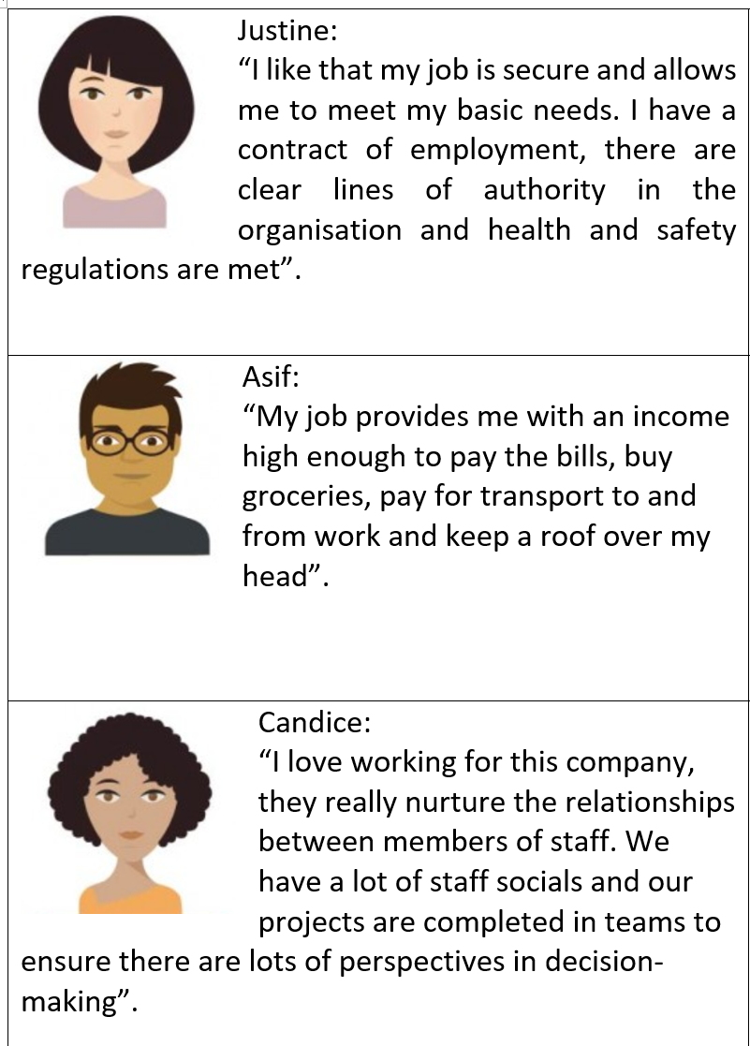
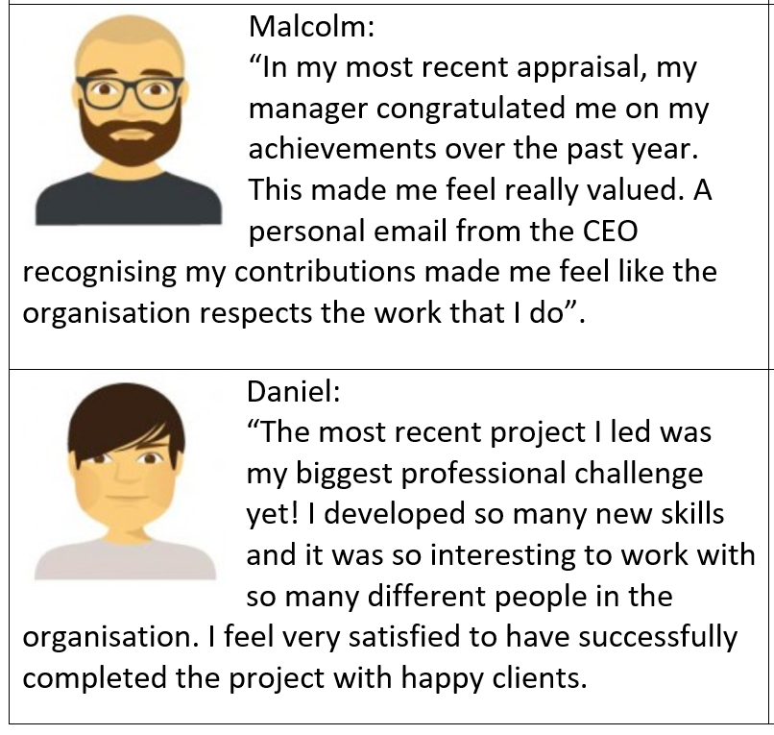

Slide 25
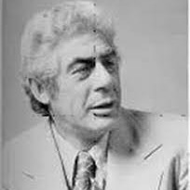
Herzberg’s Two Factor Theory
Frederick Hertzberg (1923-2000), an American industrial psychologist who looked at the issues surrounding motivation
The two-factor theory suggests that any aspect of work can either be a motivator or lead to dissatisfaction
Motivators work to increase motivation, while demotivators (hygiene factors) must be maintained or they will demotivate workers.
No matter how motivated employees are, if a hygiene factor is damaged/missing, workers could become dissatisfied
E.g. a nice workspace won’t motivate a worker but if the workspace is cramped and chaotic it could make them dissatisfied

Slide 26
Task: Classify these factors into Hygiene Factors OR motivators:
Job Security
Salary/Wage
Praise
Recognition
Carparking
Clean working environment
Pleasant coworkers
Workplace safety
Fairness in treatment
Promotion opportunities
Travel for work
Flexitime
Teleworking
Team working
Responsibility
Authority
Friendships at work

Slide 27
Herzberg’s Two Factor Theory
Job satisfaction resulted from 5 main MOTIVATORS:
  Achievement
  Recognition for achievement
  The work itself
  Responsibility
  Advancement
Job dissatisfaction resulted from 5 main HYGIENE FACTORS (demotivators)
  Company policy and administration
  Supervision
  Salary
  Relationships with others
  Working conditions
These had to be addressed by management to prevent dissatisfaction – they would not, by themselves, motivate
Motivators can be provided by adopting job enrichment:
Complete units of work
Feedback on performance
A range of tasks
If work is not interesting, rewarding or challenging then it won’t motivate, whatever the pay
Workers may be encouraged to do a job because of pay and conditions but it doesn’t mean they want to do the job – that requires motivation

Slide 28
Herzberg’s Two Factor Theory
Benefits
They had a significant impact on business practices and how we understand which factors motivate and which demotivate
Team-working has become more widespread
Workers now tend to be more responsible for the quality of their own output
Two-way communication favoured
Drawbacks
Based on surveys of 200 professional workers – results may not be replicable in other organisations or with other workers
Dated theory – may not be entirely relevant to today’s workforce
It overlooks ‘blue collar’ workforce – professional workers surveyed

Slide 29
Self-actualisation as the highest level motivator is a key aspect of which theory?
Taylor’s Scientific
Management
Mayo’s theory of human relations
Maslow’s hierarchy of needs
Herzberg’s Two Factor theory
Knowledge Check

Slide 30
Self-actualisation as the highest level motivator is a key aspect of which theory?
Taylor’s Scientific
Management
Mayo’s theory of human relations
Maslow’s hierarchy of needs
Herzberg’s Two Factor theory
Knowledge Check

Slide 31

CASE STUDY – Google
Think deeper:
Analyse the benefits to Google of having a motivated workforce?
Discussion question:
In pairs, discuss which theorists Google’s workplace seems to most align to, using examples from the video and the theories learnt to support your ideas.

Slide 32

Plenary – Answers on a post-it
Choose a theorist from today’s lesson and sum up their theory on a post-it
Pop it on the door on your way out!

