Slide 1
How does belief in God affect People?
Key Question.
How do people express their belief in God?
To begin… Mystery bag.
The items in the bags are clues to what the lesson is about.
Three students to take it in turns to pick one item out of a bag and guess what the focus of the lesson is.

Slide 2
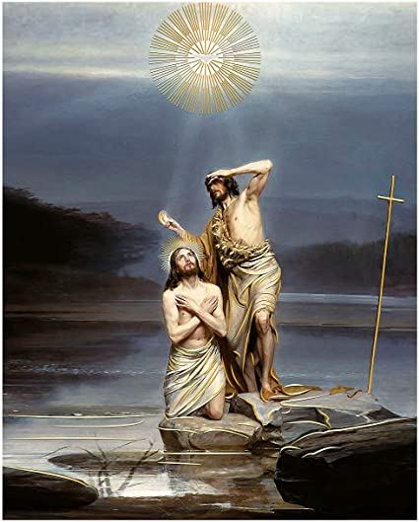
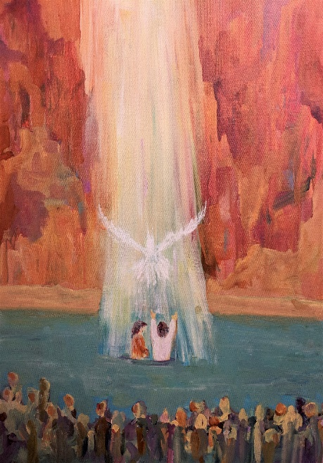
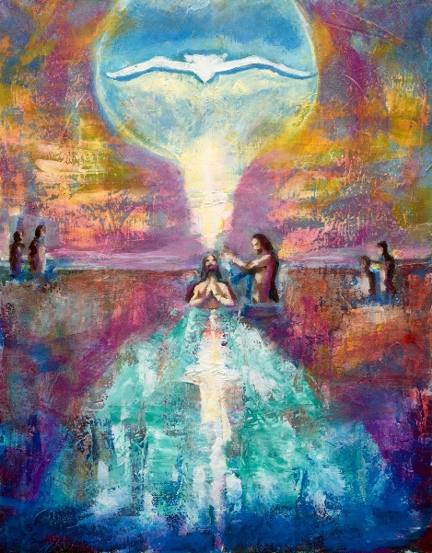
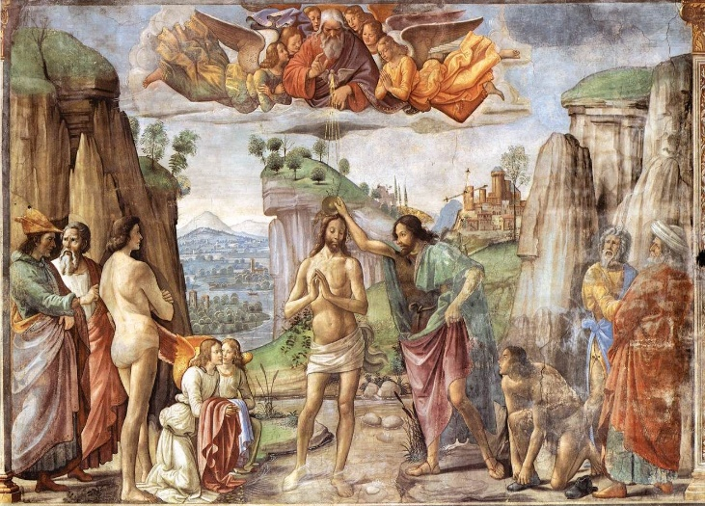
How does belief in
God affect People?
Art Appreciation!
Look at the images you will be given.
Note down observations based on the following questions about the pictures.
If you were to give the same title to all the pictures, what would it be?
Note down 3 similarities in all the pictures.
Note down something unique in each of the pictures.

Slide 3
How does belief in God affect People?
Art Appreciation (continued…)!
Note down observations based on the following questions about the pictures.
4. Note down at least 4 examples of religious symbolism in the
pictures.
5. How do these pictures relate to what Christians do to show their
belief in God?

Slide 4
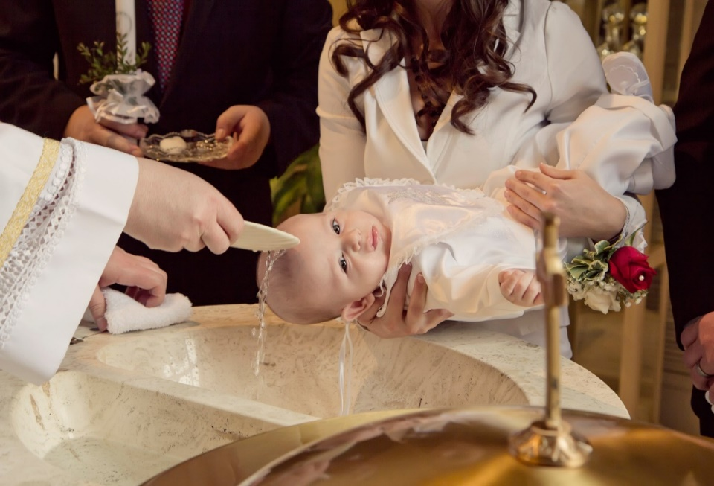
How does belief in God affect People?
Both of these pictures show baptisms.
What is a baptism?
From the pictures, explain how these two baptisms are different.
What do you think the water in baptism symbolises?
Why do you think there are different types of baptism in Christianity?
How does baptism show a person’s belief in God?

Slide 5
How does belief in God affect People?
Infant or Believer’s Baptism?
Some Christians believe we are all descended from Adam who committed the Original Sin of disobeying God. They therefore believe that humans are born with the tendency to sin. The water symbolically washes this sin away. Catholics believe this is important because if a child dies before baptism it won’t go to heaven.
Believer’s baptism happens when a person is old enough to understand the meaning of baptism and being a Christian.
They are fully immersed in the water which symbolises
all their sins are ‘washed away’ so they can
make a fresh start as a Christian.

Slide 6
How does belief in God affect People?
Infant or Believer’s Baptism?
Give 3 reasons some people choose infant baptism and 3 reasons why some people choose believer’s baptism
 | Infant Baptism |  | Believer’s Baptism
1 |  | 1
2 |  | 2
3 |  | 3

Slide 7
How does belief in God affect People?
And finally – thinking about the key question…
Choosing to be Baptised shows commitment to faith in God.
Apart from Baptism, suggest at least three ways in which a Christian might express their belief in God.
How do you think a person’s life will change after deciding to be baptised?

Slide 8
How does belief in God affect People?
And finally …
In your topic booklet, at the front of your exercise books, note down at least two new things you now know and at least two new things you now understand.

