Slide 1
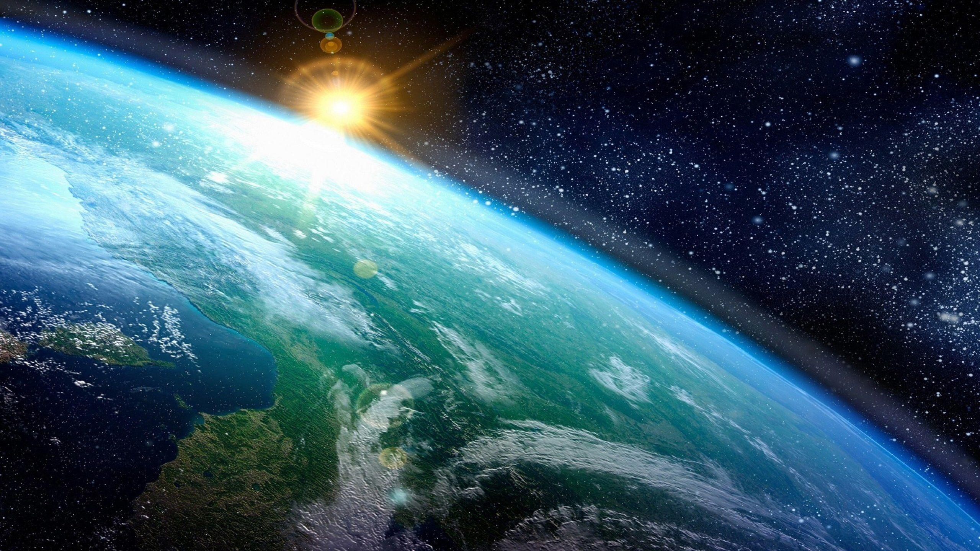
Does God Exist?
The Teleological Argument.
Key Question.
How might the design of the universe suggest that God could exist?
To begin... Wordsearch.
Find 3 words in the grid associated with the following 3 topics.
Use the picture clues to help.
7 Dimensions of Religion.
Nature of God in 3 religions.
Cosmological Argument.

Slide 2
The Teleological Argument.
The Teleological Argument is also known as the Design Argument. Unlike the Cosmological Argument which is based on the idea that God was the first cause of the universe, the Design Argument is based on the idea that the world is so intricately designed, only God could have made it.
6 Volunteers needed!
Read a scripted philosophical discussion about the Teleological Argument.
Complete the tasks on the ‘play’.

Slide 3
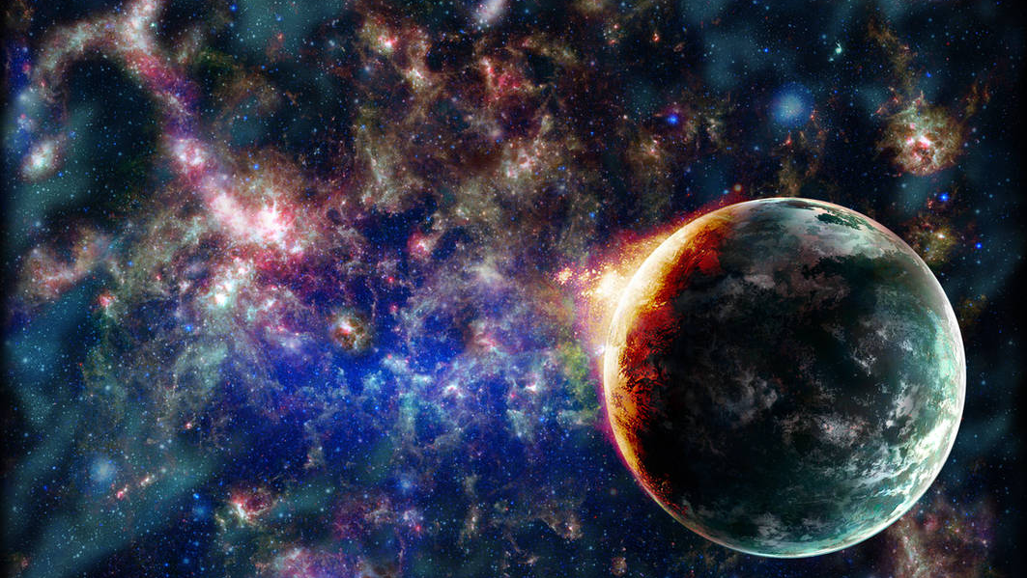
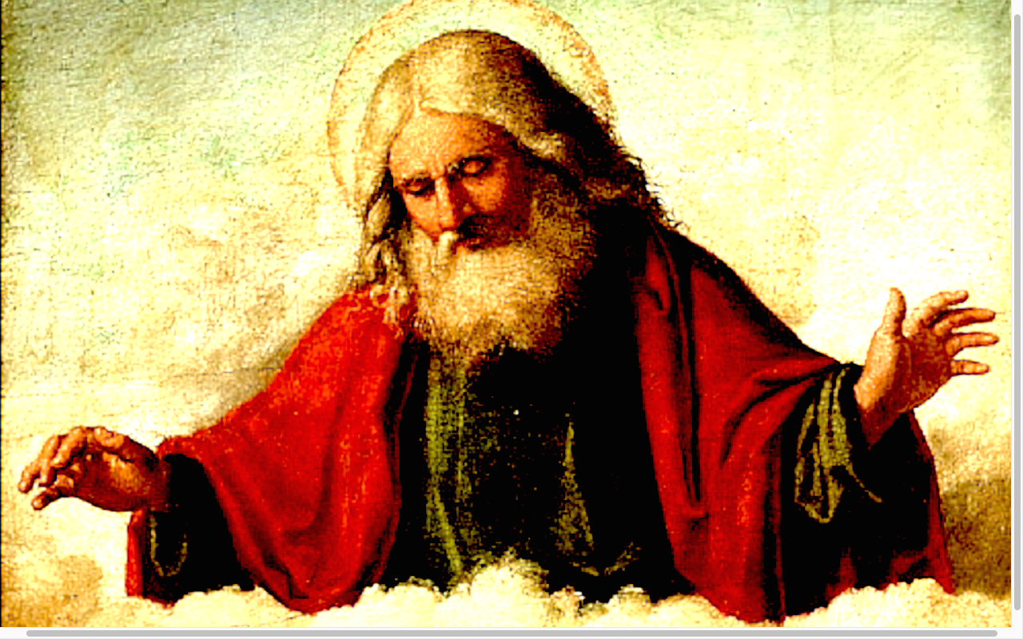
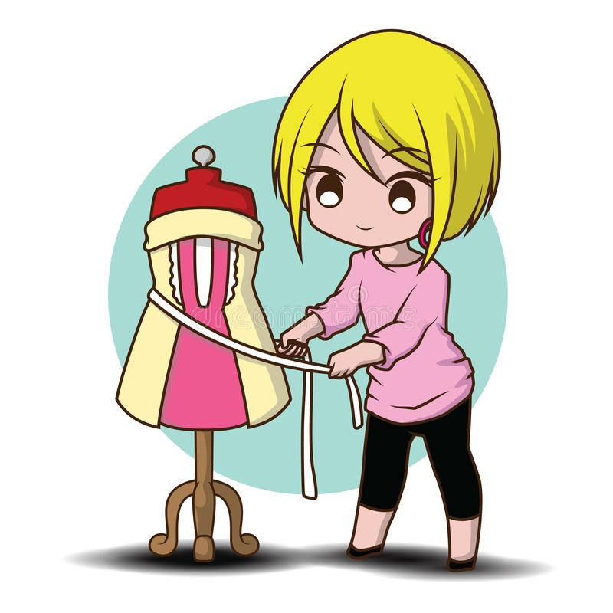
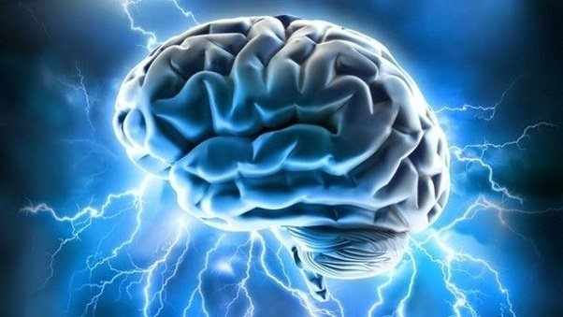
The Teleological Argument.
... believed exists because the
is very intricately designed. He realised that his
had a and compared this to the
which is far more complex than a therefore
the of the must be all and all
This describes therefore must exist.

Slide 4
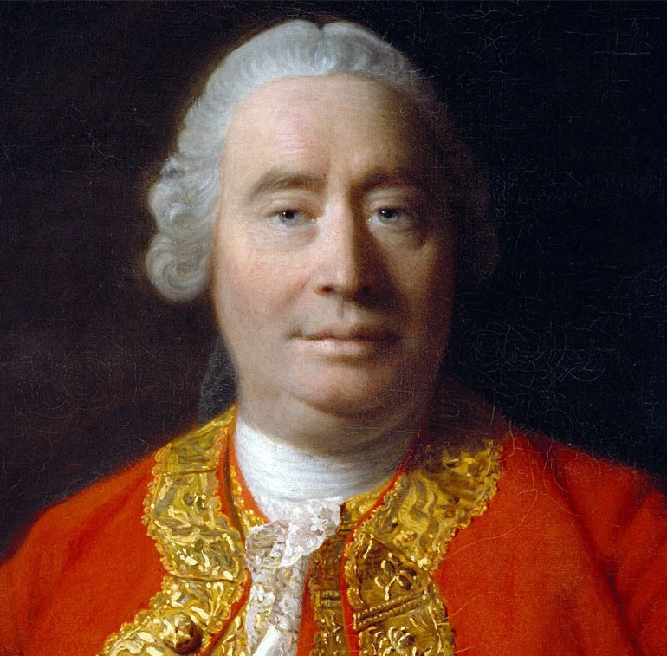
The Teleological Argument.
Explain…
Who David Hume was and what he thought about the Teleological Argument?
Who F.R. Tennent was and how he responded to the criticisms of the Teleological Argument?

Slide 5
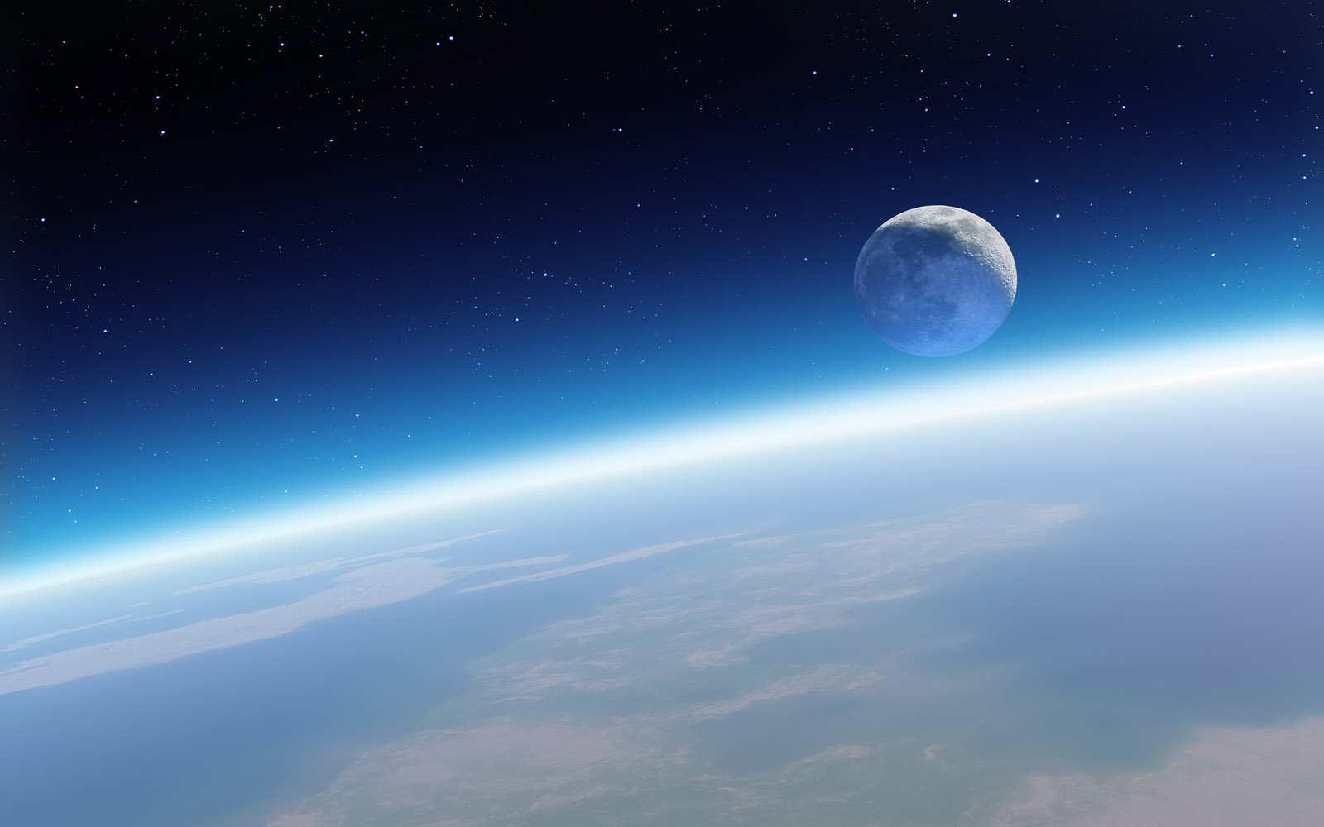
Does God Exist?
Compare…
On the Venn diagram, compare the two philosophical arguments for the existence of God?
Your Worldview…
Considering what you have learnt since beginning this topic answer the questions…
What do you think belief is?
What do you think religion is?
Does God exist?
What do you think religion is for?
How do you think religion benefits society?

Slide 6
Does God Exist?
Your Worldview…
Compare your answers in your new ‘lens’ to the one you completed at the beginning of this topic.
Have your ‘views’ changed?
If your ‘worldviews’ have changed, explain why.
If your ‘worldviews’ have remained the same, explain why.

Slide 7
The Teleological Argument.
And finally …
In your topic booklet, at the front of your exercise books, note down at least two new things you now know and at least two new things you now understand.

