Slide 1
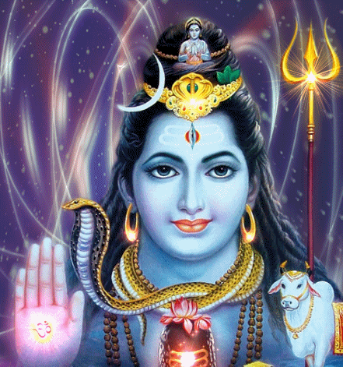
Does God Exist?
Key Question.
How have philosophers tried to prove that God exists?
To begin...
When we look for something, we need to know what it is we are looking for. Now we have looked at what three different religions believe about God, we know what kind of being we are ‘looking’ for.
Recap what you learnt about Christian, Hindu and
Islamic beliefs about God and pick three ideas about
God that all three have in common, note them down.

Slide 2
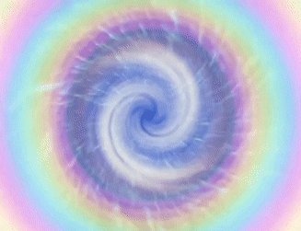
Does God Exist?
Philosophy (from Greek: φιλοσοφία, philosophia, 'love of wisdom') is the study of fundamental questions, such as those about existence, values, mind, and faith. Such questions are often posed as problems to be studied or resolved.
What is Philosophy and how does philosophy work?
An ultimate question is considered and an answer is sought e.g. Does God exist?
A process of reasoning leads to a potential answer.
The ‘answer’ is criticised – reasons are put forward to suggest the process of reasoning that led to the ‘answer’ is flawed.
Responses to the criticisms are put forward – counter arguments.
In your books...
Write a definition of philosophy and briefly explain the philosophical process.

Slide 3
Does God Exist?
The Cosmological Argument.
The Domino Analogy.
The Domino Analogy helps us explain the Cosmological Argument.
Imagine there are thousands of dominoes in a room, each placed on its edge so that if one fell it would knock the next one down, then the next etc. You could leave the dominoes for a long time, and provided nothing happened to disturb them nothing would happen.
Supposing one day, you walked into the room just at the moment the dominoes were half way through falling over. You look back to the first domino and see that it has fallen, but see no obvious reason for it to fall. Naturally you would ask, ‘what caused the first domino to fall?’ the Cosmological argument is similar to this – what started it all off?

Slide 4
Does God Exist?
The Cosmological Argument.
The Cosmological argument attempts to prove God exists by asking the question – what started it all off? The ‘it’ 13th century philosopher, St. Thomas Aquinas is thinking about is the universe. His argument goes like this…
Making connections…
Considering the beliefs about God of Christians, Muslims and Hindus do you think they would agree with the Cosmological Argument. Explain your answer.

Slide 5
Does God Exist?
The Cosmological Argument.
Making connections…
Hinduism | Christianity | Islam
Hindus may agree with the Cosmological Argument because… | Christians may agree with the Cosmological Argument because… | Muslims may agree with the Cosmological Argument because…
What do you think?
Explain your own view of the Cosmological Argument – is it a good argument for the existence of God? Make sure you use evidence to explain your arguments.

Slide 6
Does God Exist?
The Cosmological Argument.
Religion and Science.
‘Religion and science are opposed to each other’.
Is this statement correct?
In your books...
Bearing in mind the Cosmological Argument (and the beginning of the universe) why might some people agree with the above statement?

Slide 7
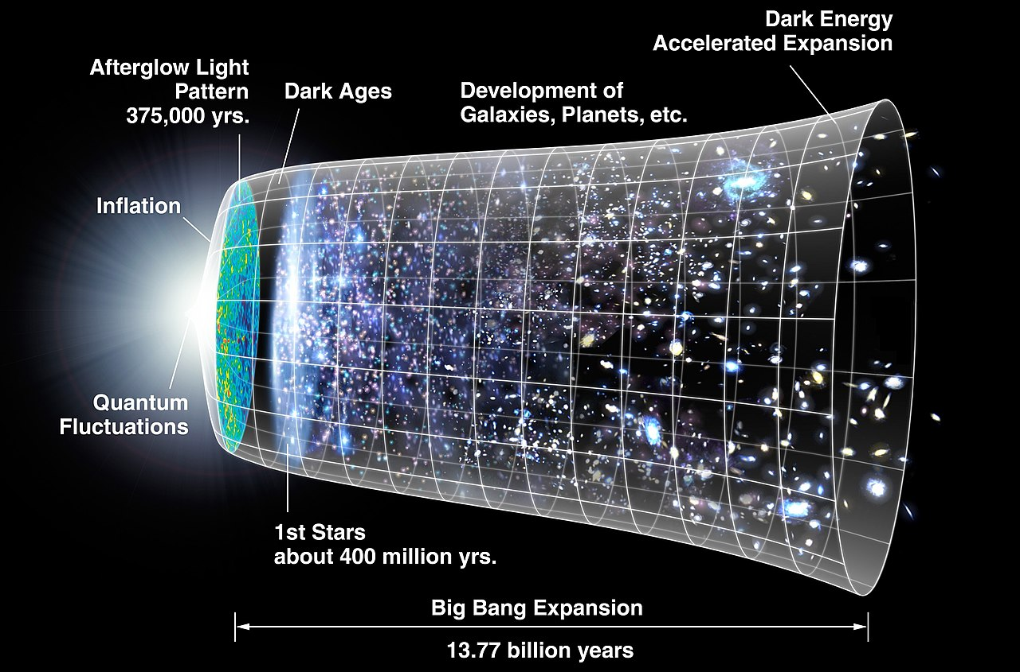
Does God Exist?
The Big Bang Theory.
The Big Bang theory is the scientific cosmological theory that explains the existence of the universe. The theory describes how the universe expanded from an initial state of high density and temperature and then in the cooling process planets etc were formed.
In your books...
Why might the Big Bang Theory be used as a criticism of the Cosmological Argument for God’s existence? Explain clearly.
However...
Why might theists suggest the Big Bang theory can still be compatible with a belief in God?

Slide 8
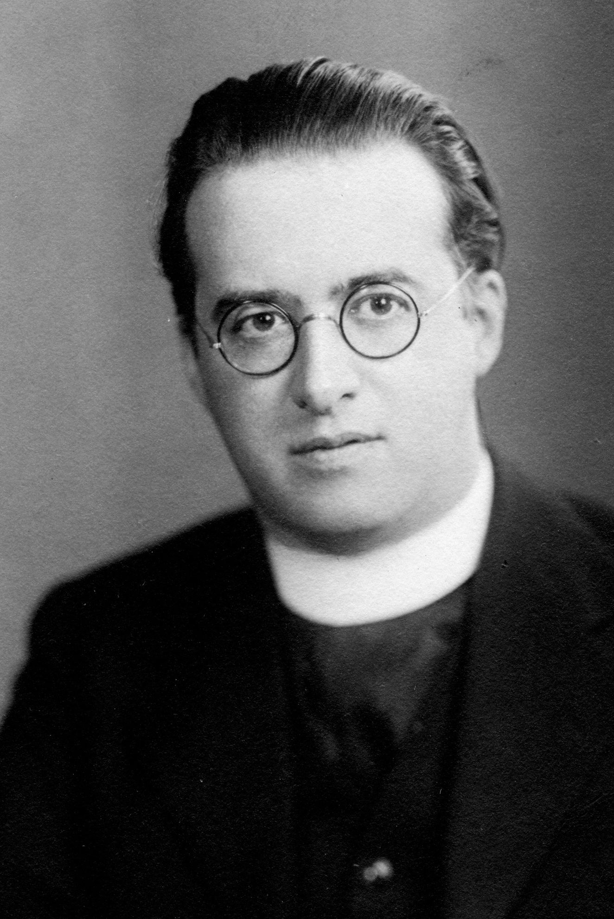
Does God Exist?
The Cosmological Argument.
‘Religion and science are opposed to each other’.
Is this statement correct?
One of the misconceptions about the Big Bang theory is that it fully explains the origin of the universe. However, the Theory does not describe how energy, time, and space were caused, but rather it describes the emergence of the present universe from an ultra-dense and high-temperature initial state.
In other words, the Theory raises questions such as, where did the mass and the energy come from that led to the ‘Big Bang’?
Did you know… That Georges Lemaitre, who developed the Big Bang Theory was a Catholic priest?

Slide 9
Does God Exist?
The Cosmological Argument.
‘Religion and science are opposed to each other’.
Is this statement correct?
And finally… two questions to consider;
Bearing in mind the information on the previous slide, has your view on the above statement changed? Explain why or why not.
Does God exist? Has the Cosmological Argument convinced you or not? Explain why or why not.

