Slide 1
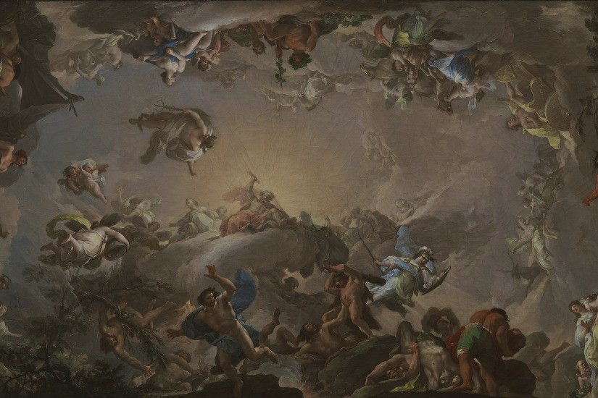
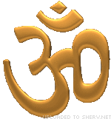
The Nature of God in Three Faiths
Key Question.
What do Christians, Muslims and Hindus believe about God?
To begin... 1-2-3… note down…
…1 belief someone might have about what God is like.
…2 places where a person might find out about God.
…3 reasons why a person may believe in God.

Slide 2
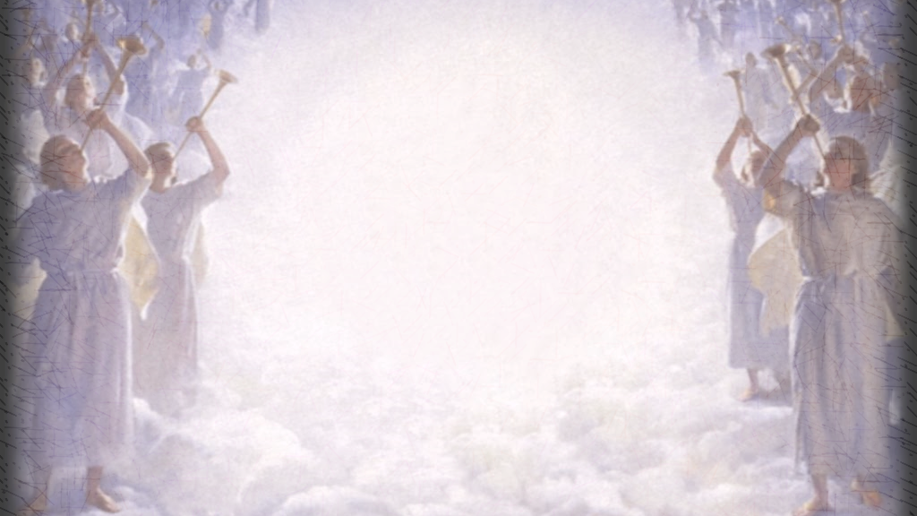
The Nature of God in Three Faiths
Task 1.
Look at the pictures you will be given.
Note down the beliefs about God that images may represent.
Task 2.
Under the headings, ‘Christianity’ ‘Islam’ and ‘Hinduism’ note down which beliefs about God that each religion believes (the beliefs may belong to more than one religion).

Slide 3
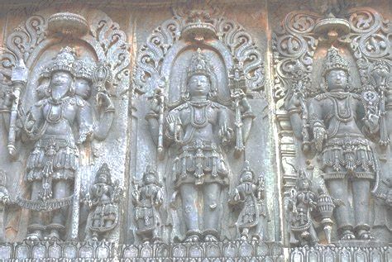
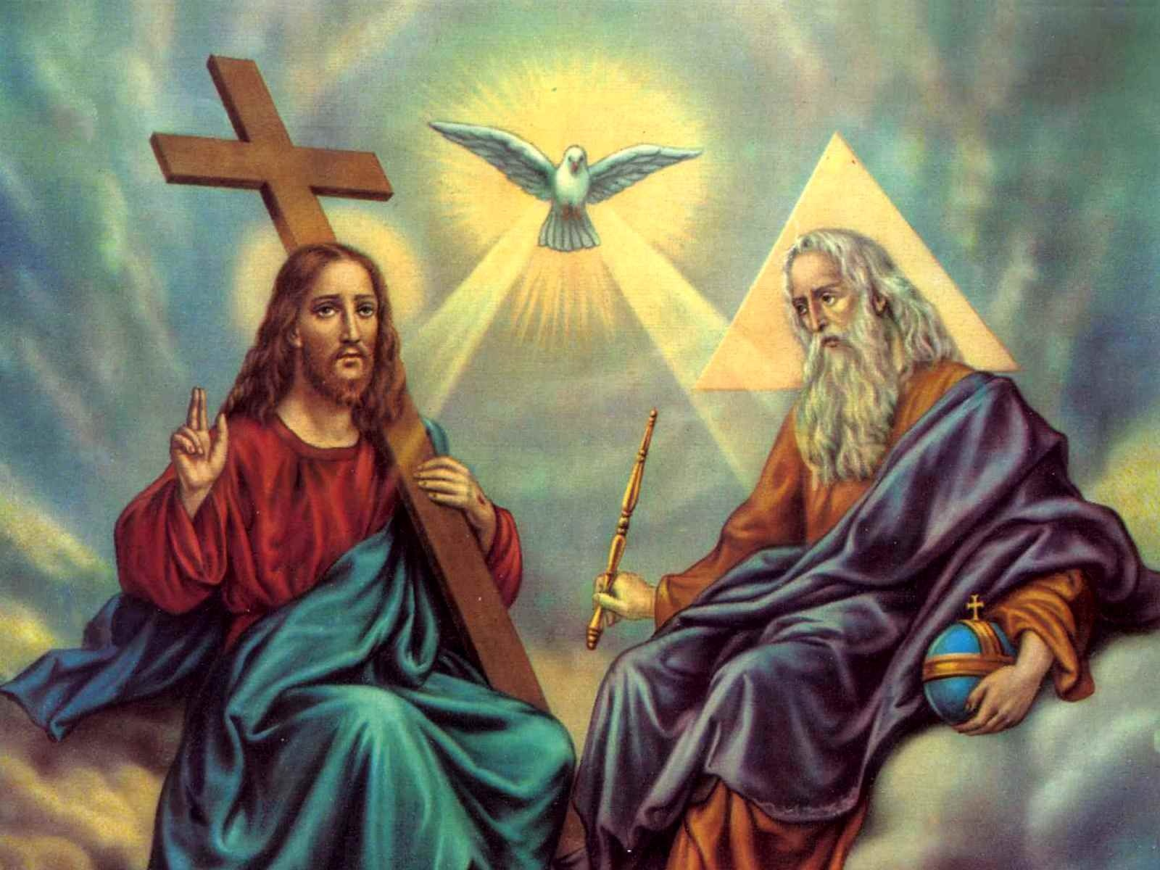
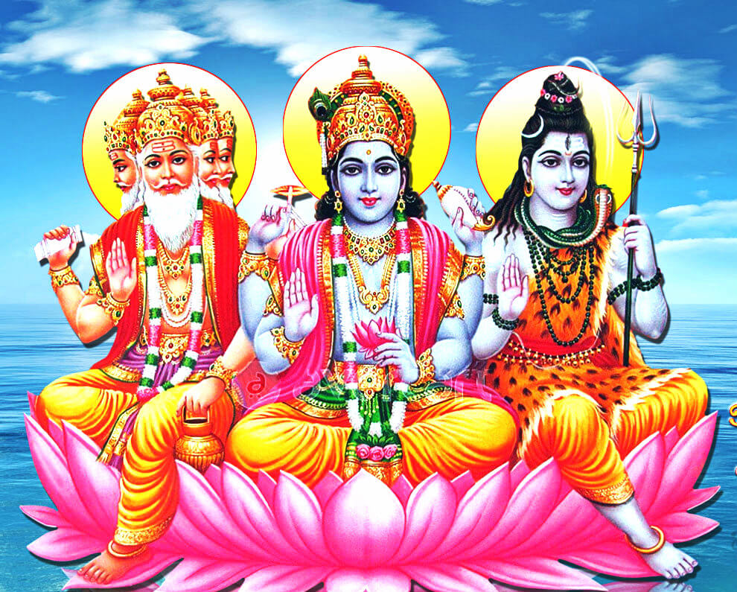
The Nature of God in Three Faiths
Trinity or Trimurti?
Trinity.
Father – The Creator
Son (Jesus) - The saviour
Holy Spirit - The Guide
Trimurti.
Brahma – The Creator
Vishnu – The Preserver
Shiva – The Destroyer

Slide 4
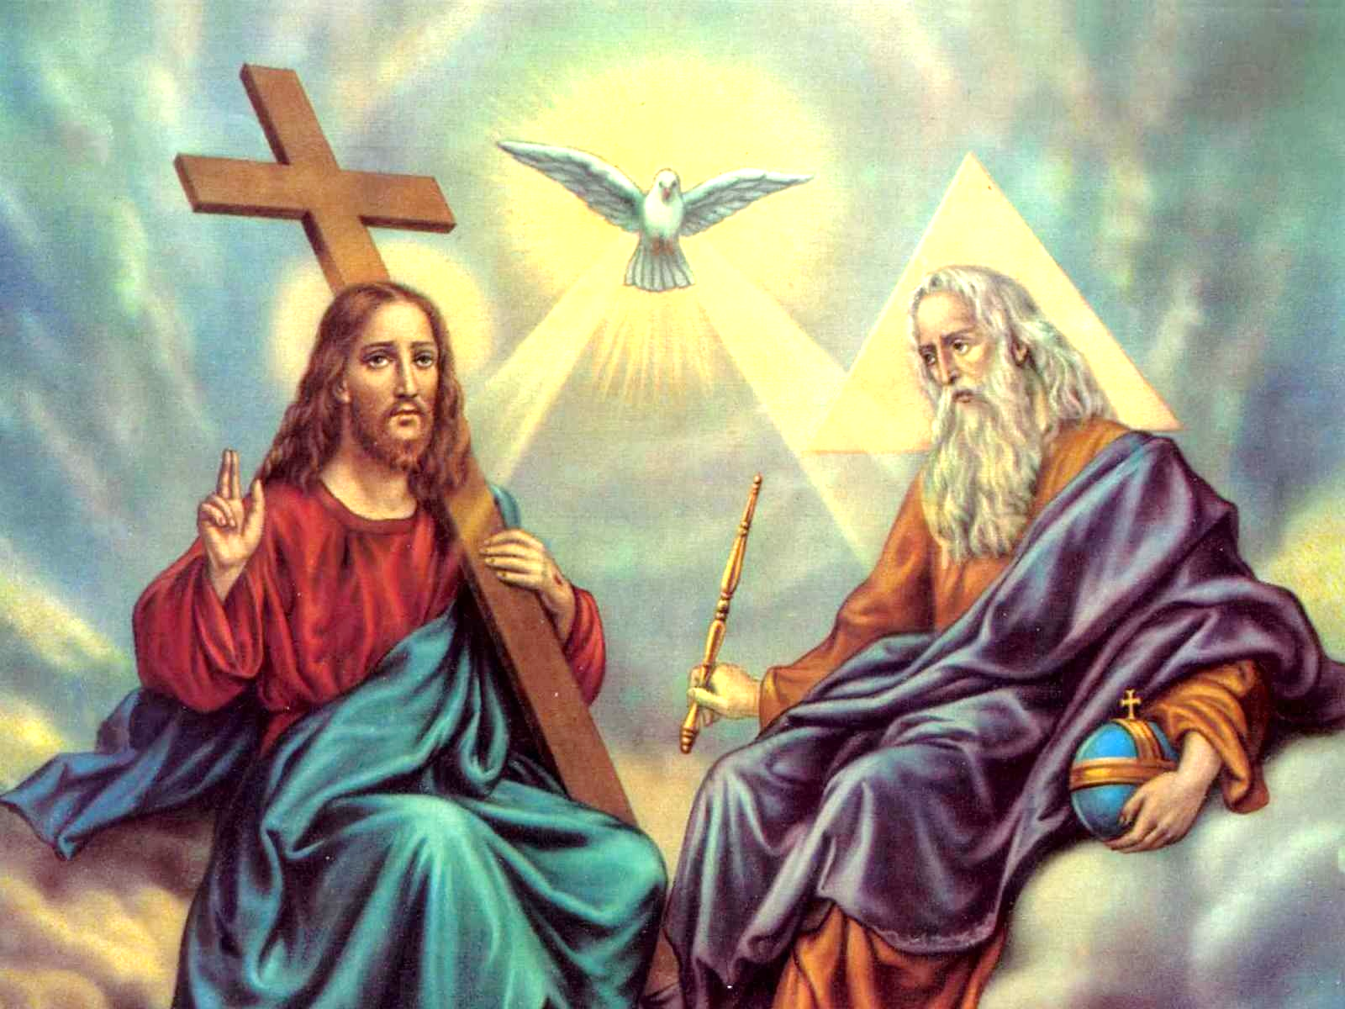
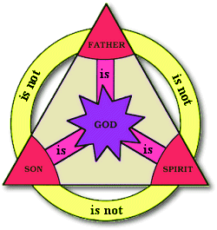
The Nature of God in Three Faiths
The Holy Trinity.
The Trinity refers to the idea that God is one, but can be known in three different Persons. The word ‘trinity’ comes from the word ‘tri’ meaning ‘three’ and ‘unity’ meaning ‘one’.
God the Father - the creator and sustainer of all things
God the Son - the incarnation of God as a human being - Jesus
Holy Spirit - the power of God which is active in the world.
Be creative... Design a model to show understanding of the idea of the Holy Trinity.

Slide 5
The Holy Trinity
Greatest Story Ever Told by Shai Linne
Write down:
Things that God does:
Things the Son does:
‘Now the Holy Spirit i__________ is the evidence for heaven’s future residents.’
Other ideas about what God is like:
https://www.youtube.com/watch?v=n2pFnen8xn4
Teacher explains:
Cain & Abel
Noah
Abraham
Sodom & Gomorrah
Exodus/Sinai/Promised Land
Atonement
400 Silent years
Emmanuel
Resurrection
Grace.

Slide 6
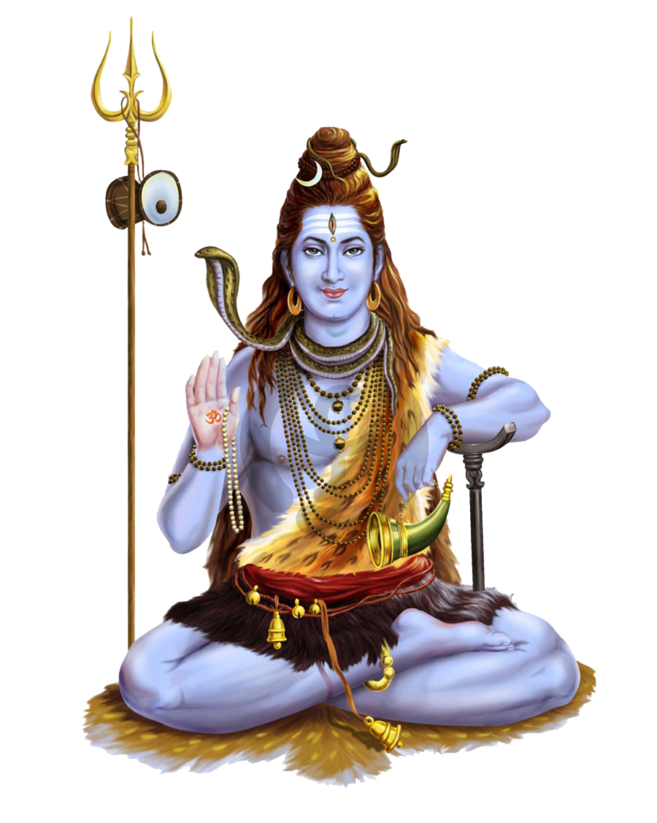
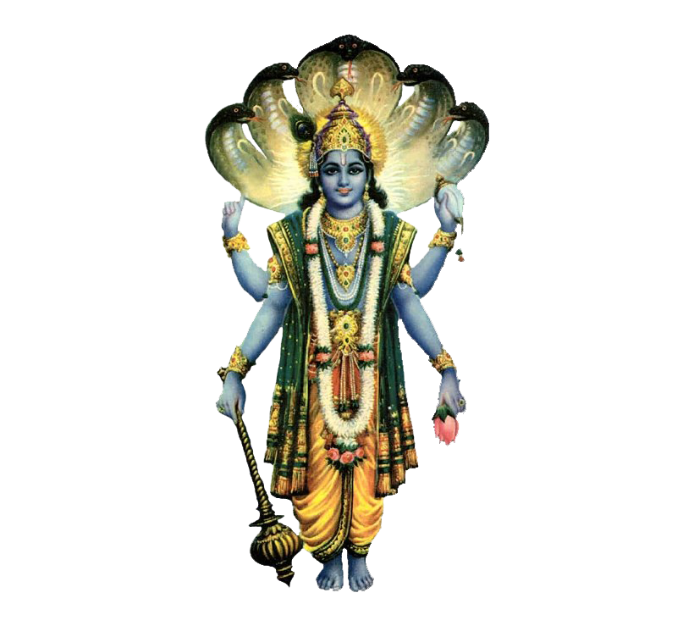
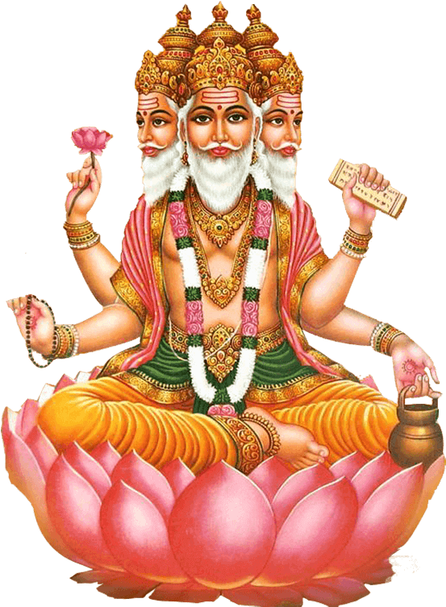
The Nature of God in Three Faiths
Three of the most important forms of Brahman, the Ultimate Reality, are Brahma, Shiva and Vishnu. The word ‘trimurti’ means ‘three forms’. In the trimurti, Brahma is the creator, Vishnu is the preserver and Shiva is the destroyer. They work together in a continuous cycle of creating, preserving and destroying creations.
Shiva
Vishnu
Brahma
Things to do...
Note down the main beliefs about each of the gods of the Trimurti.
Explain how these gods work together.
Why does Hinduism appear to be polytheistic but actually is not?

Slide 7
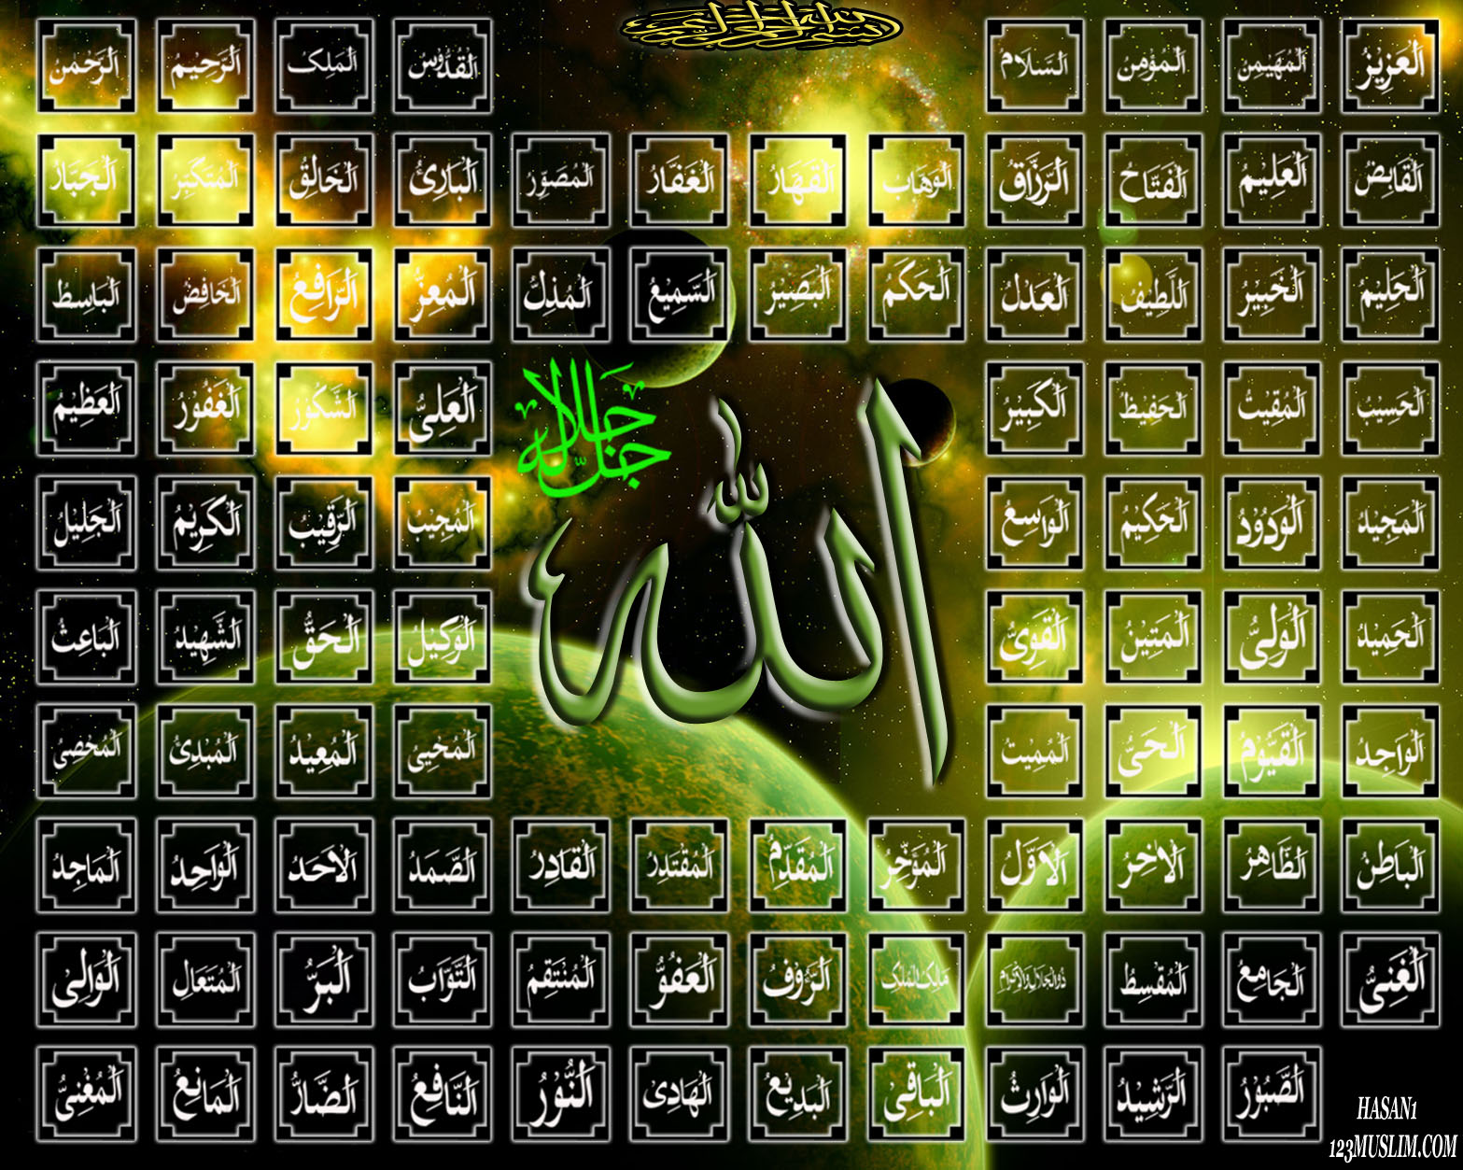
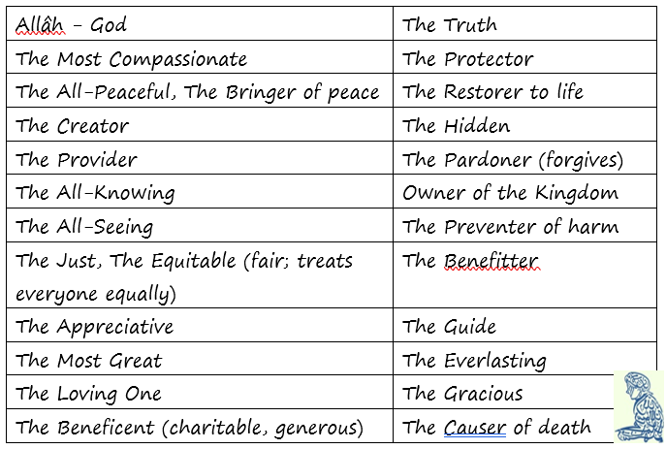
The Nature of God in Three Faiths
The 99 Names of Allah
The most important belief in Islam is that there is just One God – Allah. Muslims never attempt to try and depict Allah in pictures, instead they use words to try to describe what Allah is like.
https://www.youtube.com/watch?v=vFh6gXmWdIo

Slide 8
Things to do...
Choose 3 of the 99 Names, write them down and explain potential evidence for these ‘names’.
2. Explain why Muslims use words to describe
Allah, rather than pictures.
Things to do...
3. Do any of the Names surprise you. Choose one Name
and explain why this name surprises you. Why do you
think this name is used?

Slide 9
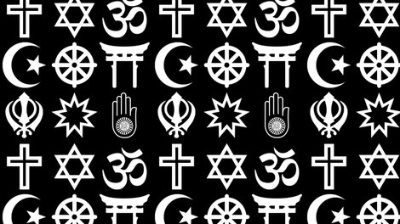
The Nature of God in Three Faiths
And finally...
Compare and contrast?
Complete a ‘comparison triad’ comparing the beliefs about God in Christianity, Hinduism and Islam
What do the results from your triad suggest about beliefs about God in these three faiths?
Islam
All
Hinduism
Christianity

Slide 10
The Nature of God in Three Faiths
And finally …
In your topic booklet, at the front of your exercise books, note down at least two new things you now know and at least two new things you now understand.

