Slide 1
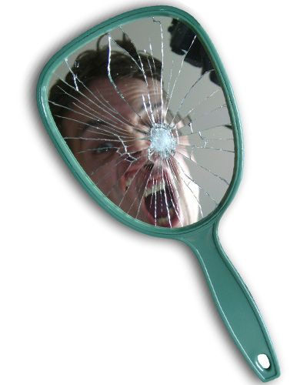
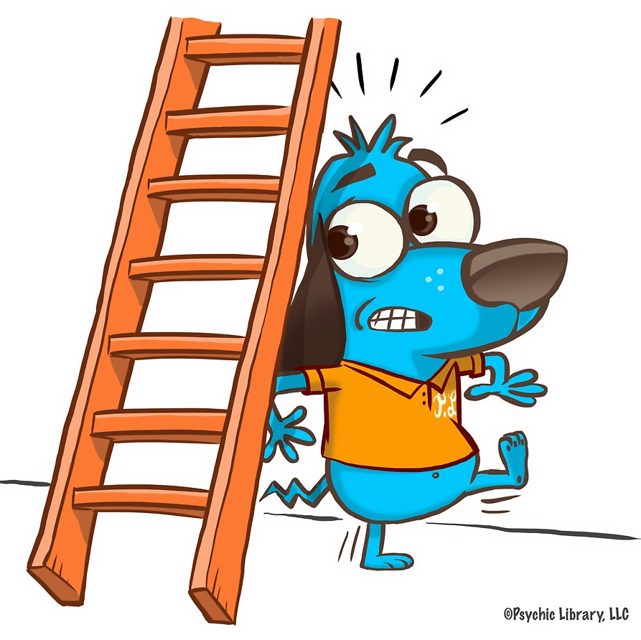
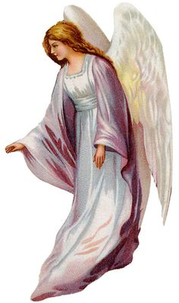
What is Belief?
Key Question.
Why are beliefs important?
Starter Task.
Look at the images.
Which is the odd one out? Explain your reasons for your choice.

Slide 2
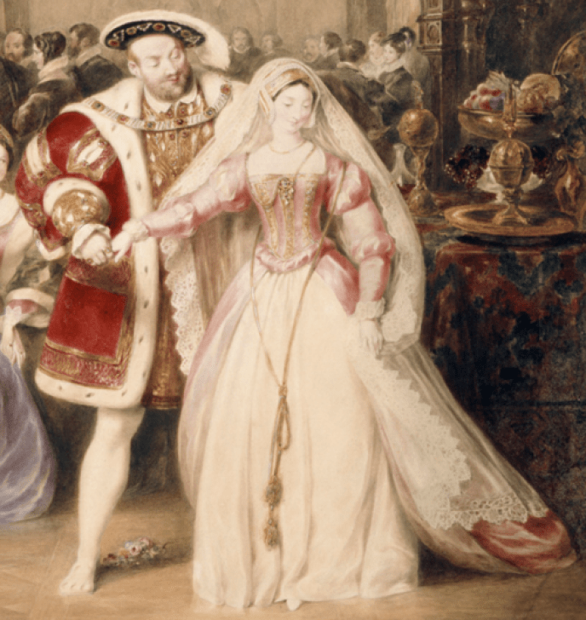
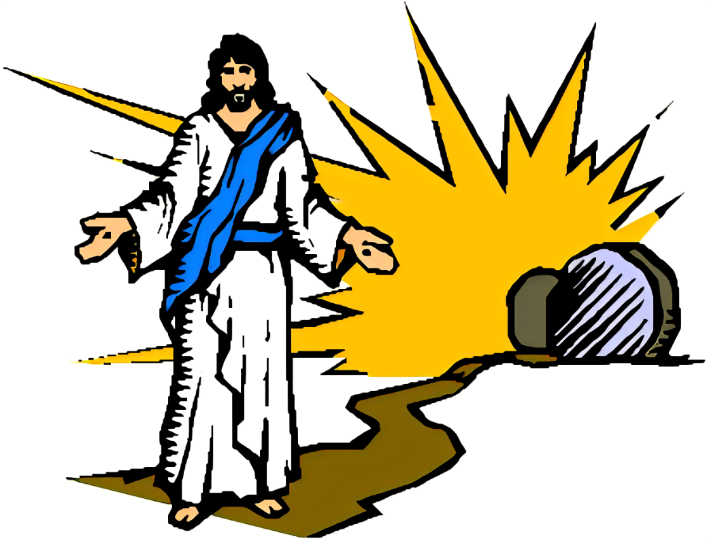
What is belief?
Spot the difference!
Read the following statements, note them down.
What is the key difference between the statements?
Henry VIII was married to Anne Boleyn.
Jesus was resurrected.
It is lucky if you find a four leaf clover.
Explain your answer.

Slide 3
What is belief?
So, can you explain
the difference between religious belief, superstition and fact?
Write definitions for each term.
How could religion be said to be fact, superstition and belief?
Read two examples of superstitions. Note down the superstition, the religious belief and any associated facts. You can discuss this in pairs, if you wish.

Slide 4
What is belief?
Questions
What, exactly do the terms mean: fact, belief and superstition?
Is it always the case that there is no factual evidence in religion?
What evidence is there to support your answer for question 2?
What are the consequences of holding certain beliefs or having certain superstitions? Explain two examples.
Why do you think you were asked the question, ‘what is belief’?
Conclusion…?
Consider your opinion… Which is the most important concept – superstition, fact or belief? Explain your view with reasons and examples.

Slide 5
What is belief?
And finally …
In your topic booklet, at the front of your exercise books, note down at least two new things you now know and at least two new things you now understand.

Slide 6
Socratic Questioning – For Teacher info
Clarifying Concepts
What, exactly does this mean?
How does this relate to the topic?
Probing implications and consequences
Do these claims make sense?
How do these claims fit with… ?
What are the consequences of that?
Probing assumptions
If this is correct, what else could we assume?
What would happen if?
Questioning viewpoints and perspectives
Who benefits from this claim?
Why is it better than…?
Why is it different from…?
Probing rationale, reasons and evidence
Why is that happening?
What evidence is there to support a view?
Questioning viewpoints and perspectives
Why do you think I asked this question?
What does that mean?

