Slide 1
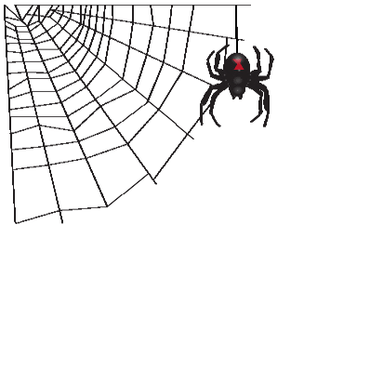
What is Religion?
Key Question.
What is religion?
To begin...
Create a spider diagram or list that includes at least seven things that you think are key elements of a religion.
Leave space to add more things at the end of the lesson.

Slide 2
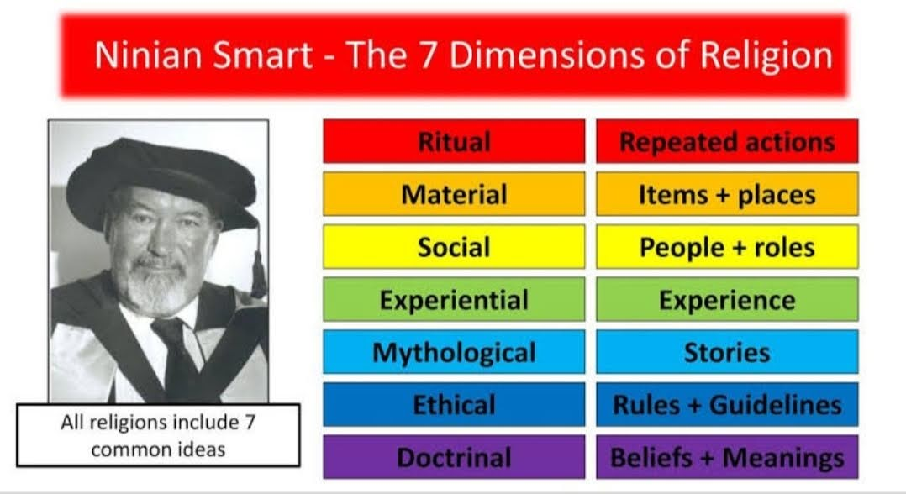
What is Religion?
Ninian Smart’s Seven Dimensions of Religion.
This is a famous example of a potential answer to the question of ‘What is Religion’?
Complete a diagram adding examples of each of the Seven Dimensions.

Slide 3
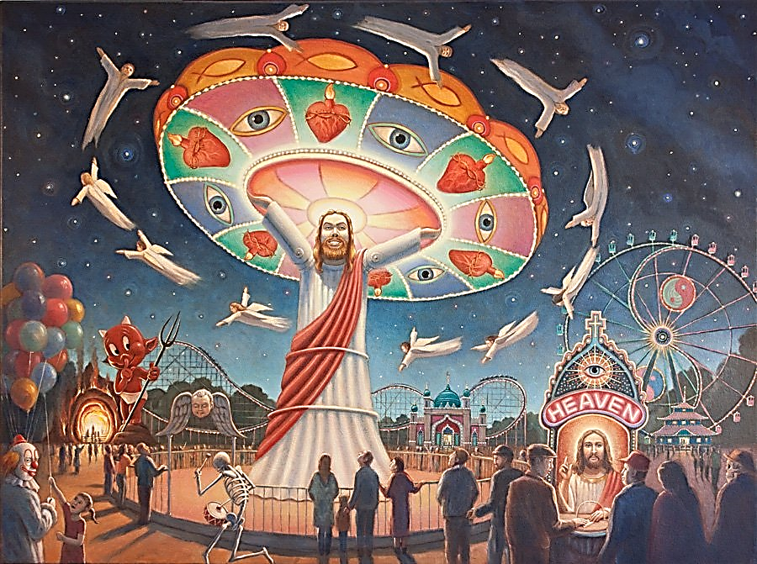
What is Religion?
Picture observation.
Study this picture. There are lots of elements of religion in it.
Note down;
Different religions represented
Different beliefs represented
Religious symbolism represented
Meanings of representation of Jesus in the picture.
Foreverland – Mark Bryan.
How does knowing the title of this painting add to your ideas about the artwork?

Slide 4
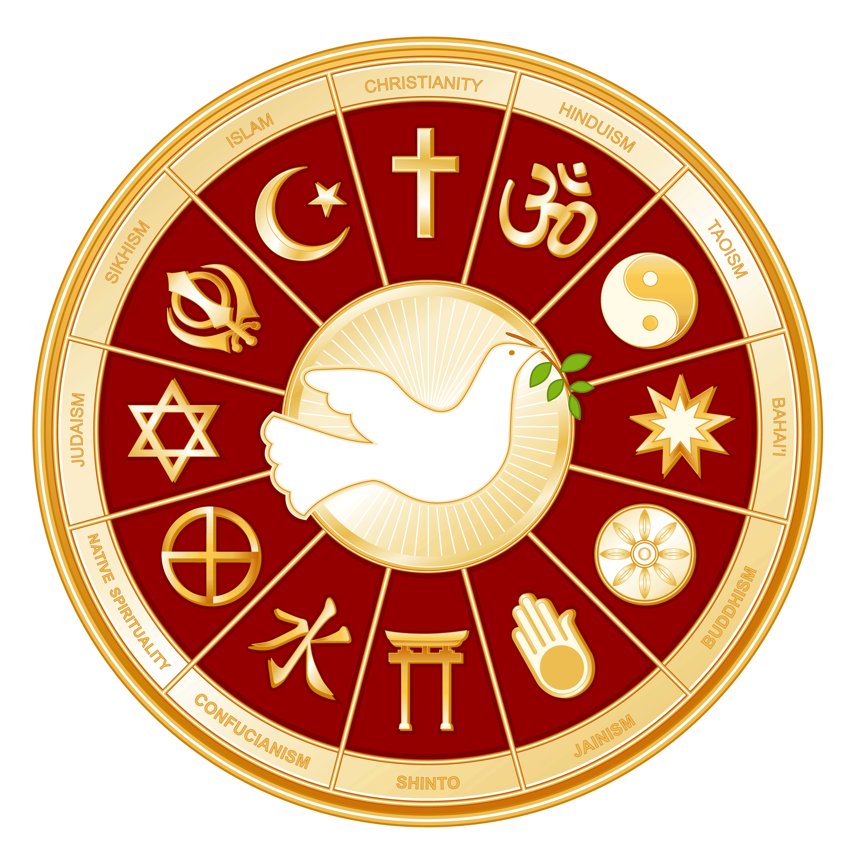
What is Religion?
Review.
After completing both tasks, consider, again your ideas about what religion is.
In a different colour, add another seven ideas to your spider diagram you did at the beginning of the lesson.

