Slide 1
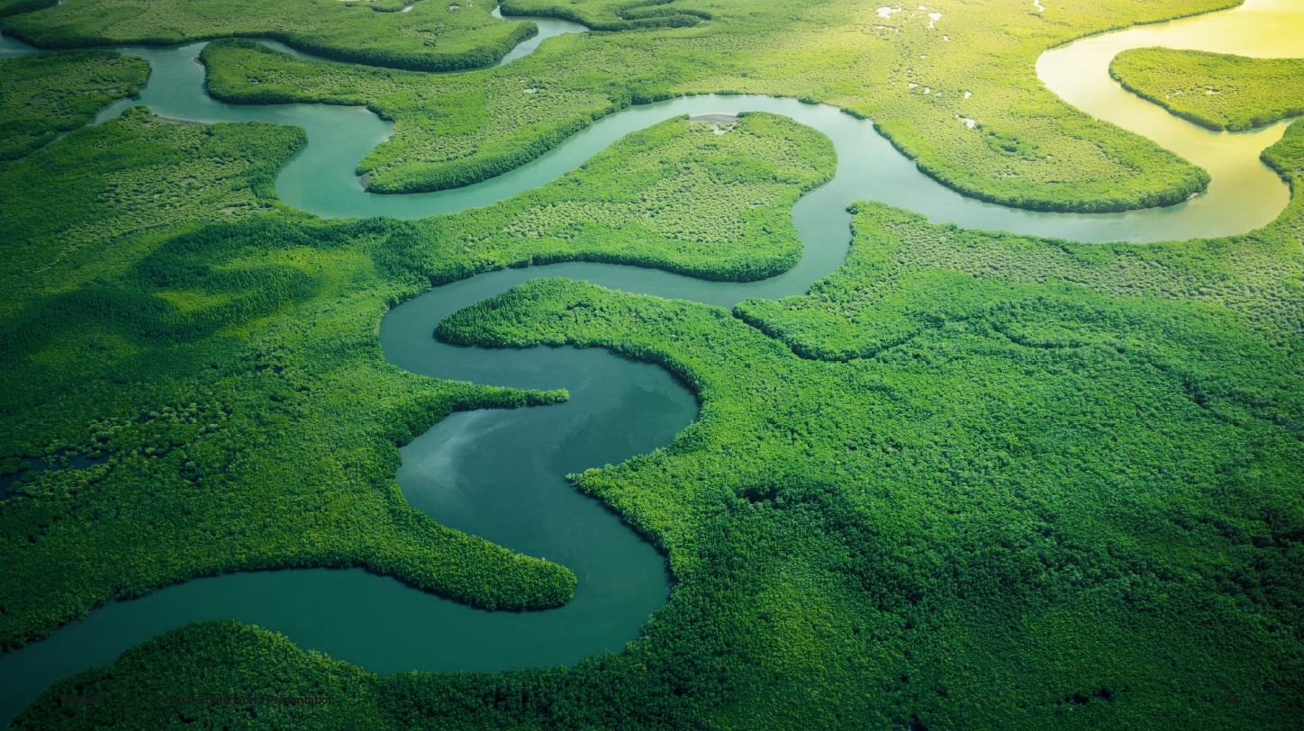
Worldview

Slide 2
YEAR 7 RE – Autumn Term
What is your Worldview?
Nobody Stands Nowhere – YouTube
WHAT'S YOUR WORLDVIEW? (QUIZ) - YouTube
Throughout your RE KS3 studies you will be considering your ‘worldview’ and how it may change with everything you learn.
But, what is a ‘worldview’?
Watch the videos and answer the questions on the sheet.

Slide 3
What is your Worldview?
A worldview is a way of looking at and explaining life and the world.
It can be seen as a lens through which the world is interpreted.
It is a set of beliefs that influences a person’s perspective, values and actions.
A person’s worldview can influence the way everything in the world is viewed, interpreted and explained.

Slide 4
What is your Worldview?
A worldview typically addresses life's biggest questions, including:
a) How did we get here?
This question addresses the origins of the universe & life on earth.
b) Why are we here?
This question addresses meaning & purpose.
c) Where are we going?
This question addresses the future and the afterlife.
d) Who's in charge?
This question addresses the existence of a supreme being.

Slide 5
What is your Worldview?
What is true?
This question is about the nature of truth and whether it is objective (based on provable evidence - facts) or subjective (based on personal views). If truth is objective, what is it based on (what is the source of truth)?
What is right and what is wrong?
This question deals with morality. Are right and wrong based on an objective set of moral standards or are they based on a person’s or group’s feelings, desires or standards that fit the time and place?

Slide 6
What is true?
Why are we here?
How do you see the World?
How did we get here?
What is right?
What is wrong?
Where are we going?
Who's in charge?

Slide 7
What is your Worldview?
Design your own ‘world view lens’.
What do you think belief is?
What do you think religion is?
In the template you will be given, note down your ideas about the questions. Draw pictures or symbolize your ideas.
Use appropriate colours to illustrate your ideas.
Does God exist?
What do you think religion is for?
How do you think religion benefits society?

Slide 8
The questions
you have noted
down your ideas for on
your ‘lens’ are all linked
to ideas we will be
studying this term.
Keep your ‘lens’ safe,
stuck in your book, we
will be returning to
it at the end of
this unit.
How do you see the World?

Slide 9
The following slides are for teacher reference/information.
The following information is from a book called ‘Making Every RE Lesson Count’. It, along with research from ‘Huh’ – Curriculum Conversations’, is the rationale for this new KS3 scheme of work. The new units will also reflect ‘Religion and Worldviews: The Way Forward’ (2018).
The idea behind the new curriculum is to encourage students to develop their thinking, reasoning and views of religion, religious and non-religious beliefs, religious people and their activities, the world and the people in it.
The idea behind the ‘lens’ is to allow the students to see how and why their views change or stay the same.

Slide 10
The questions for each ‘lens’ for each unit will be linked to the unit being taught.
The new curriculum also links to ideas in the 2021 RE Agreed Syllabus.
The level descriptors for KS3 reports will be updated and renamed using the titles, Philosophical, Theological and Social Sciences (explanations on the next slide).
These will be linked to the units taught.

Slide 11
Social Sciences
lens
Theological
lens
Philosophical
lens

Slide 12
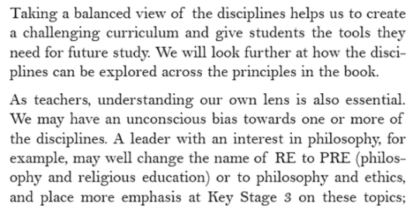
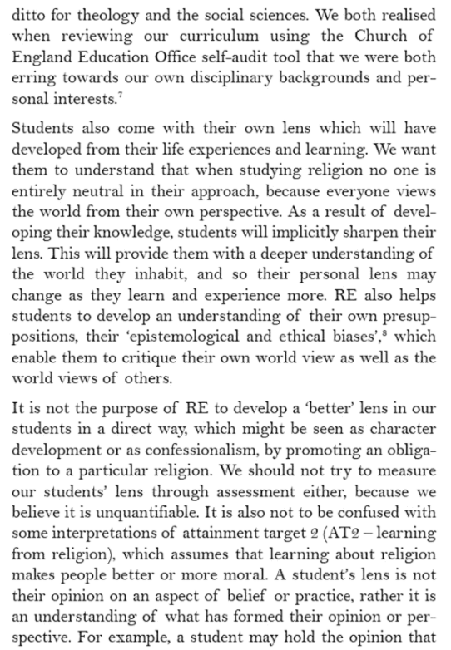

Slide 13
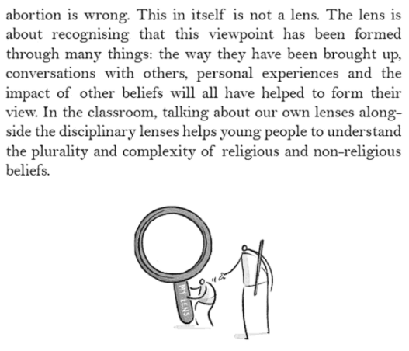
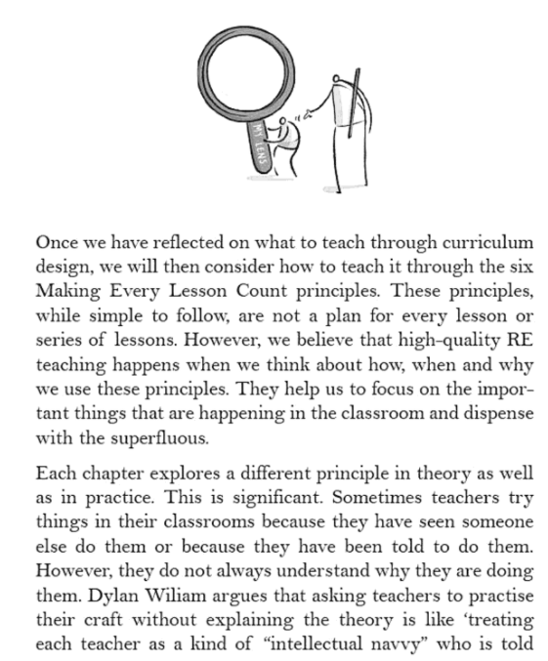

Slide 14
