Slide 1
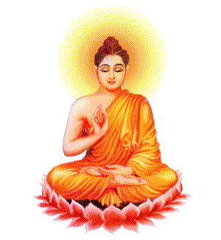
Buddhist Practices Key Words Game

Slide 2
anatta

Slide 3
anicca

Slide 4
arhat

Slide 5
Buddha

Slide 6
Buddha nature

Slide 7
Dependent arising

Slide 8
dhamma

Slide 9
dukkha

Slide 10
Eightfold Path

Slide 11
enlightenment

Slide 12
ethics

Slide 13
Five aggregates

Slide 14
Four Noble Truths

Slide 15
Kamma/karma

Slide 16
Mahayana

Slide 17
Mara

Slide 18
Amitabha Buddha

Slide 19
bodhisattva

Slide 20
meditation

Slide 21
festival

Slide 22
festival

Slide 23
The Three Poisons

Slide 24
festival

Slide 25
festival

Slide 26
Nibanna

Slide 27
The Five Ascetics

Slide 28
nidanas

Slide 29
Pali

Slide 30
Pure Land

Slide 31
samsara

Slide 32
Sanskrit

Slide 33
sunyata

Slide 34
Theravada

Slide 35
The Threefold Way

Slide 36
The Three Watches of the Night

Slide 37
Tibetan Wheel of Life

Slide 38
wisdom

Slide 39
Sukhavati

Slide 40
Zen

Slide 41
Nichiren

Slide 42
bodhisattva

Slide 43
Buddha

Slide 44
Buddha nature

Slide 45
ethics

Slide 46
Five aggregates

Slide 47
The Five Ascetics

Slide 48
Four Noble Truths

Slide 49
Kamma/karma

Slide 50
dhamma

Slide 51
Mahayana

Slide 52
Mara

Slide 53
anatta

Slide 54
dukkha

Slide 55
meditation

Slide 56
Dependent arising

Slide 57
festival

Slide 58
anicca

Slide 59
Eightfold Path

Slide 60
The Three Watches of the Night

Slide 61
festival

Slide 62
Tibetan Wheel of Life

Slide 63
festival

Slide 64
Amitabha Buddha

Slide 65
enlightenment

Slide 66
Nibanna

Slide 67
Zen

Slide 68
Pali

Slide 69
arhat

Slide 70
Pure Land

Slide 71
samsara

Slide 72
Sanskrit

Slide 73
wisdom

Slide 74
festival

Slide 75
Nichiren

Slide 76
Sukhavati

Slide 77
sunyata

Slide 78
Theravada

Slide 79
nidanas

Slide 80
The Threefold Way

Slide 81
The Three Poisons

