Slide 1
What do the following images tell you about the my weekend?
What do they have do to with a Business Studies lesson?

Slide 2
Exhibit A

Slide 3
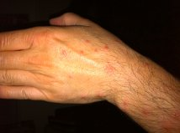
Exhibit B

Slide 4
Exhibit C

Slide 5
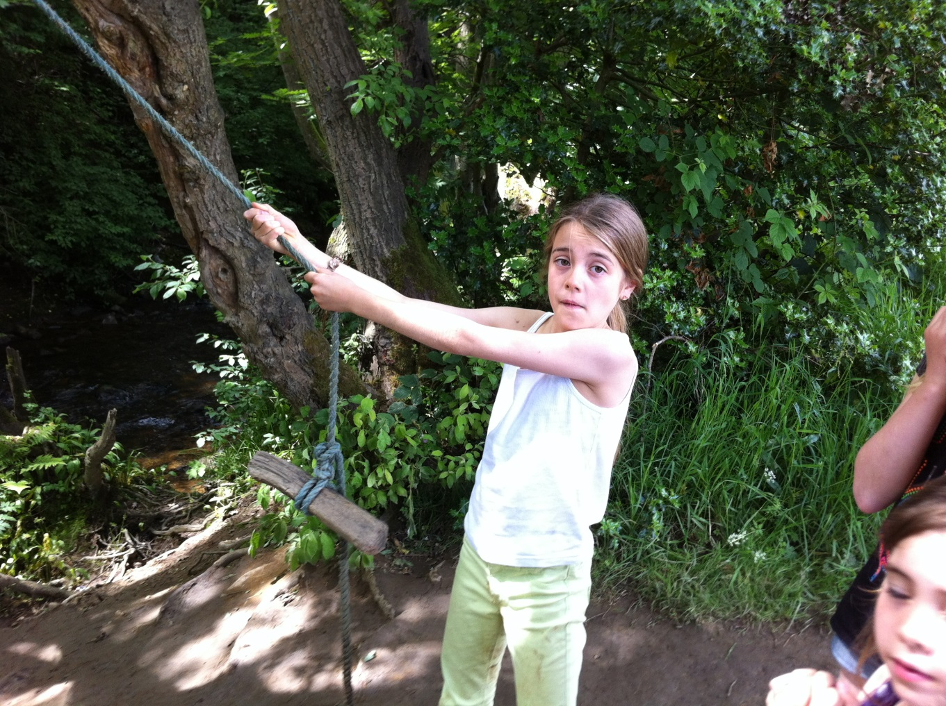
Exhibit D

Slide 6
Exhibit E

Slide 7
Exhibit F

Slide 8
Exhibit G

Slide 9
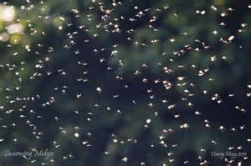
Exhibit H

Slide 10
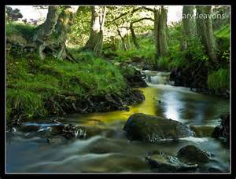
Exhibit I

Slide 11
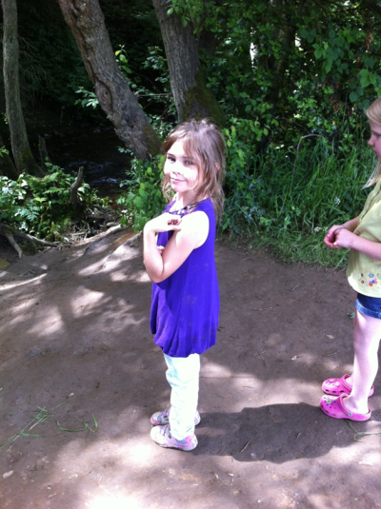
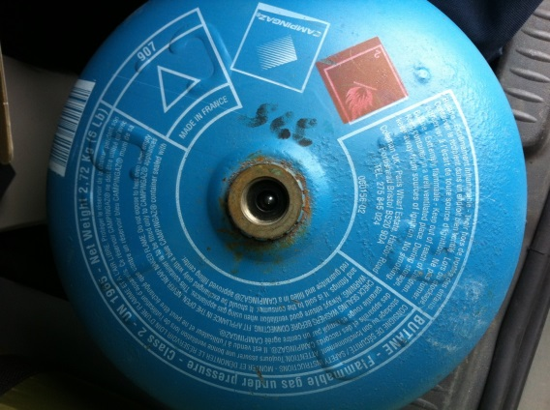
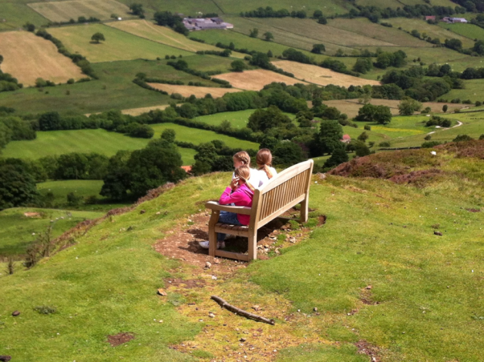
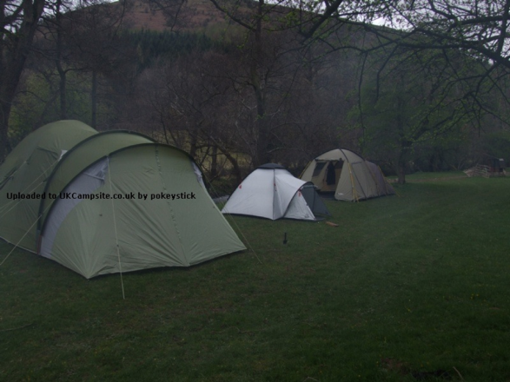
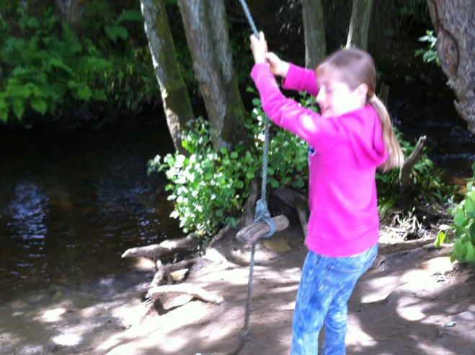
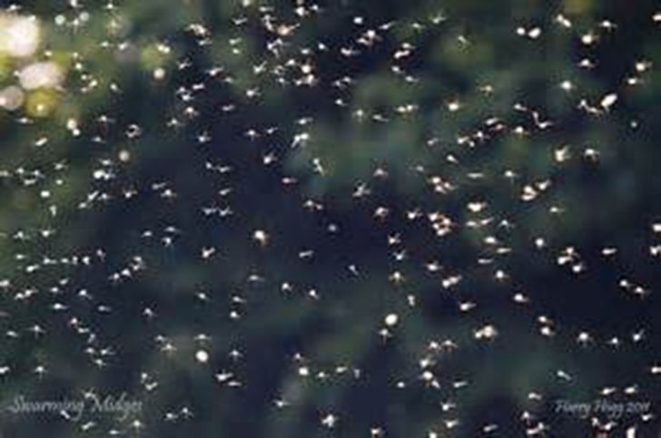

Slide 12
Fail to prepare
Prepare to Fail

Slide 13
Did all my planning lead to a successful trip?
We got there without getting lost
We arrived on time
We did get to the top of the hill and see those great views
I did manage to find a gas supplier to swap the bottle and cook the food
I took the right amount of food

Slide 14
However!
I didn’t do my research about the camp site
It was located next to a river
The Scottish Midges were out in force
I did not bring insect repellent so ended up becoming dinner for the Scottish Midges
ALL THE PLANNING IN THE WORLD CAN’T HELP YOU WHEN YOUR YOUNGEST PUSHES ANOTHER CHILD OVER INTO THE RIVER AND YOU LEAVE A DAY EARLY IN EMBARASSMENT!

Slide 15
Planning and Decision Making
So what lessons can we learn?
Detailed research and planning:
Are important when undertaking an event
Reduces the risk of things going wrong
But unforeseen events happen despite the best planning in the world!

Slide 16
Making strategic decisions
This topic covers the various techniques that may be used by the business to inform their strategic decision making.
Students should consider non-financial information as well information generated by the techniques to aid decision making

Slide 18
Critical Path Analysis

Slide 19
Get in to groups of 4
Using Post it Notes
Write down all of the steps involved in order to brew a pot of tea and serve one cup of tea!
On the Notes, estimate the duration of each task!
How long will it take for you to make one cup of tea?
Am I missing something?
Does it really take this long?

Slide 20
Times
Activity | Description | Seconds
A | Fill kettle, connect to mains | 15
B | Boil kettle | 90
C | Put tea in pot | 10
D | Pour boiling water in to pot and brew | 130
E | Prepare cups and saucers | 20
F | Pour milk in to cup | 10
G | Put sugar in to cup | 10
H | Pour brewed tea in to cup | 10
I | serve | 5
 |  | 300
 |  | 5 minutes

Slide 21
Construct your networks!
Position each activity in order on the desk.
Now determine which activities follow on from a previous activity (Boil kettle follows on after filling kettle with water)

Slide 22
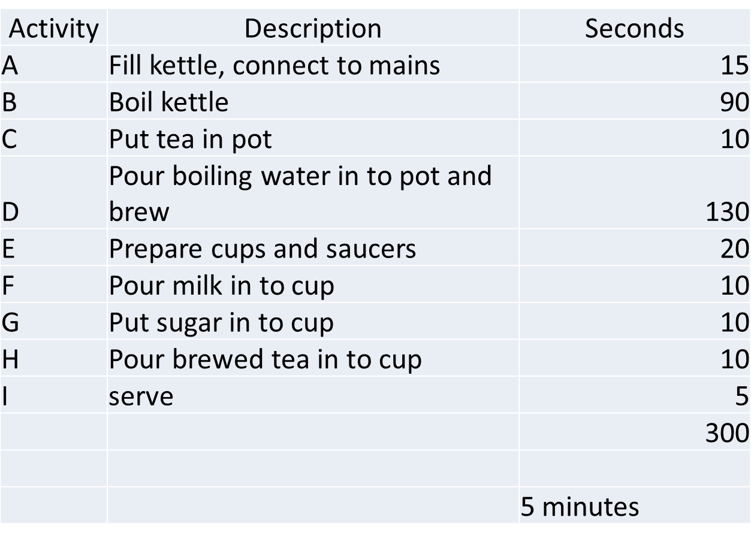
Label each activity correctly

Slide 23
Critical Path
Why have I highlighted A,B,D.H.I in red?
How long will it take?
A
B
D
15
90
130
C
H
10
10
F
E
10
I
20
G
5
10
Which activities must be closely supervised?

Slide 25
Decision Trees

Slide 26
The “tree” is a diagram that compares all possible outcomes of multi-stage decisions as shown below:
It consists of the following:
Probabilities
These are given for each “branch”
Branches
Drawn as lines, which represent an option.
Estimated Monetary Value
The financial value of each outcome
Decision Nodes
Represented by squares and numbered
Chance Nodes
Represented by circles and numbered

Slide 27
An Example Tree
Suppose a charity wanted a summer fund-raising event
They must decide whether to have it indoors or outdoors
This simple decision could be represented on a tree:
Fine
Decision Node
(square)
0.6
The figures of 0.6 and 0.4 are the probabilities of the event happening.
For each event they must add up to one
Indoors
2
(£2,000)
Wet
Event Node
(circle)
0.4
1
Fine
Outdoors
0.6
3
(£3,000)
Wet
0.4

Slide 28
A Useful Tree
Before we can use this example we must know the estimated monetary value (EMV) for every outcome
The tree would be completed as follows:
EMV
Fine
£5,000
Indoors
0.6
2
(£2,000)
Wet
£7,000
0.4
1
Fine
£10,000
Outdoors
0.6
3
(£3,000)
Wet
£4,000
0.4

Slide 29
A Useful Tree
The charity example would be completed as follows:
EV
EV = £5,800 - £2,000 = £3,800
Fine
£5,000
Indoors
0.6
2
EV = (0.6 x £5,000)+(0.4 x £7,000) = £5,800
(£2,000)
Wet
£7,000
0.4
1
Note that this symbol is used to identify options that should NOT be chosen
Fine
£10,000
Outdoors
0.6
3
EV = (0.6 x £10,000)+(0.4 x £4,000) = £7,600
(£3,000)
Wet
£4,000
EV = £7,600 - £3,000 = £4,600
0.4
The decision should be to hold the event outdoors
Since the EV is higher (£4,600 compared to £3,800)

