Slide 1
1.3.5 Marketing Strategy
a) The product life cycle
b) Extension strategies:
product
promotion
c) Boston Matrix and the product portfolio
d) Marketing strategies appropriate for different types of market:
mass markets
niche markets
business to business (B2B) and business to consumer (B2C) marketing
e) Consumer behaviour – how businesses develop customer loyalty

Slide 2
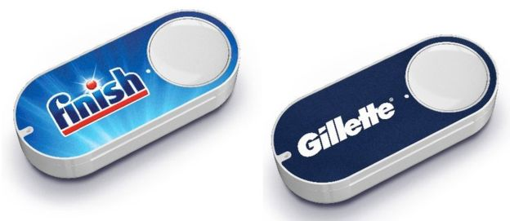
Starter
What do you think these are? How do they work? What do they cost?
Notes:
Amazon Dash Button is a Wi-Fi-connected device that reorders your favourite product with the press of a button.
Each Dash Button is paired with a product of your choice, which is selected through the Amazon App on your Android or iOS smartphone during the set-up process.
Easy to use. Press the Dash Button and never run out of your favourite products
Set the button to re-order the products you like – it is attached to wifi.

Slide 3
e) Marketing strategies appropriate for different types of market

Slide 4
Niche and Mass Markets (Introduction)
https://www.youtube.com/watch?v=OV2zbaMr-_c

Slide 5
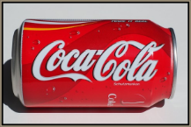
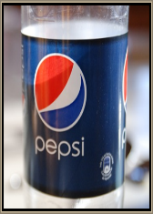
Mass market strategies
A mass market is one that caters for (almost) everyone, mass marketing is the process of selling products to all consumers regardless of age, gender, etc. in the same way
These products can be marketed to consumers all over the world in the same way
Large quantities produced mean lower average costs means EOS, which means high profits
Media used will be; TV, radio, newspapers, mass media
Examples include: Perfume, pop stars, Coca cola, computers and Microsoft

Slide 6
Mass Market
Assess the benefits to Cadbury's of using National television advertising campaigns to market their products?
https://youtu.be/TnzFRV1LwIo

Slide 7
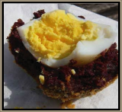
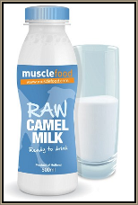
Niche market strategies
A market segment is consumers who can be grouped in different ways; income, gender, lifestyle, ethnicity, religion, age, interest
A niche market is one that caters to a small subset of a segment and will target consumers in a very specific way
Products are designed for a specific purpose
Small turnover keeps larger firms from entering market
Inelastic demand means higher prices can be charged
Media used will be; specialist magazines, trade fairs, websites, word of mouth, leaflets
Examples include; gourmet scotch eggs, Harry Potter school bags, article from BBC here, camel milk

Slide 8
Niche Marketing – Hotel Chocolat
What is different about the way in which Hotel Chocolat market their products?
Why do they do it this why?
What might the drawbacks of this be?

Slide 9
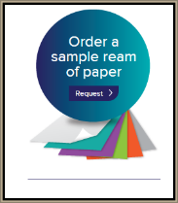
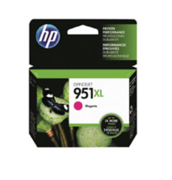
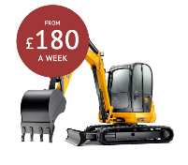
B2B marketing
B2B stands for Business to Business marketing. Many businesses just deal with other businesses rather than consumers. For example a school or college will have a paper supplier so they can keep giving you handouts and you can print your work out.
Advertising needs to be informative rather than persuasive or “clever”
This will typically involve larger transactions than with consumers (think paper again)
Suppliers need to build up closer relationships with customers
Focus will be on offering a quality product and a quality service

Slide 10
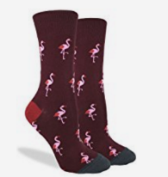
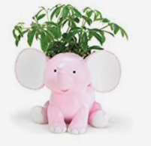
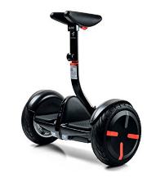
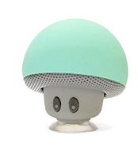
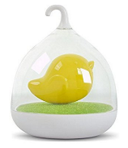
B2C Marketing
B2C means business to consumer
They are not looking to build up long term relationships with the supplier, maybe a one off purchase like a sofa
Consumers want a variety of distribution channels for convenience e.g. online, click and collect, delivery etc.
Short advertising messages which clearly point out the benefits e.g. Olay face cream will make you look 10 years younger HERE
Emotional connection with the product or supplier

Slide 11
d) Consumer behaviour – how businesses develop customer loyalty

Slide 12
Consumer behaviour – how businesses develop customer loyalty
​How do businesses build customer loyalty?
Assess the benefits of both of these methods in the following videos?
https://youtu.be/0lsIUBYP4DY
https://youtu.be/GH1TXfQSwUQ

Slide 13
Customer loyalty
Businesses have discovered that it is much cheaper to keep a loyal customer than to gain new customers through marketing
The expression “plugging the leaky bucket” is used – where business owners should focus on keeping their existing customers with loyalty schemes, discounts and extras rather than continually trying to attract new customers
Customer loyalty is creating a product or service that ensures repeat purchases

Slide 14
Effective customer service
Customer service can be defined as; the assistance and advice provided by a company to those people who buy or use its products or services
This can be
Before the purchase e.g. answering questions on the phone or by e-mail
During the purchase e.g. on a car test drive, the sales person can answer questions on fuel economy, reliability and features of the car
After the purchase e.g. repairs, warranties, guarantees and service plans

Slide 15
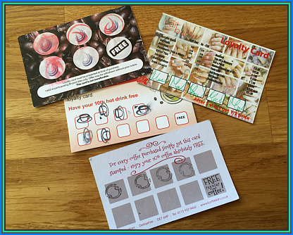
Loyalty Cards
Loyalty cards can work in a number of ways:
They can improve customer retention e.g. a coffee shop making sure customers return by offering a stamp
They can also collect important data on buyer behaviour and purchase decisions e.g. Boots advantage card, Tesco clubcard

Slide 16
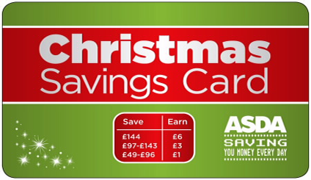
Saver schemes
Each week consumers can carry out their shopping and pay into a saver card – ready for Christmas
They are rewarded by the supermarket for paying in. Here is the current ASDA scheme:
Save £49 and get a £1 bonus
Save £97 and get a £3 bonus
Save £144 and get a £6 bonus

Slide 17
Sample Edexcel A2 questions
Notes:
No suitable A2 question for this topic so I have borrowed an Edexcel sample AS question for practice

Slide 18
Case study for question 1

Slide 19
Sample question 1
Level 1
1-2
Level 2
3-4
Level 3
5-7
Level 4
8-10

Slide 20
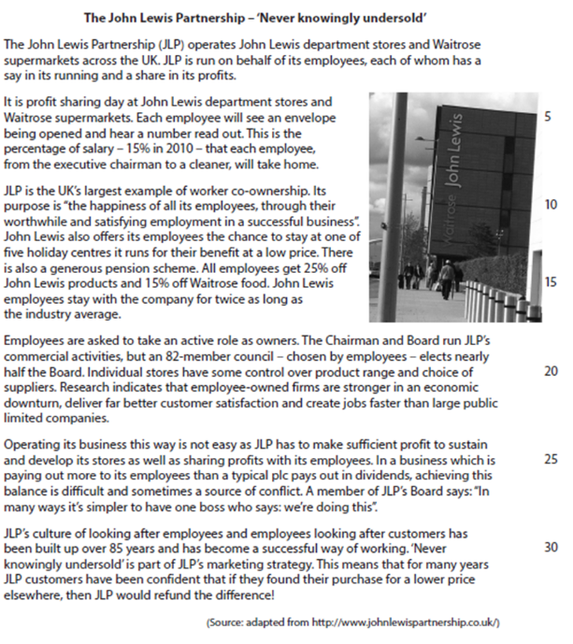
Case study for question 2

Slide 21
Sample question 2
Knowledge
2
Application
2
Analysis
2

Slide 22
Glossary
Product life Cycle; the stages that a product moves through over time
BCG matrix; The Boston Consultancy Group or Boston Matrix for short, a marketing portfolio analysis tool
Extension strategy; a plan to extend the maturity stage of a product life cycle of a product, either through changes to the product or promotions to boost sales
B2B marketing; Business to business marketing
Mass Market; A market which caters to everyone, for example corn flakes or toothpaste
Niche market; A small market with very specialised customers, for example Harley Davidson motorbikes
Dynamic market; a market that is subject to rapid or continuous change

