Slide 1
Judaeo-Christian Creation
Key Question What is the Creation story in the Bible?
Learning objectives:
All: to be able to explain the biblical creation story.
Most: compare two or more creation stories with each other and with Science.
Some: to evaluate the purpose of creation stories.
Write the date, title & key question.

Slide 2
Put the subheading, ‘Creation’s King by Paul Baloche’.
Click the link below.
In one or two sentences, explain what this song is about; the message of this song.
In the pictures, what different aspects of creation are shown?
Extension:
Use one or two quotations to illustrate your answer.
https://www.youtube.com/watch?v=AE6xK8-5Ldw

Slide 3
The Creation of the World
Genesis Chapter 1
Put the subheading above.
Read the text (linked here).
Open the document called, ‘Numbers’. Print it, if possible.
Cut out or draw the numbers.
Illustrate them with the events described in each day. (See ideas on next slide.)
Save/keep the page somewhere.
Alternative:
Do a story board of creation in seven pictures like the one on the next slide.
Extension: Read chapter 2-3 and compare it with the Raven story. https://www.biblegateway.com/passage/?search=gen+2-3&version=ESVUK How is it similar/different?
https://www.biblegateway.com/passage/?search=Genesis+1-2%3A3&version=ESVUK

Slide 4
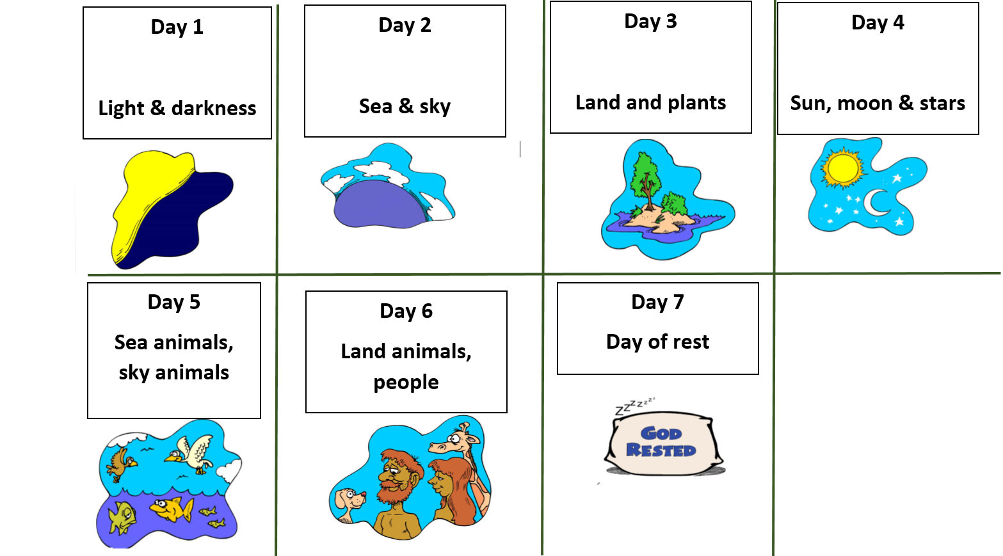
Biblical Creation

Slide 5
Compare, contrast & evaluate
Compare and contrast two creation stories. (Could be Inuit, Hindu or the Bible, but could be any other religious/mythical one you know.) Give three or more similarities and three or more differences.
Open the document called, ‘Hot Handout: Scientific Cosmology’ and read it.
Open the document called, ‘Genesis & Science’ and read it.
Compare and contrast the scientific account of the creation of the world with the Bible account. Give three differences & three similarities.
Answer in sentences:
Are religious creation stories scientific?
What is the purpose of creation stories?
Extension
What are the advantages/disadvantages or religious/mythical creation stories compared with scientific explanations?
Is the scientific account better? Explain your answer with examples.
Notes:
Discuss with the class differences between the scientific account and the Bible. Write answers on the physical w/b before answering q2.

