Slide 1
2.6.2 - Competition policy
Legislation in place by the government designed to prevent collusion – price fixing by businesses getting together and agreeing a price to charge for their products
CMA is the competition and Markets Authority who are independent regulators
The CMA aims to “promote competition for the benefit of consumers”
They investigate mergers that restrict competition
Watch the videos then try the activity on the next slide

Slide 2
Competition legislation refers to the laws and regulations that businesses need to comply with in relation to how they compete in markets.
Whilst competition legislation is very complex, the main aims of it are to:
Widen consumer choice in markets for goods and services
Ensure effective price competition between suppliers
Deal with anti-competitive behaviour which might have a negative effect on consumers

Slide 3
Anti-competitive agreements include those which:
Directly or indirectly fix purchase or selling prices, or any other trading condition (e.g. discounts or rebates)
Limit or control production, markets, technical development or investment (e.g. setting quotas or levels of output)
Share markets or sources of supply

Slide 4
Why competition is good for business
Explain why competition is good for business.

Slide 5
Price-Fixing explained
What does price-fixing look like? Why is it illegal and why can it cause harm?

Slide 6
Bid-rigging and discussing tenders
What does bid-rigging look like? Why is it illegal and what harm can it cause?

Slide 7
Dividing up and market sharing
What does market sharing look like? Why is it illegal and what harm can it cause?

Slide 8
Abuse of a Dominant Market Position
What does abuse of a dominant market position look like? Why is it illegal and what harm can it cause?

Slide 9
What is resale price maintenance (RPM)?
What is resale price maintenance? Why is it illegal and what harm can it cause?
Why was an exception made over many years for small book retailers?

Slide 10
Information you shouldn't share with other businesses
What type of information shouldn’t a business share with other businesses? Why is it illegal and what harm can it cause?

Slide 11
What happens if you break competition law
What are the consequences of breaking competition law?
Are the consequences of breaking competition law an adequate deterrent? If not, why not?

Slide 12
Research Activities
Walls ice cream – freezer wars
http://news.bbc.co.uk/1/hi/business/622037.stm
http://news.bbc.co.uk/1/hi/business/the_company_file/336660.stm
http://news.bbc.co.uk/1/hi/business/the_company_file/399001.stm
Follow these links and read the attached PDF report. Why was an investigation launched and what was the specific grievance? What was the outcome and do you agree with the judgment?

Slide 13
Research Activities
BA price fixing
http://news.bbc.co.uk/1/hi/business/6925397.stm#:~:text=British%20Airways%20has%20been%20fined,the%20prices%20of%20fuel%20surcharges.&text=It%20followed%20a%20decision%20by,response%20to%20rising%20oil%20prices.
https://www.theguardian.com/business/2010/apr/26/ba-virgin-cartel-price-fixing
https://www.ft.com/content/f5225e0c-5146-11df-aceb-00144feab49a
Follow these links. Why was an investigation launched and what was the specific grievance? What was the outcome and do you agree with the judgment?

Slide 14
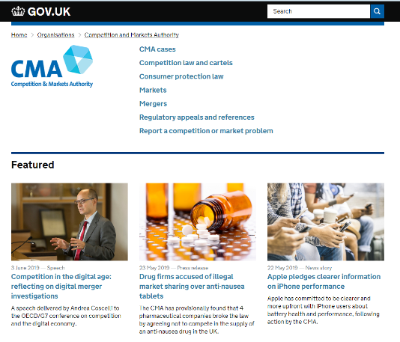
Suggested activity – CMA investigation
Have a look at the CMA website and click on the CMA cases
Find a case you are interested and dig a little deeper into the detail, make some notes about the case
Explain to your group about the case, why the CMA are involved and what the current status of the case is.
How will being investigated by CMA impact a business?
Notes:
May stop a merger, which could be very expensive if paperwork and negotiations have already taken place.

