Slide 1
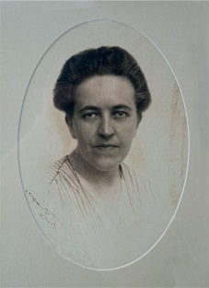
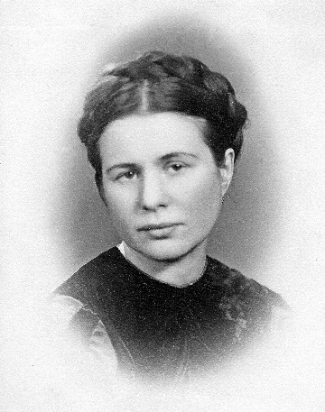
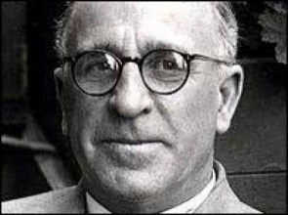
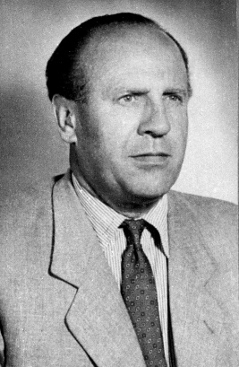
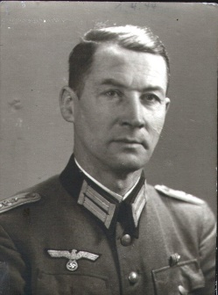
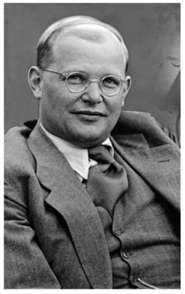
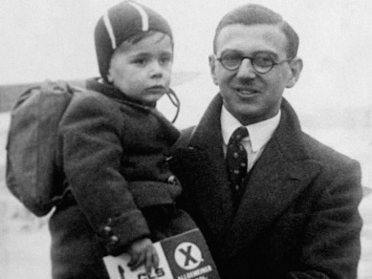
People who Helped the Jews
Read up on one of these people and be prepared to explain what he or she did to others in small groups.
Maximilian Kolbe
Corrie ten Boom
Frank Foley
Dietrich Bonhoeffer
Oskar Schindler
Irena Sendler
Sir Nicholas Winton
Capt Wilm Hosenfeld

Slide 2
Name & Form
GCSE Religious Studies
Mr Haughton
Monday per. 3

