Slide 1
Edexcel A2 Business
1.4.2 Recruitment, selection and training
Revisionstation

Slide 2
Worksheet

Slide 3
From Edexcel
a) Recruitment and selection process:
internal versus external recruitment
b) Costs of recruitment, selection and training
c) Types of training:
induction
on-the-job
off-the-job

Slide 4
Starter: identify the reasons these employees have left their current job

Slide 5
1.4.2 Recruitment, selection and training
a) Recruitment and selection process:
internal versus external recruitment
b) Costs of recruitment, selection and training
c) Types of training:
induction
on-the-job
off-the-job

Slide 6
Definition: Recruitment
Recruitment is the process of finding people to work for a company or become a new member of an organisation

Slide 7
Recruitment and selection process

Slide 8
Recruitment process - introduction
Stage 1: Identify the vacancy
Stage 2: Write a job description
Stage 3: Write a person specification
Stage 4: Advertise the vacancy
Stage 5: Candidates apply
Stage 6: Candidates shortlisted
Stage 7: Shortlisted candidates interviewed
Stage 8: Other recruitment activities
Stage 9: Successful candidate is offered the job
Get ready to make some notes on these stages of the recruitment process

Slide 9
Recruitment Process Stage 1
Stage 1 – identify the vacancy
At the start of the recruitment process the business will identify a need to fill a vacancy; perhaps a new department or new product; perhaps someone is leaving and needs to be replaced due to:
Retiring
Moving to a different job
Promoted
Moved to another department
Maternity leave

Slide 10
Recruitment Process Stage 2
Stage 2 – Write a job description
Now that the vacancy has been identified the business will need to write a job description
This will include all the responsibilities of the job so that any potential candidates can see if it will be a good fit with their work skills
For example a business teacher job description might say:
“To ensure that all students undertake independent learning and are given support where necessary to improve their skills and technique”
A job description can be quite a lengthy document, this is a real one taken from the TES
Notes:
The job description is taken from a real position for a business teacher

Slide 11
Recruitment Process Stage 3
Stage 3 – write a person specification
After the job description comes the personal specification and the human resource department would be responsible for writing it.
A Person specification will outlines the:
Personal qualities
Qualifications
Work Experience
Skills
This is a wish list of qualities that the business would like the new member of staff to have
For example a business teacher might have; a degree in business and a PGCE in secondary business education
This is a real person specification for a business teacher and is taken from the TES
Notes:
This is taken from a real person spec for a business teacher’s job

Slide 12
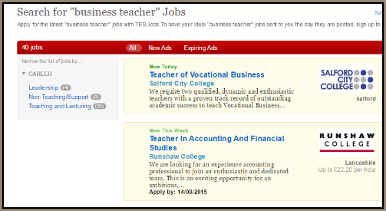
Recruitment Process Stage 4
Stage 4 – advertise the vacancy
The business may advertise the vacancy inside the company; in the company newsletter, on a noticeboard, via e-mail, or it be announced in meetings
The business may advertise outside the company to expand the pool of candidates to choose from; newspaper, speciality magazines, online, jobsite, job centre etc. Which of these methods is internal and which is external?
Teachers’ jobs are posted on the Times Educational Supplement or TES website

Slide 13
Recruitment Process Stage 5
Stage 5 – Candidates apply
Once the advert is live then candidates will be able to start to respond to it.
Candidates may have to send off an application form and covering letter to support the application
The advert will usually have a closing date to spur candidates into action
This is a real example of an application form, but would probably be several pages long

Slide 14
Stage 5 continued
Stage 5 – Candidates apply - continued
A business may also ask job applicants to send in their CVs so they can be attached to their application forms
A CV is a summary of the applicant’s working life to date
Some businesses now ask for video CVs
VIDEO CLIP BBC HERE

Slide 15
Suggested activity – write your own CV
You may have had an opportunity to create your own CV in a careers or PSHE class. If you haven’t it really good practice to have one written so you can update it through your life. This way when you go for a job you have your CV ready so you can apply quickly and easily for the vacancy.
Use these TEMPLATES or use the Word> New>Resume function to write your own

Slide 16
Recruitment Process Stage 6
A shortlisting scoring grid will be used with candidates scored according to desirable and essential qualities
Stage 6 – candidates are shortlisted
Many jobs will attract more candidates than can be possibly interviewed in the time
Candidates are shortlisted according to how well their application fit the person specification and the job description

Slide 17
Recruitment Process Stage 7
Stage 7 – Shortlisted candidates are interviewed
This may include a face-to-face interview with a panel or just one person
This may be a telephone interview, or if the job is in another country the interview may be carried out via skype
It is quite common for candidates to be called for more than one interview

Slide 18
Recruitment Process Stage 8
Stage 8 – candidates may participate in another recruitment activity
Assessment centres where candidates will take part in a series of team building exercises
In tray exercises, candidates may have to complete a task in a certain time
Psychometric testing, candidates may have to complete a test to see if they are a cultural fit with the business

Slide 19
Stage 8 continued
Stage 8 – candidates may participate in another recruitment activity
Some business may require their shortlisted candidates for the job vacancies to participate in some group activities
This may involve a role play game, a debate, a discussion or solving a problem as a team
This helps the business to identify potential leaders and managers, and who works well in a team
Notes:
Need to download this ahead of time and read – it’s a great game but you will need at least 30 mins to do this justice…

Slide 20
Suggested activity – assessment centre mock (teambuilding activities)
In some companies their recruitment process will include an assessment centre where candidates may be required to participate in a range of teambuilding activities
Try moon landing *
Try lost at sea *
* note to teachers this may require printing out in advance. Assign one student to be manager of the activities

Slide 21
Stage 8 continued
Stage 8 – candidates may participate in another recruitment activity
The business may require the shortlisted candidates for the job vacancy to complete a personality test
These can be applied in a straightforward way at the early stages of recruitment to screen-out candidates who are likely to be unsuitable for the job.
Aptitude and ability tests are designed to assess their intellectual performance

Slide 22
Suggested activity – try a personality test
There are 100s of different personality tests available to a business to help them o shortlist suitable candidates and to identify who may be a good fit with their company culture
Try this online personality test – it takes about 12 minutes.
HERE
An alternative is HERE

Slide 23
Recruitment stage 9
Stage 9 – Successful candidate is offered the job
At the end of the process hopefully the business has found a suitable candidate to fill the vacancy
They then need to let the candidates know who were unsuccessful – usually via post and the successful candidate might get a phone call and further instructions about a start date and paper work to sign

Slide 24
Costs of recruitment, selection and training

Slide 25
Recruitment costs - advertising
The recruitment of new employees can work out quite expensive for a business
This will add to the business costs which can mean that the business is less competitive
The ideal is to find the cheapest way of attracting the largest pool fo candidates to a vacancy and so this may mean a mixture of internal and external advertising

Slide 26
Recruitment costs – agency fees
If the human resources department is small or the business does not have one at all – perhaps it’s just one person, they may decide to use an agency instead.
A business may decide to use agency staff or an agency to advertise their job vacancy for them
For example – A full time permanent employee can cost as much as £2,000 to recruit from an agency
Agencies can specialise e.g. supply teachers for schools, IT staff, HGV drivers

Slide 27
Types of training

Slide 28
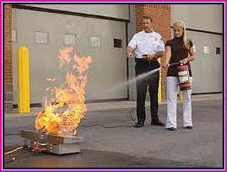
Induction
Induction training happens when an employee starts working for a new business
It may involve training on how to use fire extinguishers, or shown round the building, or introduced to colleagues
What is involved in the training will vary depending on the business and the job role

Slide 29
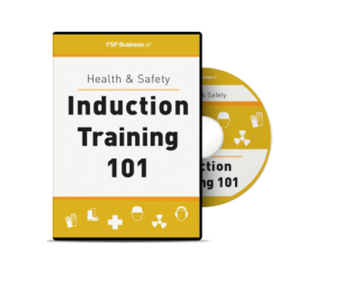
Induction training
New workers are given training to ensure they are:
Familiar with the workplace
Able to do their job
Feel part of the organisation
Quickly become productive for the business
Induction training includes: Company policies, health & safety, introduction to colleagues & job specific training

Slide 30
Induction training
Disadvantages
Induction training can cause information overload for an employee trying to find their feet in a new organisation
Advantages
Many employees make their mind up if they are staying – the first week of employment
Induction training will help to inspire the employees and integrate them with the company culture – called “onboarding”
Good induction training will help reduce the numbers of employees that leave – thus increasing retention numbers

Slide 31
On-the-job
Coaching or mentoring while doing the job.
Assistance and advice is provided by those more experienced to those less experienced.
May include work shadowing or learning to use a specific machine

Slide 32
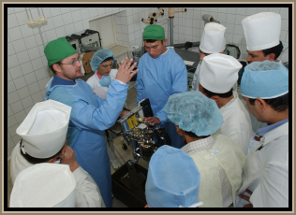
On-the-job training
Disadvantages
Taking time away from employees job to be trained
Reduces efficiency of both teaching worker and new employee
Some workers have bad habits they could pass on to the trainee
The new worker may not pick up the skills straight away/misunderstand/not ask for help
Workers which are badly trained may make expensive mistakes or be a safety hazard
Advantages
Specific training needed for the job (a full time trainer may not know all jobs methods to an up to date standard)
Less expensive than off-the-job training
Learning can be put in to practise immediately
Trainees can see relevance to job more clearly when skills are taught in the workplace

Slide 33
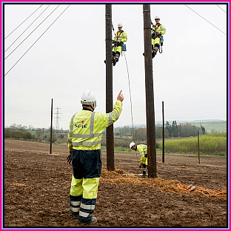
Off-the-job
Involves work at home or courses at company training centres/colleges.
Learning through demonstrations talks, and lectures.
May also be practical courses to learn ICT or machinery

Slide 34
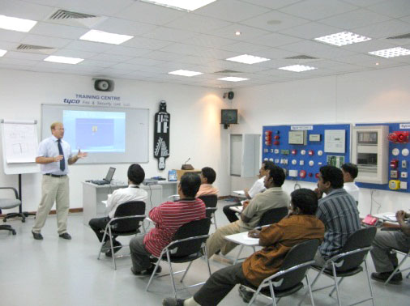
Off-the-job training
Disadvantages
More expensive than on-the-job training
Employees may fail to see link between training and workplace
Employees are taken away from production so the business loses their productivity for that day
Advantages
More focused environment with less distractions
Increases a workers motivation as they feel valued by the company to have money spent on their improvement
Less stressful compared with on the job (don't have to learn skills and do tasks as going along)
Individuals teaching the courses are trained to train
More chance to gather specialist skills

Slide 35
Revision Video

Slide 36
Bonus video

Slide 37
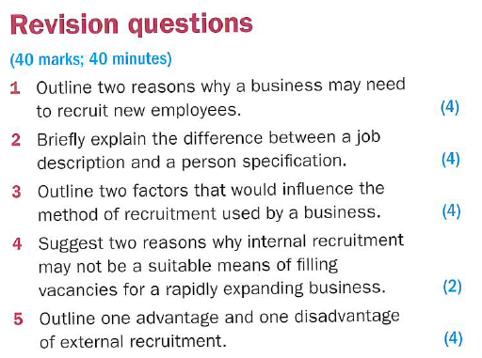
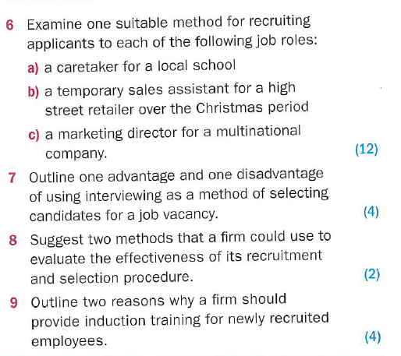

Slide 38
