Slide 1
Jewish Beliefs
Key Question;
What do Jews believe?
To begin… - Picture quiz!
Identify the items on the sheet you will be given.
Identify the religion(s) (Islam/Judaism) they are associated with.
Write a sentence about each one.

Slide 2
Jewish Beliefs
DLOs…
To be able to show knowledge of key Jewish beliefs about God.
To demonstrate understanding of the importance of the Torah.
To show links between beliefs about God, the Torah and Jewish practices.

Slide 3
Jewish Beliefs
Things to do (page 6)…
What does it mean to be Jewish - briefly explain the two ways in which the word ‘Jew’ can be used?
2. What do Jews believe about God? Include six ideas.
3. What is the Shema? Write it down.
Draw two main symbols of the Jewish faith, explain the meaning of each symbol.

Slide 4
Jewish Beliefs
Reflect…
Bearing in mind what we have learnt about Judaism so far, note down four aspects of the faith that you think are the most important. Rank them in order of importance (1-5).

Slide 5
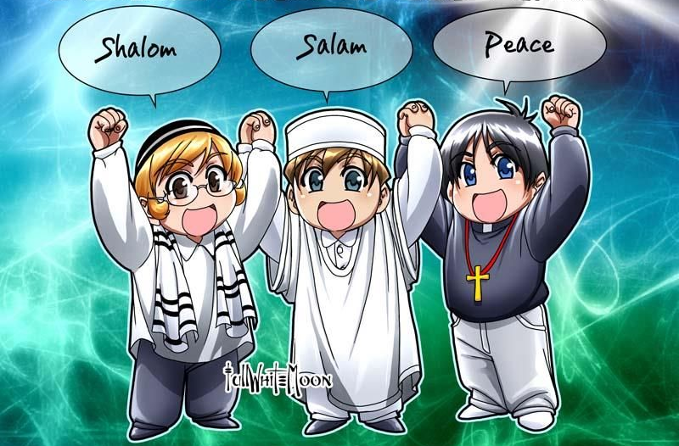
Jewish Beliefs
Things to do – Spiralizer!
Rambam’s Principles of Faith have been debated for hundreds of years. What do you think of them? Chose four of the Principles and complete a spiral text sheet considering the following:
Your idea/belief about each chosen Principle
What a Christian would think
What a Muslim would think
A question about each Principle.

Slide 6
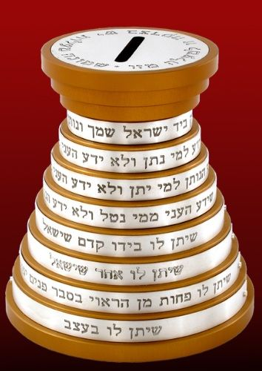
Jewish Beliefs
Eight Degrees of Charity.
Why do we give to Charity?
Note down four reasons.
Which Charities do you give to?
Why these particular charities?
Are there any charities you would not donate to?
Why/why not?
Sort Rambam’s Eight Degrees of Charity from the most charitable to the least. Stick them in order in your exercise book.

Slide 7
Jewish Beliefs
Reflect/Compare…
Complete a comparison diagram of what you have learnt about Islam and Judaism.
If you want to challenge yourself you could do a triad diagram and include Christianity in your comparison.

