Slide 1
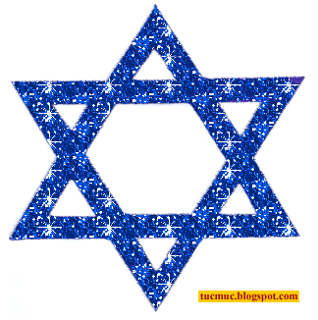
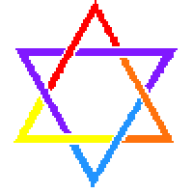
Judaism
Key Question;
What is the religion of Judaism all about?
To begin…
What do you already know about Judaism?
Note some ideas down.

Slide 2
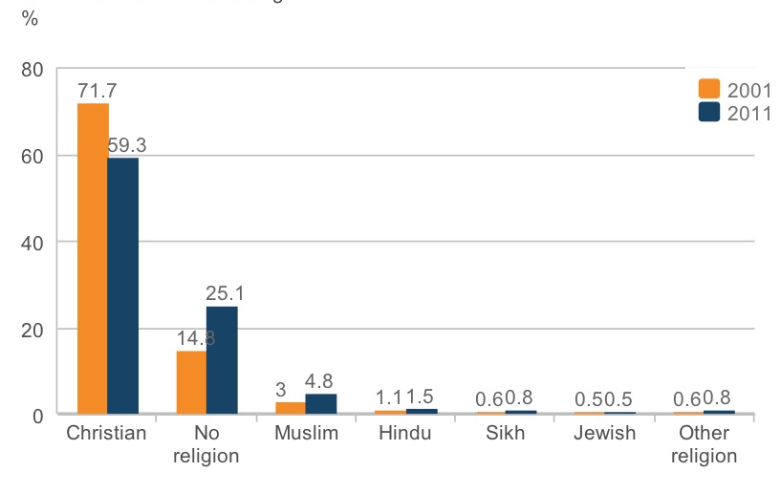
Judaism
Judaism in the UK.
Look at the census graph. Approximately how many Jews are there in the UK?

Slide 3
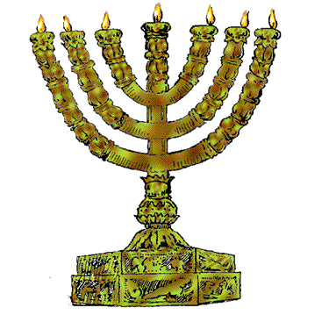
Judaism
Where does Judaism sit on a timeline of the main world religions?
Approximately when did Judaism begin?
Which other religions is Judaism connected with? Give two reasons for this.

Slide 4
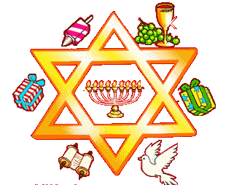
Judaism
The basics… (use the Judaism text books to help)
Complete a table noting down some of the main aspects of Judaism e.g. Holy Books, festivals, symbols etc. Include one fact about each example.

Slide 5
Judaism
And finally…3-2-1.
3 new things you have learnt about Judaism
2 things you have a better understanding of about Judaism (e.g. something you put on your starter task but now know more about).
1 thing you want to know about Judaism.

