Slide 1
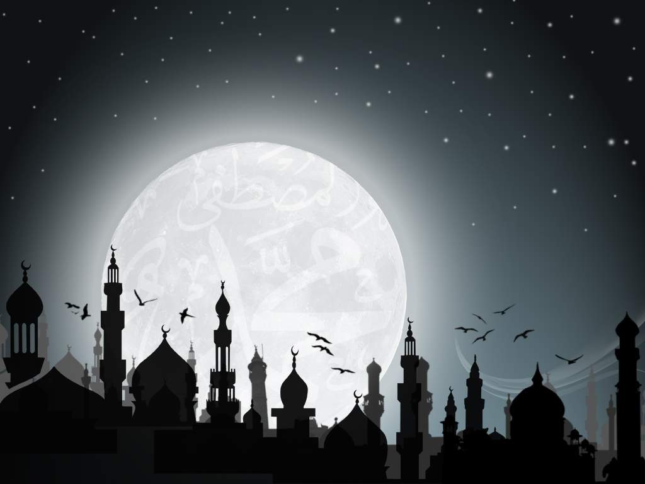
Islam - Ramadan
Key Question.
Why do Muslims fast?
To begin... Review…
Complete the sheet you
will be given, adding in
the missing words and
labelling the pictures.

Slide 2
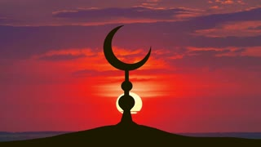
Islam - Ramadan
Things to do… the basics;
How do Muslims know when Ramadan starts and when each day’s fasting should start?
How long does Ramadan last?
Why does the time of Ramadan change each year? What affect does this have on how long Muslims fast each day?
Give four reasons why Muslims fast.
More things to do…
On the template, give examples and explain some of the benefits of fasting.
http://www.bbc.co.uk/newsround/23286976

Slide 3
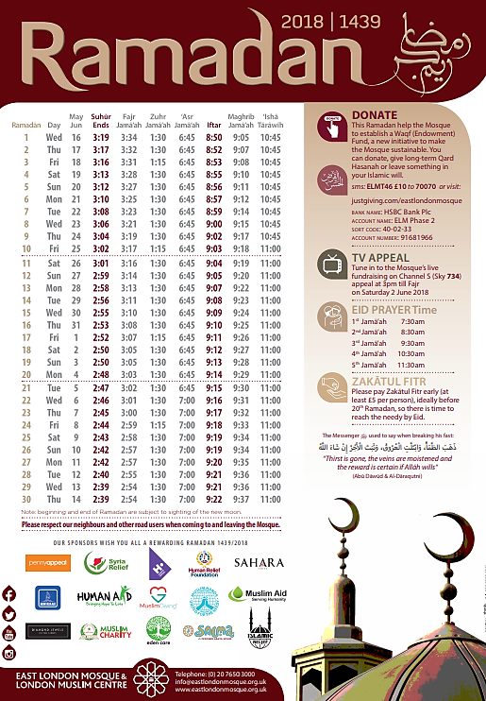
When do Muslims fast this year?
Look at the calendar and note down the following…
1. What year is it in Islamic terms?
2. When was the first day of Ramadan?
3. When is the last day?
4. At what time does fasting start today?
5. At what time is the Isha Tarawih prayer?
6. What time does fasting end today?
7. How long are Muslims fasting for
today?
8. At what time is the Eid prayer?
9. Looking at the poster, what
does it suggest are two big
features of the month of
Ramadan (other than fasting)?

Slide 4
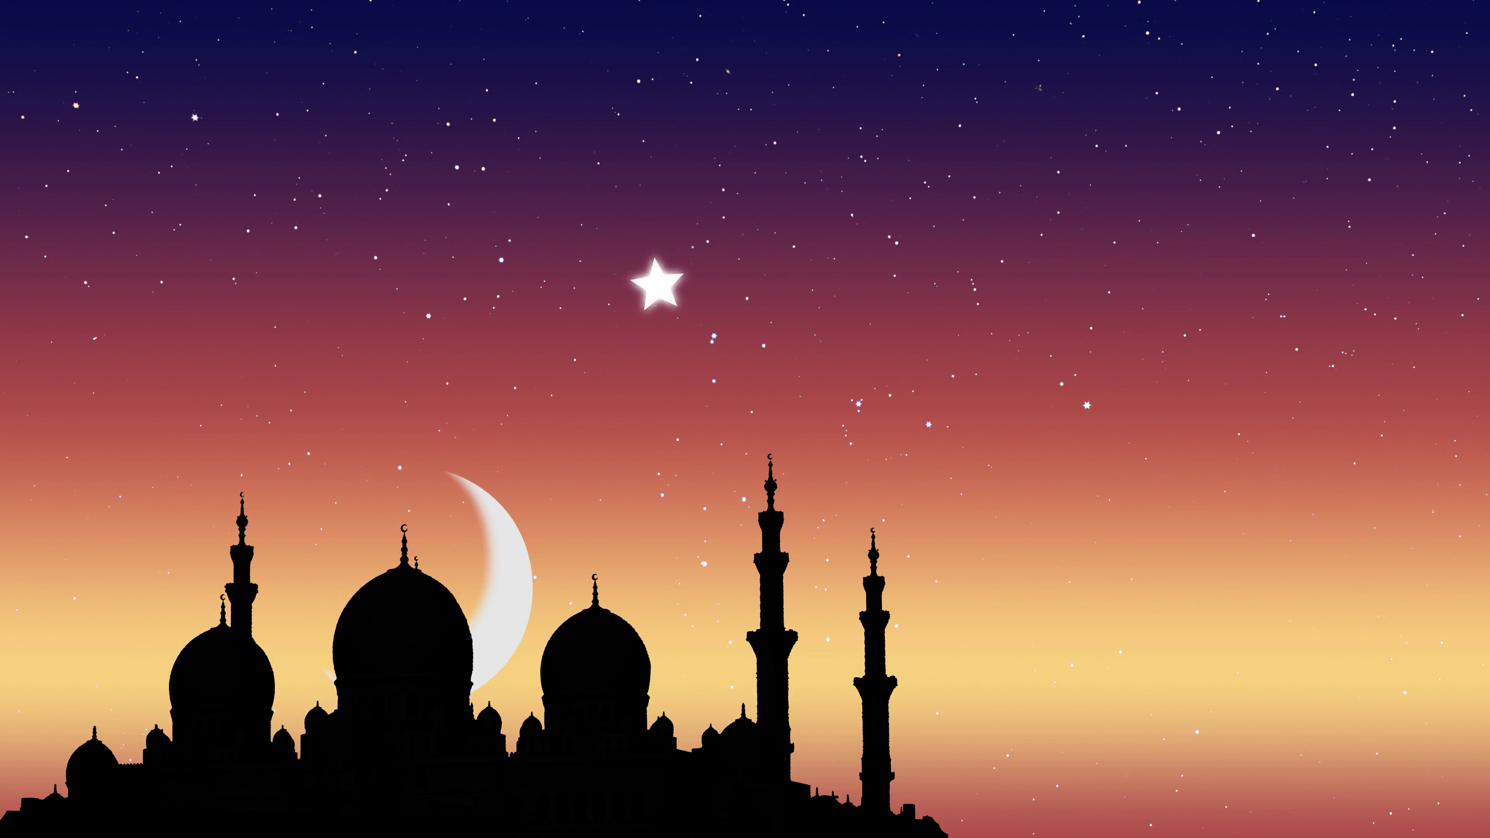
Islam - Ramadan
Things to do… Who should fast?
Complete the table to identify who should fast and why.
How do Muslims break their fast each day?
What should Muslims do if the (a) cannot fast (b) miss a day of fasting for no good reason?
What happens at the end of Ramadan?
And finally…
In three sentences note down why Ramadan is the most important month in the Islamic calendar

