Slide 1
The Masjid
Key Question;
What is a masjid like?
To begin…
Look at the pictures of masjids on the next slide.
Note down your impressions and any similarities you see.

Slide 2
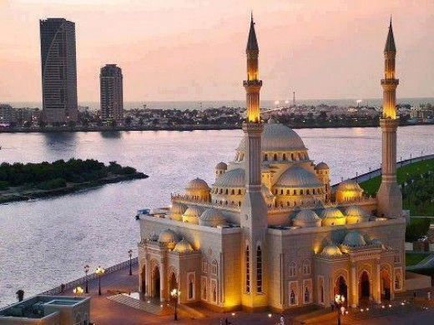
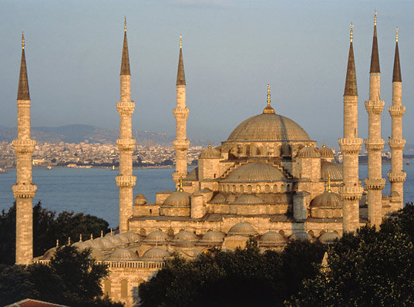
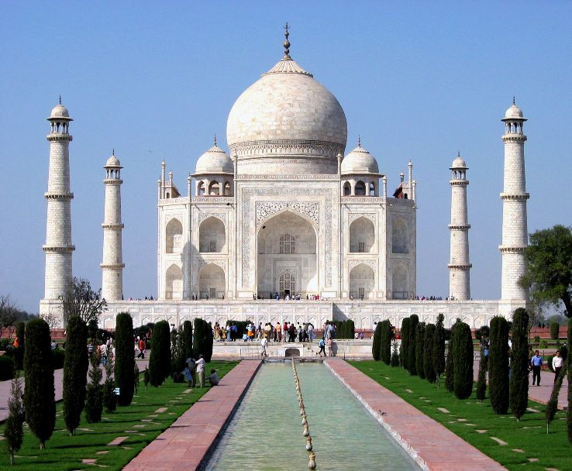
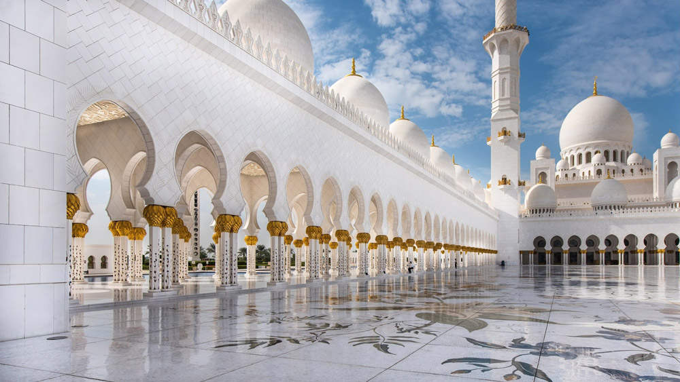
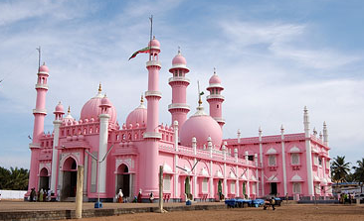

Slide 3
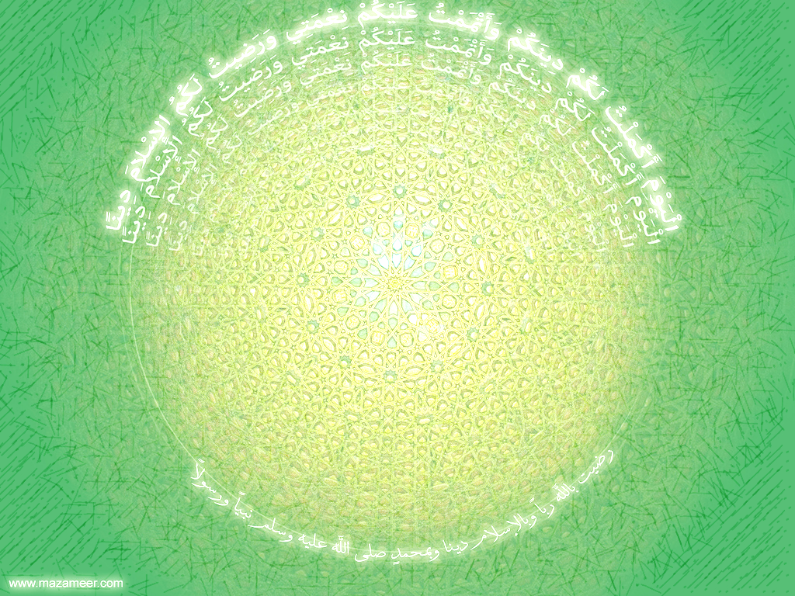
The Masjid
https://www.truetube.co.uk/film/holy-cribs-mosque
http://www.thebcom.org/mosquetour/
Watch, label and explain…
Watch the video about the masjid in London and then the virtual tour of Bolton masjid.
Label the diagram you will be given and then explain more about the following parts of the masjid;
Why there is a wash room
Why there is a mihrab
Why there is a library
The symbolism of the chandelier
Why the clock is important.
Why there are shoe racks
Why there is a madrassa (school room)
Why there is a separate women’s room

Slide 4
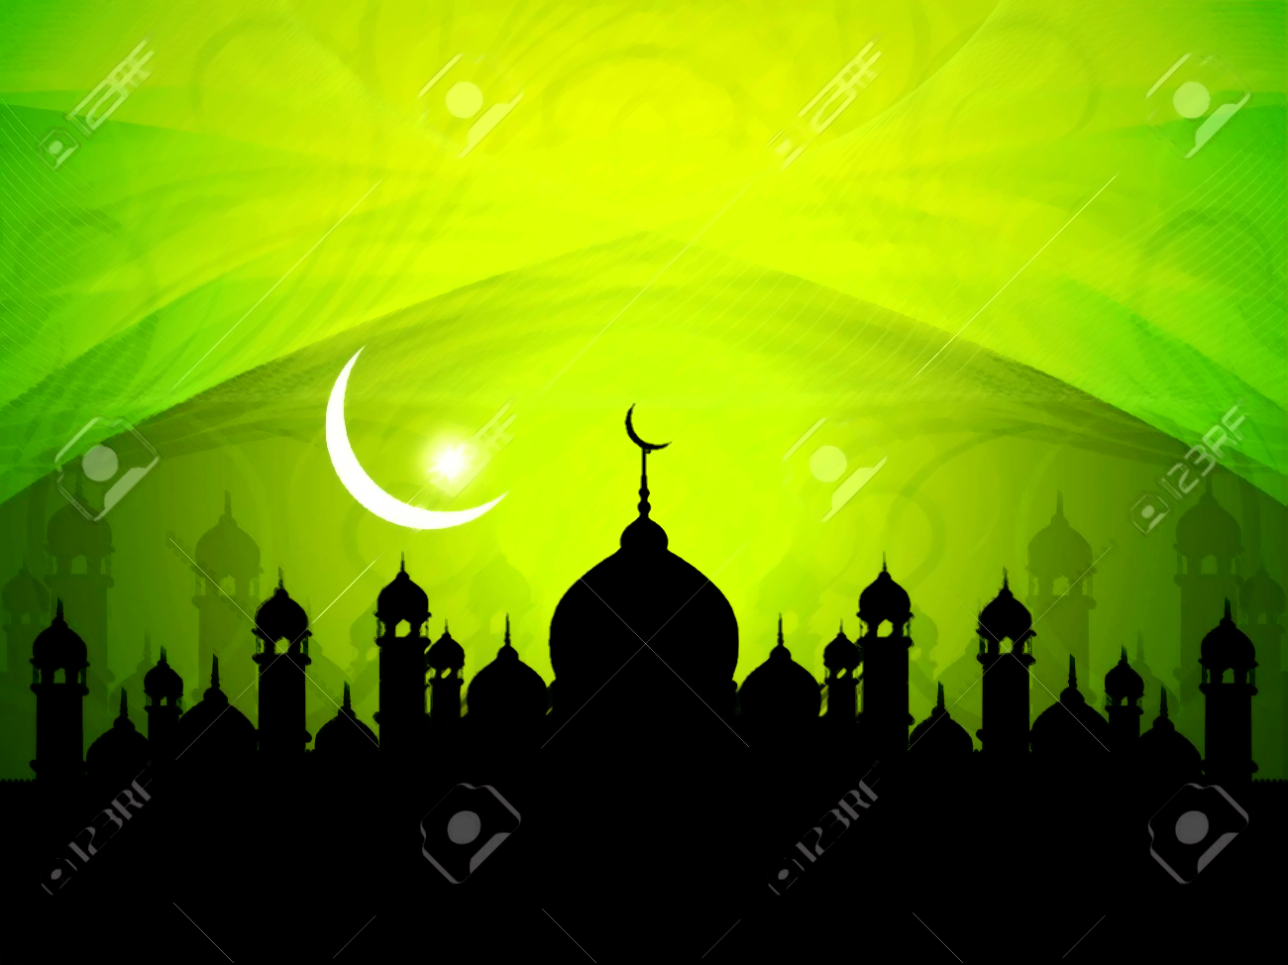
The Masjid
Make a masjid!
Decorate one of the templates for the masjid. Remember geometric patterns and nature are popular, but no animals or people. You could use nice lettering to highlight some of the key things you have learnt about Islam, if you wish.
Once you have made it look beautiful, stick it together to make your masjid.
http://www.zaufishan.co.uk/2012/08/mosque-model-template.html
https://www.rafiqandfriends.com/3-d-masjid-model/

Slide 5
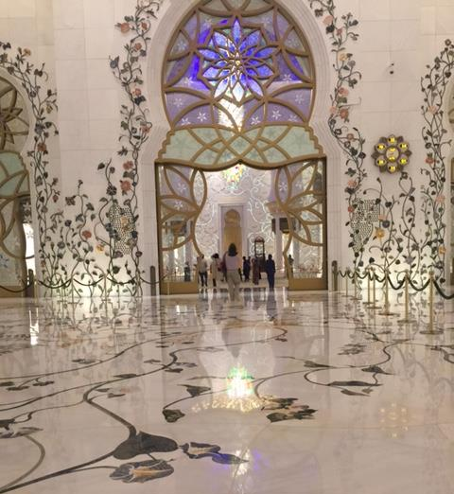
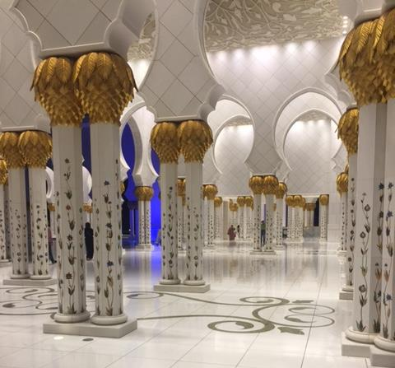
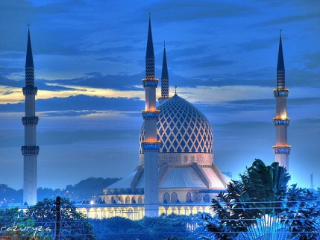
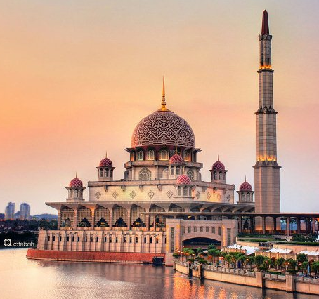
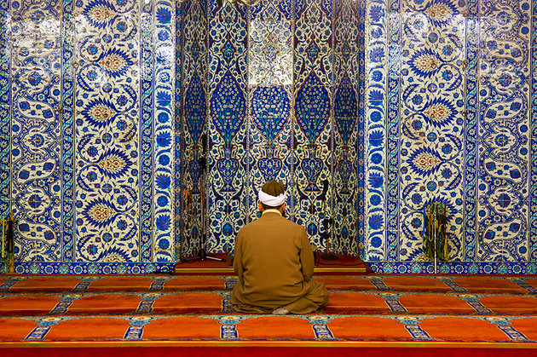
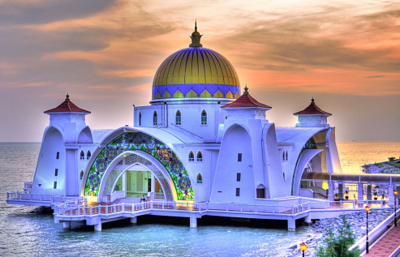
Beautiful Masjids
around the world

Slide 6
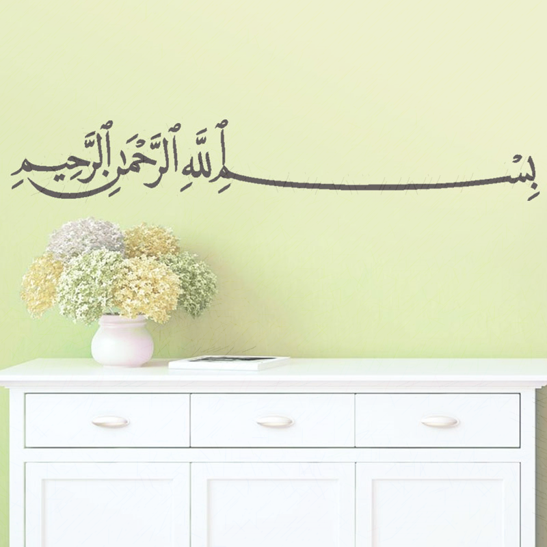
The Masjid
And finally…
What do the design and features of a masjid suggest about what is important in Islam?
And finally (extension)…
Why do you think a masjid is important for the whole community?

