Slide 1
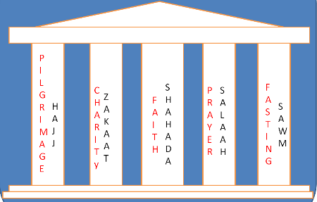
The Five Pillars of Islam
Key Question;
What is important in Islam?

Slide 2
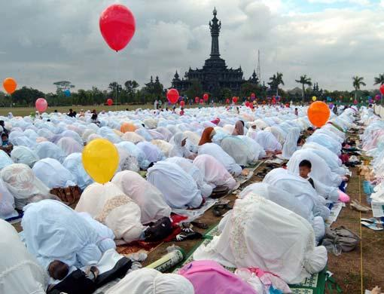
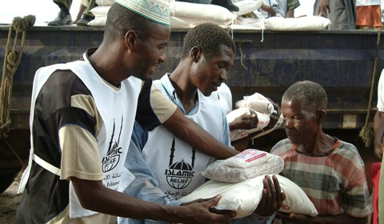
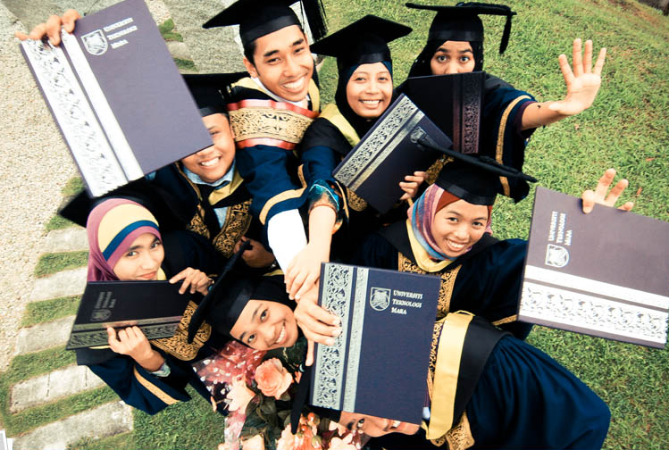
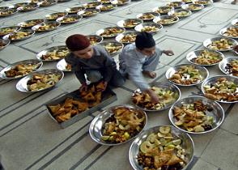
The Five Pillars of Islam
To begin…
Look at the pictures and briefly note down what you see.
1
2
Starter;
What is your impression of the people in the pictures?
3
4

Slide 3
The Five Pillars of Islam
Lesson Outcomes;
To know what the most important things in Islam are.
To show understanding of how the Five pillars of Islam affects the lives of Muslims.
To evaluate how far some media attitudes to Islam reflect the truth about Islam.

Slide 4
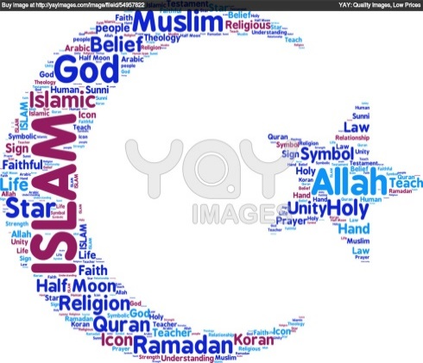
The Five Pillars of Islam
Things to do;
If you are given a card with a word on it go to the front of the room. The rest of the class needs to prioritise the actions on the cards.
On the template of the Five Pillars of Islam, note down and explain each of the Five Pillars.
Things to do;
Create a ‘wordle’ in an the outline of the symbol of Islam. Include words that reflect some of the things you have learnt about Islam.

Slide 5
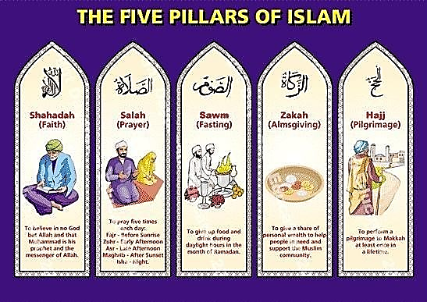

Slide 6
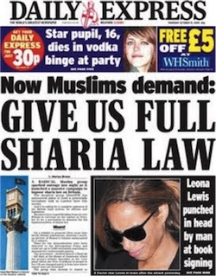
Islam in the Media

Slide 7
Islam – what is the truth?
Meanings…
What do the following words mean?
Jihad
Shariah Law
Evalute;
Think about the views of Islam shown in the headlines on the previous slide.
Complete the
following…
I think the media often portrays Islam in a negative way because…
I think the beliefs and practices of Islam show that Muslims are…
How far do the media representations of Islam reflect the truth about Islam.

