Slide 1
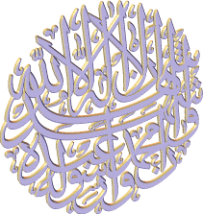
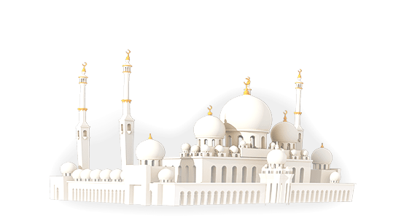
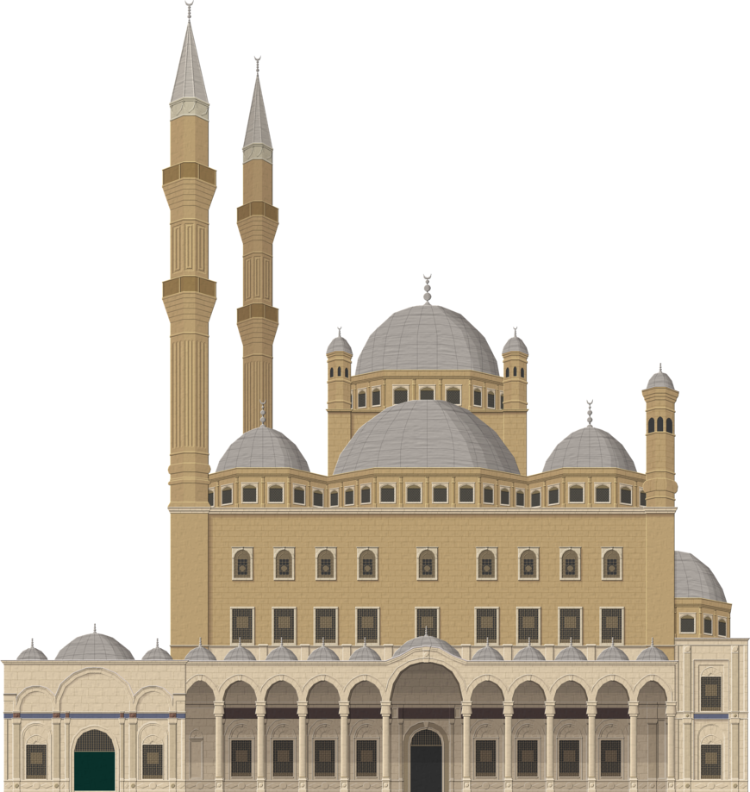
Islamic Beliefs
Key Question;
What do Muslims believe?
To begin…
What are the 5 most important things in your life?
Your five things can include objects, people and/or beliefs.

Slide 2
Islamic Beliefs
DLOs…
To be able to recall key information from last lesson.
To demonstrate understanding of the importance of the Qur’an.
To show links between the Islam, Christianity and Judaism.

Slide 3
Islamic Beliefs
Things to do…
1. What is the most important belief in Islam?
2. Explain why Muhammad is believed to be a prophet of Allah.
3. What is the Qur’an and how was it revealed to Muhammad?
In an outline of the Islamic symbol, explain the meaning of the symbol.
https://create.kahoot.it/#quiz/7517e359-66d3-4007-9dc3-0b8b893f1cbf

Slide 4
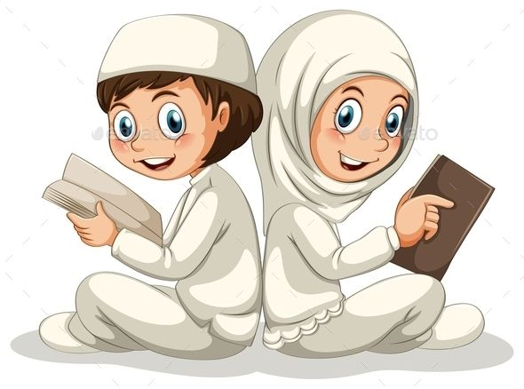
Islamic Beliefs
Things to do…
Note down definitions of the key terms.
Read the information and about the Qur’an.
write between 8 to 10 questions about the information on
post-it notes.
Pass your questions to someone else in the class to
stick in their exercise book and answer.

Slide 5
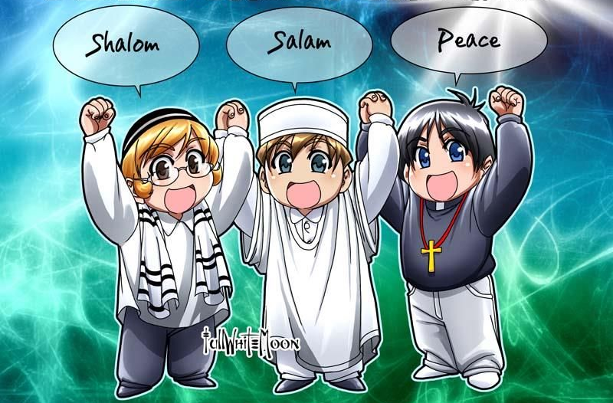
Islamic Beliefs
Compare and contrast…
From what you have learnt so far complete a ‘venn diagram’ of similarities and differences between Islam and Christianity and Judaism.
Or – challenge yourself..
Complete a similarities and differences triad.
Islam
Judaism & Christianity
Islam
Similarities
Similarities
Christianity
Judaism

Slide 6
Islamic Beliefs
And finally… what’s wrong?
Look at the pictures and statements below. There is something not quite right in each. Note down what is wrong in the pictures/statements and explain.
Allah recited the Hadith to Muhammad through the Angel Jibril.
The most important belief Muslims have is that they should pray five times a day.
The symbol
of Islam
The Qur’an –
Holy book of Islam
Muhammad was the profit of God.

