Slide 1
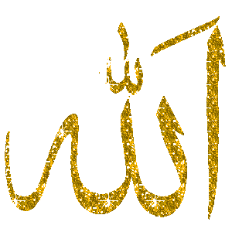
Islam
Key Question;
What is the religion of Islam all about?
To begin…
What do you already know about Islam?
Note some ideas down.

Slide 2
Islam
Where did Islam start and where is Islam practiced today?
On a map of the world add the names of countries/continents where marked.
Which is the largest world religion?
Why are these religions called ‘world religions’?
Look at the census graph. Approximately how many Muslims are there in the UK?
If the population of the UK is approximately 63 million, what percentage of people say they are religious?

Slide 3
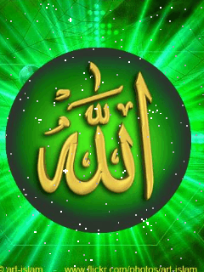
Islam
Where does Islam sit on a timeline of the main world religions?
Approximately when did Islam begin?
How are Judaism, Christianity and Islam connected?

Slide 4
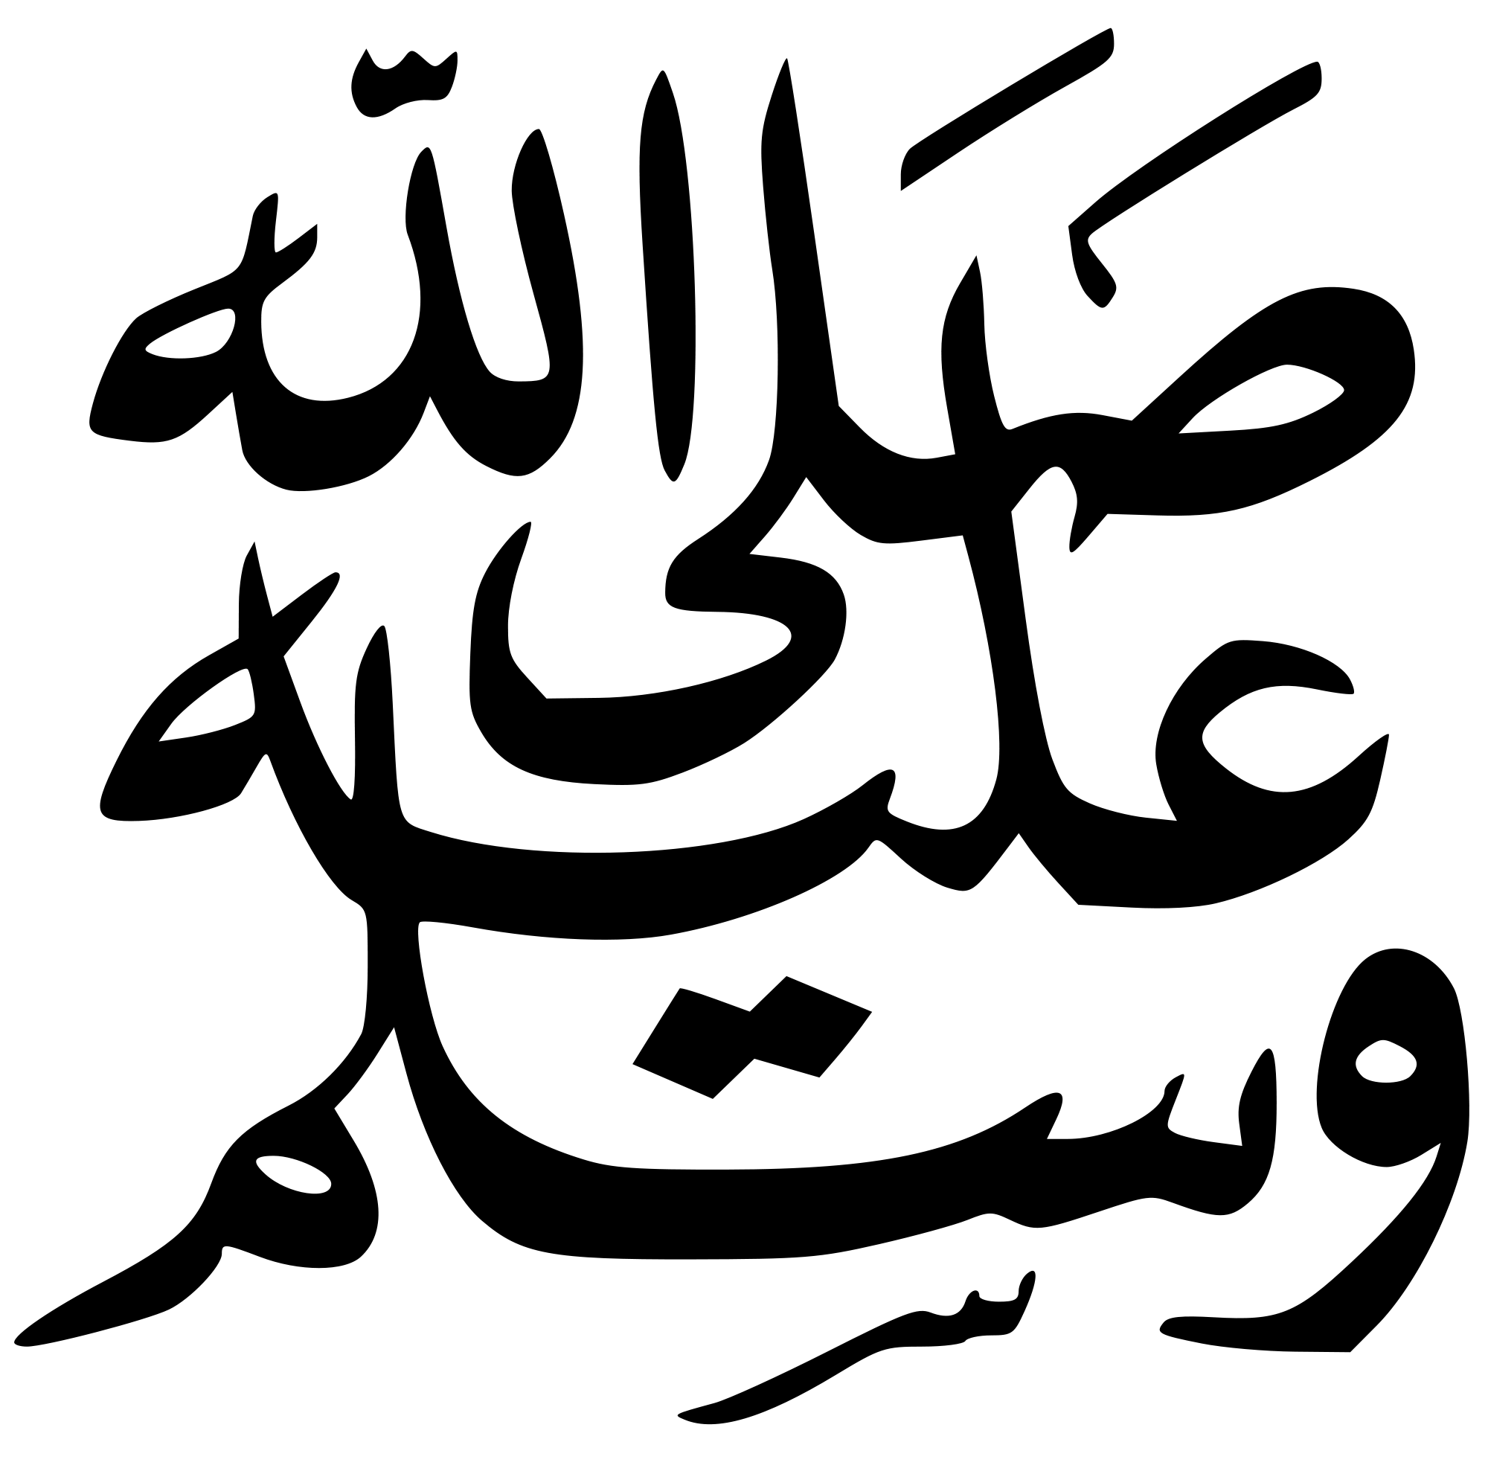
Islam
How did Islam begin?
Complete a story board of the life of Muhammad.
Who was Muhammad?
How did he ‘discover’ Islam?

Slide 5
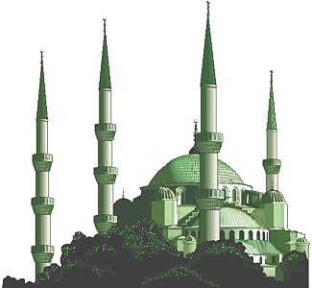
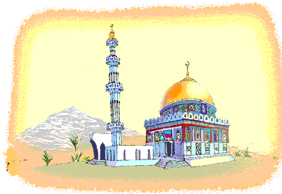
Islam
And finally…3-2-1.
3 new things you have learnt about Islam
2 things you have learnt about world religions
1 thing you found surprising.

