Slide 1

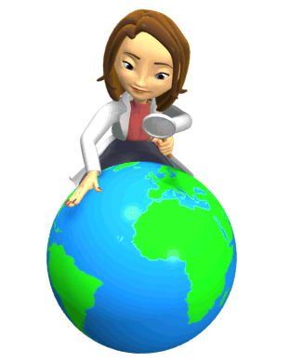
Sacred Earth
Key Question
What is so special about planet Earth?
Starter Task;
What do we know about the world?
Pick some countries at random (maybe spin a globe and stick your finger on one place with your eyes closed). What do you know about each country? Is it desert, rainforest, mountainous, full of lakes, etc.? What animal & plants live there? Write some examples.

Slide 2
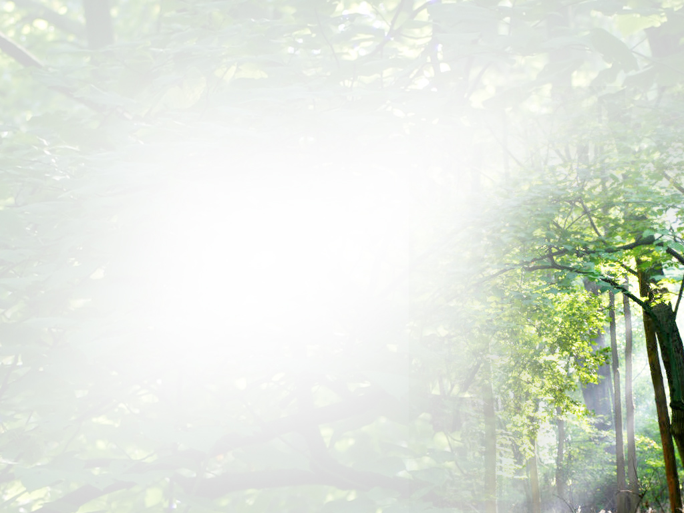
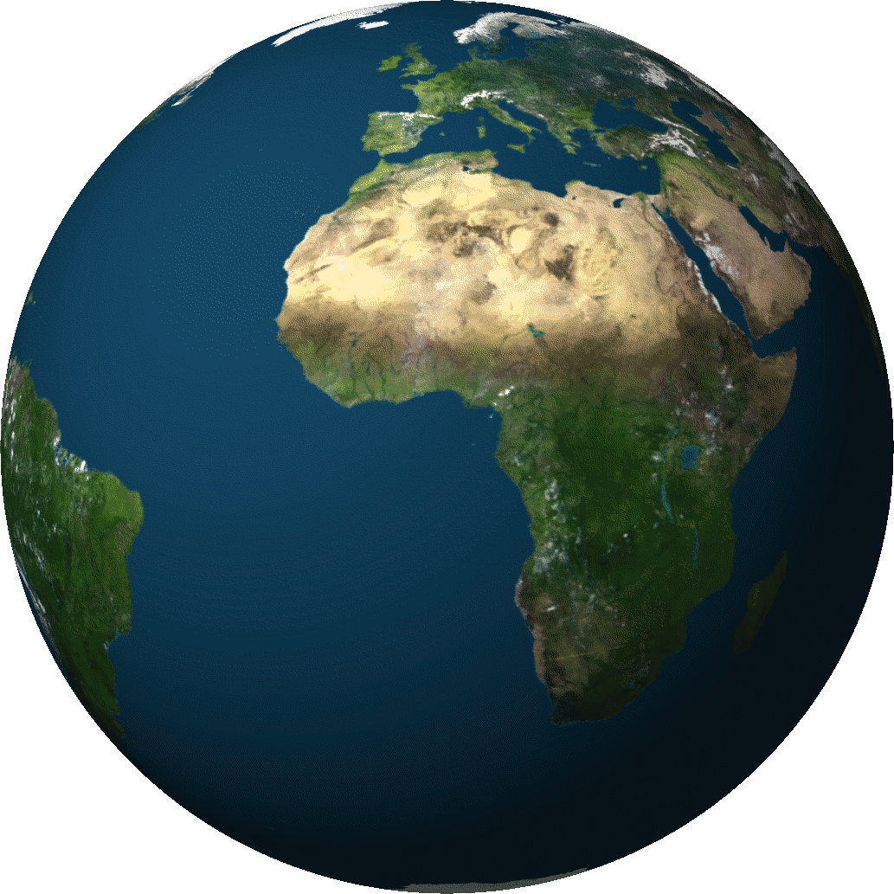
Sacred Earth
Outcomes of the lesson.
To have found out what is to be learnt in this unit.
To have interpreted a poem to consider what makes the Earth a special place.
To have evaluated whose responsibility it is to look after the world.

Slide 3
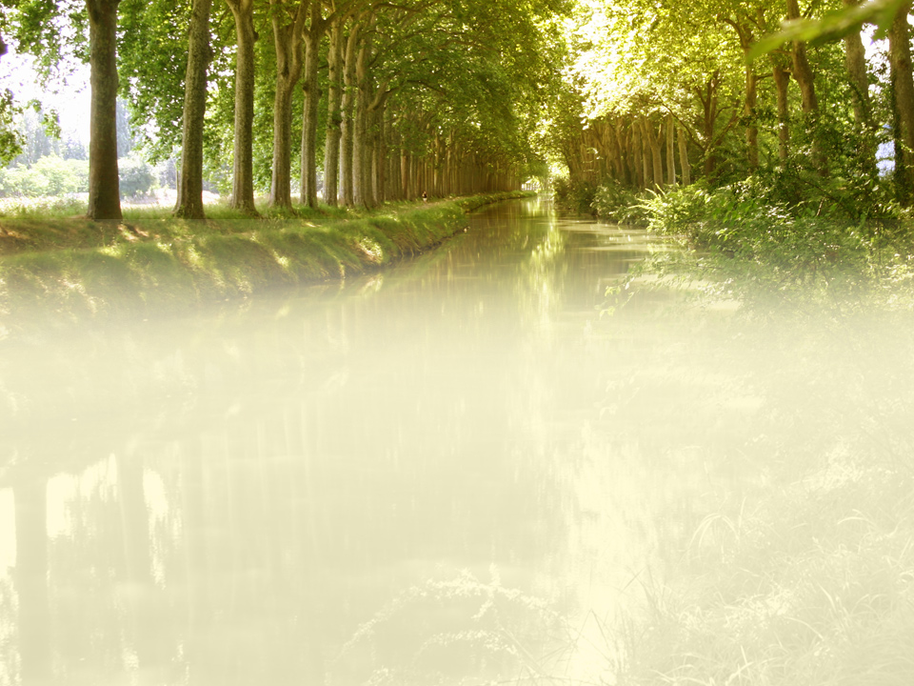
Sacred Earth
Open the document called, ‘Lesson 1 Sacred Earth’.
Things to do:
Read ‘If the Earth were … ‘
From the poem note down some of the wonders of the earth.
How does this poem suggest the earth is a special place? Give reasons and evidence for your answer.

Slide 4
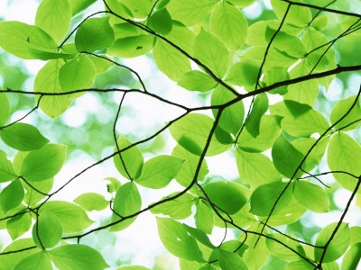
Sacred Earth
Write some answers.
Whose Responsibility?
How do you see the world – are you worried about what might be happening to it?
Are the problems of the world someone else’s or are they ours?
Can we do as we like or do our choices and actions affect others and the world we live in?
Can one person make a difference? How?/Why not?

Slide 5
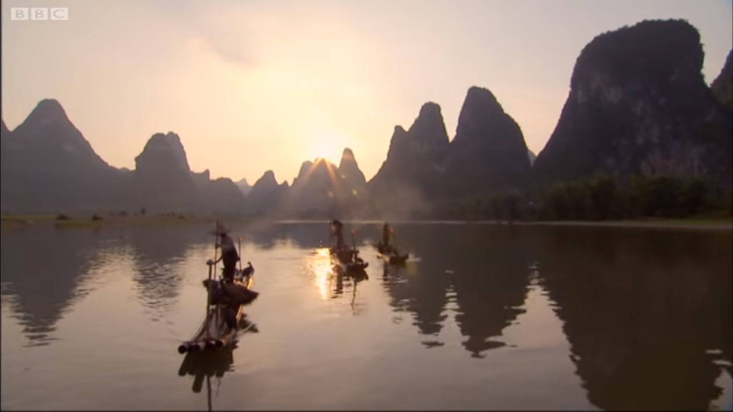
Watch the video about the AMAZING Chinese fishing cormorants. They make the same noise as Wookies from Star Wars. I love the bit where they go on strike.
https://www.youtube.com/watch?v=JNEplaYZtpI

Slide 6

Sacred Earth
What does Chief Seattle mean?
This we know, all things are
connected. Like the blood which unites one family, all things are connected. Whatever befalls the earth, befalls the sons of earth.
Man did not weave the web of life, he is merely a strand in it.
What he does to the web, he does to himself.
This we know.
Chief Seattle 1854
Review/Reflect.
Why does it matter that we realise that everything in connected?
Note down at least 3 possible consequences of failing to do the
following things;
* putting rubbish in the bins; * doing the washing up.
Write full-sentence answers to the questions below.

Slide 7

Sacred Earth
Write answers in full sentences.
Reflect.
It is a foolish person who does nothing, because he can only do a little.
(Edmund Burke).
What do you think this quotation means?
What ‘little things’ could we do to help planet earth?
Why would a person be foolish if he did nothing?

