Slide 1
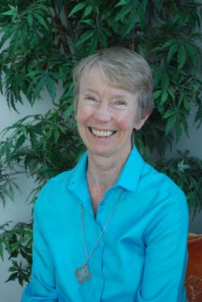
Making a
Difference.
Sister Frances Dominica
Key Question;
How did Sister Frances Dominica help children?
Notes:
Replace these sample pictures with cute ones of your own. It’s easy to do: Select the sample picture and delete it. Now click the Insert Pictures icon inside the frame, and locate the picture you want display.

Slide 2
Making a
Difference.
DLOs;
To show understanding of why the Children’s Hospice movement was set up.
To have made comparisons between Sister Frances’ actions and Jesus’ actions.
To have reflected on why the Children’s Hospice Movement began.
Notes:
Replace these sample pictures with cute ones of your own. It’s easy to do: Select the sample picture and delete it. Now click the Insert Pictures icon inside the frame, and locate the picture you want display.

Slide 3
Things to do;
Read the story about the starfish.
Use the starfish outlines to
suggest how the starfish felt at the beginning of the story and at the end of the story.
Timeline;
Use the pictures you will be given to build up a timeline of events in Sister Frances Dominica’s life.
Making a Difference.
Notes:
Replace these sample pictures with cute ones of your own. It’s easy to do: Select the sample picture and delete it. Now click the Insert Pictures icon inside the frame, and locate the picture you want display.

Slide 4
Using the Helen House
brochure;
1. Note down the expressions
of the children you notice.
2. What surprises you about
their expressions?
3. What questions would
you like to ask some of the
children?
4. Note down some examples
of how Helen House raises
funds.
5. Note down some examples
of how Helen
and Douglas House help young people.
6. Note down some of the
ways in which the children at the hospices have fun.
Making a
Difference.
Notes:
Replace these sample pictures with cute ones of your own. It’s easy to do: Select the sample picture and delete it. Now click the Insert Pictures icon inside the frame, and locate the picture you want display.

Slide 5
Making a
Difference.
Making Comparisons;
Read the following Bible passages and make comparisons between Sister Frances’ actions and Jesus’ actions.
Notes:
Replace these sample pictures with cute ones of your own. It’s easy to do: Select the sample picture and delete it. Now click the Insert Pictures icon inside the frame, and locate the picture you want display.

Slide 6
Making a Difference.
Review – Write questions about what you have learnt in this lesson. Start your questions with the following words;
Who –
What –
Where –
When –
How -
Why -
Pass your questions to someone else and answer their questions.

