Slide 1
Desmond Tutu and Apartheid
Key Question;
What was apartheid and who is Desmond Tutu?
DLOs;
To have used song lyrics to begin to understand what apartheid was.
To have used a question grid to write and answer a range of questions on what has been learnt.
To have evaluated the effectiveness of a speech.

Slide 2
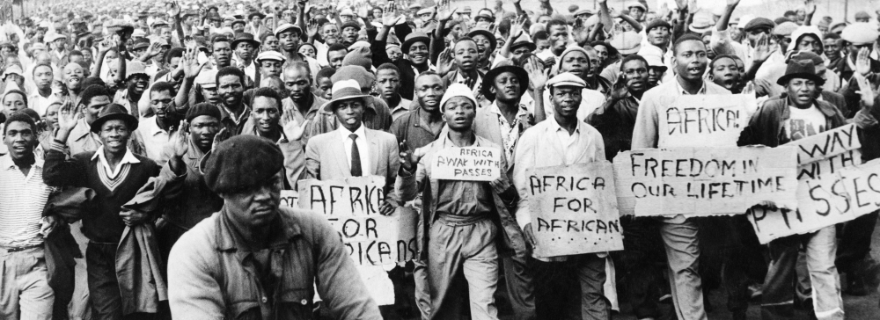
Desmond Tutu and Apartheid
Starter Task;
Watch the video and read the lyrics of the song ‘Sun City’.
What do some of the images and words tell you about what was going on in South Africa and the different ways different people lived.
http://www.youtube.com/watch?v=qzkKxwKBaNQ

Slide 3
Desmond Tutu and Apartheid
Things to do;
Read about Desmond Tutu and apartheid. Complete the tasks on the sheet.
 |  |  | What | When/where? | Who? | Why? | How?
 |  |  | Event | Situation | Person | Reason | Means
1 | Is? | Present
2 | Did? | Past |  |  |  | Desmond Tutu fight apartheid?
3 | Can? | Possibility
4 | Would? | Probability
5 | Will? | Prediction | Apartheid happen again?

Slide 4
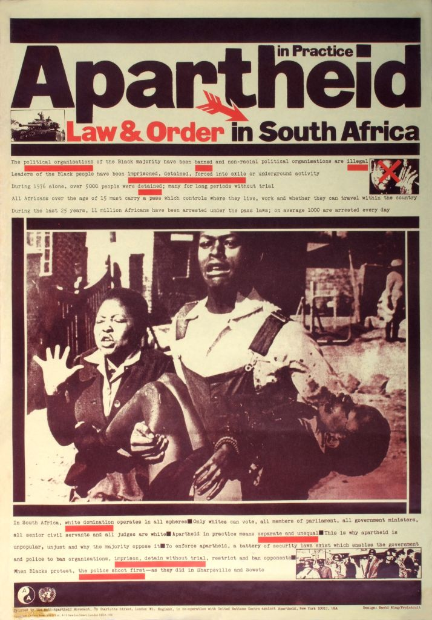
Desmond Tutu and Apartheid
Questions;
When you got to the end of the speech what were your first initial feelings?
Highlight key words and phrases that you particularly agree with.
What are the differences between the beginning and the end of the speech?
Do you think this is an effective speech? Give reasons for your answer.
In your exercise books note down one phrase you agree with the most and explain why you agree with it.

Slide 5
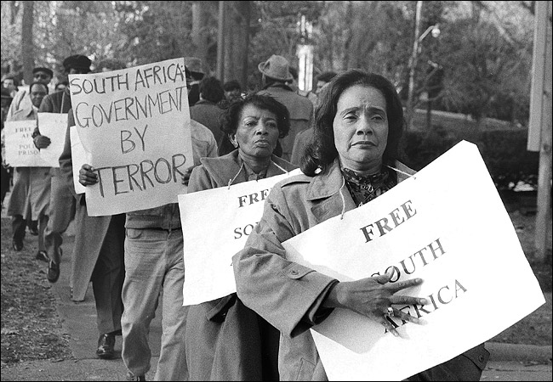
Desmond Tutu and Apartheid
Review/Reflect – 3-2-1;
Note down;
3 New things/facts you learnt.
2 New things you learnt that surprised or shocked you.
1 New key word with a definition (put this on you
key word sheet.

