Slide 1
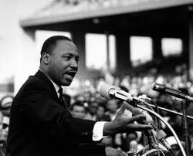
Martin Luther King
Part 1
A study of vision & values in practice
Key question
What were the vision & values of Martin Luther King?
Starter tasks
Rule off then put the date, title and key question in your books.
Discussion question: Do you personally know anyone who has been treated unfairly because of their race, gender, age, nationality, etc.? How did that feel for them?
https://www.youtube.com/watch?v=HEFRPLM0nEA&spfreload=10

Slide 2
Learning Objectives
All of you will be able to explain how racism can impact individuals and the wider community;
Many of you will be able to explain difficulties of putting non-violence into practice;
Some of you will be able to compare Martin Luther King’s values and vision with those of Malcolm X and evaluate which is better in your view.

Slide 3
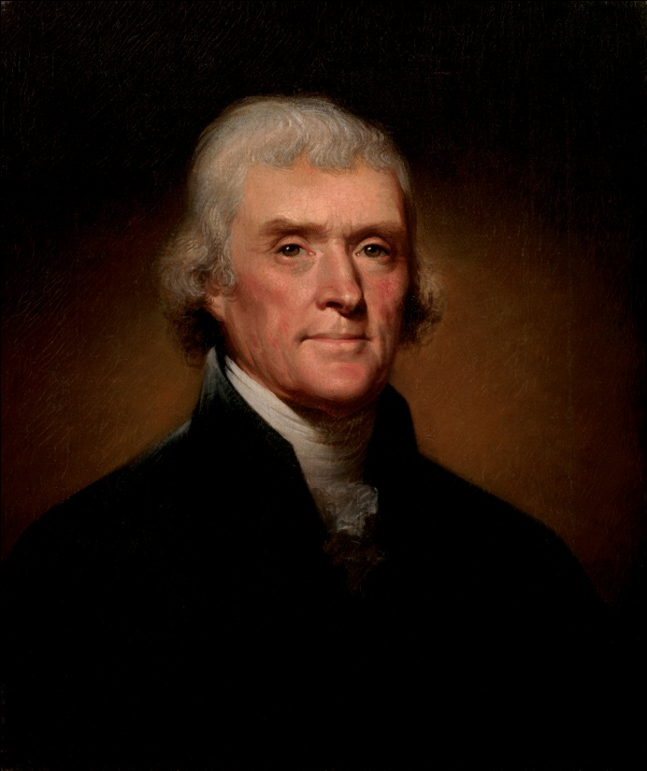
The US Declaration of Independence, 1776
We hold these truths to be self-evident, that all men are created equal, that they are endowed by their Creator with certain unalienable Rights, that among these are Life, Liberty and the pursuit of Happiness.
Thomas Jefferson
Copy the quotation and explain what it means.

Slide 4
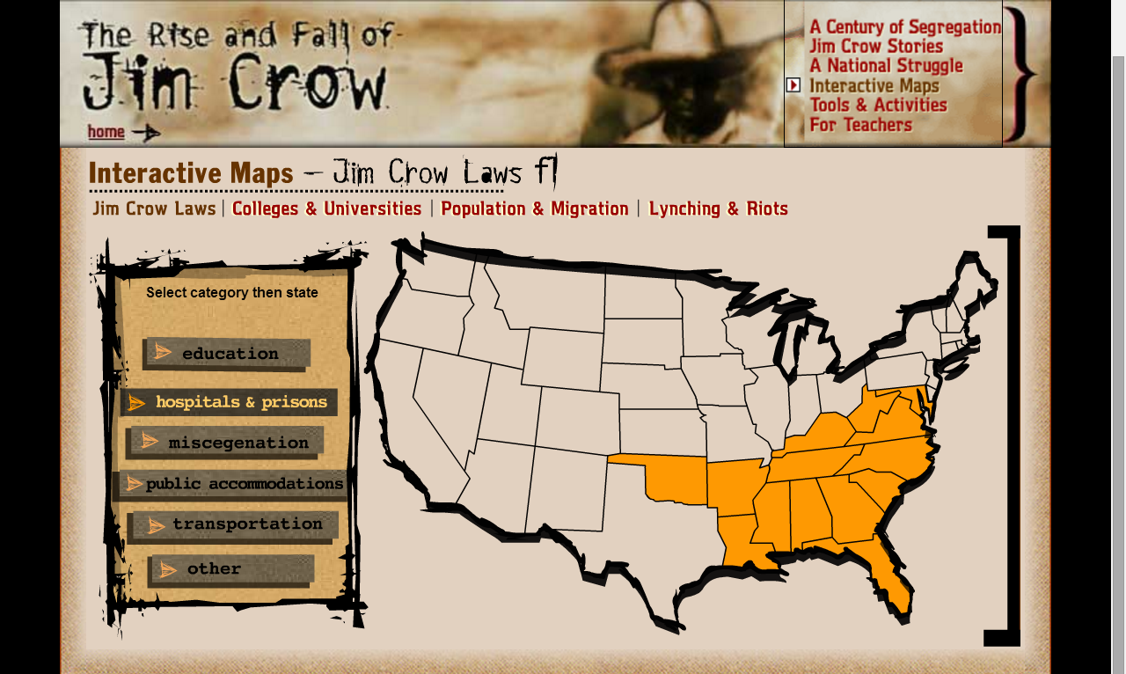
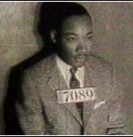
The screenshot on the right shows a map of the USA. On the left of it is a list of categories. Each category relates to racist local laws that existed in the south of America in the 1950s & 1960s.
http://www.pbs.org/wnet/jimcrow/themap/map.html
Task 1
Write at least three ways in law in which black people were treated unfairly in the USA.
How do you think it must have felt to be a black person living in America at this time?
Extension
If laws are racist should you obey them? Give reasons for your view and examples.

Slide 5
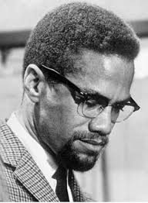
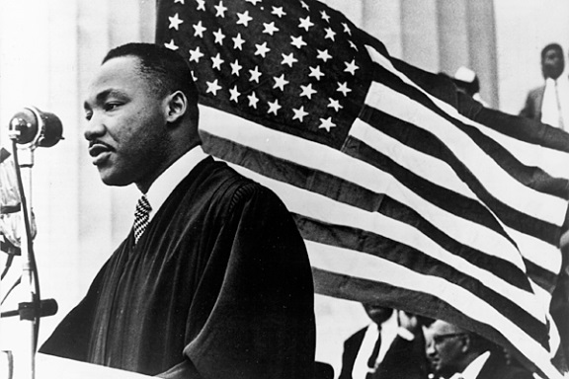
Task 2
Please open the Malcolm X profile (pdf) and the MLK profile (Word doc). Then read the yellow writing below. It’s the same questions for both people.
Describe the early life of Malcolm X or Martin Luther King in no more than four lines.
What was his vision for African Americans?
What methods did he believe in to achieve his vision?
What were the difficulties of this way of going about it?
Extension
Where did Malcolm X or Martin Luther King get his ideas from?
For the person you are writing about, were his methods likely to succeed or were they unrealistic?
How did his early life affect the development of his views?
Were these methods morally justified in your view? Give reasons.
There are two profiles: Malcolm X and Martin Luther King. For each, there is an easier version and a harder version. You choose which version to read. 1. Read the MLK profile first. 2. Answer the questions on him in writing (above on this slide). 3. Do the same for Malcolm X.

Slide 6
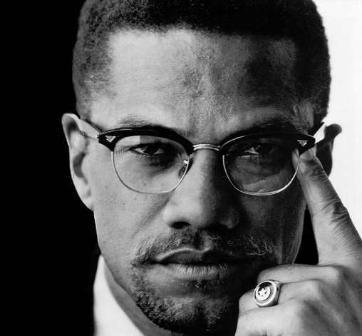
The response of Malcolm X
Listen to the video clip.
What are the values and vision of Malcolm X?
https://www.youtube.com/watch?v=6dfSpjyCplg

Slide 7
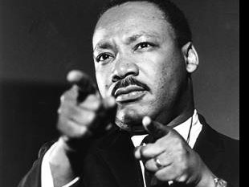
The response of Martin Luther King
Listen to the video clip.
What are the values and vision of Martin Luther King?
https://www.youtube.com/watch?v=3vDWWy4CMhE&spfreload=10

Slide 8
The responses of Martin Luther King and Malcolm X
The next two slides contain quotations. Copy them down, say who they are by, and explain what they mean.

Slide 9
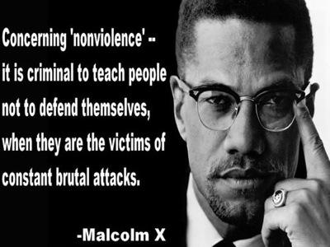

Slide 11
Reflect and review
In your opinion, which is better; the approach of Malcolm X or Martin Luther King? Give reasons for your opinion.

