Slide 1
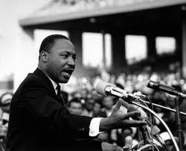
Martin Luther King
Part 1
A study of vision & values in practice
Key question
What were the vision & values of Martin Luther King?
Starter tasks
Rule off then put the date, title and key question in your books.
Discussion question: Do you personally know anyone who has been treated unfairly because of their race, gender, age, nationality, etc.? How did that feel for them?
https://www.youtube.com/watch?v=HEFRPLM0nEA&spfreload=10

Slide 2
Learning Objectives
All of you will be able to explain how racism can impact individuals and the wider community;
Many of you will be able to explain difficulties of putting non-violence into practice;
Some of you will be able to compare Martin Luther King’s values and vision with those of Malcolm X and evaluate which is better in your view.

Slide 3
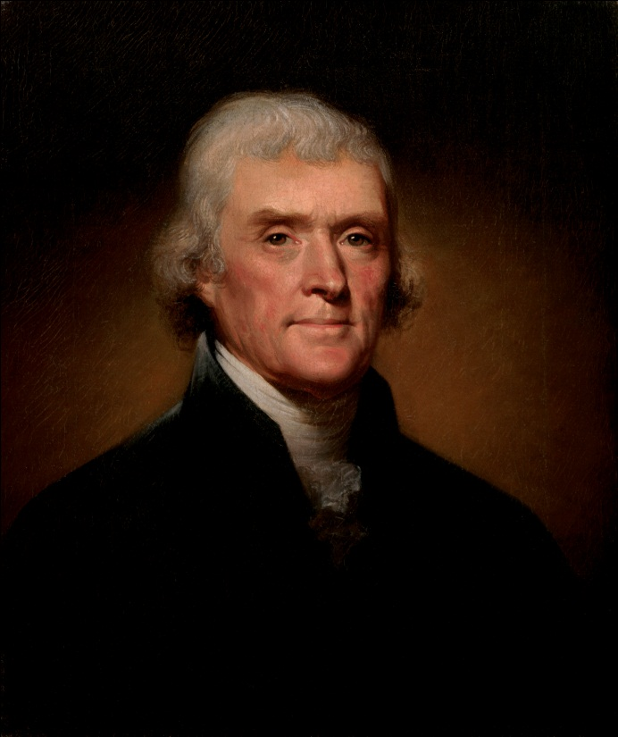
The US Declaration of Independence, 1776
We hold these truths to be self-evident, that all men are created equal, that they are endowed by their Creator with certain unalienable Rights, that among these are Life, Liberty and the pursuit of Happiness.
Thomas Jefferson

Slide 4
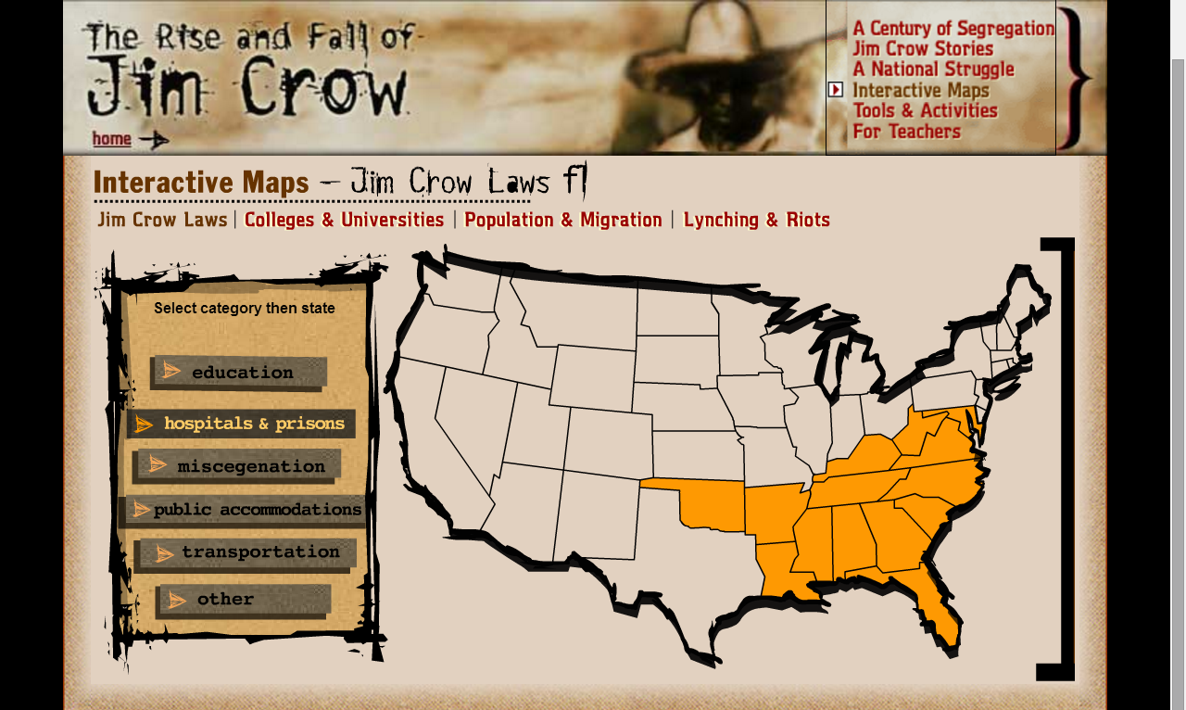
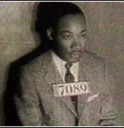
Click the link.
Click ‘Jim Crow Laws’ on the left.
Explore the map & different racist laws.
http://www.pbs.org/wnet/jimcrow/themap/map.html
Task 1
Write at least three ways in which black people were treated unfairly in the USA.
How do you think it must have felt to be a black person living in America at this time?
Extension
If laws are racist should you obey them? Give reasons for your view and examples.

Slide 5
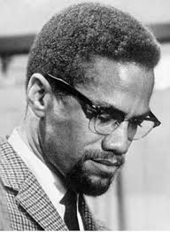
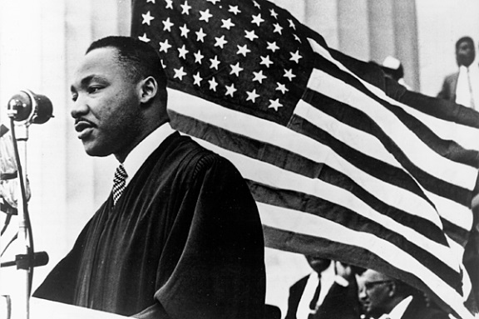
Task 2
One of you will be reading an information sheet about Malcolm X and the other one will be reading about Martin Luther King. Answer these questions in your book.
Describe the early life of Malcolm X or Martin Luther King in no more than four lines.
What was his vision for African Americans?
What methods did he believe in to achieve his vision?
What were the difficulties of this way of going about it?
Extension
Where did Malcolm X or MLK get his ideas from?
For the person you are writing about, were his methods likely to succeed or were they unrealistic?
How did his early life affect the development of his views?
Were these methods morally justified in your view? Give reasons.
Open the profile documents of MLK and Malcolm X. There is an easier/harder version of each. You choose which version to read.

Slide 6
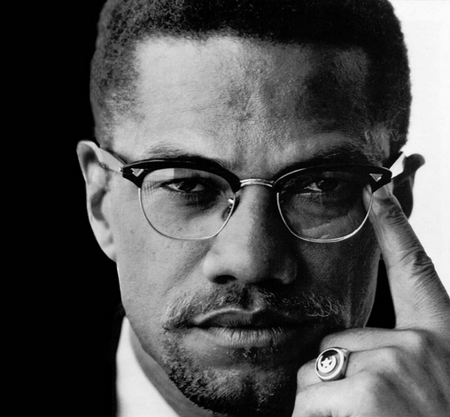
The response of Malcolm X
Listen to the video clip.
What are the values and vision of Malcolm X?
https://www.youtube.com/watch?v=6dfSpjyCplg

Slide 7
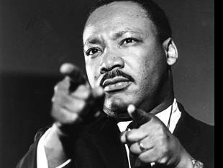
The response of Martin Luther King
Listen to the video clip.
What are the values and vision of Martin Luther King?
https://www.youtube.com/watch?v=3vDWWy4CMhE&spfreload=10

Slide 8
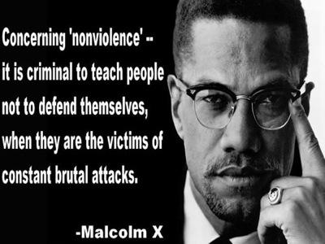

Slide 9
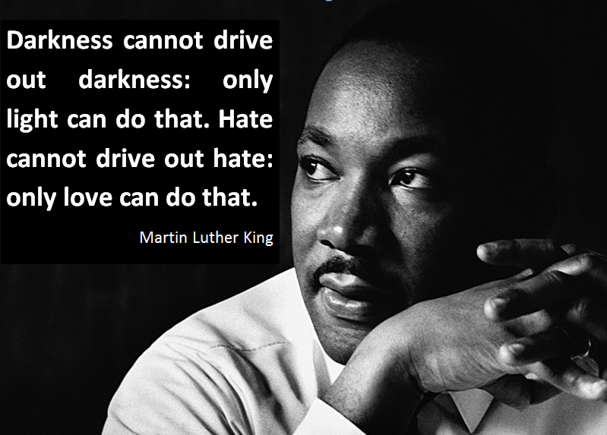

Slide 10
Reflect and review
In your opinion, which is better; the approach of Malcolm X or Martin Luther King? Give reasons for your opinion.

