Slide 1
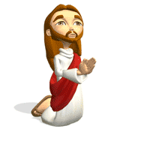
The Nature of Jesus
Key Question;
What was so special about Jesus?
DLOs;
To have completed a mind map to establish what we have learned and what we already know.
To have evaluated the validity of Jesus as a teacher, miracle worker or leader.
www.biblegateway.com

Slide 2
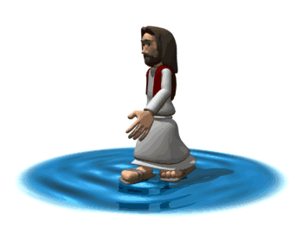
The Nature of Jesus
Starter Task: Complete a mind map as outlined below;
Jesus a leader?
Examples?
Jesus’ Miracles
Examples?
Jesus
What have I
already learned?
Jesus’ Parables
Examples?

Slide 3
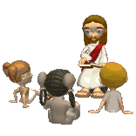
Teacher?
The Nature
of Jesus
Teachers are obviously very special people. Jesus was often referred to as ‘Rabbi’, meaning teacher, but what is the evidence of this?
What was his own education and training for this role?
What did Jesus teach?
Watch…
https://www.youtube.com/watch?v=osfQg4yKtq8
What was Jesus trying to teach in this parable?
Did people learn from this story? What evidence is there for this?

Slide 4
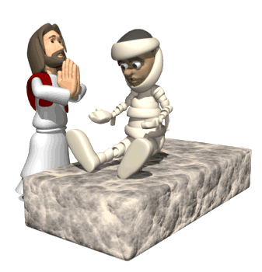
The Nature of Jesus
Miracle Worker?
Many of Jesus’ miracles are well known but did he really perform miracles or was he just a clever illusionist?
What is the evidence?
Watch…
https://www.youtube.com/watch?v=1FT04jjh3Q8
What were some of Jesus’ miracles?
What was the miracle Jesus performed in the video clip?
Could there be modern explanations for this miracle?
What was the purpose of this miracle?

Slide 5
Leader?
The Nature
of Jesus
Leaders need to have certain qualities is there any evidence for Jesus having such qualities?
What are the qualities of a leader?
Did Jesus have any of these qualities?
Watch…
https://www.youtube.com/watch?v=z-39h0xYqdE
What is the evidence of Jesus’ leadership in the story on the video clip?
Does he still lead people today? What is the evidence for this?

Slide 6
The Nature of Jesus
Review and Reflect. Consider the evidence.
Thinking what you have learnt in this lesson, why is Jesus so special to many millions of Christians today?
Write an answer to the above question and include evidence to ‘prove’ your points.

