Slide 1
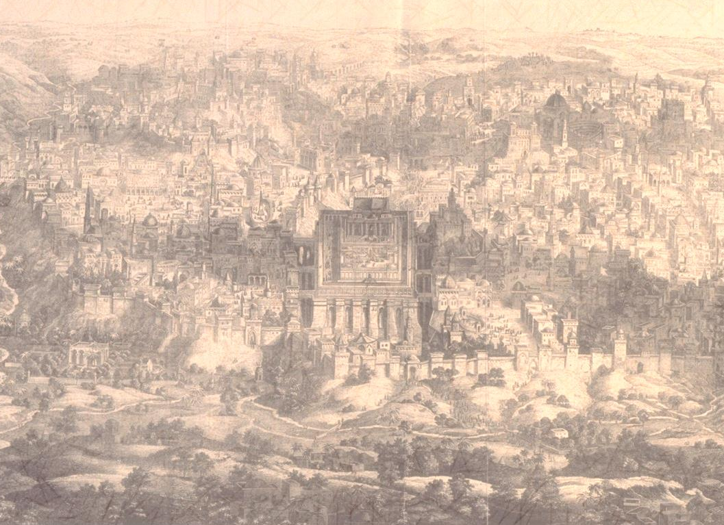
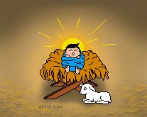
Jesus
Key Question:
What was Jesus like?
DLOs:
To have used pictures to begin to investigate the nature of Jesus.
To have used a poem to outline the main points of the life of Jesus.
To have used music to evaluate beliefs about the nature of Jesus.

Slide 2
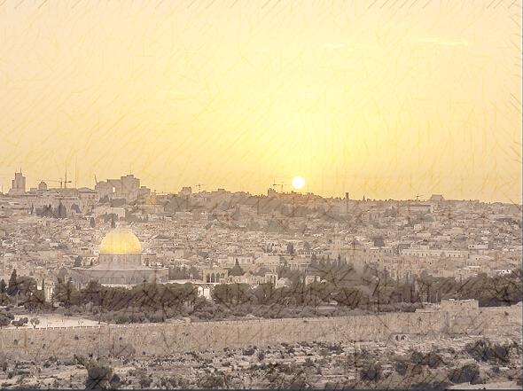
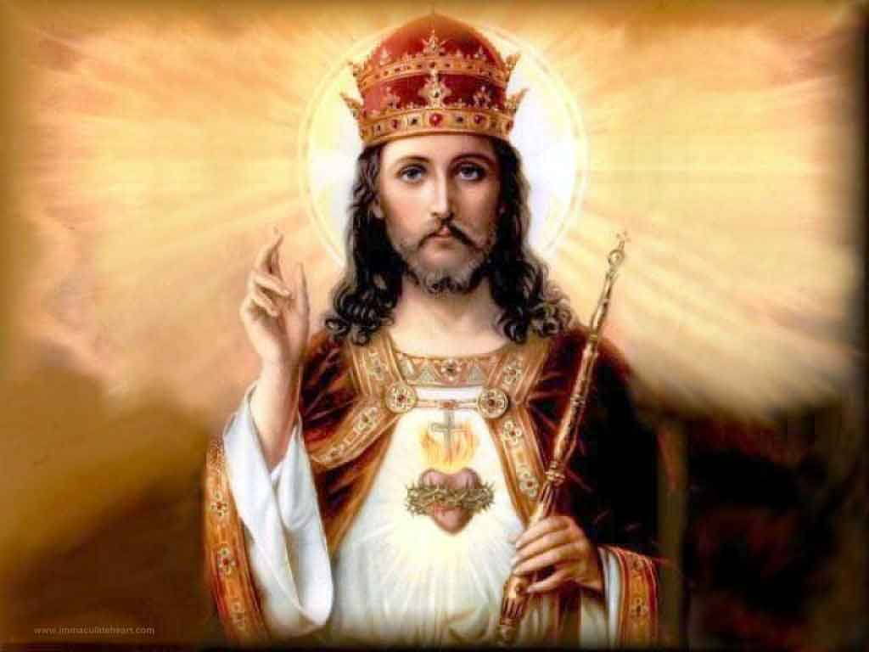
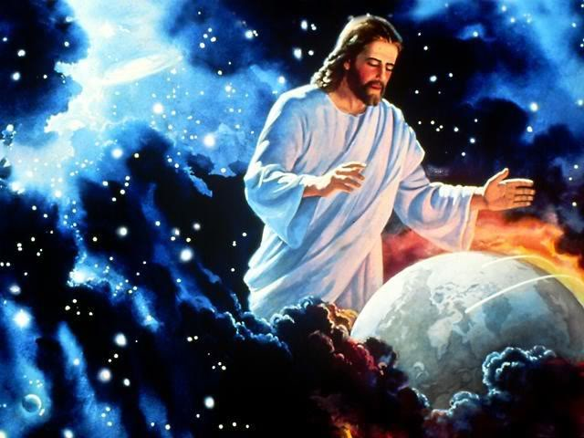
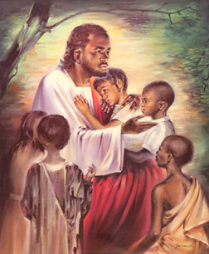
Jesus
Starter Task:
Look at the images of Jesus. What do they suggest about the nature of Jesus?
Extension;
How do we know these are pictures of Jesus?

Slide 3
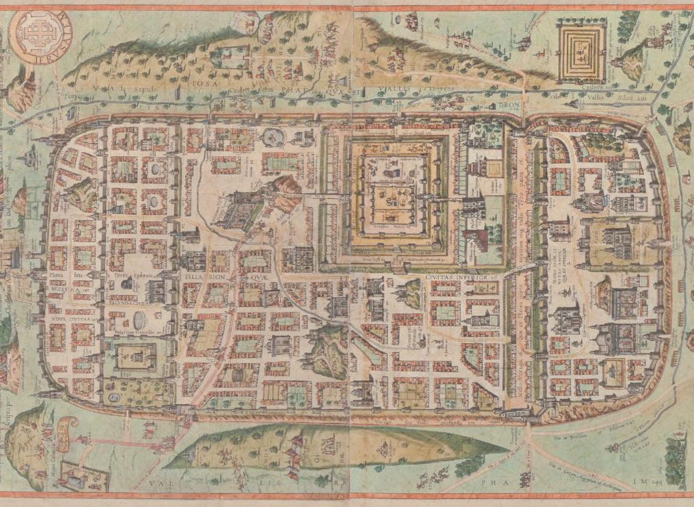
Jesus
Things to do:
Read the poem about Jesus.
Using a double page, draw a time line of the key events as outlined in the poem: words first then add pictures.
Extension: Write and illustrate an acrostic using ‘Jesus Christ’ to show the life and personality of Jesus in the style of an illuminated manuscript.
Here is a man born in an obscure village, the child of a peasant.
He worked in a carpenter’s shop until he was thirty, and then became a wandering teacher.
He never went to college, he never wrote a book, he never owned a home.
He never travelled two hundred miles from where he was born.
Whilst still a young man people turned against him.
His friends ran away and; one of them betrayed him.
He was handed over to his enemies.
He went through a mockery of a trial.
He was nailed to a cross between two thieves.
His executioners gambled for the only piece of property he had – his coat.
When he was dead he was taken down and buried in a borrowed grave through the pity of a friend.
2000 years have come and gone.
I tell you I am not far from the mark when I say that all the armies that have marched, all the parliaments that ever sat and all the kings that ever reigned, put together, have not affected the life of people on earth as powerfully as that one solitary life.
James Hefley

Slide 4
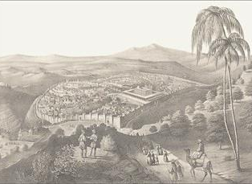
My Song is Love Unknown
by Samuel Crossman (1624-1684)
Copy these tasks into your exercise books and leave about five lines in between each question.
According to verse 1 why has Jesus come?
Write one or more quotations that show that Jesus is swapping places with people in his death.
Describe what Samuel Crossman thinks of Jesus.
Extension
List some of the good deeds of Jesus mentioned in the hymn.
Read the first four lines for verse 3. What event is this talking about?
What evidence is there here of Christian belief in the divinity of Christ?
Why would the Christ have been ‘longed for’?

Slide 5
My Song is Love Unknown
by Samuel Crossman (1624-1684)
7. Here might I stay and sing,
No story so divine;
Never was love, dear King,
Never was grief like thine.
This is my friend in whose sweet praise
I all my days could gladly spend.
1. My song is love unknown,
My Saviour’s love to me,
Love to the loveless shown,
That they might lovely be.
O who am I, that for my sake,
My Lord should take frail flesh and die?
2. He came from his blest throne,
Salvation to bestow;
But men made strange and none the Longed-for Christ would know.
But O, my friend, my friend indeed,
Who at my need his life did spend!
3. Sometimes they strew his way,
And his sweet praises sing;
Resounding all the day
Hosannas to their king;
Then ‘Crucify’ is all their breath,
And for his death they thirst and cry.
4. Why, what hath my Lord done?
What makes this rage and spite?
He made the lame to run,
He gave the blind their sight.
Sweet injuries! Yet they at these
Themselves displease, and ‘gainst him rise.
5. They rise and needs will have
My dear Lord made away;
A murderer they save,
The Prince of Life they slay.
Yet cheerful he to suff’ring goes,
That he his foes from thence might free.
6. In life , no house, no home
My Lord on earth might have;
In death, no friendly tomb,
But what a stranger gave.
What may I say? Heaven was his home;
But mine the tomb wherein he lay.
https://www.youtube.com/watch?v=bNN9DBobCdw

Slide 6
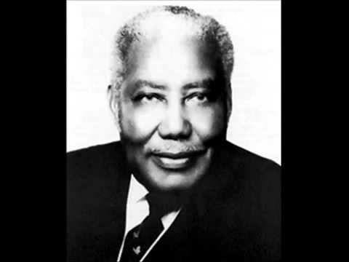
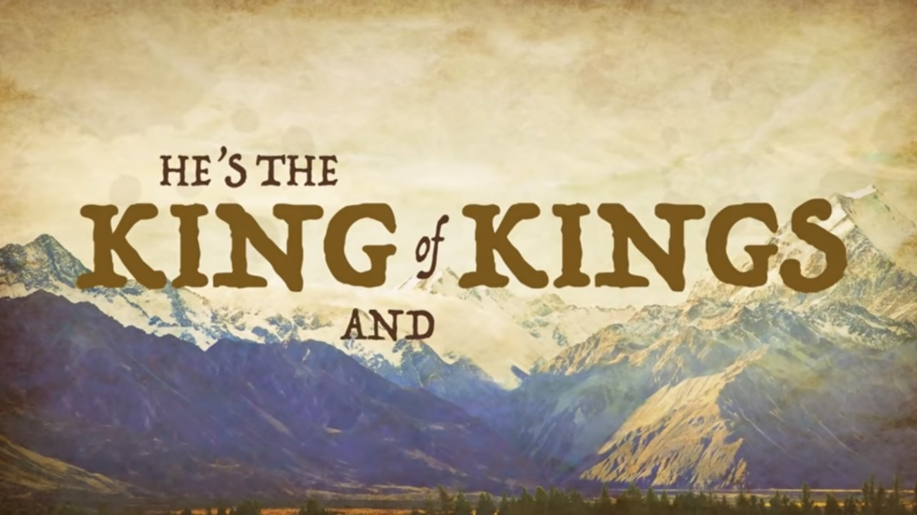
That’s My King
S.M. Lockridge
Write down at least three things that S.M. Lockridge says about Jesus.
https://www.youtube.com/watch?v=9K80pozOfrU

Slide 7
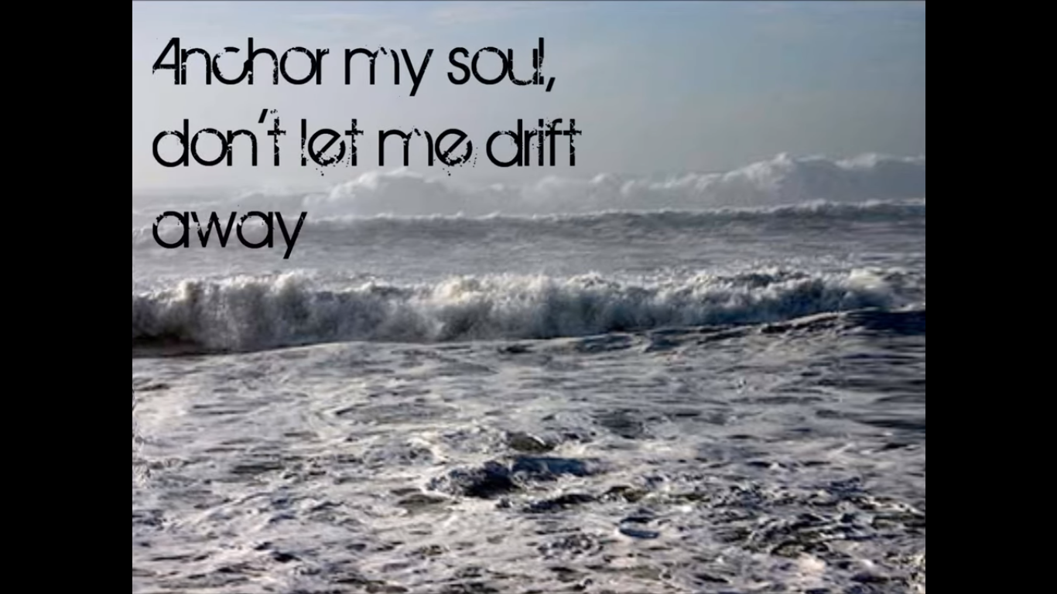
https://www.youtube.com/watch?v=ENZWRzO-oNc
Anchor of My Soul by Telecast
Christians believe that they can know Jesus personally today.
What does the songwriter gain from knowing God, according to the words of the song?

Slide 8
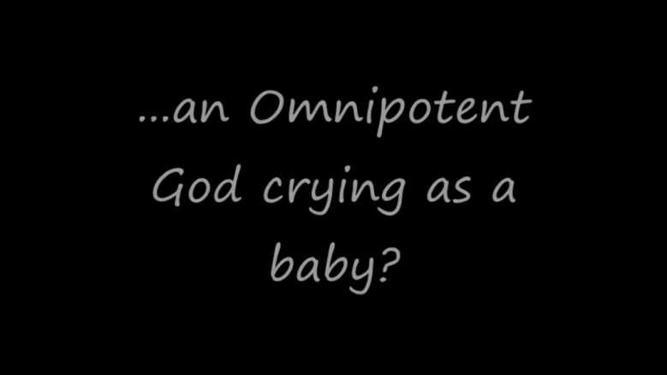
The Humility of Christ
by Timothy Brindle
Some keys words:
Messiah – Judaism/Christianity – ‘anointed one’; king & saviour of Israel
Christ – Christianity - = Messiah
deity – all religions - = divinity, being a god/God

Slide 9
The Humility of Christ
by Timothy Brindle
Copy the questions, leaving spaces
What is Christ’s goal?
How is Jesus showing commitment here?
https://www.youtube.com/watch?v=nf6EUKPHQMU

Slide 10
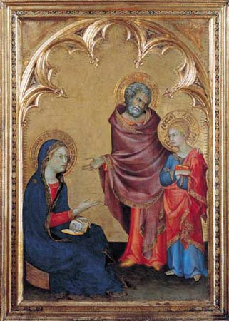
Jesus
Jesus – Human, Divine or Both?
Simone Martini painted this icon in 1342. It shows 12 year old Jesus being found by Mary & Joseph at the Temple in Jerusalem after he had been missing for three days.
Martini shows Jesus has having a dual nature – Human and Divine.
How does Martini do this?
(See bigger image on next slide.)
Luke Chapter 2
https://www.biblegateway.com/passage/?search=Luke+2&version=NIVUK

Slide 12
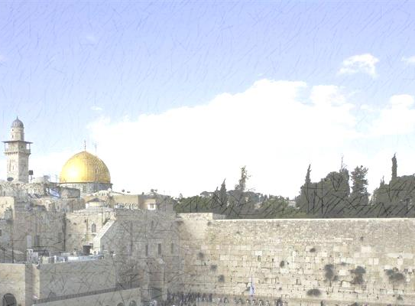
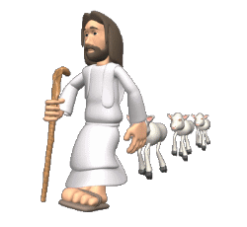
Jesus
Review and Reflect.
Consider the relationship between Jesus and his parents – Mary and Joseph as shown in the painting.
What emotions do you think Mary and Joseph were going through when Jesus disappeared?
2. How does Jesus appear to be feeling?
3. What does this relationship suggest about the nature of Jesus?
Think about all the evidence from today’s lesson and suggest an answer to the key question;
What was Jesus like? Explain your answer using evidence.

