Slide 1
GCSE/IGCSE-FM Functions
Dr J Frost (jamie@drfrostmaths.com) @DrFrostMaths
www.drfrostmaths.com
Last modified: 2nd October 2019

Slide 2
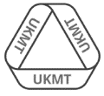
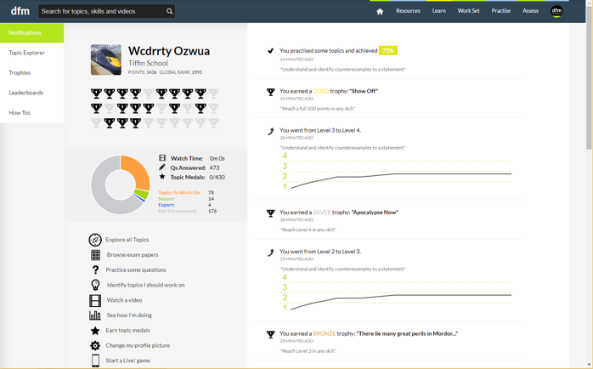
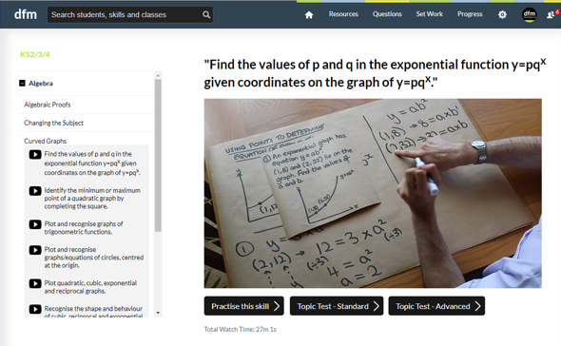
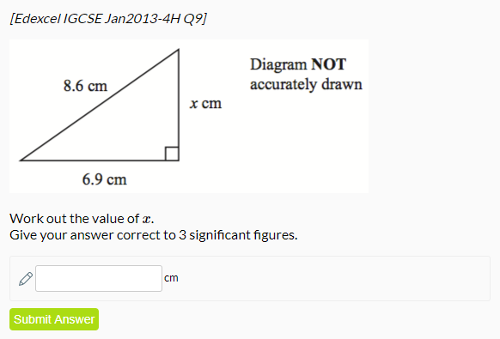
www.drfrostmaths.com
Everything is completely free.
Why not register?
Register now to interactively practise questions on this topic, including past paper questions and extension questions (including UKMT).
Teachers: you can create student accounts (or students can register themselves), to set work, monitor progress and even create worksheets.
With questions by:
Dashboard with points, trophies, notifications and student progress.
Questions organised by topic, difficulty and past paper.
Teaching videos with topic tests to check understanding.

Slide 3
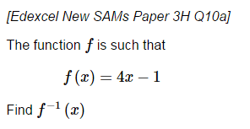
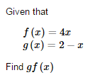
OVERVIEW
#1: Understanding of functions
#2: Inverse Functions
GCSE
IGCSEFM
GCSE
#3: Composite Functions
GCSE

Slide 4
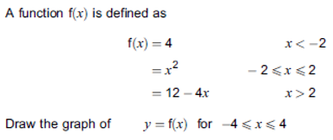
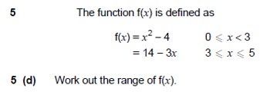
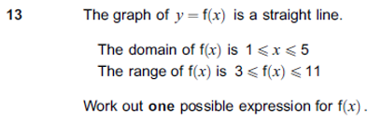
OVERVIEW
#4: Piecewise functions
#5: Domain/Range of common functions (particularly quadratic and trigonometric)
IGCSEFM
IGCSEFM
#6: Domain/Range of other functions
#7: Constructing a function based on a given domain/range.
IGCSEFM
IGCSEFM

Slide 5
What are Functions?
A function is something which provides a rule on how to map inputs to outputs.
From primary school you might have seen this as a ‘number machine’.
Input
Output
$$x$$
f
$$2x$$
?
Name of the function (usually $f$ or $g$)
Input
Output
$$f(x)=2x$$

Slide 6
Check Your Understanding
$$f(x)=x2+2$$
Q1
What does this function do?
It squares the input then adds 2 to it.
?
Q2
What is $f(3)$?
$f\left(3\right)=3^{2}+2=11$
What is $f(−5)$?
$f\left(−5\right)={\left(−5\right)}^{2}+2=27$
If $f\left(a\right)=38$, what is $a$?
$a^{2}+2=38$
So $a=±6$
?
Q3
?
This question is asking the opposite, i.e. “what input $a$ would give an output of 38?”
Q4
?

Slide 7
Algebraic Inputs
If you change the input of the function ($x$), just replace each occurrence of $x$ in the output.
If $f\left(x\right)=x+1$ what is:
If $f\left(x\right)=x^{2}−1$ what is:
?
$$f\left(x−1\right)=\left(x−1\right)+1=x \\ f\left(x^{2}\right)=x^{2}+1 \\ f{\left(x\right)}^{2}={\left(x+1\right)}^{2} \\ f\left(2x\right)=2x+1$$
$$f\left(x−1\right)={\left(x−1\right)}^{2}−1 \\ =x^{2}−2x \\ f\left(2x\right)={\left(2x\right)}^{2}−1 \\ =4x^{2}−1 \\ f\left(x^{2}+1\right)={\left(x^{2}+1\right)}^{2}−1 \\ =x^{4}+2x^{2}$$
?
?
?
?
?
?
If $f\left(x\right)=2x$ what is:
$$f\left(x−1\right)=2\left(x−1\right) \\ =2x−2 \\ f\left(x^{2}\right)=2x^{2} \\ f{\left(x\right)}^{2}={\left(2x\right)}^{2}=4x^{2}$$
?
?
?

Slide 8
Test Your Understanding
A
If $g\left(x\right)=3x−1$, determine:
$g\left(x−1\right)=3\left(x−1\right)−1=3x−4$
$g\left(2x\right)=3\left(2x\right)−1=6x−1$
$g\left(x^{3}\right)=3x^{3}−1$
?
?
?
B
If $f\left(x\right)=2x+1$, solve $f\left(x^{2}\right)=51$
$$2x^{2}+1=51 \\ x=±5$$
?

Slide 9
Exercise 1
(exercises on provided sheet)
1
If $f\left(x\right)=2x+5$, find:
$f\left(3\right)=11$
$f\left(−1\right)=3$
$f\left(\frac{1}{2}\right)=6$
If $f\left(x\right)=x^{2}+5$, find
$f\left(−1\right)=6$
the possible values of $a$ such that $f\left(a\right)=41 a=±6$
The possible values of $k$ such that $f\left(k\right)=5.25$ $k=±\frac{1}{2}$
[AQA Worksheet] $f\left(x\right)=2x^{3}−250$. Work out $x$ when $f\left(x\right)=0$
$$2x^{3}−250=0 → x=5$$
4
[AQA Worksheet] $f\left(x\right)=x^{2}+ax−8$. If $f\left(−3\right)=13$, determine the value of $a$.
$$9−3a−8=13 \\ a=−4$$
If $f\left(x\right)=5x+2$, determine the following, simplifying where possible.
$f\left(x+1\right)=5\left(x+1\right)+2=5x+7$
$f\left(x^{2}\right)=5x^{2}+2$
[AQA IGCSEFM June 2012 Paper 2] $f\left(x\right)=3x−5$ for all values of $x$. Solve $f\left(x^{2}\right)=43$
$$3x^{2}−5=43 \\ x=±4$$
?
?
?
?
2
5
?
?
?
?
?
6
3
?
?

Slide 10
Exercise 1
(exercises on provided sheet)
9
[Edexcel Specimen Papers Set 1, Paper 2H Q18]
$$f\left(x\right)=3x^{2}−2x−8$$
Express $f\left(x+2\right)$ in the form $ax^{2}+bx$
$$3x^{2}+10x$$
[Senior Kangaroo 2011 Q20] The polynomial $f\left(x\right)$ is such that $f\left(x^{2}+1\right)=x^{4}+4x^{2}$ and $f\left(x^{2}−1\right)=ax^{4}+4bx^{2}+c$. What is the value of $a^{2}+b^{2}+c^{2}$?
$$f\left(x^{2}+1\right)=x^{2}(x^{2}+4)$$
By letting $y=x^{2}+1$:
$$f\left(y\right)=(y−1)(y+3)$$
Thus $f\left(x^{2}−1\right)=f\left(y−2\right)$ $$=\left(y−3\right)\left(y+1\right) \\ =\left(x^{2}−2\right)\left(x^{2}+2\right) \\ =x^{4}−4$$
$$a=1, b=0, c=−4 \\ a^{2}+b^{2}+c^{2}=17$$
7
[AQA Worksheet] $f\left(x\right)=x^{2}+3x−10$ Show that $f\left(x+2\right)=x\left(x+7\right)$
$$f\left(x+2\right)={\left(x+2\right)}^{2}+3\left(x+2\right)−10 \\ =x^{2}+4x+4+3x+6−10 \\ =x^{2}+7x=x\left(x+7\right)$$
If $f\left(x\right)=2x−1$ determine: (a) $f\left(2x\right)=4x−1$ (b) $f\left(x^{2}\right)=2x^{2}−1$ (c) $f\left(2x−1\right)=2\left(2x−1\right)−1=4x−3$ (d) $f\left(1+2f\left(x−1\right)\right)$ $$=f\left(4x−5\right)=8x−11$$ (e) Solve $f\left(x+1\right)+f\left(x−1\right)=0$
$$2\left(x+1\right)−1+2\left(x−1\right)−1=0 \\ 4x−2=0 → x=\frac{1}{2}$$
?
?
N
8
?
?
?
?
?
?

Slide 11
Inverse Functions
A function takes and input and produces an output.
The inverse of a function does the opposite: it describes how we get from the output back to the input.
Input
Output
$$×3$$
$$2$$
$$6$$
?
$$÷3$$
Bro-notation: The -1 notation means that we apply the function “-1 times”, i.e. once backwards! You’ve actually seen this before, remember $\sin^{−1}{(x)}$ from trigonometry to mean “inverse sin”?
It’s possible to have $f^{2}(x)$, we’ll see this when we cover composite functions.
So if $f\left(x\right)=3x$, then the inverse function is :
$$f^{−1}\left(x\right)=\frac{x}{3}$$
?

Slide 12
Quickfire Questions
In your head, find the inverse functions, by thinking what the original functions does, and what the reverse process would therefore be.
$$f\left(x\right)=x+5$$
?
$$f^{−1}\left(x\right)=x−5$$
$$f^{−1}\left(x\right)=\frac{x+1}{3}$$
$$f\left(x\right)=3x−1$$
?
$$f\left(x\right)=\sqrt{x}+3$$
?
$$f^{−1}\left(x\right)={\left(x−3\right)}^{2}$$
$$f\left(x\right)=\frac{1}{x}$$
$$f^{−1}\left(x\right)=\frac{1}{x}$$
?
Bro Fact: If a function is the same as its inverse, it is known as self-inverse. $f\left(x\right)=1−x$ is also a self-inverse function.

Slide 13
Full Method
If $f\left(x\right)=\frac{x}{5}+1$, find $f^{−1}(x)$.
?
$$y=\frac{x}{5}+1$$
STEP 1: Write the output $f(x)$ as $y$
This is purely for convenience.
?
$$y−1=\frac{x}{5} \\ 5y−5=x$$
STEP 2: Get the input in terms of the output (make $x$ the subject).
This is because the inverse function is the reverse process, i.e. finding the input $x$ in terms of the output $y$.
?
$$f^{−1}\left(x\right)=5x−5$$
STEP 3: Swap $y$ back for $x$ and $x$ back for $f^{−1}\left(x\right)$.
This is because the input to a function is generally written as $x$ rather than $y$.
But technically $f^{−1}\left(y\right)=5y−5$ would be correct!

Slide 14
Harder One
If $f\left(x\right)=\frac{x+1}{x−2}$, find $f^{−1}(x)$.
?
$$y=\frac{x+1}{x−2} \\ xy−2y=x+1 \\ xy−x=1+2y \\ x\left(y−1\right)=1+2y \\ x=\frac{1+2y}{y−1} \\ f^{−1}\left(x\right)=\frac{1+2x}{x−1}$$

Slide 15
Test Your Understanding
If $f\left(x\right)=\frac{2x+1}{3}$, find $f^{−1}(4)$.
If $f\left(x\right)=\frac{x}{2x−1}$, find $f^{−1}(x)$.
?
?
$$y=\frac{2x+1}{3} \\ 3y=2x+1 \\ 3y−1=2x \\ x=\frac{3y−1}{2} \\ f^{−1}\left(x\right)=\frac{3x−1}{2} \\ f^{−1}\left(3\right)=\frac{11}{2}$$
$$y=\frac{x}{2x−1} \\ 2xy−y=x \\ 2xy−x=y \\ x\left(2y−1\right)=y \\ x=\frac{y}{2y−1}$$
$$f^{−1}\left(x\right)=\frac{x}{2x−1}$$

Slide 16
Exercise 2
(exercises on provided sheet)
1
Find $f^{−1}(x)$ for the following functions.
$f\left(x\right)=5x$ $f^{−1}\left(x\right)=\frac{x}{5}$
$f\left(x\right)=1+x$ $f^{−1}\left(x\right)=x−1$
$f\left(x\right)=6x−4$ $f^{−1}\left(x\right)=\frac{x+4}{6}$
$f\left(x\right)=\frac{x+7}{3}$ $f^{−1}\left(x\right)=3x−7$
$f\left(x\right)=5\sqrt{x}+1$ $f^{−1}\left(x\right)={\left(\frac{x−1}{5}\right)}^{2}$
$f\left(x\right)=10−3x$ $f^{−1}\left(x\right)=\frac{10−x}{3}$
[Edexcel IGCSE Jan2016(R)-3H Q16c]
$$f\left(x\right)=\frac{2x}{x−1}$$
Find $f^{−1}\left(x\right)$
$$=\frac{x}{x−2}$$
3
Find $f^{−1}(x)$ for the following functions.
$$f\left(x\right)=\frac{x}{x+3} f^{−1}\left(x\right)=\frac{3x}{1−x}$$
$$f\left(x\right)=\frac{x−2}{x} f^{−1}\left(x\right)=\frac{2}{1−x}$$
$$f\left(x\right)=\frac{2x−1}{x−1} f^{−1}\left(x\right)=\frac{x−1}{x−2}$$
$$f\left(x\right)=\frac{1−x}{3x+1} f^{−1}\left(x\right)=\frac{1−x}{3x+1}$$
$$f\left(x\right)=\frac{3x}{3+2x} f^{−1}\left(x\right)=\frac{3x}{3−2x}$$
Find the value of $a$ for which $f\left(x\right)=\frac{x}{x+a}$ is a self inverse function.
$$f^{−1}\left(x\right)=\frac{ax}{1−x}$$
If self-inverse: $\frac{x}{x+a}≡\frac{ax}{1−x}$ $$ax^{2}+a^{2}x≡x−x^{2}$$
For $x^{2}$ and $x$ terms to match, $a=−1$.
?
?
a
a
b
?
?
?
b
c
?
?
d
c
e
?
?
f
?
d
?
2
e
N
?
?

Slide 17
Composite Functions
$$f\left(x\right)=3x+1 \\ g\left(x\right)=x^{2}$$
Have a guess! (Click your answer)
$$fg\left(2\right)=$$
49?
13?
$fg(2)$ means $f\left(g\left(2\right)\right)$, i.e. “$f$ of $g$ of 2”.
We therefore apply the functions to the input in sequence from right to left.

Slide 18
Examples
$$f\left(x\right)=3x+1 \\ g\left(x\right)=x^{2}$$
Bro Tip: I highly encourage you to write this first. It will help you when you come to the algebraic ones.
Determine:
$$fg\left(5\right)=f\left(g\left(5\right)\right)=f\left(25\right)=76$$
$$gf\left(−1\right)=g\left(f\left(−1\right)\right)=g\left(−2\right)=4$$
$$ff\left(4\right)=f\left(f\left(4\right)\right)=f\left(13\right)=40$$
$$gf\left(x\right)=g\left(f\left(x\right)\right)=g\left(3x+1\right) \\ ={\left(3x+1\right)}^{2}$$
?
?
?
Bro Note: This can also be written as $f^{2}(x)$, but you won’t encounter this notation in GCSE/IGCSE FM.
?

Slide 19
More Algebraic Examples
$$f\left(x\right)=2x+1 \\ g\left(x\right)=\frac{1}{x}$$
Determine:
$$fg\left(x\right)=f\left(g\left(x\right)\right)=f\left(\frac{1}{x}\right) \\ =2\left(\frac{1}{x}\right)+1=\frac{2}{x}+1$$
$$gf\left(x\right)=g\left(2x+1\right)=\frac{1}{2x+1}$$
$$ff\left(x\right)=f\left(2x+1\right)=2\left(2x+1\right)+1=4x+3 \\ gg\left(x\right)=g\left(\frac{1}{x}\right)=\frac{1}{\left(\frac{1}{x}\right)}=x$$
?
?
?
?
?

Slide 20
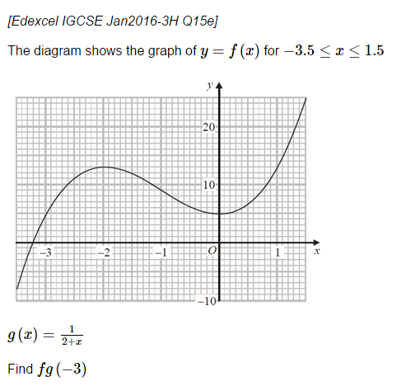
Test Your Understanding
1
If $f\left(x\right)=\frac{2}{x+1}$ and $g\left(x\right)=x^{2}−1$, determine $fg(x)$.
$$f\left(x^{2}−1\right)=\frac{2}{x^{2}−1+1}=\frac{2}{x^{2}}$$
2
?
3
A function $f$ is such that
$$f\left(x\right)=3x+1$$
The function $g$ is such that
$g\left(x\right)=kx^{2}$ where $k$ is a constant.
Given that $fg\left(3\right)=55$, determine the value of $k$.
$$fg\left(3\right)=f\left(9k\right)=3\left(9k\right)+1 \\ =27k+1=55$$
$$k=2$$
?
$$fg\left(−3\right)=f\left(g\left(−3\right)\right) \\ =f\left(−1\right) \\ =9$$
?

Slide 21
Exercise 3
(exercises on provided sheet)
1
If $f\left(x\right)=3x$ and $g\left(x\right)=x+1$, determine:
$fg\left(2\right)=9$ $gf\left(4\right)=13$ $fg\left(x\right)=3x+3$ $gf\left(x\right)=3x+1$ $gg\left(x\right)=x+2$
If $f\left(x\right)=2x+1$ and $g\left(x\right)=3x+1$ determine:
$fg\left(x\right)=6x+3$ $gf\left(x\right)=6x+4$ $ff\left(x\right)=4x+3$
If $f\left(x\right)=x^{2}−2x$ and $g\left(x\right)=x+1$, find $fg(x)$, simplifying your expression.
$$f\left(x+1\right)={\left(x+1\right)}^{2}−2\left(x+1\right) \\ =x^{2}+2x+1−2x−2 \\ =x^{2}−1$$
If $f\left(x\right)=x+k$ and $g\left(x\right)=x^{2}$ and $gf\left(3\right)=16$, find the possible values of $k$.
$$gf\left(3\right)=g\left(3+k\right)={\left(3+k\right)}^{2}=16 \\ k=1,−7$$
If $f\left(x\right)=2(x+k)$ and $g\left(x\right)=x^{2}−x$ and $fg\left(3\right)=30$, find $k$.
$$f\left(g\left(3\right)\right)=f\left(6\right)=2\left(6+k\right)=30 \\ k=9$$
6
Let $f\left(x\right)=x+1$ and $g\left(x\right)=x^{2}+1$.
If $gf\left(x\right)=17$, determine the possible values of $x$.
$$gf\left(x\right)={\left(x+1\right)}^{2}+1=17 \\ x^{2}+2x+2=17 \\ x^{2}+2x−15=0 \\ \left(x+5\right)\left(x−3\right)=0 \\ x=−5 or x=3$$
Let $f\left(x\right)=x^{2}+3x$ and $g\left(x\right)=x−2$.
If $fg\left(x\right)=0$, determine the possible values of $x$.
$$x=−1 or x=2$$
[Based on MAT question]
$f\left(x\right)=x+1$ and $g\left(x\right)=2x$
Let $f^{n}(x)$ means that you apply the function $f$ $n$ times.
a) Find $f^{n}(x)$ in terms of $x$ and $n$.
$=x+n$
b) Note that $gf^{2}g\left(x\right)=4x+4$. Find all other ways of combining $f$ and $g$ that result in the function $4x+4$.
$$g^{2}f, f^{2}gfg, f^{4}g^{2}$$
?
?
?
?
?
?
2
?
?
?
7
3
?
?
N
4
?
5
?
?

Slide 22
This be ye end of GCSE functions content.
Beyond this point there be IGCSE Further Maths.
Yarr.

Slide 23
#4 :: Piecewise Functions
Sometimes functions are defined in ‘pieces’, with a different function for different ranges of $x$ values.
Sketch >
Sketch >
Sketch >
(2, 9)
(0, 5)
(-1, 0)
(5, 0)

Slide 24
Test Your Understanding
$$f\left(x\right)=\left\{\begin{matrix}x^{2} & 0≤x<1 \\ 1 & 1≤x<2 \\ 3−x & 2≤x<3\end{matrix}\right.$$
Sketch
Sketch
Sketch
This example was used on the specification itself!
(1, 1)
(2, 1)
(3, 0)

Slide 25
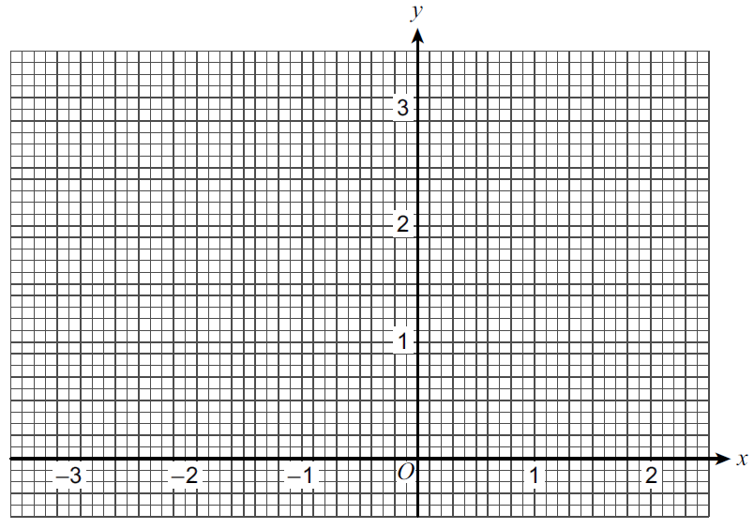
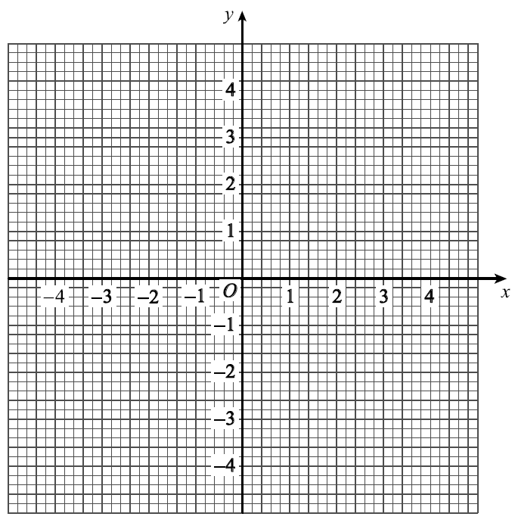
Exercise 4
(Exercises on provided sheet)
[Jan 2013 Paper 2] A function $f(x)$ is defined as:
$$f\left(x\right)=\left\{\begin{matrix}4 & x<−2 \\ x^{2} & −2≤x≤2 \\ 12−4x & x>2\end{matrix}\right.$$
Draw the graph of $y=f(x)$ for $−4≤x≤4$
Use your graph to write down how many solutions there are to $f\left(x\right)=3$ 3 sols
Solve $f\left(x\right)=−10$ $12−4x=−10 →x=\frac{11}{2}$
[June 2013 Paper 2] A function $f(x)$ is defined as:
$$f\left(x\right)=\left\{\begin{matrix}x+3 & −3≤x<0 \\ 3 & 0≤x<1 \\ 5−2x & 1≤x≤2\end{matrix}\right.$$
Draw the graph of $y=f(x)$ for $$−3≤x<2$$
1
2
b ?
?
c ?
a ?

Slide 26
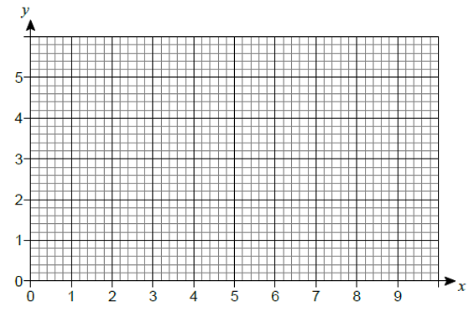
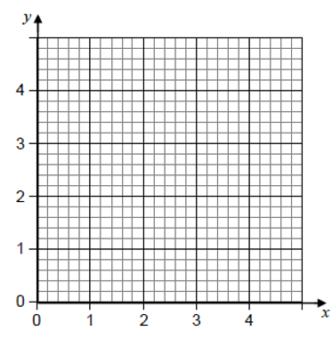
Exercise 4
(Exercises on provided sheet)
3
[Set 1 Paper 1] A function $f(x)$ is defined as:
$$f\left(x\right)=\left\{\begin{matrix}3 & 0≤x<2 \\ x+1 & 2≤x<4 \\ 9−x & 4≤x≤9\end{matrix}\right.$$
Draw the graph of $y=f(x)$ for $0≤x≤9$.
4
[Specimen 1 Q4] A function $f(x)$ is defined as:
$$f\left(x\right)=\left\{\begin{matrix}3x & 0≤x<1 \\ 3 & 1≤x<3 \\ 12−3x & 3≤x≤4\end{matrix}\right.$$
Calculate the area enclosed by the graph of $y=f\left(x\right)$ and the $x−$axis.
?
Sketch ?
Area = $9$
?

Slide 27
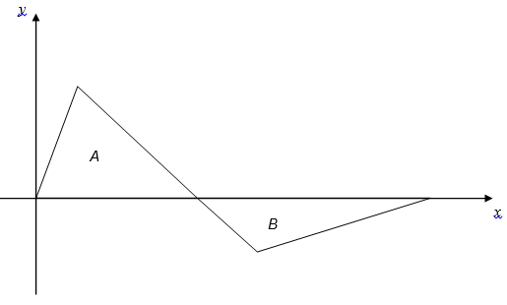
Exercise 4
(Exercises on provided sheet)
[AQA Worksheet Q9]
$$f\left(x\right)=\left\{\begin{matrix}−x^{2} & 0≤x<2 \\ −4 & 2≤x<3 \\ 2x−10 & 3≤x≤5\end{matrix}\right.$$
Draw the graph of $f(x)$ from $0≤x≤5$.
[AQA Worksheet Q10]
$$f\left(x\right)=\left\{\begin{matrix}2x & 0≤x<1 \\ 3−x & 1≤x<4 \\ \frac{x−7}{3} & 4≤x≤7\end{matrix}\right.$$
5
6
?
2
-1
-2
-3
-4
1 2 3 4 5
3
7
-1
Show that $area of A:area of B=3:2$
Area of $A=\frac{1}{2}×3×2=3$
Area of $B=\frac{1}{2}×4×1=2$
?

Slide 28
Domain and Range
Inputs
-1
1
Outputs
0
0
$$f\left(x\right)=x^{2}$$
2.89
1.7
2
4
3.1
9.61
...
...
! The domain of a function is the set of possible inputs.
! The range of a function is the set of possible outputs.

Slide 29
Example
$$y$$
$$f\left(x\right)=x^{2}$$
Sketch:
$$x$$
Bro Note: By ‘suitable’, I mean the largest possible set of values that could be input into the function.
Suitable
Domain:
for all $x$
?
We can use any real number as the input!
In ‘proper’ maths we’d use $x∈ℝ$ to mean “$x$ can be any element in the set of real numbers”, but the syllabus is looking for “for all $x$”.
Range:
?
$$f\left(x\right)≥0$$
Look at the $y$ values on the graph.
The output has to be positive, since it’s been squared.
B Bro Tip: Note that the domain is in terms of $x$ and the range in terms of $f\left(x\right)$.

Slide 30
Test Your Understanding
$$y$$
?
$$f\left(x\right)=\sqrt{x}$$
Sketch:
$$x$$
Suitable
Domain:
$$x≥0$$
?
Presuming the output has to be a real number, we can’t input negative numbers into our function.
Range:
?
$$f\left(x\right)≥0$$
The output, again, can only be positive.

Slide 31
Mini-Exercise
In pairs, work out a suitable domain and the range of each function.
A sketch may help with each one.
3
1
2
Function | $$f\left(x\right)=\frac{1}{x}$$
Domain | For all $x$ except 0
Range | For all $f\left(x\right)$ except 0
Function | $$f\left(x\right)=2x$$
Domain | For all $x$
Range | For all $f(x)$
Function | $$f\left(x\right)=2^{x}$$
Domain | For all $x$
Range | $$f\left(x\right)>0$$
?
?
?
4
5
6
Function | $$f\left(x\right)=\sin{x}$$
Domain | For all $x$
Range | $$−1≤f\left(x\right)≤1$$
Function | $$f\left(x\right)=2\cos{x}$$
Domain | For all $x$
Range | $$−2≤f\left(x\right)≤2$$
Function | $$f\left(x\right)=x^{3}+1$$
Domain | For all $x$
Range | For all $f(x)$
?
?
?
7
Function | $$f\left(x\right)=\frac{1}{x−2}+1$$
Domain | For all $x$ except 2
Range | For all $f\left(x\right)$ except 1
8
Function | $$f\left(x\right)=2cos\left(\sqrt{x+1}\right)$$
Domain | $$x>−1$$
Range | $$−2≤f\left(x\right)≤2$$
?
?

Slide 32
Range of Quadratics
A common exam question is to determine the range of a quadratic.
The sketch shows the function $y=f(x)$ where $f\left(x\right)=x^{2}−4x+7$.
Determine the range of $f(x)$.
$$y$$
?
We need the minimum point, since from the graph we can see that $y$ (i.e. $f(x)$) can be anything greater than this.
$$f\left(x\right)={\left(x−2\right)}^{2}+3$$
The minimum point is $(2,3)$ thus the range is:
$$f\left(x\right)≥3$$
(note the $≥$ rather than $>$)
$$3$$
$$x$$
An alternative way of thinking about it, once you’ve completed the square, is that anything squared is at least 0. So if ${\left(x−2\right)}^{3}$ is at least 0, then clearly ${\left(x−2\right)}^{2}+3$ is at least 3.

Slide 33
Test Your Understanding
$$y$$
The sketch shows the function $y=f(x)$ where $f\left(x\right)=\left(x+2\right)\left(x−4\right)$.
Determine the range of $f(x)$.
?
$$\left(x+2\right)\left(x−4\right)=x^{2}−2x−8 \\ ={\left(x−1\right)}^{2}−9$$
Therefore $f\left(x\right)≥−9$
$$x$$
$$\left(1,−9\right)$$
$$y$$
The sketch shows the function $y=f(x)$ where $f\left(x\right)=21+4x−x^{2}$.
Determine the range of $f(x)$.
$$\left(2,25\right)$$
?
$$−\left(x^{2}−4x−21\right)=−\left({\left(x−2\right)}^{2}−4−21\right) \\ =25−{\left(x−2\right)}^{2}$$
Therefore $f\left(x\right)≤25$
$$x$$

Slide 34
Range for Restricted Domains
Some questions are a bit jammy by restricting the domain. Look out for this, because it affects the domain!
$$f\left(x\right)=x^{2}+4x+3, x≥1$$
Determine the range of $f(x)$.
?
$$y$$
Notice how the domain is $x≥1$.
$$f\left(x\right)=(x+1)(x+3)$$
When $x=1, y=1^{2}+4+3=8$
Sketching the graph, we see that when $x=1$, the function is increasing.
Therefore when $x≥1,$
$$f\left(x\right)≥8$$
$$x$$
$$−3$$
$$−1$$
$$1$$

Slide 35
Test Your Understanding
$$f\left(x\right)=x^{2}−3, x≤−2$$
Determine the range of $f(x)$.
$$f\left(x\right)=3x−2, 0≤x<4$$
Determine the range of $f(x)$.
?
?
$$y$$
When $x=0, f\left(x\right)=−2$
When $x=4, f\left(x\right)=10$
Range:
$$−2≤f\left(x\right)<10$$
$$x$$
$$−2$$
When $x=−2, f\left(x\right)=1$
As $x$ decreases from -2, $f(x)$ is increasing. Therefore:
$$f\left(x\right)≥1$$

Slide 36
Range of Trigonometric Functions
$$90°$$
$$180°$$
$$270°$$
$$360°$$
Suppose we restricted the domain in different ways.
Determine the range in each case (or vice versa). Ignore angles below 0 or above 360.
Domain | Range
For all $x$ (i.e. unrestricted) | $$−1≤f\left(x\right)≤1$$
$$180≤x≤360$$ | $$−1≤f\left(x\right)≤0$$
$$0≤x≤180$$ | $$0≤f\left(x\right)≤1$$
?
?
?

Slide 37
Range of Piecewise Functions
It’s a simple case of just sketching the full function.
The sketch shows the graph of $y=f(x)$ with the domain $0≤x≤9$
$$f\left(x\right)=\left\{\begin{matrix}3 & 0≤x<2 \\ x+1 & 2≤x<4 \\ 9−x & 4≤x≤9\end{matrix}\right.$$
Determine the range of $f(x)$.
Graph ?
Range ?
Range:
$$0≤f\left(x\right)≤5$$

Slide 38
Test Your Understanding
The function $f(x)$ is defined for all $x$:
$$f\left(x\right)=\left\{\begin{matrix}4 & x<−2 \\ x^{2} & −2≤x≤2 \\ 12−4x & x>2\end{matrix}\right.$$
Determine the range of $f(x)$.
Graph ?
Range ?
Range:
$$f\left(x\right)≤4$$

Slide 39
Exercise 5
(exercises on provided sheet)
1
Work out the range for each of these functions. (a) $f\left(x\right)=x^{2}+6$ for all $x$
$$f\left(x\right)≥6$$ (b) $f\left(x\right)=3x−5, −2≤x≤6$
$$−11≤f\left(x\right)≤13$$ (c) $f\left(x\right)=3x^{4}, x<−2$
$$f\left(x\right)>48$$
(a) $f\left(x\right)=\frac{x+2}{x−3}$ Give a reason why $x>0$ is not a suitable domain for $f(x)$.
It would include 3, for which $f(x)$ is undefined. (b) Give a possible domain for $f\left(x\right)=\sqrt{x−5}$ $x≥5$
$$f\left(x\right)=3−2x, a<x<b$$ The range of $f(x)$ is $−5<f\left(x\right)<5$ Work out $a$ and $b$.
$$a=−1, b=4$$
4
[Set 1 Paper 2] (a) The function $f(x)$ is defined as: $$f\left(x\right)=22−7x, −2≤x≤p$$ The range of $f(x)$ is $−13≤f\left(x\right)≤36$ Work out the value of $p$.
$$p=5$$
(b) The function $g(x)$ is defined as $g\left(x\right)=x^{2}−4x+5$ for all $x$. (i) Express $g(x)$ in the form ${\left(x−a\right)}^{2}+b$
$$g\left(x\right)={\left(x−2\right)}^{2}+1$$ (ii) Hence write down the range of $g(x)$.
$$g\left(x\right)≥1$$
[June 2012 Paper 1] $f\left(x\right)=2x^{2}+7$ for all values of $x$. (a) What is the value of $f\left(−1\right)$?
$$f\left(−1\right)=9$$ (b) What is the range of $f(x)$?
$$f\left(x\right)≥7$$
?
?
?
?
2
?
?
?
5
?
?
3
?
?

Slide 40
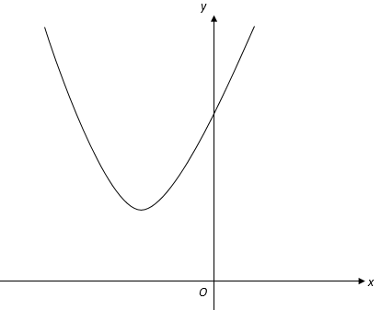
Exercise 5
(exercises on provided sheet)
6
[Jan 2013 Paper 2] $$f\left(x\right)=\sin{x} 180°≤x≤360° \\ g\left(x\right)=\cos{x} 0°≤x≤θ$$ (a) What is the range of $f(x)$?
$$−1≤f\left(x\right)≤0$$ (b) You are given that $0≤g\left(x\right)≤1$. Work out the value of $θ$.
$$θ=90°$$
By completing the square or otherwise, determine the range of the following functions: (a) $f\left(x\right)=x^{2}−2x+5,$for all $x$
$$={\left(x−1\right)}^{2}+4$$
Range: $f\left(x\right)≥4$
(b) $f\left(x\right)=x^{2}+6x−2,$ for all $x$
$$={\left(x+3\right)}^{2}−11$$
Range: $f\left(x\right)≥−11$
8
?
?
Here is a sketch of
$f\left(x\right)=x^{2}+6x+a$ for all $x$, where $a$ is a constant. The range of $f(x)$ is $f\left(x\right)≥11$. Work out the value of $a$.
$$f\left(x\right)={\left(x+3\right)}^{2}−9+a \\ −9+a=11 \\ a=20$$
7
?
?
?

Slide 41
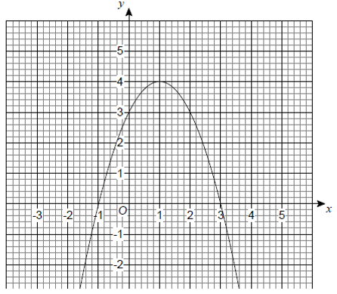
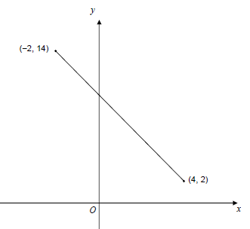
Exercise 5
(exercises on provided sheet)
9
10
The straight line shows a sketch of $y=f(x)$ for the full domain of the function. (a) State the domain of the function.
$$2≤f\left(x\right)≤14$$ (b) Work out the equation of the line.
$$f\left(x\right)=−2x+10$$
$f(x)$ is a quadratic function with domain all real values of $x$. Part of the graph of $y=f\left(x\right)$ is shown.
(a) Write down the range of $f(x)$.
$$f\left(x\right)≤4$$ (b) Use the graph to find solutions of the equation $f\left(x\right)=1$.
$$x=−0.7, 2.7$$ (c) Use the graph to solve $f\left(x\right)<0$.
$$x<−1 or x>3$$
?
?
?
?
?

Slide 42
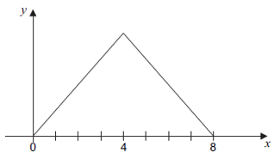
Exercise 5
(exercises on provided sheet)
11
The function $f(x)$ is defined as: $$f\left(x\right)=\left\{\begin{matrix}x^{2}−4 & 0≤x<3 \\ 14−3x & 3≤x≤5\end{matrix}\right.$$ Work out the range of $f\left(x\right)$.
$$f(x)≤5$$
The function $f(x)$ has the domain $−3≤x≤3$ and is defined as: $$f\left(x\right)=\left\{\begin{matrix}x^{2}+3x+2 & −3≤x<0 \\ 2+x & 0≤x≤3\end{matrix}\right.$$ Work out the range of $f\left(x\right)$.
$$−\frac{1}{4}≤f\left(x\right)≤5$$
13
?
12
[June 2012 Paper 2] A sketch of $y=g(x)$ for domain $0≤x≤8$ is shown. The graph is symmetrical about $x=4$. The range of $g(x)$ is $0≤g\left(x\right)≤12$. Work out the function $g(x)$. $$g\left(x\right)=\left\{\begin{matrix}? & 0≤x≤4 \\ ? & 4<x≤8\end{matrix}\right.$$
$$g\left(x\right)=\left\{\begin{matrix}3x & 0≤x≤4 \\ 24−3x & 4<x≤8\end{matrix}\right.$$
?
?

Slide 43
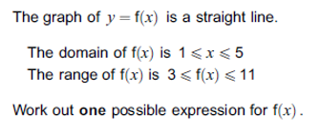
Constructing a function from a domain/range
June 2013 Paper 2
What would be the simplest function to use that has this domain/range?
A straight line! Note, that could either be going up or down (provided it starts and ends at a corner)
What is the equation of this?
$$m=\frac{8}{4}=2$$
$$y−3=2\left(x−1\right) \\ y=2x+1 \\ f\left(x\right)=2x+1$$
$$y$$
$$11$$
?
$$3$$
?
$$x$$
$$1$$
$$5$$

Slide 44
Constructing a function from a domain/range
Sometimes there’s the additional constraint that the function is ‘increasing’ or ‘decreasing’. We’ll cover this in more depth when we do calculus, but the meaning of these words should be obvious.
$f\left(x\right)$ is a decreasing function with domain $4≤x≤6$ and range $7≤f\left(x\right)≤19$.
?
$$y$$
$$m=−\frac{12}{2}=−6$$
$$y−7=−6\left(x−6\right) \\ y=−6x+43 \\ f\left(x\right)=43−6x$$
$$19$$
$$7$$
$$x$$
$$4$$
$$6$$

Slide 45
Exercise 6
(exercises on provided sheet)
1
Domain is $1≤x<3$. Range $1≤f\left(x\right)≤3$. $f(x)$ is an increasing function.
$$f\left(x\right)=x$$
Domain is $1≤x≤3$. Range $1≤f\left(x\right)≤3$.$f(x)$ is a decreasing function.
$$f\left(x\right)=24−x$$
Domain is $5≤x≤7$. Range $7≤f\left(x\right)≤11$. $f(x)$ is an increasing function.
$$f\left(x\right)=24x−3$$
Domain is $5≤x≤7$. Range $7≤f\left(x\right)≤11$. $f(x)$ is a decreasing function.
$$f\left(x\right)=21−2x$$
Domain is $−4≤x≤7$. Range $4≤f\left(x\right)≤8$. $f(x)$ is a decreasing function.
$$f\left(x\right)=\frac{72}{11}−\frac{4}{11}x$$
?
2
?
3
?
4
?
5
?

