Slide 1
IGCSEFM Proof
Dr J Frost (jfrost@tiffin.kingston.sch.uk)
Objectives: (from the specification)
Last modified: 22nd February 2016

Slide 2
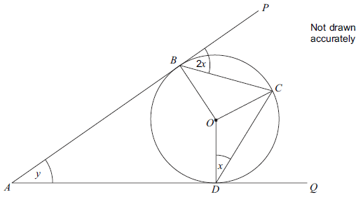
Overview
From GCSE, you should remember that a ‘proof’ is a sequence of justified steps, sometimes used to prove a statement works in all possible cases.
Algebraic Proofs
Geometric Proofs
“Prove that the sum of three consecutive even numbers is a multiple of 6.”
?
$$2n+\left(2n+2\right)+\left(2n+4\right) \\ =6n+6 \\ =6(n+1)$$
which is a multiple of 6.
Prove that $y=x$
Recall that the key at the end is to factorise out the 6.
(We will need to recap some circle theorems)

Slide 3
Algebraic Proof
Two common types of question:
Prove that the difference between the squares of two consecutive odd numbers is a multiple of 8.
?
Let numbers be $2n−1$ and $2n+1.$
$${\left(2n+1\right)}^{2}−{\left(2n−1\right)}^{2} \\ =4n^{2}+4n+1−\left(4n^{2}−4n+1\right) \\ =4n^{2}+4n+1−4n^{2}+4n−1 \\ =8n$$
which is divisible by 8.
We could have also used $2n+1$ and $2n+3$.
Prove that $x^{2}−4x+7>0$ for all $x$.
?
$$x^{2}−4x+7 \\ ={\left(x−2\right)}^{2}−4+7 \\ ={\left(x−2\right)}^{2}+3$$
Since ${\left(x−2\right)}^{2}≥0$, thus ${\left(x−2\right)}^{2}+3>0$
Bro Hint: We know that anything ‘squared’ is at least 0. Could we perhaps complete the square?

Slide 4
Test Your Understanding
1
[Specimen2 Q12] $n$ is an integer.
Prove that ${\left(n−2\right)}^{2}+n\left(8−n\right)$ is always a multiple of 4.
$$n^{2}−4n+4+8n−n^{2} \\ =4n+4 \\ =4(n+1)$$
[June 2013 P2 Q12] Prove that $\left(5n+3\right)\left(n−1\right)+n(n+2)$ is a multiple of 3 for all integer values of $n$.
$$=5n^{2}+3n−5n−3+n^{2}+2n \\ =6n^{2}−3 \\ =3\left(2n^{2}−1\right)$$
[Jan 2013 P1 Q5] $n$ is a positive integer.
Write down the next odd number after $2n−1$ $2n+1$
Prove that the product of two consecutive odd numbers is always one less than a multiple of 4. $\left(2n−1\right)\left(2n+1\right)=4n^{2}−1$ $4n^{2}$ is a multiple of 4.
4
Prove that for all values of $x$,
$$x^{2}−6x+10>0$$
$$x^{2}−6x+10={\left(x−3\right)}^{2}+1$$
${\left(x−3\right)}^{2}≥0$ thus ${\left(x−3\right)}^{2}+1>0$
[Set 4 P1 Q16] Prove that, for all values of $x$,
$$2x^{2}−8x+9>0$$
$$2\left(x^{2}−4x+\frac{9}{2}\right) \\ =2\left({\left(x−2\right)}^{2}−4+\frac{9}{2}\right) \\ =2\left({\left(x−2\right)}^{2}+\frac{1}{2}\right) \\ =2{\left(x−2\right)}^{2}+1$$
${\left(x−2\right)}^{2}≥0$ therefore $2{\left(x−2\right)}^{2}+1>0$
?
?
5
2
?
?
3
?
?

Slide 5
Identities
What values of $x$ make the following equality hold true?
$$x^{2}=4$$
$x$ is 2 or -2
?
$$x^{2}−x=x\left(x−1\right)$$
$x$ could be anything!
?
! The identity $f(x)≡g(x)$ means that $f\left(x\right)=g(x)$ for all values of $x$. e.g.
$$x^{2}−x≡x\left(x−1\right)$$
So $x^{2}≡4$ would be wrong as it is not true when say $x$ is 1.
When you have a quadratic/cubic/etc, all the coefficients must match to guarantee both sides of the identity are equal for all $x$.
[Set 4 P1 Q2] In this identity, $h$ and $k$ are integer constants.
$$4\left(hx−1\right)−3\left(x+h\right)=5\left(x+k\right)$$
Work out the values of $h$ and $k$
$$4hx−4−3x−3h=5x+5k$$
Comparing $x$ terms: $4h−3=5 → h=2$
Comparing constant terms: $−4−3h=5k → k=−2$
?

Slide 6
Test Your Understanding
[Set 3 P1 Q2] $5\left(3x−2\right)−3\left(x−h\right)≡4(kx+2)$
Work out the values of $h$ and $k$.
?
$$15x−10−3x+3h≡4kx+8 \\ 12x−10+3h=4kx+8$$
Comparing $x$ terms: $12=4k → k=3$
Comparing constant terms: $−10+3h=8 → h=6$

Slide 7
AQA Worksheet (Algebraic Proof)
BONUS QUESTIONS:
1
Prove algebraically that the sum of two consecutive odd numbers is divisible by 4.
$\left(2n−1\right)+\left(2n+1\right)=4n$ which is divisible by 4.
3
Prove that the difference between two consecutive cubes is one more than a multiple of 6.
$${\left(n+1\right)}^{3}−n^{3} \\ =n^{3}+3n^{2}+3n+1−n^{3} \\ =3n^{2}+3n+1$$ $=3n\left(n+1\right)+1$
The product of two consecutive integers is even, thus $3n(n+1)$ is divisible by 6.
?
?
2
[GCSE] I think of two consecutive integers. Prove that the difference of the squares of these integers is equal to the sum of the two integers.
Two numbers are: $x$ and $x+1$
Difference of squares:
$${\left(x+1\right)}^{2}−x^{2}=2x+1$$
Sum of numbers: $x+\left(x+1\right)=2x+1$
These are equal.
?
4
Prove that the product of four consecutive numbers is one less than a square number.
$$a\left(a+1\right)\left(a+2\right)\left(a+3\right) \\ =\left(a^{2}+a\right)\left(a^{2}+5a+6\right) \\ =a^{4}+6a^{3}+11a^{2}+6a+1 \\ ={\left(a^{2}+3a+1\right)}^{2}$$
?

Slide 8
Geometric Proof
A recap of general angle theorems and Circle Theorems:
?
Alternate angles are equal.
Corresponding angles are equal.
(Sometimes known as ‘F’ angles)
?
$$a$$
$$a+b=180°$$
$$b$$
?
Vertically opposite angles are equal.
?
Cointerior angles sum to $180°$.

Slide 9
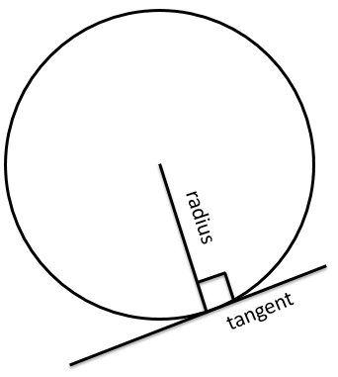
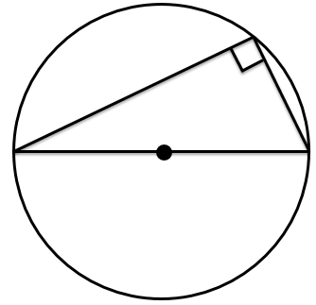
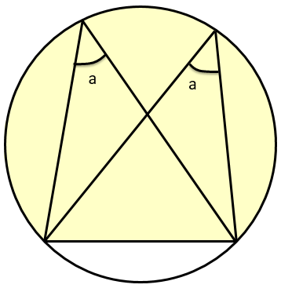
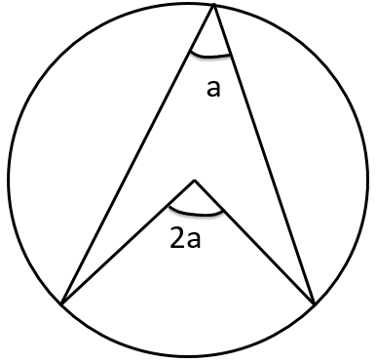
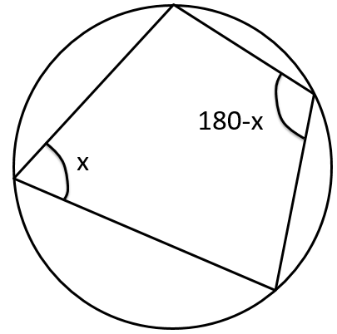
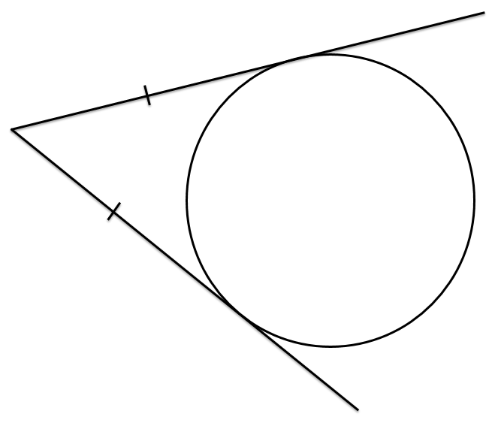
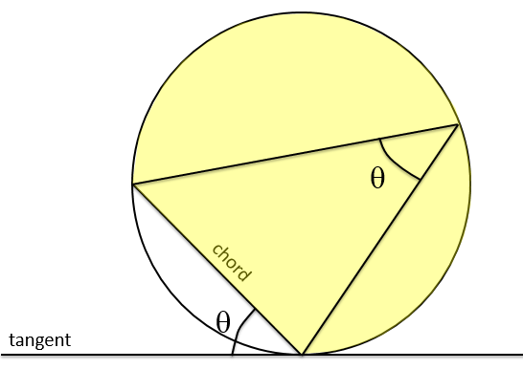
RECAP :: Circle Theorems
?
?
?
Angle between radius and tangent is $90°$.
Angle in semicircle is $90°$
Angles in same segment are equal.
Angle at centre is twice angle at circumference.
?
?
?
?
Alternate Segment Theorem.
Opposite angles of cyclic quadrilateral add to 180$°$.
Tangents from a point to a circle are equal in length.

Slide 10
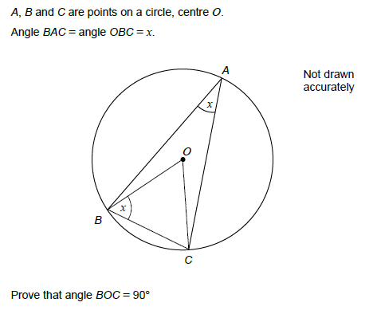
Form of a Geometric Proof
Set 1 Paper 1 Q8
! Write statements in the form:
$$∠ABC=value (reason)$$
$∠OCB=x$ (base angles of isosceles triangle are equal)
$∠BOC=2x$ (angle at centre is double angle at circumference)
Angles in $ΔOBC$ add to $180°$ $∴$
$$x+x+2x=180 \\ 4x=180 \\ x=45 \\ ∠BOC=2x=90°$$
?
?
?

Slide 11
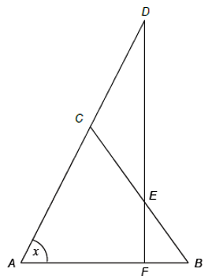
Test Your Understanding
Triangle $ABC$ is isosceles with $AC=BC$.
Triangle $CDE$ is isosceles with $CD=CE$.
$ACD$ and $DEF$ are straight lines.
Prove that angle $DCE=2x$ $∠CBA=x$ (base angles of isosceles triangle are equal) $∠ACB=180−2x$ (angles in $ΔABC$ add to 180) $∠DCE=2x$ (angles on straight line add to 180)
Prove that $DF$ is perpendicular to $AB$. $∠DEC=\frac{180−2x}{2}=90−x$ (base angles of isosceles triangle are equal) $∠DFA=180−\left(90−x\right)−x=90°$ $∴DF$ is perpendicular to $AB$.
?
?

Slide 12
Last Step
What do you think we would be the last step in your proof in each of these cases?
$$D$$
Prove that $ABC$ is a straight line.
…
$∠ABD+∠DBC=180$
therefore $ABC$ is a straight line.
$$C$$
?
Bro Tip: It’s a good idea to finish by stating the thing you’re trying to prove.
$$B$$
$$A$$
$$B$$
Prove that the line $AC$ bisects $∠BAD$.
…
$∠BAC=∠CAD$ therefore $AC$ bisects $∠BAD$.
$$C$$
?
$$A$$
$$D$$
$$B$$
Prove that triangle $ABC$ is isosceles.
…
$∠BAC=∠ACB$ therefore $ΔABC$ is isosceles.
?
$$A$$
$$C$$

Slide 13
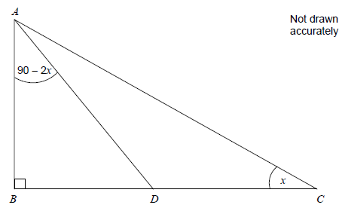
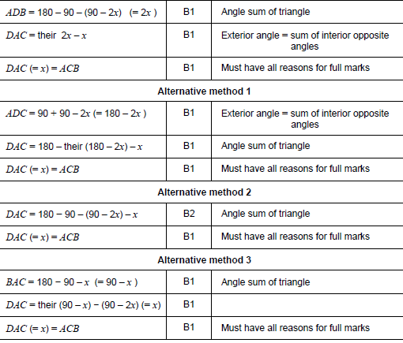
Exercises
Question 1 [Set 4 Paper 1 Q4]
$ABC$ is a right-angled triangle. Angle $ACB=x$. Angle $BAD=90−2x$.
Prove that $ACD$ is an isosceles triangle.
?

Slide 14
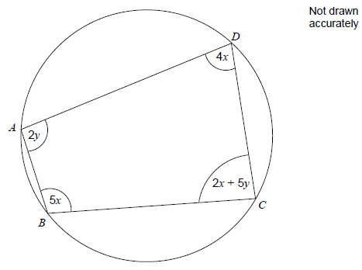
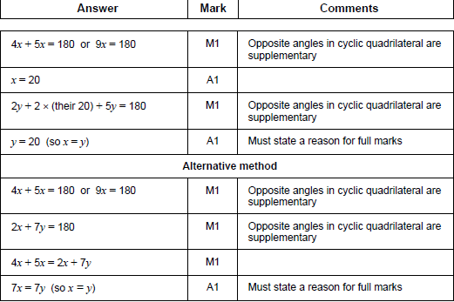
Question 2
$ABCD$ is a quadrilateral.
Prove that $x=y$.
?

Slide 15
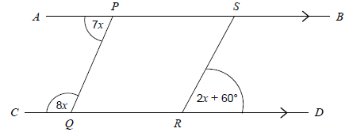
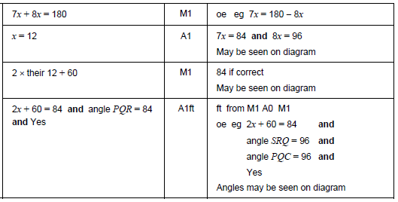
Question 3
$AB$ is parallel to $CD$. Is $PQ$ parallel to $SR$? You must show your working.
?

Slide 16
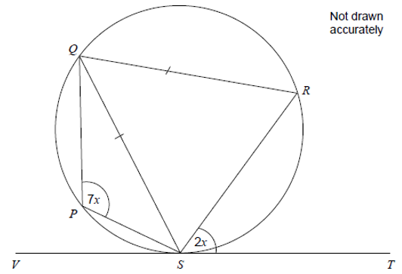
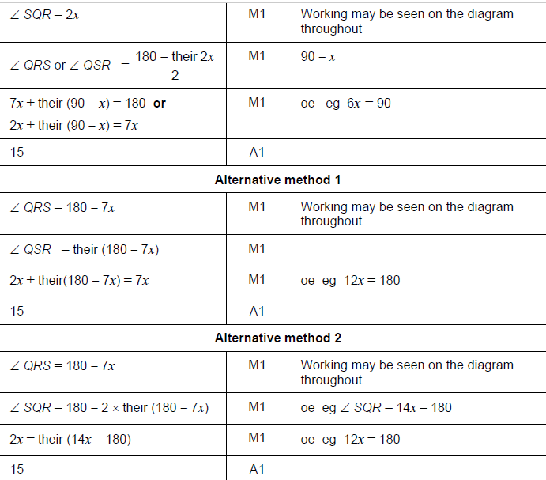
Question 4
?
$PQRS$ is a cyclic quadrilateral. $QS=QR$. $VST$ is a tangent to the circle.
Work out the value of $x$. You must show your working.

Slide 17
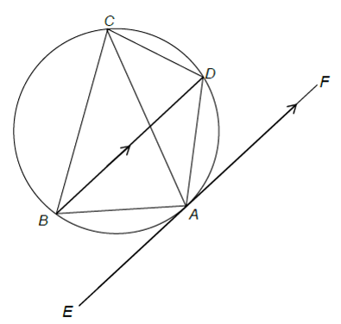
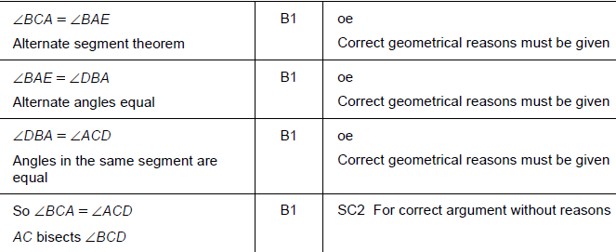
Question 5
$A$, $B$, $C$ and $D$ are points on the circumference of a circle such that $BD$ is parallel to the tangent to the circle at $A$.
Prove that $AC$ bisects angle $BCD$. Give reasons at each stage of your working.
?

Slide 18
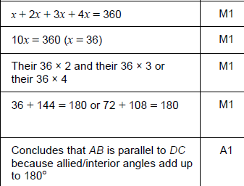
Question 6
Prove that $AB$ is parallel to $DC$.
?

Slide 19
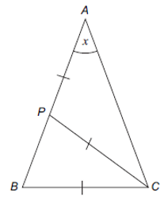
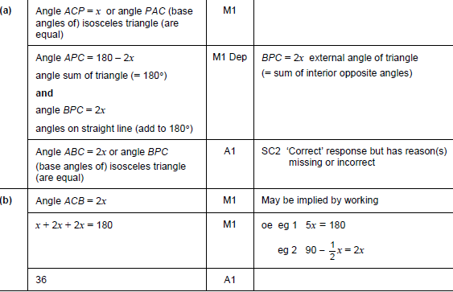
Question 7
$ABC$ is a triangle. $P$ is a point on $AB$ such that $AP=PC=BC$. Angle $BAC=x$.
Prove that angle $ABC=2x$.
You are also given that $AB=AC$. Work out the value of $x$.
?

