Slide 1
GCSE: Tangents To Circles
Dr J Frost (jfrost@tiffin.kingston.sch.uk)
www.drfrostmaths.com
Last modified: 18th February 2017

Slide 2
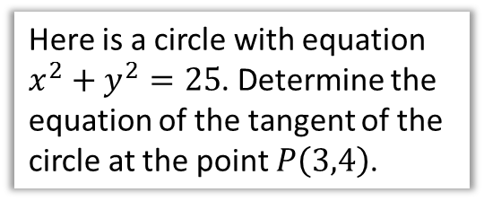
Example
Here is a circle with equation $x^{2}+y^{2}=25$. Determine the equation of the tangent of the circle at the point $P\left(3,4\right)$.
5
$$P\left(3,4\right)$$
$$x$$
-5
5
As always, to get an equation of a line we need:
A point (we have that!)
The gradient.
-5
There’s only ONE thing you need to remember for this topic, related to finding the gradient of the tangent:
?
! The tangent is perpendicular to the radius.

Slide 3
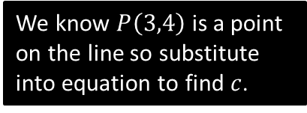
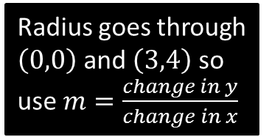

Example
Here is a circle with equation $x^{2}+y^{2}=25$. Determine the equation of the tangent of the circle at the point $P\left(3,4\right)$.
$$P\left(3,4\right)$$
$$x$$
-5
5
?
Gradient of radius: $\frac{4}{3}$
Gradient of tangent: $−\frac{3}{4}$
Equation of tangent so far:
$$y=−\frac{3}{4}x+c$$
At $P$: $4=−\frac{3}{4}×3+c$ $4=−\frac{9}{4}+c$ $c=\frac{25}{4} → y=−\frac{3}{4}x+\frac{25}{4}$
Radius goes through $\left(0,0\right)$ and $\left(3,4\right)$ so use $m=\frac{change in y}{change in x}$
?
-5
?
Use negative reciprocal for perpendicular gradient.
?
We know $P\left(3,4\right)$ is a point on the line so substitute into equation to find $c$.

Slide 4



Further Example
Here is a circle with equation $x^{2}+y^{2}=100$. The tangent at the point $P\left(8,6\right)$ cuts the $x$-axis at the point $A$. Determine the area of triangle $OPA$.
10
$$P\left(8,6\right)$$
$$x$$
-10
$$O$$
10
$$A$$
Full equation of tangent:
$$m=\frac{6}{8}=\frac{3}{4} \\ y=−\frac{4}{3}x+c \\ 6=\left(−\frac{4}{3}×8\right)+c → c=\frac{50}{3} \\ y=−\frac{4}{3}x+\frac{50}{3}$$
?
Bro Tip: If you have an equation with fractions, multiply appropriately to make your life easier.
At $A$, $y=0$:
$$0=−\frac{4}{3}x+\frac{50}{3} \\ 0=−4x+50 \\ 4x=50 \\ x=\frac{25}{2}$$
Therefore area of $OPA$ $$=\frac{1}{2}×\frac{25}{2}×6=\frac{75}{2}$$
?
?
-10
?
Bro Tip: Note that the perpendicular height of the triangle is the $y$ value of $P$.
$$6$$
$$25/2$$

Slide 5

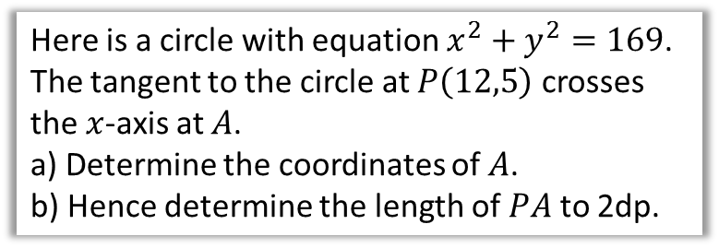
Test Your Understanding
Here is a circle with equation $x^{2}+y^{2}=169$. The tangent to the circle at $P\left(12,5\right)$ crosses the $x$-axis at $A$.
a) Determine the coordinates of $A$.
b) Hence determine the length of $PA$ to 2dp.
13
$$P\left(12,5\right)$$
$$x$$
-13
13
$$m_{r}=\frac{5}{12} → m_{t}=−\frac{12}{5} \\ y=−\frac{12}{5}x+c \\ 5=\left(−\frac{12}{5}×12\right)+c → c=\frac{169}{5} \\ y=−\frac{12}{5}x+\frac{169}{5}$$
When $y=0$:
$$0=−\frac{12}{5}x+\frac{169}{5} → 0=−12x+169 \\ x=\frac{169}{12}$$
Length of $PA: \sqrt{{\left(\frac{169}{12}−12\right)}^{2}+{\left(0−5\right)}^{2}}=22.37$
?
-13
Bro Recap:
The distance between two points is:
$$d=\sqrt{{\left(Δx\right)}^{2}+{\left(Δy\right)}^{2}}$$
Where $Δx$ is change in $x$.

Slide 6

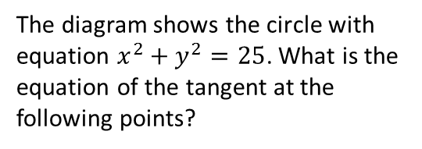
Exercise
1
The diagram shows the circle with equation $x^{2}+y^{2}=25$. What is the equation of the tangent at the following points?
2
13
$$A\left(5,12\right)$$
$$B$$
$$x$$
-13
$$O$$
13
5
$$A\left(0,5\right)$$
$$C\left(−3,4\right)$$
$$B\left(4,3\right)$$
-13
The tangent to the above circle at the point $A\left(5,12\right)$ intersects the $x$ axis at the point $B$.
Find the equation of the tangent to the circle at the point $A$. $y=−\frac{5}{12}x+\frac{169}{12}$
Find the area of triangle $OAB$. When $y=0, x=\frac{169}{5}$ Area $=\frac{1}{2}×\frac{169}{5}×12=\frac{1014}{5}=202.8$
The line $l$ is tangent at the point $P(x,y)$ to the circle with equation $x^{2}+y^{2}=1$. The gradient of $l$ is $−\frac{1}{2}$. Determine the point $P\left(x,y\right)$.
Gradient of radius is 2 therefore equation of radius is $y=2x$. Solving simultaneously with $x^{2}+y^{2}=1$:
$$x^{2}+{\left(2x\right)}^{2}=1 → x=\frac{1}{\sqrt{5}}, y=\frac{2}{\sqrt{5}}$$
-5
5
$$x$$
a
?
-5
b
?
a
?
$$A\left(0,5\right): y=5 \\ B\left(4,3\right): y=−\frac{4}{3}x+\frac{25}{3} \\ C\left(−3,4\right):y=\frac{3}{4}x+\frac{25}{4}$$
b
?
N
c
?
?

