Slide 1
IGCSE Equations of Circles
Dr J Frost (jfrost@tiffin.kingston.sch.uk)
Objectives: Determine the equation of a circle given its radius and centre, or given an equation in the incorrect form.
Use coordinate geometry/Pythagoras to establish the centre/radius of a circle.
Determine the equation of the tangent of a circle.
Last modified: 19th August 2015

Slide 2
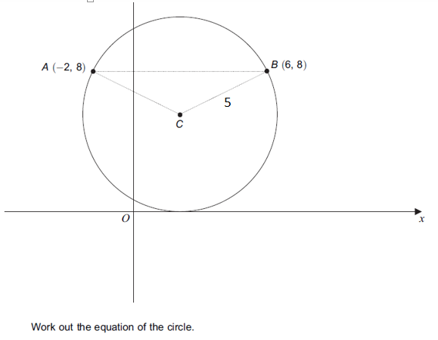
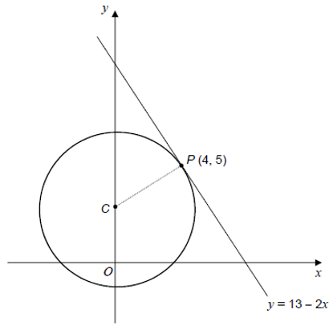
Overview
#1: Understand and use the equation of a circle.
#4: Complete the square to determine the centre and radius of a circle.
#2: Find $x$ for given $y$ and vice versa
#3: Use Pythagoras/geometry to determine the centre and radius of a circle.
#5: Find the equation of a tangent to a circle.

Slide 3
RECAP of Coordinate Geometry
$$B(15,5)$$
What is the:
Centre of $A$ and $B$? $\left(9, 2\frac{1}{2}\right)$
The length $AB$? $d=\sqrt{Δx^{2}+Δy^{2}}$ $=\sqrt{{12}^{2}+5^{2}}$ $=13$
$$A(3,0)$$
?
?

Slide 4
RECAP of GCSE
The equation of this circle is:
x² + y² = 25
$$y$$
?
5
The equation of a circle with centre at the origin and radius r is: $x^{2}+y^{2}=r^{2}$
$$x$$
-5
5
-5

Slide 5
Quickfire Circles
1
?
3
4
-1
1
-3
3
-4
4
-1
-3
-4
?
?
x² + y² = 1
x² + y² = 9
x² + y² = 16
?
?
8
10
6
-8
8
-10
10
-6
6
-8
-10
-6
x² + y² = 64
?
x² + y² = 100
x² + y² = 36

Slide 6
Proof
$$y$$
How could we show how $r$, $x$ and $y$ are related?
(Hint: draw a right-angled triangle inside your circle, with one vertex at the origin and another at the circumference)
$$r$$
$$\left(x,y\right)$$
$$r$$
$$y$$
?
$$x$$
$$x^{2}+y^{2}=r^{2}$$
$$x$$
$$r$$

Slide 7
Equation of a circle
$$y$$
Now suppose we shift the circle so it’s now centred at (a,b). What’s the equation now?
(Hint: What would the sides of this right-angled triangle be now?)
$$r$$
$$(a,b)$$
?
$$x$$
$${\left(x−a\right)}^{2}+{\left(y−b\right)}^{2}=r^{2}$$
! The equation of a circle with radius $r$ and centre $(a,b)$ is:
$${\left(x−a\right)}^{2}+{\left(y−b\right)}^{2}=r^{2}$$

Slide 8
Quickfire Questions
Centre
Radius
Equation
(0,0)
5
x² + y² = 25
?
(1,2)
6
(x-1)² + (y-2)² = 36
?
(-3,5)
?
1
?
(x+3)² + (y-5)² = 1
(-5,2)
?
7
?
(x+5)² + (y-2)² = 49
(-6,-7)
?
4
?
(x+6)² + (y+7)² = 16
(1,-1)
?
$$\sqrt{3}$$
?
(x-1)² + (y+1)² = 3
(0,3)
?
$$2\sqrt{2}$$
?
$$x^{2}+{\left(y−3\right)}^{2}=8$$

Slide 9
#2: Find $x$ for given $y$ and vice versa
A circle has centre $(3,4)$ and has the radius $5$. The circle intercepts the $x$-axis at the origin and the point $A$ and the $y$-axis at the origin and the point $B$.
Determine the coordinates of these points.
$$y$$
$$B$$
(3,4)
Equation is:
$${\left(x−3\right)}^{2}+{\left(y−4\right)}^{2}=25$$
When $y=0$:
$${\left(x−3\right)}^{2}+16=25 \\ {\left(x−3\right)}^{2}=9 \\ x−3=±3 \\ x=0 or 6 \\ A\left(6,0\right)$$
When $x=0$:
$$9+{\left(y−4\right)}^{2}=25 \\ y=0 or 8$$
$$B\left(0,8\right)$$
?
$$x$$
$$A$$
?
?

Slide 10
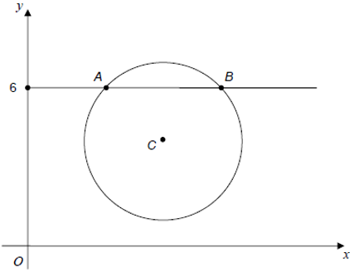
Test Your Understanding
A circle has centre $\left(4,7\right)$ and radius $10$. Find the coordinates of the points on the circle where $y=13$.
AQA Practice Paper Set 2 Paper 2
The diagram shows a sketch of the circle ${\left(x−7\right)}^{2}+{\left(y−4\right)}^{2}=9$. The line $y=6$ intersects the circle at the points $A$ and $B$. Show that $AB=2\sqrt{5}$
?
$${\left(x−4\right)}^{2}+{\left(y−7\right)}^{2}=100$$
When $y=13$:
$${\left(x−4\right)}^{2}+{\left(13−7\right)}^{2}=100 \\ {\left(x−4\right)}^{2}+36=100 \\ {\left(x−4\right)}^{2}=64 \\ x−4=±8 \\ x=−4 or 12 \\ \left(−4,13\right), \left(12,13\right)$$
?
$${\left(x−7\right)}^{2}+4=9 \\ x−7=±\sqrt{5} \\ x=7±\sqrt{5} \\ A\left(7−\sqrt{5},6\right), B(7+\sqrt{5},6)$$
$$∴AB=\left(7+\sqrt{5}\right)−\left(7−\sqrt{5}\right)=2\sqrt{5}$$
Does the circle with equation $x^{2}+{\left(y−1\right)}^{2}=16$ pass through the point $(2,5)$?
?
$$x^{2}+{\left(y−1\right)}^{2}=2^{2}+4^{2}=20$$
Since $20≠16$ it is not on the circle.

Slide 11
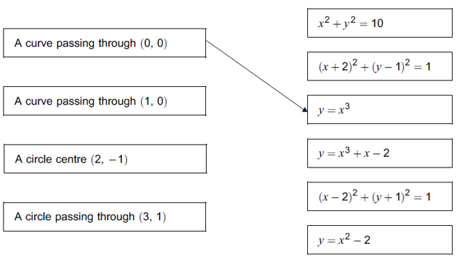
Exercise 1
1
Question 1: Write down the equation of each of these circles:
Centre (0,3) radius 2. $x^{2}+{\left(y−3\right)}^{2}=4$
Centre (1, -5) radius 4 ${\left(x−1\right)}^{2}+{\left(y+5\right)}^{2}=16$
Centre (-3, 4) radius $\sqrt{7}$ ${\left(x+3\right)}^{2}+{\left(y−4\right)}^{2}=7$
Centre (8, 15) radius 17 ${\left(x−8\right)}^{2}+{\left(y−15\right)}^{2}=289$ Does the circle pass through the origin? Show working to support your answer. Yes as $8^{2}+{15}^{2}={17}^{2}$
Question 2: Write down the centre and radius of each of these circles.
$x^{2}+y^{2}=36$ Centre (0,0) Radius = 6
${\left(x−3\right)}^{2}+{\left(y−4\right)}^{2}=100$ Centre (3,4) Radius = 10
${\left(x+5\right)}^{2}+y^{2}=3$ Centre (-5,0) Radius $=\sqrt{3}$
Question 3: Determine whether the point $A$ lies on each of these circles.
$A\left(1,1\right)$ on $x^{2}+{\left(y+2\right)}^{2}=10$ Yes.
$A(4,7)$ on ${\left(x−1\right)}^{2}+{\left(y−2\right)}^{2}=9$x No.
4
Question 4: [AQA] A circle has equation ${\left(x−5\right)}^{2}+{\left(y−4\right)}^{2}=100$ Show that the point $\left(13,−2\right)$ lies on the circle. ${\left(13−5\right)}^{2}+{\left(−2−4\right)}^{2}=100$
Question 5: [AQA] The point $\left(13,−2\right)$ lies on the circle $${\left(x−a\right)}^{2}+{\left(y−4\right)}^{2}=100$$ Work out the two possible values of $a$.
$$a=5 or 21$$
Question 6: [Jan 2013 Paper 2] Match each statement with an equation. You will not use all the equations.
?
?
?
?
5
?
?
?
2
6
?
?
?
3
?
?
?

Slide 12
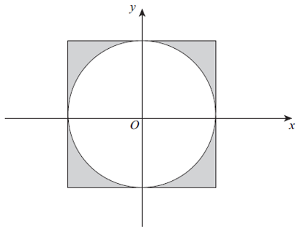
Exercise 1
9
Question 9: [AQA] Circle A has equation: $x^{2}+y^{2}=16$ Circle $B$ has equation ${\left(x+6\right)}^{2}+{\left(y−8\right)}^{2}=25$ (a) Work out the distance between the centres of the circles. Distance between $(0,0)$ and $\left(−6,8\right)$ is $10$ (b) Circle the correct statement: The circles overlap The circles touch The circles do not overlap
The circles do not overlap as $4+5=9<10$
Question 10: Determine the coordinates of the points where the circle with equation: $${\left(x+5\right)}^{2}+{\left(y−12\right)}^{2}=169$$ intercepts either axis.
When $x=0$, $y=0 or 24 →\left(0,0\right), \left(0,24\right)$ When $y=0, x=0 or 10 →\left(0,0\right), \left(10,0\right)$
Question 11: Determine the points $A$ and $B$ where the circle with equation: $${\left(x−4\right)}^{2}+{\left(y+3\right)}^{2}=100$$ intersects the line with equation $x=12$. Hence determine the length $AB$. $A\left(12,−9\right) B(12,3)$
$$AB=12$$
7
Question 7: [Jan 2012 Paper 2] A circle has the equation $x^{2}+y^{2}=36$. Work out its circumference. Radius = 6 $∴$ Circumference = $12π$ Question 8: [June 2013 Paper 2] The circle $x^{2}+y^{2}=25$ touches each side of the square as shown. Work out the total shaded area.
?
?
8
?
10
?
Area = ${10}^{2}−\left(π×5^{2}\right)$
$$=100−25π$$
?
11
?

Slide 13
#3: Determine radius and centre using geom/Pythag
We’ve seen how we can get the radius/centre of a circle using the equation of the circle. But sometimes we need to used coordinate geometry or Pythagoras to determine them, so that we can get the equation of the circle.
$$B$$
Example: $A(4,7)$ and $B\left(10,15\right)$ are points on a circle and $AB$ is a diameter of the circle.
Determine the centre and radius of the circle.
Hence find the equation of the circle.
$$A$$
?
Centre is midpoint: $\left(7,11\right)$ Radius is distance between centre and A or B. $r=\sqrt{3^{2}+4^{2}}=5$
Equation therefore is: ${\left(x−7\right)}^{2}+{\left(y−11\right)}^{2}=25$
?

Slide 14
Another Example
The radius of this circle is 5.
More difficult!
$$11$$
$$12$$
$$5$$
$$4$$
$$a$$
$$3$$
$$5$$
$$5$$
$$7$$
$$7$$
$$3$$
$$2$$
$$a$$
Determine the value of $a$ and hence the centre of the circle.
Find the equation of the circle.
?
We can use Pythagoras to find the $x$ value of the centre as 3. Centre is $(3,8)$
Equation: ${\left(x−3\right)}^{2}+{\left(y−8\right)}^{2}=25$
?
$$a=\sqrt{7^{2}−5^{2}}=\sqrt{24}=2\sqrt{6}$$
Centre: $\left(2\sqrt{6}, 7\right)$

Slide 15
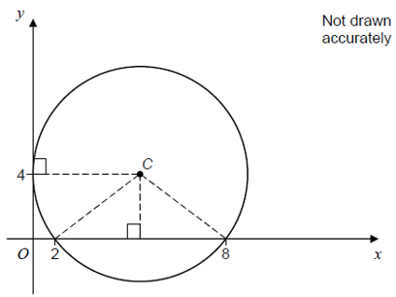
Check Your Understanding
Practice Paper Set 1 Paper 2 Q18
Frost Special
The diagram shows a circle, centre $C$.
The circle touches the $y$-axis at (0, 4).
The circle intersects the $x$-axis at (2, 0) and (8, 0).
Work out the equation of the circle.
A circle has diameter $AB$ where $A(−10,4)$ and $B\left(14, 8\right)$. Determine the equation of the circle.
?
Centre is $(2, 6)$
Radius $=\sqrt{{12}^{2}+2^{2}}=\sqrt{148}$
Equation:
$${\left(x−2\right)}^{2}+{\left(y−6\right)}^{2}=148$$
?
Centre: (5,4) Radius 5
Equation: ${\left(x−5\right)}^{2}+{\left(y−4\right)}^{2}=25$

Slide 16
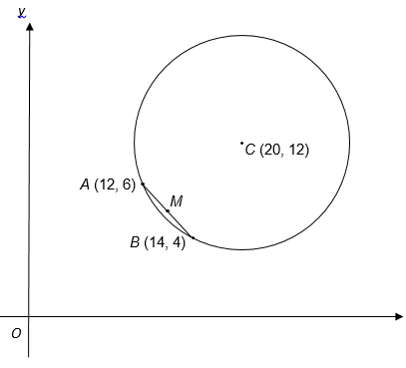
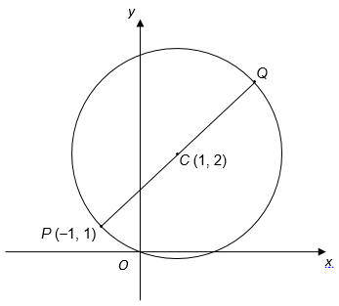
Exercise 2
Question 1: [AQA] $AB$ is the diameter of a circle. $A$ is $\left(−3,6\right)$ and $B$ is $\left(5,12\right)$. Work out the equation of the circle.
$${\left(x−1\right)}^{2}+{\left(y−9\right)}^{2}=25$$
Question 2: [AQA] $PQ$ is a diameter of a circle, centre $C$.
Question 3: [AQA] $A(12, 6)$ and $B(14, 4)$ are two points on a circle, centre $C\left(20, 12\right)$.
?
Work out the coordinates of the midpoint $M$ of $AB$. $\left(13,5\right)$
Show that the length $CM=7\sqrt{2}$
Work out the radius of the circle. Using Pythagoras on $ΔBMC$: $r=\sqrt{{\left(7\sqrt{2}\right)}^{2}+{\left(\sqrt{2}\right)}^{2}}=10$
?
?
(a) Work out the coordinates of $Q$. $\left(3,3\right)$ (b) Work out the equation of the circle. ${\left(x−1\right)}^{2}+{\left(y−2\right)}^{2}=5$
?
?

Slide 17
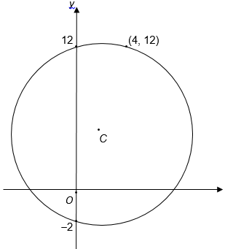
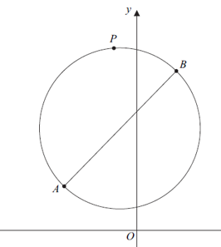
Exercise 2
Question 4: [AQA] (0, -2), (0, 12) and (4, 12) are three points on a circle, centre $C$. Work out the coordinate of $C$.
Solution: (2, 5)
Question 5: [June 2013 Paper 1 Q2] A is (-4,3) and B is (2,11). AB is a diameter of the circle.
Work out the coordinates of the centre of the circle. (-1, 7)
Work out the radius of the circle. 5
Write down the equation of the circle. ${\left(x+1\right)}^{2}+{\left(y−7\right)}^{2}=25$
P is another point on the circle. The gradient of the line $AP$ is 2. Write down the gradient of the line $PB$. $−\frac{1}{2}$
?
?
?
?
?

Slide 18
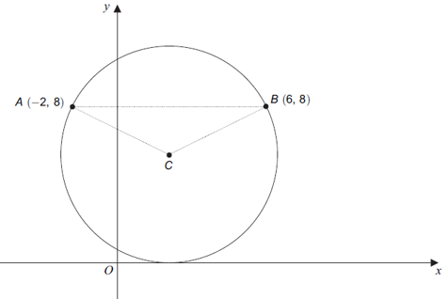
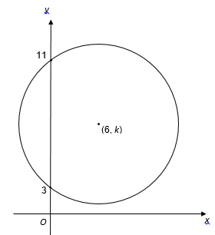
Exercise 2
Question 6: [June 2012 Paper 2 Q14] The sketch shows a circle, centre C, radius 5. The circle passes through the points A(-2,8) and B(6,8). The $x$-axis is a tangent to the circle. Work out the equation of the circle.
Using Pythagoras, centre is $\left(2,5\right)$.
Equation: ${\left(x−2\right)}^{2}+{\left(y−5\right)}^{2}=25$
Question 7: A circle passes through the points (0,3) and (0,11) and has centre (6,k).
Work out the value of $k$. Sol: 7
Hence find the equation of the circle. ${\left(x−6\right)}^{2}+{\left(y−7\right)}^{2}=25$
?
?

Slide 19
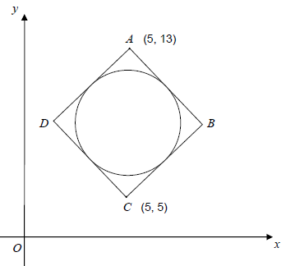
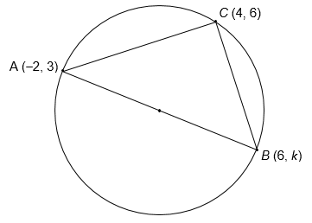
Exercise 2
Question 8: AB is a diameter of the circle ABC. Work out the value of $k$. (Hint: What do you know about the line AC relative to CB? Can you find an equation of the line CB?)
Gradient of AC = $\frac{1}{2}$ $∴$ gradient of CB = -2
Equation of $CB$: $y−6=−2(x−4)$
$y=−2x+14$
Subbing (6, k) in:
$$k=−2\left(6\right)+14=2$$
Question 9: ABCD is a square. $A$ is the point (5,13). $C$ is the point (5,5). The circle touches the sides of the square. Work out the equation of the circle.
Length AC = 8. If $x$ is side of square, then $x^{2}+x^{2}=8^{2}$, therefore $x=\sqrt{32}=4\sqrt{2}$.
Thus radius of circle $=2\sqrt{2}$
Equation: ${\left(x−5\right)}^{2}+{\left(y−9\right)}^{2}=8$
?
?

Slide 20
#4 :: Completing the square to find radius/centre
Jan 2013 Paper 1 Q14
?
To get in the form ${\left(x−a\right)}^{2}+{\left(y−b\right)}^{2}=r^{2}$, we need to complete the square.
$${\left(x−1\right)}^{2}−1+{\left(y−3\right)}^{2}−9=0 \\ {\left(x−1\right)}^{2}+{\left(y−3\right)}^{2}=10$$
So centre is $\left(1,3\right)$ and radius is $\sqrt{10}$

Slide 21
Test Your Understanding
The circle C, with centre at the point A, has equation x² + y² – 10x + 9 = 0.
Find
(a) the coordinates of A,
(b) the radius of C,
(c) the coordinates of the points at which C crosses the x-axis.
Tip: Put the $x$ terms together first and the $y$ terms together.
$$x^{2}−10x+y^{2}+9=0 \\ {\left(x−5\right)}^{2}−25+y^{2}+9=0 \\ {\left(x−5\right)}^{2}+y^{2}=16$$
Centre is (5, 0)
Radius is 4
When $y=0$: ${\left(x−5\right)}^{2}=16$ $x−5=±4$ $x=5±4=1 or 9$ $\left(1,0\right) or \left(9,0\right)$
?

Slide 22
Mini Exercise
Equation | Centre | Radius
$$x^{2}+y^{2}−6y+2=0$$ | (0, 3) | $$\sqrt{7}$$
$$x^{2}+y^{2}+4x−3=0$$ | (-2, 0) | $$\sqrt{7}$$
$$x^{2}+y^{2}−8x+4y+5=0$$ | (4, -2) | $$\sqrt{15}$$
$$x^{2}+y^{2}−10x+2y=0$$ | (5, -1) | $$\sqrt{26}$$
$$x^{2}+y^{2}−2x+6y=7$$ | (2, -3) | $$4$$
$$x^{2}+y^{2}+x−y=0$$ | (-0.5, 0.5) | $$1/2$$
?
?
?
?
?
?
?
?
?
?
?
?

Slide 23
#5 :: Tangents and other circle theorems
There are three circle theorems relevant to IGCSE circle questions.
Tangent is at right-angles to the radius.
e.g. “Find equation of the tangent at the point (2,4)”
Angle in a semi-circle is $90°$ (so two top lines are perpendicular)
e.g. Use fact lines are perpendicular to find other side of diameter.
The perpendicular bisector of any chord passes through the centre of the circle.
e.g. Given two points on the circumference of the circle, if the centre of the circle is (3, $k$), find $k$.
What is it?
What is it?
What is it?
Possible exam q?
Possible exam q?
Possible exam q?

Slide 24
Recap of perpendicular lines
All of these theorems involved perpendicular lines.
We’ll also need to use the formula for the equation of a line.
Gradient of line | Gradient of perpendicular line
$$3$$ | $$−\frac{1}{3}$$
$$−4$$ | $$\frac{1}{4}$$
$$\frac{1}{2}$$ | $$−2$$
$$−\frac{3}{4}$$ | $$\frac{4}{3}$$
?
?
?
?
If a line has gradient $m$ and passes through the point $\left(x_{1}, y_{1}\right)$ then it has equation:
$$y−y_{1}=m\left(x−x_{1}\right)$$
?

Slide 25
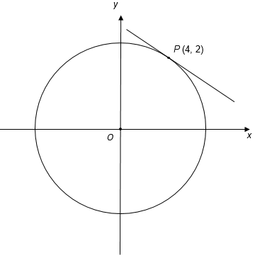
Example Question
The equation of this circle is $x^{2}+y^{2}=20$
$P\left(4,2\right)$ is a point on the circle.
Work out the equation of the tangent to the circle at $P$, in the form $y=mx+c$
?
As always, to find an equation we need (i) a point and (ii) the gradient.
Point: (4,2)
Gradient?
Gradient of radius is $\frac{2}{4}=\frac{1}{2}$
Gradient of tangent $=−2$
$$y−2=−2\left(x−4\right) \\ y=−2x+10$$

Slide 26
Another Example
Two points on the circumference of a circle are (2,0) and (0,4). If the centre of the circle is $\left(6,k\right)$, determine $k$.
Diagram ?
Working ?
Gradient of chord: $−\frac{4}{2}=−2$
Midpoint of chord: (1,2)
Gradient of radius $=\frac{1}{2}$
Equation of radius:
$$y−2=\frac{1}{2}\left(x−1\right)$$
If $x=6$:
$$y−2=\frac{1}{2}\left(6−1\right) \\ y=4.5$$
$$(6,k)$$
$$4$$
$$2$$

Slide 27
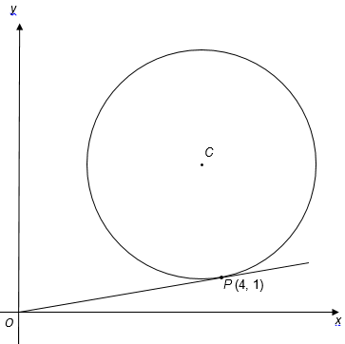
Test Your Understanding
The equation of this circle, centre C, is ${\left(x−3\right)}^{2}+{\left(y−5\right)}^{2}=17$
Show working to explain why $OP$ is a tangent to the circle.
Show that the length $OP$ is equal to the radius of the circle.
Points $A(1,3)$ and $(5,9)$ form a chord of a circle. If the centre of the circle is at $(12,k)$, find $k$.
?
Midpoint = $\left(3, 6\right)$
Gradient of AB $=\frac{6}{4}=\frac{3}{2}$
Gradient of radius $=−\frac{2}{3}$
Equation of radius:
$$y−6=−\frac{2}{3}\left(x−3\right) \\ y−6=−\frac{2}{3}x+2 \\ y=−\frac{2}{3}x+8$$
If $x=12$:
$$k=−\frac{2}{3}\left(12\right)+8 \\ =−8+8=0$$
Gradient of OP = $\frac{1}{4}$
Gradient of $CP=\frac{1−5}{4−3}=−4$
$\frac{1}{4}×−4=−1$ $∴$ line is perpendicular to the radius.
?

Slide 28
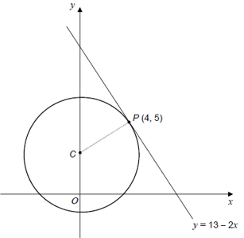
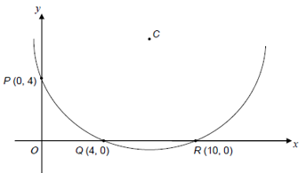
Exercise 3
Question 1: [AQA Practice Paper] The sketch show point $P$ on a circle, centre C. The equation of the tangent at P is $y=13−2x$.
Work out the gradient of PC. $\frac{1}{2}$
Work out the equation of the circle. Equation of PC: $y−5=\frac{1}{2}\left(x−4\right)$ $C\left(0,3\right) → x^{2}+{\left(y−3\right)}^{2}=20$
Question 2: [AQA Practice Paper] The sketch shows part of a circle, centre C, that intersects the axes at points $P, Q$ and $R$.
Explain why the centre of the circle lies on the line $x=7$ Because $(7,0)$ is the midpoint of $QR$ and the perpendicular bisector of QR goes through the centre of the circle.
Show that the line $y=x$ is the perpendicular bisector of the line $PQ$. Midpoint of $PQ$: (2,2). Gradient: $−1$. Therefore perp bis.: $y−2=1(x−2)$
Work out the equation of the circle. Centre: (7,7) Radius: $\sqrt{50}$ ${\left(x−7\right)}^{2}+{\left(y−7\right)}^{2}=50$
?
?
?
?
?

Slide 29
Exercise 3
Question 3: The points $A(3,5)$ and $B\left(10,k\right)$ form a diameter of a circle. The point $C\left(9,8\right)$ is another point on the circle.
Determine the gradient of the line $AC$. $\frac{1}{2}$
Hence determine the equation of the line $CB$. $y−8=−2\left(x−9\right)$
Hence, given that the point $B$ lies on this line, determine the value of $k$. (10, 6)
Question 4: The diagram shows points $A\left(4,3\right), B(10,5)$ and $C(12,q)$. $C$ is the centre of the circle and $AB$ form a chord of the circle. $M$ is the midpoint of $AB$.
Determine the gradient of $AB$ and the coordinate of $M$. $m=\frac{1}{3}, M(7,4)$
Hence find the equation of $MC$. $y−4=−3(x−7)$
Hence determine the value of $q$. $q=−11$
Find the equation of the circle. ${\left(x−12\right)}^{2}+{\left(y+11\right)}^{2}=260$
?
?
?
?
?
?
?
$$y$$
$$C\left(9,8\right)$$
$$B\left(10,5\right)$$
$$B\left(10,k\right)$$
$$A\left(3,5\right)$$
$$M$$
$$A\left(4,3\right)$$
$$C\left(12,q\right)$$
$$x$$

Slide 30
Exercise 3
Question 5: A line with equation $y=4x−13$ is tangent to a circle at the point $P\left(5,7\right)$.
Determine the equation of $PC$. $y−7=−\frac{1}{4}\left(x−5\right)$
Determine the value of $k$. $k=6$
Hence determine the equation of the circle. ${\left(x−9\right)}^{2}+{\left(y−6\right)}^{2}=17$
Question 6: The points $A\left(3,5\right)$ and $B\left(6,14\right)$ lie on the circumference of a circle, and $B$ is at the top of the circle. Determine:
The centre of the circle. $(6,9)$
The equation of the circle. ${\left(x−6\right)}^{2}+{\left(y−9\right)}^{2}=25$
?
?
?
?
$$B\left(6,14\right)$$
?
$$y=4x−13$$
$$C$$
$$P\left(5,7\right)$$
$$A\left(3,5\right)$$
$$C\left(9,k\right)$$

