Slide 1
GCSE Circle Theorems
Dr J Frost (jfrost@tiffin.kingston.sch.uk)
www.drfrostmaths.com
Last modified: 20th November 2016

Slide 2
RECAP: Parts of a Circle
!
(Minor) Arc
?
Sector
?
Chord
?
Radius
?
(Minor)
Segment
?
Diameter
?
Tangent
?
Circumference
?

Slide 3
What are Circle Theorems
Circle Theorems are laws that apply to both angles and lengths when circles are involved. We’ll deal with them in groups.
#1 Non-Circle Theorems
These are not circle theorems, but are useful in questions involving circle theorems.
130
?
50
Angles in a quadrilateral add up to 360.
Base angles of an isosceles triangle are equal.

Slide 4
#2 Circle Theorems Involving Right Angles
Bro Tip: Remember the wording in the black boxes, because you’re often required to justify in words a particular angle in an exam.
!
radius
tangent
“Angle in semicircle is 90°.”
“Angle between radius and tangent is 90°”.
Note that the hypotenuse of the triangle MUST be the diameter.

Slide 5
#3 Circle Theorems Involving Other Angles
!
$$a$$
$$a$$
$$a$$
$$2a$$
“Angles in same segment are equal.”
“Angle at centre is twice the angle at the circumference.”

Slide 6
#3 Circle Theorems Involving Other Angles
!
x
$$180−x$$
$$x$$
Opposite angles of cyclic quadrilateral add up to 180.

Slide 7
#4 Circle Theorems Involving Lengths
Lengths of the tangents from a point to the circle are equal.

Slide 8
#4 Circle Theorems Involving Lengths
Radius is of constant length
Bro Tip: When you have multiple radii, put a mark on each of them to remind yourself they’re the same length.
This result is that any triangle with one vertex at the centre, and the other two on the circumference, must be isosceles.

Slide 9
Which Circle Theorem?
Identify which circle theorems you could use to solve each question.
Angle in semicircle is 90°
Reveal
Angle between tangent and radius is 90°
Opposite angles of cyclic quadrilateral add to 180°
Angles in same segment are equal
O
Angle at centre is twice angle at circumference
160°
?
Lengths of the tangents from a point to the circle are equal
100°
Base angles of isosceles triangle are equal.
Angles of quadrilateral add to 360°

Slide 10
Which Circle Theorem?
Identify which circle theorems you could use to solve each question.
Angle in semicircle is 90°
Reveal
Angle between tangent and radius is 90°
Opposite angles of cyclic quadrilateral add to 180°
70°
Angles in same segment are equal
70°
?
60°
Angle at centre is twice angle at circumference
Lengths of the tangents from a point to the circle are equal
Base angles of isosceles triangle are equal.
Angles of quadrilateral add to 360°

Slide 11
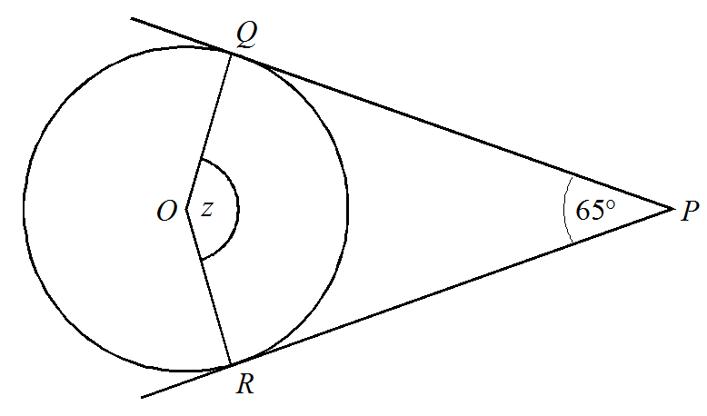
Which Circle Theorem?
Identify which circle theorems you could use to solve each question.
Angle in semicircle is 90°
Reveal
Angle between tangent and radius is 90°
Opposite angles of cyclic quadrilateral add to 180°
Angles in same segment are equal
?
115°
Angle at centre is twice angle at circumference
Lengths of the tangents from a point to the circle are equal
Base angles of isosceles triangle are equal.
Angles of quadrilateral add to 360°

Slide 12
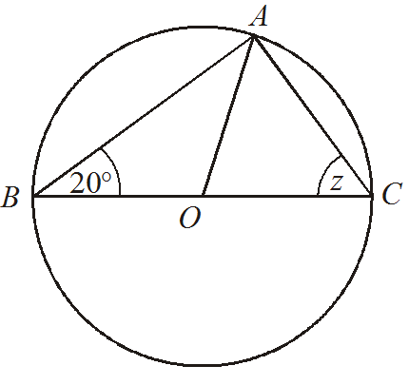
Which Circle Theorem?
Identify which circle theorems you could use to solve each question.
Angle in semicircle is 90°
Reveal
Angle between tangent and radius is 90°
Opposite angles of cyclic quadrilateral add to 180°
Angles in same segment are equal
?
70°
Angle at centre is twice angle at circumference
Lengths of the tangents from a point to the circle are equal
Base angles of isosceles triangle are equal.
Angles of quadrilateral add to 360°

Slide 13
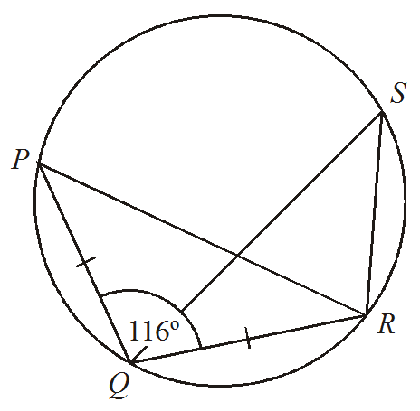
Which Circle Theorem?
Identify which circle theorems you could use to solve each question.
Angle in semicircle is 90°
Reveal
Angle between tangent and radius is 90°
Opposite angles of cyclic quadrilateral add to 180°
?
Angles in same segment are equal
32°
Angle at centre is twice angle at circumference
Lengths of the tangents from a point to the circle are equal
Base angles of isosceles triangle are equal.
Angles of quadrilateral add to 360°

Slide 14
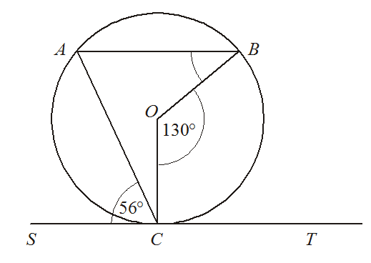
Which Circle Theorem?
Identify which circle theorems you could use to solve each question.
Angle in semicircle is 90°
Reveal
Angle between tangent and radius is 90°
Opposite angles of cyclic quadrilateral add to 180°
?
31°
Angles in same segment are equal
Angle at centre is twice angle at circumference
Lengths of the tangents from a point to the circle are equal
Base angles of isosceles triangle are equal.
Angles of quadrilateral add to 360°

Slide 15

Check Your Understanding
$$A$$
?
$$x=110°$$
$$D$$
$$73°$$
$$x$$
$$B$$
$$37°$$
$$C$$
$$O$$
$$x$$
$$A$$
$$y$$
$$x=66° \\ y=57°$$
$$24°$$
?
$$C$$
$$B$$

Slide 16
Exercise 1
1
a
b
c
$$A$$
$$B$$
$$x$$
$$x$$
$$x$$
$$O$$
$$150°$$
$$85°$$
$$60°$$
$$D$$
$$C$$
$$51°$$
$$x=75°$$
$$x=95°$$
$$x=51°$$
?
?
?
d
e
f
$$O$$
$$O$$
$$O$$
$$x$$
$$x$$
$$80°$$
$$x$$
$$50°$$
$$x=90°$$
$$x=40°$$
?
?
?
$$x=80°$$

Slide 17
Exercise 1
2
a
$$A$$
b
$$A$$
?
$$x=100°$$
$$O$$
$$O$$
$$x$$
$$80°$$
$$x$$
$$B$$
$$B$$
$$110°$$
?
$$D$$
$$x=140°$$
$$C$$
$$C$$
c
d
$$A$$
e
$$A$$
$$A$$
$$D$$
$$30°$$
$$85°$$
$$O$$
$$O$$
$$x$$
$$B$$
$$80°$$
$$x$$
$$x$$
$$C$$
$$70°$$
$$C$$
$$C$$
$$B$$
$$B$$
?
?
?
$$x=40°$$
$$x=140°$$
$$x=55°$$

Slide 18
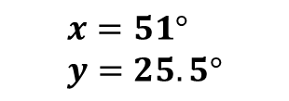
Exercise 1
3
a
b
$$C$$
?
$$B$$
$$x$$
$$x=51° \\ y=25.5°$$
?
$$A$$
$$82°$$
$$y$$
$$D$$
$$78°$$
$$x$$
$$E$$
$$x=50°$$
$$x=16°$$
?
?
c
d
$$80°$$
$$x$$
$$x$$
$$x=45°$$
?

Slide 19
Exercise 1
4
Determine each indicated angle in terms of $x$.
$$A$$
$$B$$
$$A$$
$$O$$
$$O$$
$$x$$
$$A$$
$$x$$
$$x$$
$$C$$
$$B$$
$$D$$
$$B$$
?
?
$$∠BAC=\frac{1}{2}x$$
$$∠AOB=360−2x$$
$$∠AOB=180−2x$$
?

Slide 20
Exercise 1
N
a
b
$$B$$
$$A$$
$$A$$
$$70°$$
$$D$$
$$x$$
$$x$$
$$x=125°$$
$$B$$
?
$$C$$
?
$$x=75°$$
$$P$$
$$Q$$
c
$$100°$$
$$150°$$
$$S$$
$$V$$
$$x$$
$$T$$
?
$$x=110°$$
$$U$$

Slide 21
#5 Alternate Segment Theorem
This one is probably the hardest to remember and a particular favourite in the Intermediate/Senior Maths Challenges.
!
Click to Start Bromanimation
This is called the alternate segment because it’s the segment on the other side of the chord.
θ
...is equal to the angle in the alternate segment
chord
θ
tangent
The angle between the tangent and a chord...

Slide 22
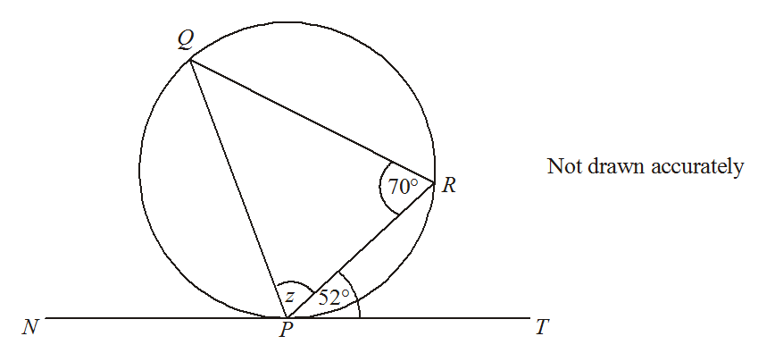
Check Your Understanding
z = 58°
?

Slide 23
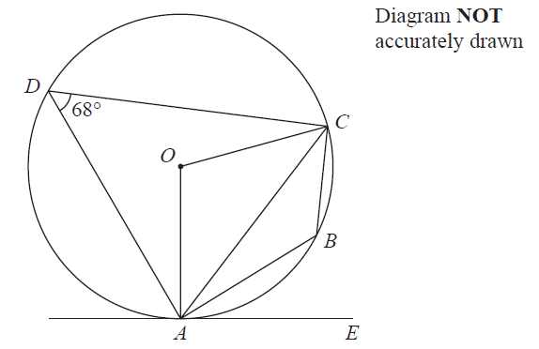
Check Your Understanding
Source: IGCSE Jan 2014 (R)
Angle ABC =
Angle AOC =
Angle CAE =
?
?
?
112°
136°
68°
Give a reason:
Give a reason:
Give a reason:
?
?
?
Supplementary angles of cyclic quadrilateral add up to 180.
Angle at centre is double angle at circumference.
Alternate Segment Theorem.

Slide 24

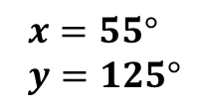
Exercise 2
1
2
$$B$$
$$55°$$
$$x$$
$$A$$
$$x$$
$$y$$
$$70°$$
?
$$65°$$
$$y$$
$$D$$
$$x=55° \\ y=125°$$
$$C$$
?
?
$$B$$
$$x=65° \\ y=60°$$
3
?
$$49°$$
$$A$$
$$O$$
$$x$$
$$71°$$
$$D$$
?
$$x=41°$$
$$C$$

Slide 25
Exercise 2
4
$$B$$
5
$$A$$
$$x$$
$$B$$
$$A$$
$$O$$
$$70°$$
$$121°$$
$$C$$
$$x$$
$$E$$
$$63°$$
$$62°$$
$$D$$
$$C$$
$$D$$
$$x=58°$$
?
$$x=42°$$
?
$$A$$
6
$$B$$
$$x$$
$$O$$
?
$$81°$$
$$x=49°$$
$$58°$$
$$C$$
$$D$$

Slide 26
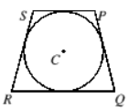
Exercise 2
$$A$$
7
$$B$$
8
?
$$x=49°$$
$$82°$$
$$A$$
$$C$$
$$115°$$
$$C$$
$$B$$
$$x$$
$$70°$$
$$D$$
$$E$$
?
$$x$$
$$x=45°$$
$$D$$
N₁
[SMC 2012 Q20] In trapezium $PQRS$, $SR=PQ=$ 25cm and $SP$ is parallel to $RQ$. All four sides of $PQRS$ are tangent to a circle with centre $C$. The area of the trapezium is $600cm^{2}$. What is the radius of the circle?
?
$r=12$cm

Slide 27
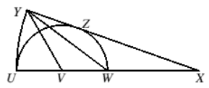
Exercise 2
N₂
[SMC 2012 Q22] A semicircle of radius $r$ is drawn with centre $V$ and diameter $UW$. The line $UW$ is then extended to the point $X$, such that $UW$ and $WX$ are of equal length. An arc of the circle with centre $X$ and radius $4r$ is then drawn so that the line $XY$ is a tangent to the semicircle at $Z$, as shown. What, in terms of $r$, is the area of triangle $YVW$?
$$\frac{2}{3}r^{2}$$
?

Slide 28
APPENDIX: Circle Theorem Proofs
B
a
?
90-a
?
180-2a
?
90-a
?
2a
a
?
A
C
O
Let angle BAO be a. Triangle ABO is isosceles so ABO = a. Remaining angle in triangle must be 180-2a. Thus BOC = 2a. Since triangle BOC is isosceles, angle BOC = OCB = 90 – a. Thus angle ABC = ABO + OBC = a + 90 – a = 90.

Slide 29
APPENDIX: Circle Theorem Proofs
!
b
?
x
This combined angle
= 180 – a – b
(angles in a triangle)
?
a
Adding opposite angles:
a + b + 180 – a – b = 180
b
?
a
Opposite angles of cyclic quadrilateral add up to 180.

Slide 30
APPENDIX: Circle Theorem Proofs
C
1: Angle between tangent and radius is 90, so angle CAD = 90 - θ
θ
?₃
B
2: Angle in semicircle is 90.
?₄
D
θ
?₂
3: Angles in triangle add up to 180.
4: But any other angle in the same segment will be the same.
?₁
90-θ
θ
A
Alternate Segment Theorem

