Slide 1
GCSE :: Graph Transformations
www.drfrostmaths.com
Dr J Frost (jamie@drfrostmaths.com)
@DrFrostMaths
Last modified: 30th January 2020

Slide 2
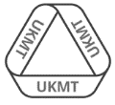
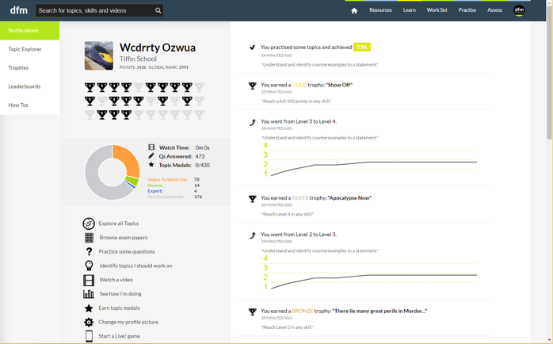
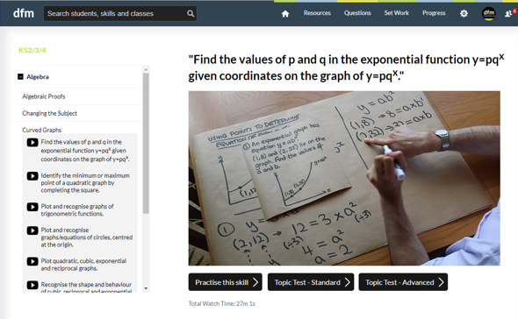
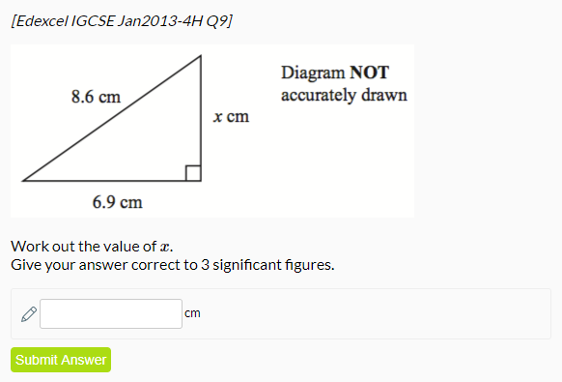
www.drfrostmaths.com
Everything is completely free.
Why not register?
Register now to interactively practise questions on this topic, including past paper questions and extension questions (including UKMT).
Teachers: you can create student accounts (or students can register themselves), to set work, monitor progress and even create worksheets.
With questions by:
Dashboard with points, trophies, notifications and student progress.
Questions organised by topic, difficulty and past paper.
Teaching videos with topic tests to check understanding.

Slide 3
RECAP :: What are Functions?
A function is something which provides a rule on how to map inputs to outputs.
You might have seen this as a ‘number machine’.
Input
Output
$$x$$
$$f$$
$$2x$$
?
Name of the function (usually $f$ or $g$)
Input
Output
$$f(x)=2x$$

Slide 4
RECAP :: Using Functions
Let $f$ be a function where $f\left(x\right)=x^{2}+1$.
$$f\left(3\right)=3^{2}+1=10 \\ f\left(−2\right)={\left(−2\right)}^{2}+1=5 \\ f\left(2x\right)={\left(2x\right)}^{2}+1=4x^{2}+1 \\ f\left(x+1\right)={\left(x+1\right)}^{2}+1$$
?
We’re making the input 3, so substitute each instance of $x$ for 3.
?
?
?
Don’t be upset by the fact we’re substituting in an algebraic expression rather than a number. The principle remains the same: we replace each $x$ in the expression with $2x$.

Slide 5
Transformations of Functions
Suppose $f\left(x\right)=x^{2}$
?
Then $f\left(x+2\right)={\left(x+2\right)}^{2}$
Sketch $y=f\left(x\right):$
Sketch $y=f\left(x+2\right)$:
?
?
$$y$$
$$y$$
$$y={\left(x+2\right)}^{2}$$
$$y=x^{2}$$
$$x$$
$$x$$
$$−2$$
What do you notice about the relationship between the graphs of $y=f\left(x\right)$ and $y=f\left(x+2\right)$?
The graph/line has translated 2 units to the left.
?

Slide 6
Transformations of Functions
We saw that sketching $y=f\left(x+2\right)$ decreases the $x$ values by 2 relative to $y=f\left(x\right)$.
Can we come with rules more generally for how modifications inside and outside of the $f(…)$ will affect the graph?
!
Affects which axis?
What we expect or opposite?
Change inside $f( )$
?
$$x$$
?
Opposite
$$y$$
Change outside $f( )$
?
?
What we expect
Hence describe the transformation from $y=f\left(x\right)$ to:
Translation by $\left(\begin{matrix}−2 \\ 0\end{matrix}\right)$
$$y=f\left(x+2\right)$$
?
(i.e. reduce $x$ values by 2)
Translation by $\left(\begin{matrix}0 \\ 3\end{matrix}\right)$
?
$$y=f\left(x\right)+3$$
(i.e. increase $y$ values by 3)
?
$$y=f\left(x−1\right)$$
Translation by $\left(\begin{matrix}1 \\ 0\end{matrix}\right)$
(i.e. increase $x$ values by 1)
Translation by $\left(\begin{matrix}−5 \\ 0\end{matrix}\right)$
$$y=f\left(x\right)−5$$
?
(i.e. reduce $y$ values by 5)

Slide 7
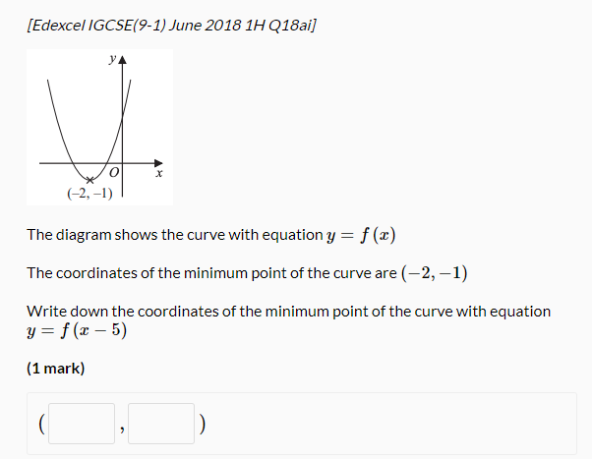
SKILL #1 :: Effect on specific points
Sometimes an exam question might just ask you to determine the effect of the graph transformation on a single point.
Change: | Affects:
Inside $f(…)$ | $x$ values | Opposite
Outside $f(…)$ | $y$ values | What we expect
The -5 is inside the function, so affects the $x$ values and ‘does the opposite’, i.e. we +5 to $x$.
?
3
-1
The $y$ value is unaffected.

Slide 8
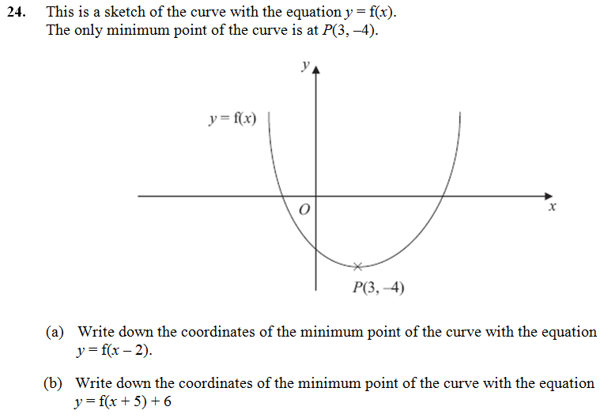
Further Exam Example
Edexcel
Change: | Affects:
Inside $f(…)$ | $x$ values | Opposite
Outside $f(…)$ | $y$ values | What we expect
?
(5, -4)
(-2, 2)
?

Slide 9
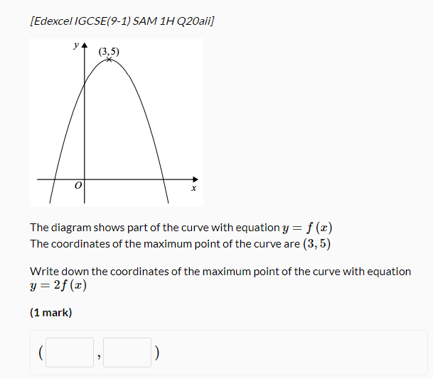
Stretches*
Stretches have been removed from the main 2017+ GCSE syllabus.
But we can use exactly the same rules as before!
Change: | Affects:
Inside $f(…)$ | $x$ values | Opposite
Outside $f(…)$ | $y$ values | What we expect
The $×2$ is outside the $f(..)$, so affects the $y$ values and does what we expect, i.e. multiplies them by 2.
The $x$ values are unaffected.
?
3
10

Slide 10
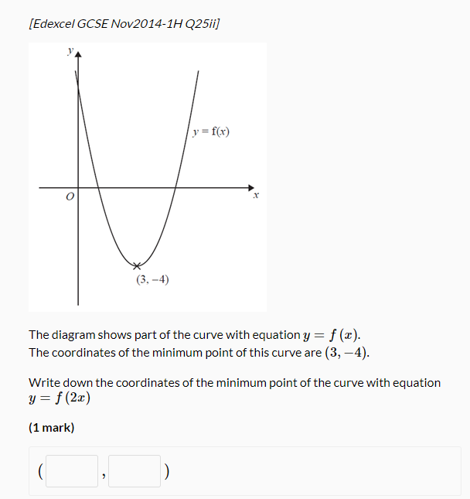
Stretches*
Change: | Affects:
Inside $f(…)$ | $x$ values | Opposite
Outside $f(…)$ | $y$ values | What we expect
The $×2$ is inside the $f(..)$, so affects the $x$ values and does the opposite, i.e. divides them by 2.
The $y$ values are unaffected.
?
1.5
-4

Slide 11
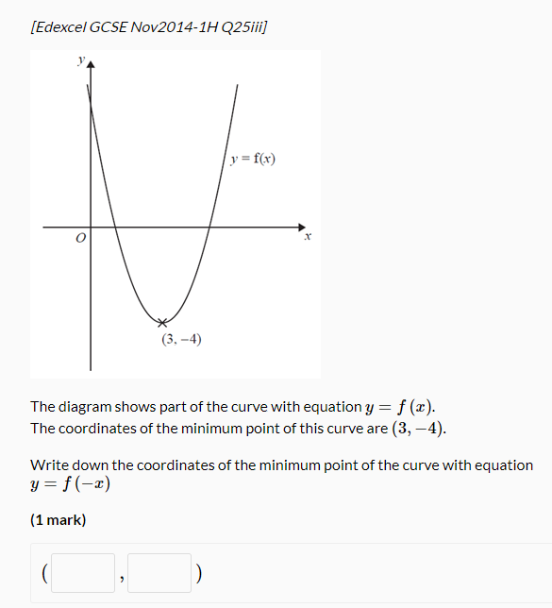
Reflections
Change: | Affects:
Inside $f(…)$ | $x$ values | Opposite
Outside $f(…)$ | $y$ values | What we expect
Note the change is inside $f(…)$.
The opposite of multiplying $x$ by -1 is dividing by -1 (i.e. the same).
So we just negate the $x$ value (i.e. if negative make it positive, and vice versa).
! $y=f(−x)$ gives a reflection in the $y$-axis (as the $x$ values are negated)
?
-3
-4

Slide 12
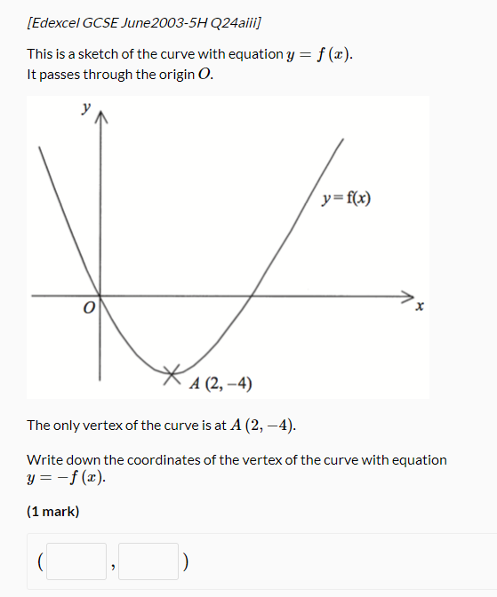
Reflections
Change: | Affects:
Inside $f(…)$ | $x$ values | Opposite
Outside $f(…)$ | $y$ values | What we expect
This time we negate the $y$ value.
! $y=−f(x)$ gives a reflection in the $x$-axis (as the $y$ values are negated)
?
2
4

Slide 13
Mini-Exercise
What effect will the following transformations have on these points?
!
$$y=f\left(x\right)$$ | $$\left(4,3\right)$$ | $$\left(1,0\right)$$ | $$\left(6,−4\right)$$
$$y=f\left(x+1\right)$$ | $$\left(3,3\right)$$ | $$\left(0,0\right)$$ | $$\left(5,−4\right)$$
$$y=f\left(x\right)−1$$ | $$\left(4,2\right)$$ | $$\left(1,−1\right)$$ | $$\left(6,−5\right)$$
$$y=f\left(−x\right)$$ | $$\left(−4,3\right)$$ | $$\left(−1,0\right)$$ | $$\left(−6,−4\right)$$
$$y=−f\left(x\right)$$ | $$\left(4,−3\right)$$ | $$\left(1,0\right)$$ | $$\left(6,4\right)$$
$$y=f\left(2x\right)$$ | $$\left(2,3\right)$$ | $$\left(0.5, 0\right)$$ | $$\left(3, −4\right)$$
$$y=3f\left(x\right)$$ | $$\left(4,9\right)$$ | $$\left(1,0\right)$$ | $$\left(6,−12\right)$$
$$y=f\left(\frac{x}{4}\right)$$ | $$\left(12,3\right)$$ | $$\left(4,0\right)$$ | $$\left(24,−4\right)$$
a
?
?
?
b
?
?
?
c
?
?
?
d
?
?
?
e
?
?
?
f
?
?
?
?
?
?
g

Slide 14
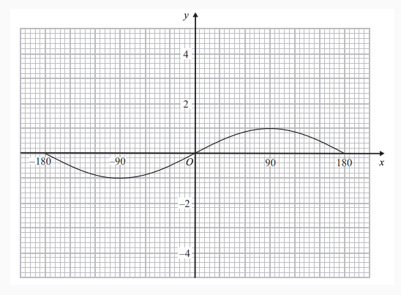
SKILL #2 :: Sketching curves using transformations
[Edexcel GCSE(9-1) June 2018 1H Q18
Here is a sketch of $y=\sin{x°}$, for $−180°≤x≤180°$
Exam Tip: The markscheme will be checking whether your transformed curve goes through certain key points.
Pick key points on the graph that have nice coordinates (e.g. $\left(90,1\right)$) to transform. Only then, join these up.
On the graph, draw the curve with equation $y=\sin{x°}+2$
Note the +2 is outside the sin function.

Slide 15
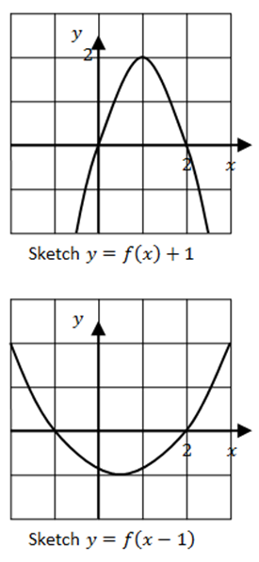
Test Your Understanding

Slide 16
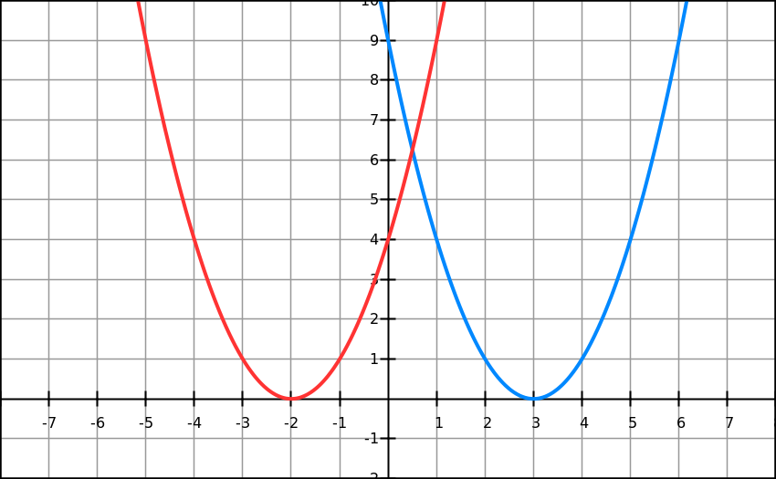
SKILL #3 :: Describing Transforms
$$y=f(x)$$
$$Graph G$$
The blue graph shows the line with equation $y=f(x)$.
What is the equation of graph G, in terms of $f$?
The graph has translated 5 units to the left.
This has affected the $x$ values, so we do the change inside the function and do the opposite, i.e. +5 to $x$:
$$y=f(x+5)$$
?

Slide 17
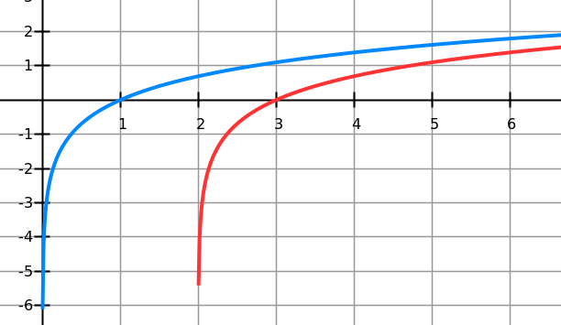
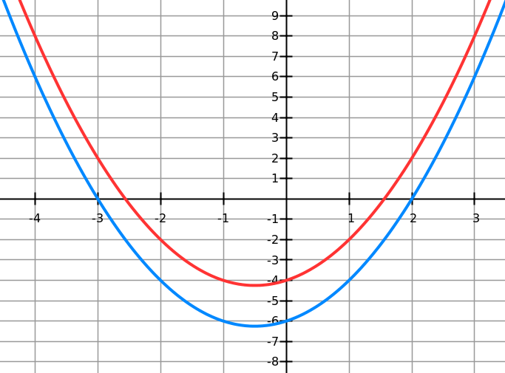
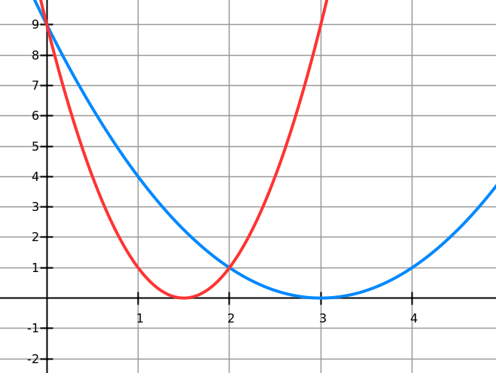
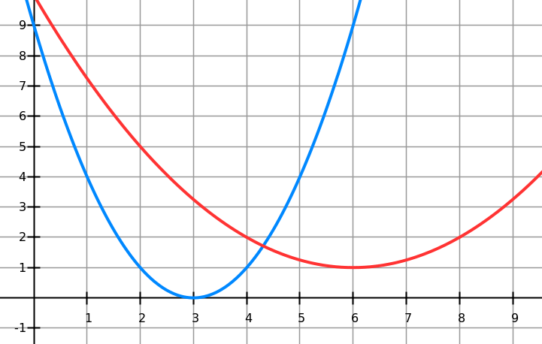
Quickfire Describing Transforms
Given the blue graph has equation $y=f(x)$, determine the equation of the red graph.
?
$$y=f(x−2)$$
$$y=f\left(x\right)+2$$
?
?
?
$$y=f(2x)$$
$$y=f\left(\frac{1}{2}x\right)+1$$

Slide 18
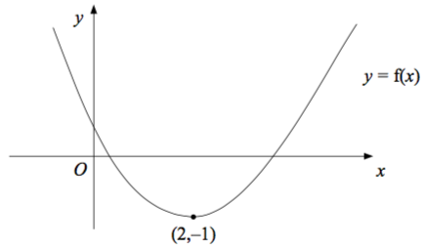
Exercise
(on provided sheet)
1
All questions in this exercise used with permission by Edexcel.
The diagram shows part of the curve with equation $y=f\left(x\right)$.The minimum point of the curve is at (2,–1)
Write down the coordinates of the minimum point of the curve with equation $y=f\left(x+2\right)$
$$\left(0,−1\right)$$
?

Slide 19
Exercise
(on provided sheet)
2
The diagram shows part of the curve with equation $y=f\left(x\right)$. The minimum point of the curve is at (2,–1)
Write down the coordinates of the minimum point of the curve with equation $y=3f\left(x\right)$
$$(2,−3)$$
?

Slide 20
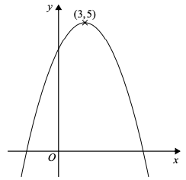
Exercise
(on provided sheet)
3
The diagram shows part of the curve with equation $y=f\left(x\right)$
The coordinates of the maximum point of the curve are $\left(3,5\right)$.
Write down the coordinates of the maximum point of the curve with equation $y=f\left(3x\right)$
$$\left(1,5\right)$$
?

Slide 21
Exercise
(on provided sheet)
4
The curve with equation $y=f\left(x\right)$ has a maximum point at $\left(2,−7\right)$.
Find the coordinates of the minimum point of the curve with equation $y=−f\left(x\right)$
$$\left(2,7\right)$$
?

Slide 22
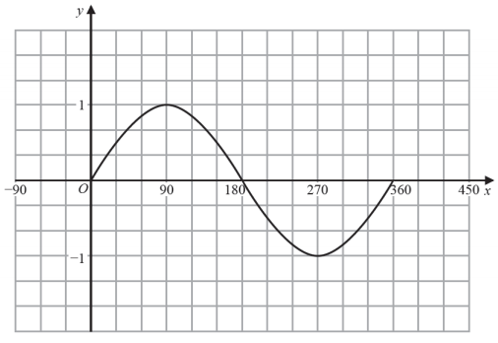
Exercise
(on provided sheet)
5
Here is the graph of $y= sin x^{°}$ for $0≤x≤360$
In $0≤x≤360$, the graph of $y= sin {\left(\frac{x}{2}\right)}^{°}+3$ has a maximum at the point $A$.
Write down the coordinates of $A$. $\left(180,4\right)$
?

Slide 23
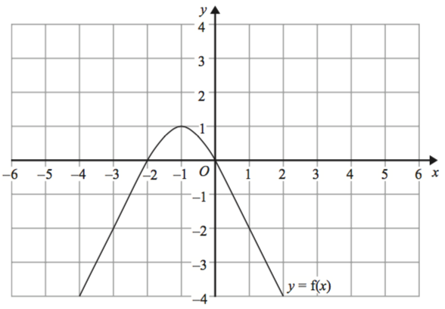
Exercise
(on provided sheet)
6
The graph of $y=f\left(x\right)$ is shown on the grid.
The graph of $y=f\left(x\right)$ has a turning point at the point $\left(−1,1\right)$. Write down the coordinates of the turning point of the graph of $y=f\left(−x\right)+2$
$$(1,3)$$
?

Slide 24
Exercise
(on provided sheet)
7
The diagram shows part of the curve with equation $y=f\left(x\right)$ The coordinates of the maximum point of the curve are $\left(3,5\right)$. The curve with equation $y=f\left(x\right)$ is transformed to give the curve with equation $y=f\left(x\right)−4$
Describe the transformation.
?
Translation by $\left(\begin{matrix}0 \\ 4\end{matrix}\right)$

Slide 25
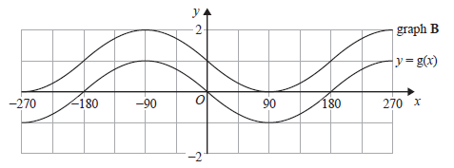
Exercise
(on provided sheet)
8
The graph of $y=g\left(x\right)$ is shown on the grid.
Graph $B$ is a translation of the graph of $y=g\left(x\right)$.
Write down the equation of graph $B$.
$$y=g\left(x\right)+1$$
?

Slide 26
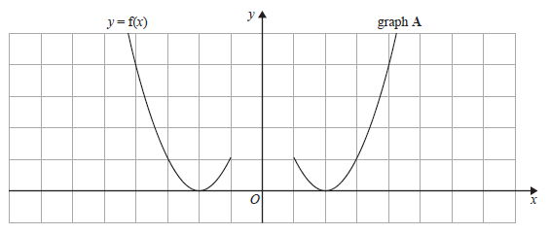
Exercise
(on provided sheet)
9
The graph of $y=f\left(x\right)$ is shown on the grid.
Graph $A$ is a reflection of the graph of $y=f\left(x\right)$.
Write down the equation of graph $A$.
$$y=f\left(−x\right)$$
?

Slide 27
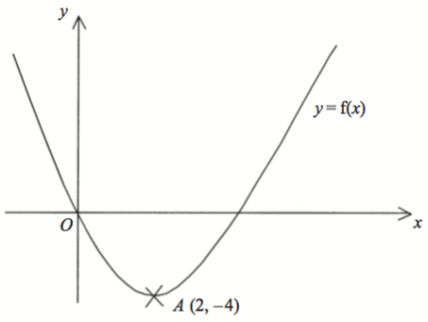
Exercise
(on provided sheet)
10
This is a sketch of the curve with equation $y=f\left(x\right)$ . It passes through the origin $O$.
The only vertex of the curve is at $A\left(2,−4\right)$.
The curve with equation $y=x^{2}$ has been translated to give the curve $y=f\left(x\right)$.
Find $f\left(x\right)$ in terms of $x$.
?
$f\left(x\right)={\left(x−2\right)}^{2}−4$

Slide 28
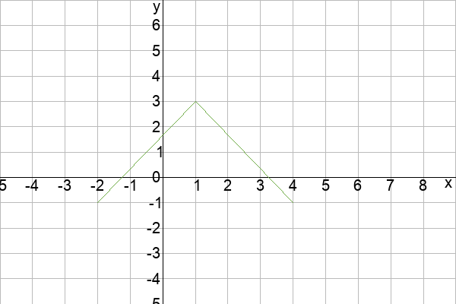
Exercise
(on provided sheet)
11
Here is the graph of $y=f\left(x\right)$
On the grid, draw the graph of $y=2f\left(x\right)$
? Reveal

Slide 29
Exercise
(on provided sheet)
12
Here is the graph of $y=f\left(x\right)$
On the grid, draw the graph of $y=f\left(−x\right)$
? Reveal

Slide 30
Exercise
(on provided sheet)
13
The coordinates of the turning point of the graph of $y=x^{2}−8x+25$ is $\left(4,9\right)$.
Hence describe the single transformation which maps the graph of $y=x^{2}$ onto the graph of $y=x^{2}−8x+25$.
Completing the square: $y={\left(x−4\right)}^{2}+9$. Therefore:
Translation by $\left(\begin{matrix}4 \\ 9\end{matrix}\right)$
?

Slide 31
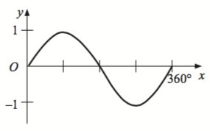
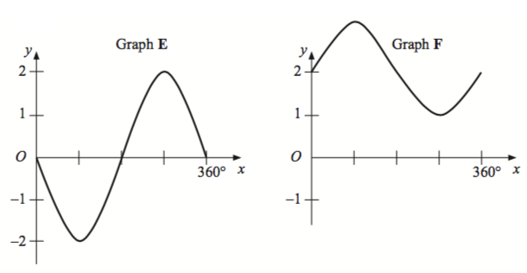
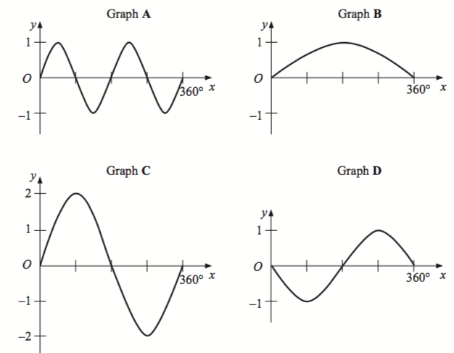
Exercise
(on provided sheet)
14
Here is the graph of $y= sin x$, where $0^{°}≤x≤{360}^{°}$
Match the following graphs to the equations.
Equation | Graph
$$y=2 sin x$$ | C
$$y=− sin x$$ | D
$$y= sin 2x$$ | A
$$y= sin x+2$$ | F
$$y= sin \frac{1}{2}x$$ | B
$$y=−2 sin x$$ | E
?

Slide 32
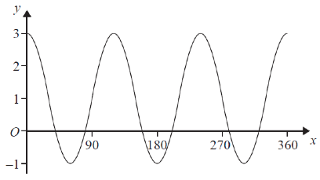
Exercise
(on provided sheet)
15
Here is a sketch of the curve y = a cos bx° + c, 0 ≤ x ≤ 360
Find the values of a, b and c.
The $b$ controls the horizontal stretch. Ordinarily a cos graph does ‘one cycle’ per $360°$, but above it does 3, so $b=3$.
Ordinarily a cos graph goes from -1 to 1 on the $y$-axis, i.e. a height of 2. But above the height is 4, so $a=2$.
But this would make $y$ be between -2 and 2, so we need to add 1 to $y$. Therefore $c=1$.
?

