Slide 1
GCSE: Curved Graphs
Dr J Frost (jfrost@tiffin.kingston.sch.uk)
www.drfrostmaths.com
Last modified: 28th December 2016

Slide 2
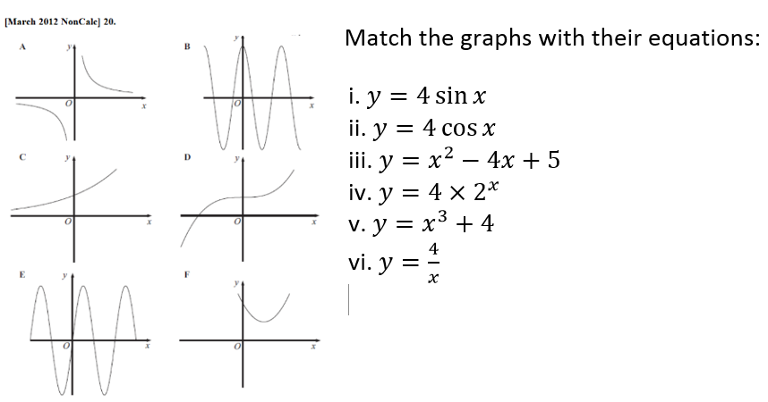
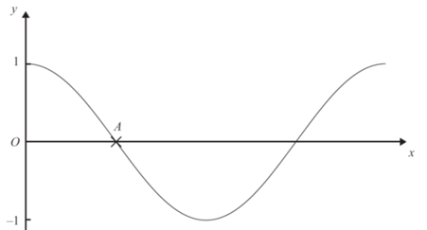
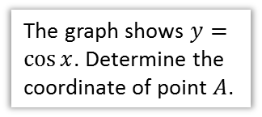
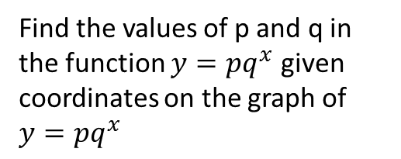
GCSE Specification
1
Plot and recognise quadratic, cubic, reciprocal, exponential and circular functions.
Plot and recognise trigonometric functions $y=\sin{x}$ and $y=\cos{x}$, within the range -360° to +360°
2
Find the values of p and q in the function $y=pq^{x}$ given coordinates on the graph of $y=pq^{x}$
“Given that $\left(2,6\right)$ and $\left(5,162\right)$ are points on the curve $y=ka^{x}$, find the value of $k$ and $a$.”
3
Use the graphs of these functions to find approximate solutions to equations, e.g. given $x$ find $y$ (and vice versa)
The diagram shows the graph of y = x² – 5x – 3
(a) Use the graph to find estimates for the solutions of
(i) x² – 5x – 3 = 0
(ii) x² – 5x – 3 = 6
1b
We already covered this in “Advanced Trig”
The graph shows $y=\cos{x}$. Determine the coordinate of point $A$.
4
We’ll separately cover quadratic graphs in more detail.

Slide 3
Skill #1: Recognising Graphs
Linear
$$y=ax+b$$
When $a>0$
$$y=ax+b$$
When $a<0$
?
?
?
MATT DAMON MOMENT
The line is known as a straight line.

Slide 4
Skill #1: Recognising Graphs
Quadratic
$$y=ax^{2}+bx+c$$
When $a>0$
$$y=ax^{2}+bx+c$$
When $a<0$
?
?
The line for a quadratic equation is known as a parabola.
?

Slide 5
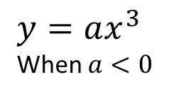
Skill #1: Recognising Graphs
Cubic
$$y=ax3$$
When $a>0$
$$y=ax^{3}+bx^{2}+cx+d$$
When $a>0$
y
?
?
x
$$y=ax^{3}$$
When $a<0$
$$y=ax^{3}+bx^{2}+cx+d$$
When $a<0$
y
?
?
x

Slide 6
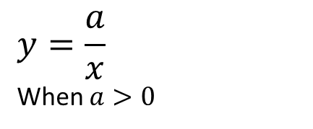

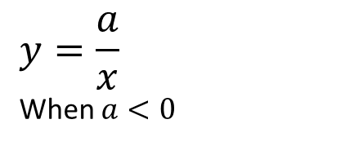
Skill #1: Recognising Graphs
Reciprocal
$$y=\frac{a}{x}$$
When $a>0$
$a$ is a constant while $x$ is a variable, so we might have $y=\frac{3}{x}$
$$y=\frac{a}{x}$$
When $a<0$
?
?
?
The lines $x=0$and $y=0$ are called asymptotes.
! An asymptote is a straight line which the curve approaches at infinity.
You don’t need to know this until A Level.

Slide 7
Skill #1: Recognising Graphs
Exponential
$$y=a×b^{x}$$
?
y
$$a$$
x
?
The $y$-intercept is $a$ because $a×b^{0}=a×1=a$.
(unless $a = 0$, but let’s not go there!)

Slide 8
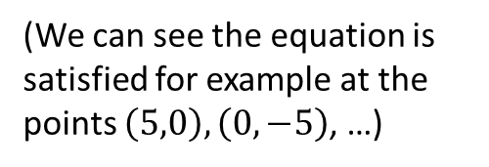
Skill #1: Recognising Graphs
Circle
The equation of this circle is:
$$x^{2}+y^{2}=25$$
$$y$$
?
5
(We can see the equation is satisfied for example at the points $\left(5,0\right), \left(0,−5\right)$, …)
$$x$$
-5
5
-5
The equation of a circle with centre at the origin and radius $r$ is: $x^{2}+y^{2}=r^{2}$

Slide 9
Quickfire Circles
1
?
3
4
-1
1
-3
3
-4
4
-1
-3
-4
?
?
$$x^{2}+y^{2}=1$$
$$x^{2}+y^{2}=9$$
$$x^{2}+y^{2}=16$$
?
?
8
10
6
-8
8
-10
10
-6
6
-8
-10
-6
$$x^{2}+y^{2}=64$$
$$x^{2}+y^{2}=100$$
$$x^{2}+y^{2}=36$$
?

Slide 10
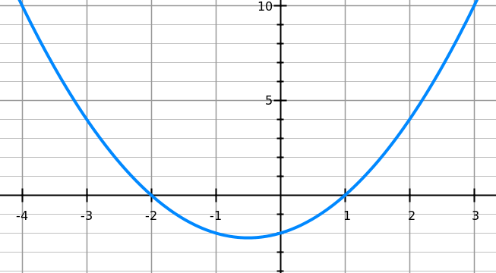
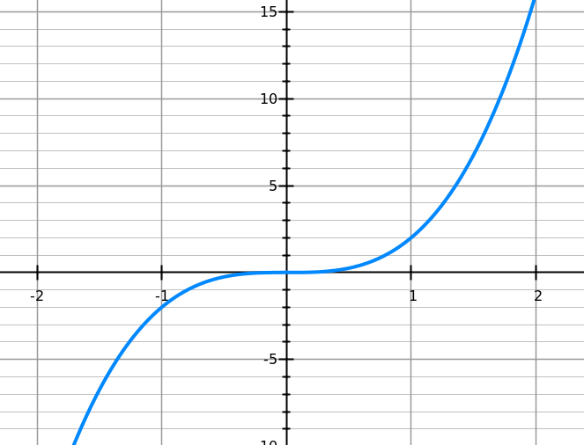
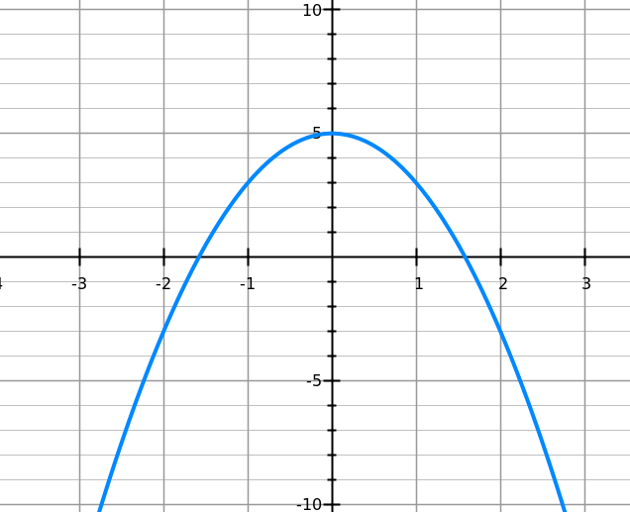
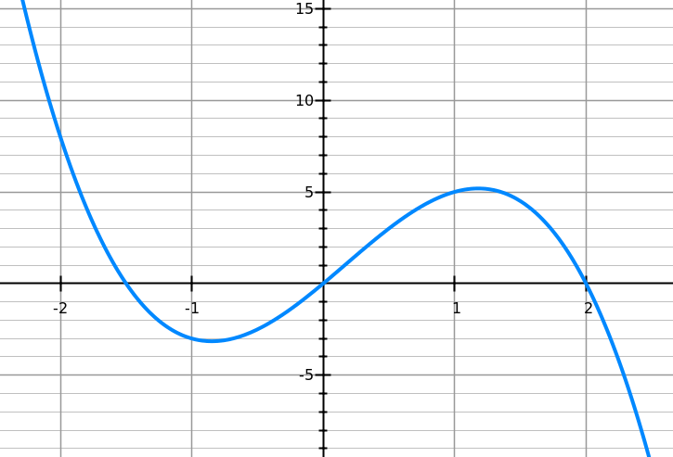
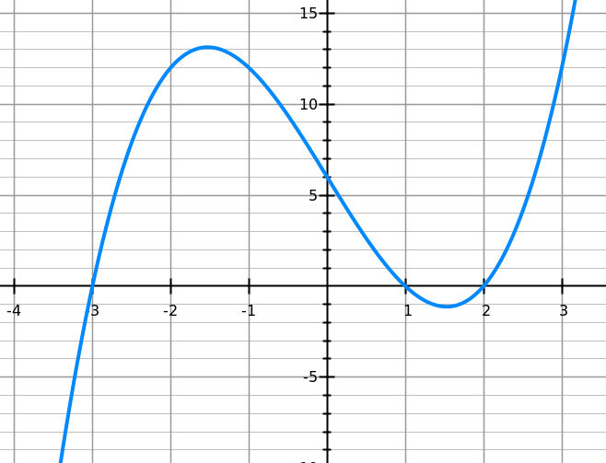
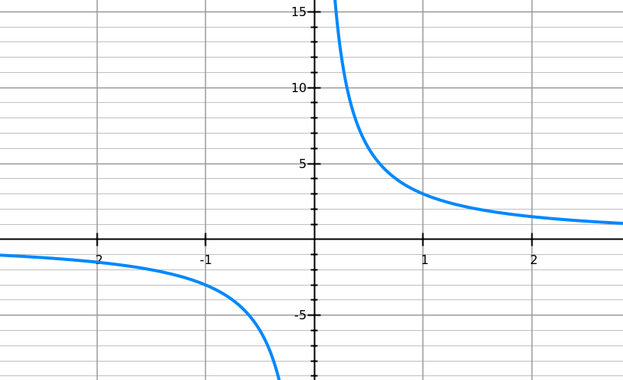
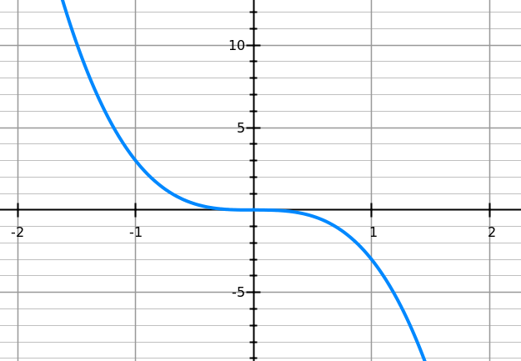
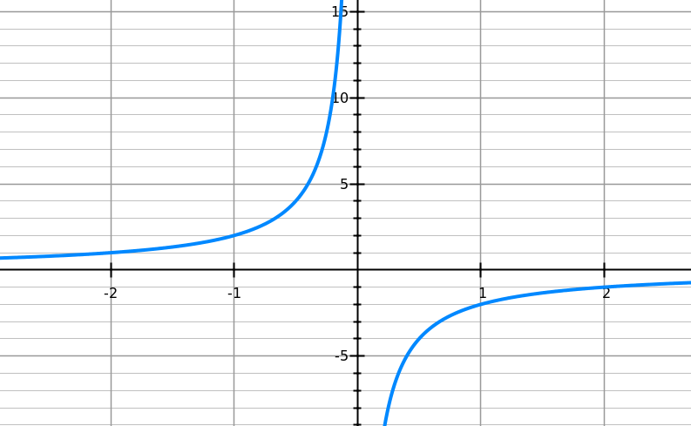
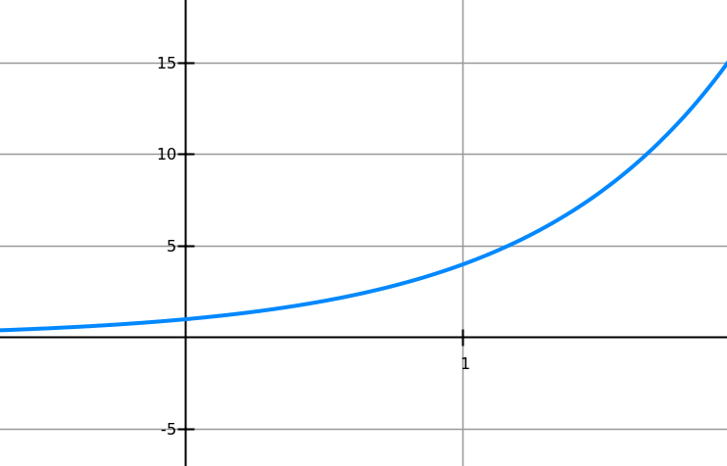
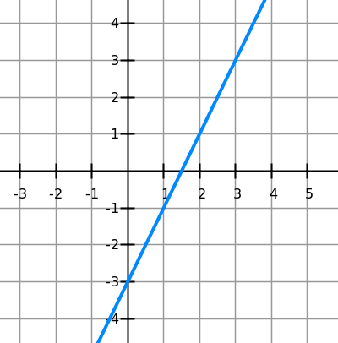
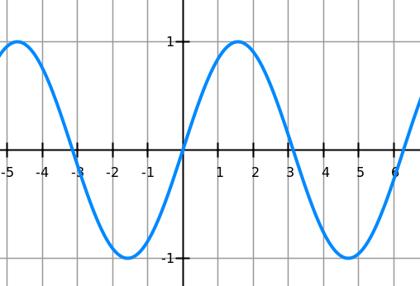
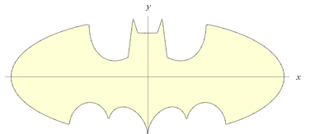
Card Sort
Match the graphs with the equations.
A
B
C
D
Equation types:
A: quadratic
B: cubic
C: quadratic
D: cubic
E: cubic
F: reciprocal
G: cubic
H: reciprocal
I: exponential
J: linear
K: sinusoidal
L: fictional
?
?
?
?
?
E
F
G
H
?
?
?
?
?
?
?
I
J
K
L
i) y = 5 - 2x²
iv) y = 3/x
vii) y=-2x³ + x² + 6x
x) y = x² + x - 2
←
Click to reveal answers.
ii) y = 4^{x}
v) y = x³ – 7x + 6
viii) y = -2/x
xi) y = sin (x)
iii) y = -3x³
vi)
ix) y = 2x³
xii) y = 2x – 3

Slide 11
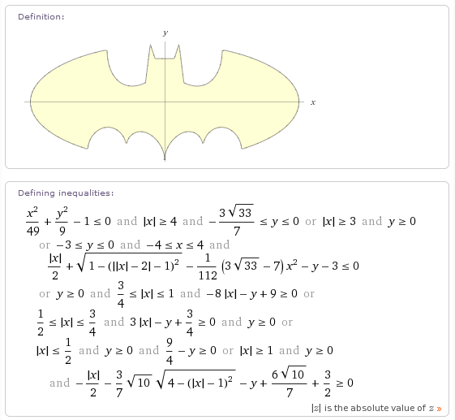

Slide 12
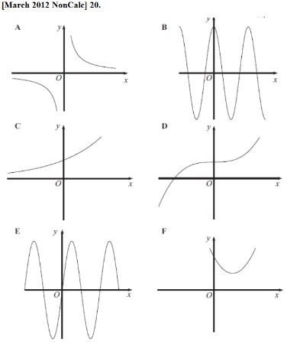
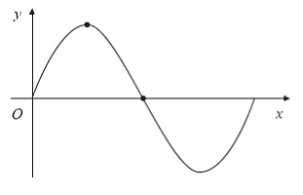
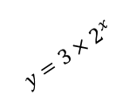
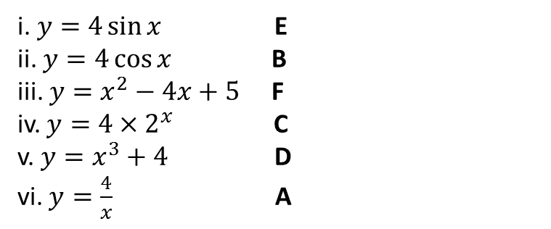
Exercise 1 (on provided sheet)
1
Identify the coordinates of the indicated points.
3
Match the graphs to their equations.
$$A$$
$$y=3×2^{x}$$
$$y=\sin{x}$$
$$C$$
$$B$$
$$x^{2}+y^{2}=9$$
$$y=\frac{4}{x}$$
$$D$$
$$E$$
1
$$A\left(90,1\right) B\left(180,0\right) \\ C\left(0,3\right) D\left(−3,0\right) \\ E\left(1,4\right)$$
?
?
?
?
?
2
Which of these graphs could have the equation $y=x^{3}−2x^{2}+3$?
?
i. $y=4\sin{x}$ E ii. $y=4\cos{x}$ B iii. $y=x^{2}−4x+5$ F iv. $y=4×2^{x}$ C v. $y=x^{3}+4$ D vi. $y=\frac{4}{x}$ A
a
b
c
c, because a is the wrong way up (given $x^{3}$ term has positive coefficient) and b has the wrong y-intercept.
?

Slide 13

SKILL #2: Finding constants of $y=a×b^{x}$
The graph shows two points $\left(1,7\right)$ and $\left(3,175\right)$ on a line with equation:
$$y=ka^{x}$$
Determine $k$ and $a$ (where $k$ and $a$ are positive constants).
(3,175)
(1,7)
Answer:
$$7=ka^{1} \\ 175=ka^{3}$$
Dividing:
$$25=a^{2} \\ a=5$$
Substituting back into 1st equation: $$k=\frac{7}{5}$$
?
Bro Hint: Substitute the values of the coordinates in to form two equations. You’re used to solving simultaneous equations by elimination – either adding or subtracting. Is there another arithmetic operation?

Slide 14
Test Your Understanding
Q
Given that $\left(2,6\right)$ and $\left(5,162\right)$ are points on the curve $y=ka^{x}$, find the value of $k$ and $a$.
$$6=ka^{2} \\ 162=ka^{5} \\ →27=a^{3} \\ a=3 \\ k=\frac{6}{3^{2}}=\frac{2}{3}$$
Given that $\left(3, 45\right)$ and $\left(1,\frac{9}{5} \right)$ are points on the curve $y=a^{2}b^{x}$ where $a$ and $b$ are positive constants, find the value of $a$ and $b$.
$$45=a^{2}b^{3} \\ \frac{9}{5}=a^{2}b \\ →25=b^{2} \\ b=5 \\ a=\sqrt{\frac{45}{b^{3}}}=\sqrt{\frac{45}{125}}=\sqrt{\frac{9}{25}}=\frac{3}{5}$$
?
N
?

Slide 15
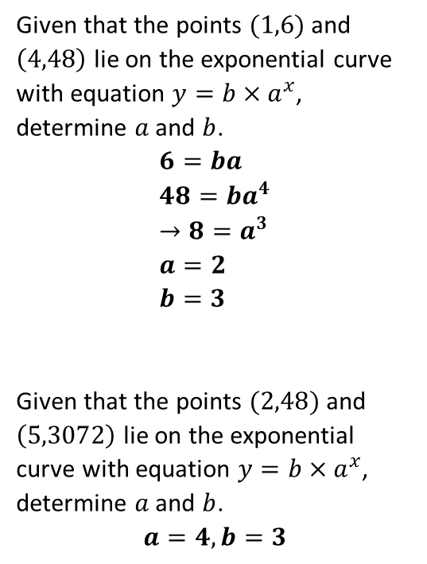
Exercise 2
1
Given that the points $(1,6)$ and $\left(4,48\right)$ lie on the exponential curve with equation $y=b×a^{x}$, determine $a$ and $b$.
$$6=ba \\ 48=ba^{4} \\ →8=a^{3} \\ a=2 \\ b=3$$
Given that the points $(2,48)$ and $\left(5,3072\right)$ lie on the exponential curve with equation $y=b×a^{x}$, determine $a$ and $b$.
$$a=4, b=3$$
3
Given that the points $(1,3)$ and $\left(3,108\right)$ lie on the exponential curve with equation $y=b×a^{x}$, determine $a$ and $b$.
$$a=3, b=\frac{1}{2}$$
Given that the points $(3,\frac{1}{72})$ and $\left(7,\frac{1}{1152}\right)$ lie on the exponential curve with equation $y=b^{2}a^{x}$, determine $a$ and $b$.
$$a=\frac{1}{2},b=\frac{1}{3}$$
?
?
4
2
?
?

