Slide 1
GCSE: Changing the Subject
Dr J Frost (jfrost@tiffin.kingston.sch.uk)
www.drfrostmaths.com
Last modified: 13th October 2016

Slide 2
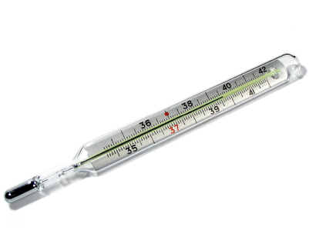
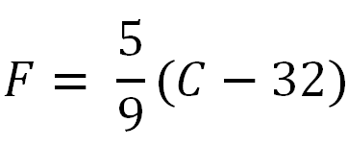
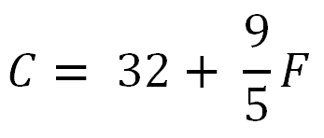
Motivation
The formula to calculate a temperature in Fahrenheit if we have the temperature in Celsius:
How could we find a new formula that allows us to determine the temperature in Celsius given the temperature in Fahrenheit?
?

Slide 3
Basic Skill #1: ‘Undoing’ to Unlock
Make $x$ the subject of the formula.
Undo the last thing done to the subject each time by doing the opposite.
Bro Tip: It doesn’t matter what side the subject is on, provided it’s on its own!
$$y=x−2$$
?
$$x=y+2$$
$$x=\frac{y−2}{3}$$
?
$$y=3x+2$$
?
$$y=\sqrt{x}+1$$
$$x={\left(y−1\right)}^{2}$$
$$y=\frac{x^{2}−a}{4}$$
$$x=±\sqrt{4y+a}$$
?

Slide 4
Basic Skill #2: Subject trapped in a negative term
When the subject is within the first argument of a subtraction, it’s easy to ‘release’.
$$2x=y+3$$
$$y=2x−3$$
?
However, it’s a tiny bit harder if the subject is in the term being subtracted.
When the subject is inside a negative term, just add it to both sides.
?
$$y=3−2x$$
$$y+2x=3$$
$$2x=3−y$$
?

Slide 5
Doing it in one step… (if you like)
How could you rearrange the numbers in $9−5=4$ to get another subtraction?
$$9−4=5$$
?
This suggests you can swap the thing you’re subtracting with the result. (i.e. Only the thing to the left of the subtraction stays put)
Examples:
$$a−x=b \\ a−b=x$$
$$bc=b^{2}−2x \\ 2x=b^{2}−bc \\ x=\frac{b^{2}−bc}{2}$$
$$yz^{2}−ax^{2}=by \\ ax^{2}=yz^{2}−by \\ x^{2}=\frac{yz^{2}−by}{a} \\ x=±\sqrt{\frac{yz^{2}−by}{a}}$$
?
?
?

Slide 6
Exercise 1
In each case make $x$ the subject of the formula. (Set 1 & 2: Only do odd questions)
$$\frac{x}{a}+b=c →x=a\left(c−b\right) \\ \sqrt{x}−2b=c →{x=\left(c+2b\right)}^{2}$$
$$a\sqrt{x+b}=c →x={\left(\frac{c}{a}\right)}^{2}−b$$
$$z^{2}=3\left(x+4\right) →x=\frac{z^{2}}{3}−4 \\ 4x^{2}+b^{2}=c →x=±\sqrt{\frac{c−b^{2}}{4}}$$
?
1
?
$$\frac{2−3x}{r}=2s →x=\frac{2−2rs}{3}$$
$$1−\frac{a}{2}\left(b−x^{2}\right)=c \\ →x=±\sqrt{b−\frac{2−2c}{a}}$$
$$y=1−{\left(1−x\right)}^{2} → x=1±\sqrt{1−y}$$
$$ab=c^{2}−d\sqrt{x} →x={\left(\frac{c^{2}−ab}{d}\right)}^{2} \\ y=1−\sqrt{1−\sqrt{1−x}} \\ →x=1−{\left(1−{\left(1−y\right)}^{2}\right)}^{2}$$
$$a−\frac{b−c\sqrt{x}}{d+e}=f−g \\ →x={\left(\frac{b−\left(a+g−f\right)\left(d+e\right)}{c}\right)}^{2}$$
15
2
?
3
?
16
4
?
?
?
5
17
?
?
?
18
6
$$b^{2}−x=c → x=b^{2}−c \\ pq=a−3x →x=\frac{a−pq}{3} \\ 1−\sqrt{x}=y →x={\left(1−y\right)}^{2} \\ ab^{2}=c^{3}−x^{2} →x=±\sqrt{c^{3}−ab^{2}} \\ a−\frac{x}{b}=c →x=b\left(a−c\right) \\ a−\frac{x}{b−d}=c →x=\left(a−c\right)\left(b−d\right) \\ a\left(b−x\right)=d →x=\frac{ab−d}{a} \\ 3−\frac{x+a}{b}=cd →x=b\left(3−cd\right)−a \\ q=3−\sqrt{cd−x} →x=cd−{\left(3−q\right)}^{2}$$
7
?
?
N
8
9
?
?
10
?
11
?
N
?
?
12
13
?
14
?

Slide 7
Basic Skill #3: Subject trapped in a denominator
When the subject is in the numerator of a fraction, it’s easy to ‘release’ the subject from the fraction.
$$y=\frac{x}{q}$$
?
$$x=qy$$
But it’s a bit harder if the subject is in the denominator…
In general, whenever you have a fraction in an equation, your instinct should be to multiply both sides by the denominator.
$$y=\frac{q}{x+1}$$
?
$$y\left(x+1\right)=q$$
$$x+1=\frac{q}{y}$$
?
$$x=\frac{q}{y}−1$$
?

Slide 8
Basic Skill #3: Subject trapped in a denominator
! Isolate the fraction on one side of the equation, then multiply by denominator.
$$a=\frac{b−c}{x} \\ x=\frac{b−c}{a}$$
$$\frac{a}{x}+b=c \\ \frac{a}{x}=c−b \\ a=x\left(c−b\right) \\ \frac{a}{c−b}=x$$
1
2
?
?
$$a=b−\frac{c}{x} \\ \frac{c}{x}=b−a \\ x=\frac{c}{b−a}$$
3
?

Slide 9
Doing it in one step… (if you like)
How would you rearrange the numbers in $\frac{12}{4}=3$ to get another division?
$$\frac{12}{3}=4$$
?
Thus we can swap the thing we’re dividing by and the result. The numerator is left unchanged.
?
$$c=\frac{b}{4−2x}$$
$$4−2x=\frac{b}{c}$$
Examples:
$$y=\frac{y^{2}}{x+y}−2 \\ y+2=\frac{y^{2}}{x+y} \\ x+y=\frac{y^{2}}{y+2} \\ x=\frac{y^{2}}{y+2}−y$$
E3
$$a=\frac{b}{x} \\ x=\frac{b}{a}$$
$$\frac{a−b^{2}}{x+1}=c \\ x+1=\frac{a−b^{2}}{c}$$
+2 first as was last thing done to $x$
E1
E2
?
?
?

Slide 10
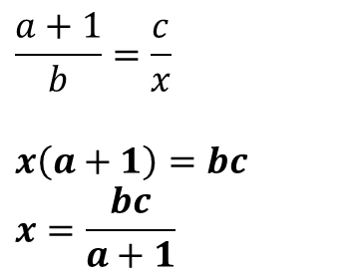
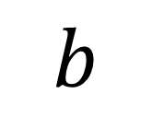
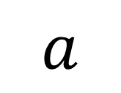
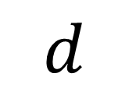


Skill #3b: ‘Cross multiplying’
If you have just a fraction on each side of the equation, you can ‘cross multiply’.
$$a$$
$$c$$
$$=$$
Click for Bromanimation
$$b$$
$$d$$
Examples:
Make $x$ the subject:
$$\frac{b^{2}}{x−1}=\frac{c}{d}$$
$$b^{2}d=c\left(x−1\right) \\ \frac{b^{2}d}{c}=x−1 \\ \frac{b^{2}d}{c}+1=x$$
$$\frac{a+1}{b}=\frac{c}{x}$$
$$x\left(a+1\right)=bc \\ x=\frac{bc}{a+1}$$
E2
E1
?
?

Slide 11
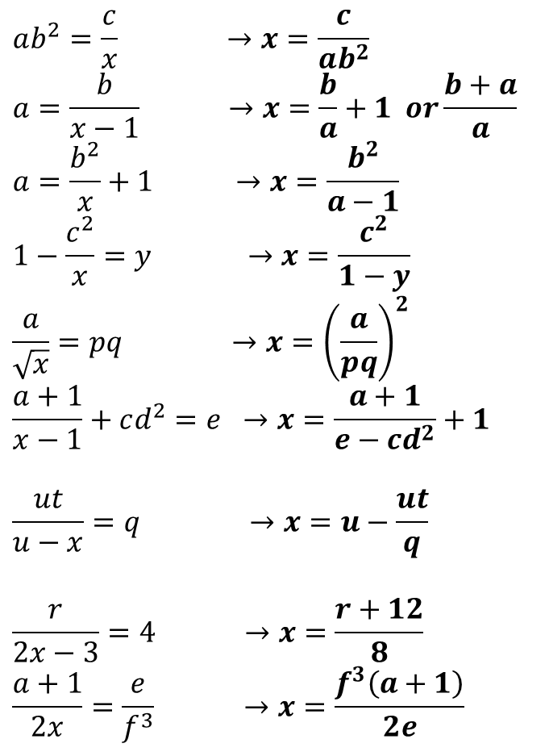
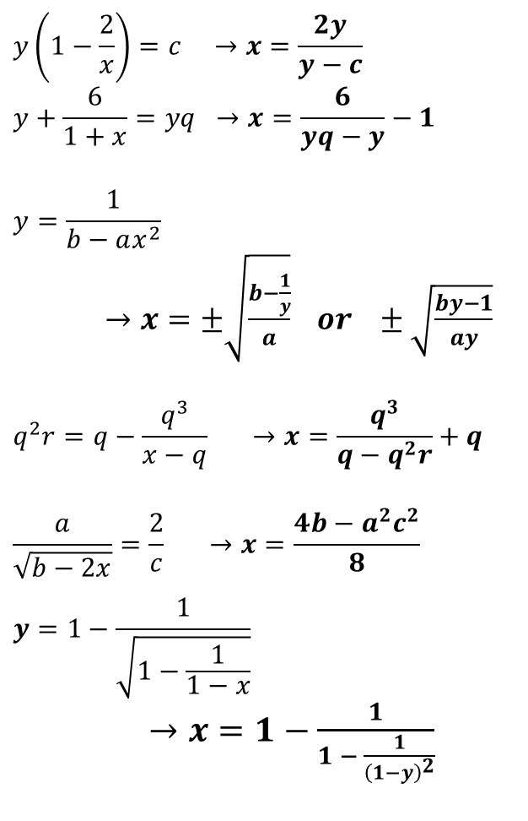
Exercise 2
In each case make $x$ the subject of the formula. (Sets 1 & 2: Odd numbered questions)
?
?
$$ab^{2}=\frac{c}{x} →x=\frac{c}{ab^{2}} \\ a=\frac{b}{x−1} →x=\frac{b}{a}+1 or\frac{b+a}{a} \\ a=\frac{b^{2}}{x}+1 →x=\frac{b^{2}}{a−1} \\ 1−\frac{c^{2}}{x}=y →x=\frac{c^{2}}{1−y} \\ \frac{a}{\sqrt{x}}=pq →x={\left(\frac{a}{pq}\right)}^{2} \\ \frac{a+1}{x−1}+cd^{2}=e →x=\frac{a+1}{e−cd^{2}}+1$$
$$\frac{ut}{u−x}=q →x=u−\frac{ut}{q}$$
$$\frac{r}{2x−3}=4 →x=\frac{r+12}{8} \\ \frac{a+1}{2x}=\frac{e}{f^{3}} →x=\frac{f^{3}\left(a+1\right)}{2e}$$
$$y\left(1−\frac{2}{x}\right)=c →x=\frac{2y}{y−c}$$
$$y+\frac{6}{1+x}=yq →x=\frac{6}{yq−y}−1$$
$$y=\frac{1}{b−ax^{2}}$$ $→x=±\sqrt{\frac{b−\frac{1}{y}}{a}} or ±\sqrt{\frac{by−1}{ay}}$
$$q^{2}r=q−\frac{q^{3}}{x−q} →x=\frac{q^{3}}{q−q^{2}r}+q$$
$$\frac{a}{\sqrt{b−2x}}=\frac{2}{c} →x=\frac{4b−a^{2}c^{2}}{8}$$
$$y=1−\frac{1}{\sqrt{1−\frac{1}{1−x}}}$$ $→x=1−\frac{1}{1 − \frac{1}{{\left(1−y\right)}^{2}}}$
1
11
?
?
2
12
?
3
13
?
4
?
?
5
?
?
6
14
?
?
7
N
?
N
8
?
?
9

Slide 12
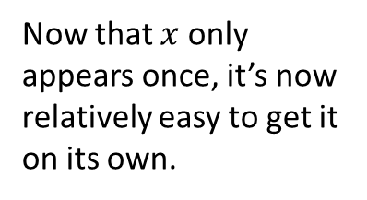

What if the subject appears multiple times?
Make $x$ the subject of:
$$2x+πx=3$$
What could we do on the LHS which would mean $x$ only appears once?
?
$$x\left(2+π\right)=3 \\ x=\frac{3}{2+π}$$
Now that $x$ only appears once, it’s now relatively easy to get it on its own.
?

Slide 13



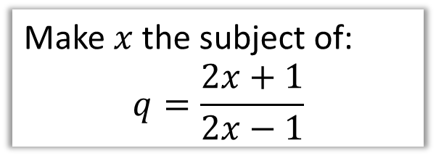
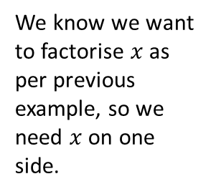
More examples
Make $x$ the subject of:
$$y=\frac{x+1}{2x}$$
Make $x$ the subject of:
$$q=\frac{2x+1}{2x−1}$$
We don’t like fractions in equations, so…
?
$$2xy=x+1 \\ 2xy−x=1 \\ x\left(2y−1\right)=1 \\ x=\frac{1}{2y−1}$$
?
?
We know we want to factorise $x$ as per previous example, so we need $x$ on one side.
$$q\left(2x−1\right)=2x+1 \\ 2xq−q=2x+1 \\ 2xq−2x=1+q \\ x\left(2q−2\right)=1+q \\ x=\frac{1+q}{2q−2}$$
?
?
Make $a$ the subject of:
$$a+\frac{πa}{2}=b$$
$$2a+πa=2b \\ a\left(2+π\right)=2b \\ a=\frac{2b}{2+π}$$
?

Slide 14
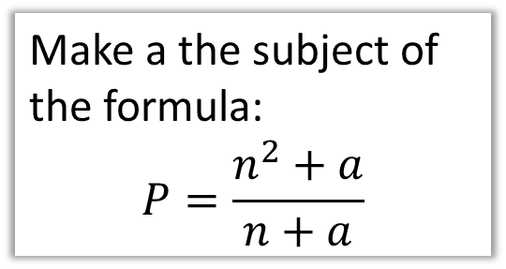


Test Your Understanding
Method Reminder:
Isolate subject on one side (and other terms of other side).
Factorise it.
Make $x$ the subject of the formula $x+1=ax+3$
Make a the subject of the formula:
$$P=\frac{n^{2}+a}{n+a}$$
$$x−ax=2 \\ x\left(1−a\right)=2 \\ x=\frac{2}{1−a}$$
?
Bro Note: According to the Examiner’s Report, only 5% of students got full marks to this question)
$$P\left(n+a\right)=n^{2}+a \\ Pn+Pa=n^{2}+a \\ Pn−n^{2}=a−Pa \\ Pn−n^{2}=a\left(1−P\right) \\ a=\frac{Pn−n^{2}}{1−P}$$
?

Slide 15
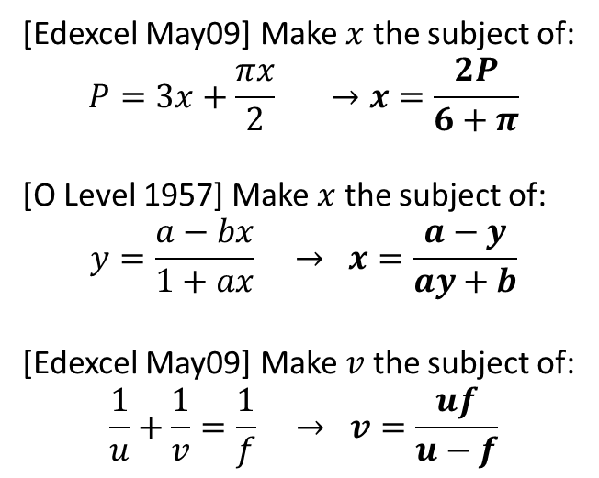
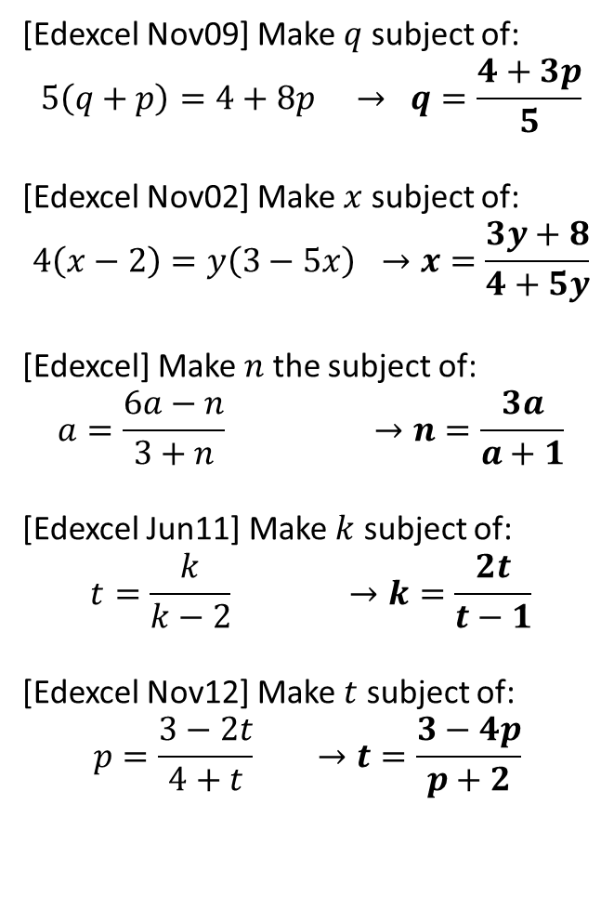
Exercise 3
1
[Edexcel Nov09] Make $q$ subject of:
$$5\left(q+p\right)=4+8p → q=\frac{4+3p}{5}$$
[Edexcel Nov02] Make $x$ subject of:
$$4\left(x−2\right)=y\left(3−5x\right) →x=\frac{3y+8}{4+5y}$$
[Edexcel] Make $n$ the subject of:
$$a=\frac{6a−n}{3+n} →n=\frac{3a}{a+1}$$
[Edexcel Jun11] Make $k$ subject of:
$$t=\frac{k}{k−2} →k=\frac{2t}{t−1}$$
[Edexcel Nov12] Make $t$ subject of:
$$p=\frac{3−2t}{4+t} →t=\frac{3−4p}{p+2}$$
6
[Edexcel May09] Make $x$ the subject of:
$$P=3x+\frac{πx}{2} →x=\frac{2P}{6+π}$$
[O Level 1957] Make $x$ the subject of:
$$y=\frac{a−bx}{1+ax} → x=\frac{a−y}{ay+b}$$
[Edexcel May09] Make $v$ the subject of:
$$\frac{1}{u}+\frac{1}{v}=\frac{1}{f} → v=\frac{uf}{u−f}$$
?
?
2
7
?
?
3
8
?
?
4
?
5
?

Slide 16
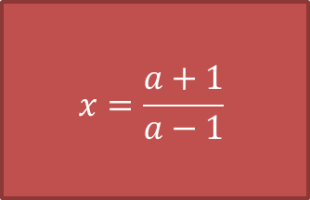
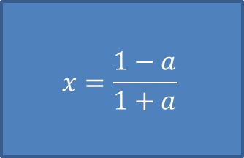
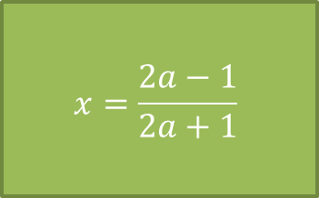
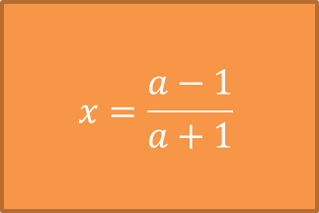
Make $x$ the subject
$$a=\frac{x+1}{x−1}$$
$$x=\frac{a+1}{a−1}$$
$$x=\frac{a−1}{a+1}$$
$$x=\frac{2a−1}{2a+1}$$
$$x=\frac{1−a}{1+a}$$

Slide 17
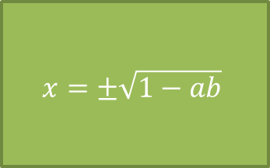
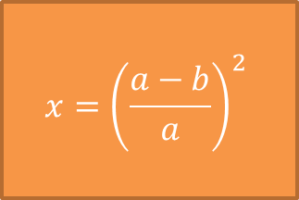
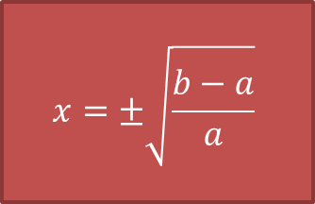
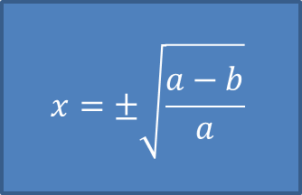
Make $x$ the subject
$$a=\frac{b}{1−x^{2}}$$
$$x=±\sqrt{\frac{b−a}{a}}$$
$$x={\left(\frac{a−b}{a}\right)}^{2}$$
$$x=±\sqrt{1−ab}$$
$$x=±\sqrt{\frac{a−b}{a}}$$

Slide 18
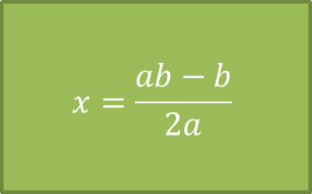
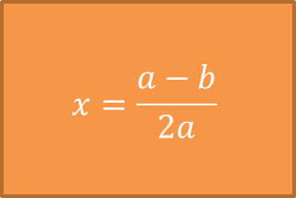
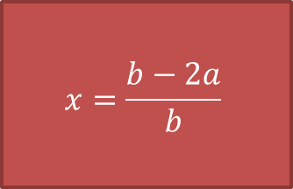
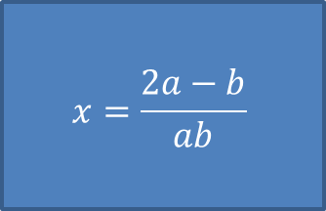
Make $x$ the subject
$$a=\frac{ax+b}{b−x}$$
$$x=\frac{b−2a}{b}$$
$$x=\frac{a−b}{2a}$$
$$x=\frac{ab−b}{2a}$$
$$x=\frac{2a−b}{ab}$$

Slide 19
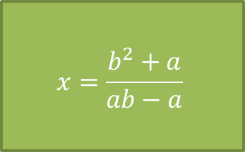
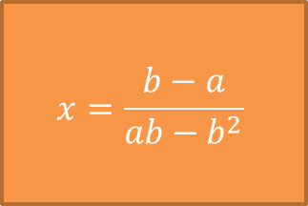
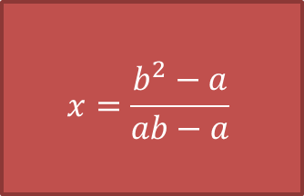
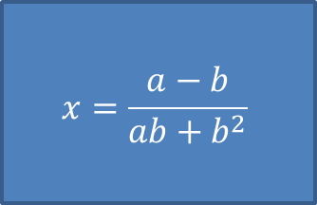
Make $x$ the subject
$$a=\frac{b^{2}x+b}{bx+1}$$
$$x=\frac{b^{2}−a}{ab−a}$$
$$x=\frac{b−a}{ab−b^{2}}$$
$$x=\frac{b^{2}+a}{ab−a}$$
$$x=\frac{a−b}{ab+b^{2}}$$

Slide 20
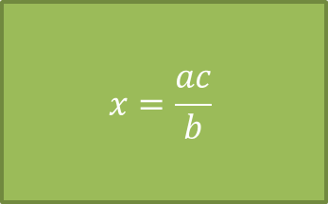
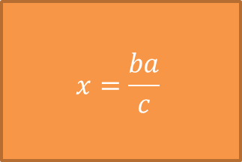
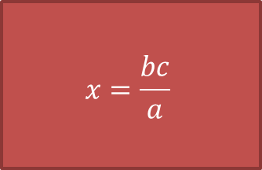
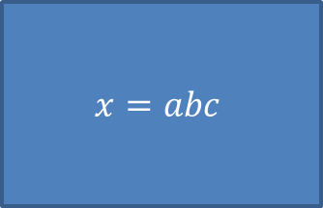
Make $x$ the subject
$$\frac{a}{b}=\frac{c}{x}$$
$$x=\frac{bc}{a}$$
$$x=\frac{ba}{c}$$
$$x=\frac{ac}{b}$$
$$x=abc$$

Slide 21
Further Exercises
In all cases make $x$ the subject.
$a=b+c\sqrt{x}$ $x={\left(\frac{a−b}{c}\right)}^{2}$
$a=\sqrt{\frac{b}{x}}$ $x=\frac{b}{a^{2}}$
$a=bx+cx$ $x=\frac{a}{b+c}$
$2x=3+πx$ $x=\frac{3}{2−π}$
$2=\frac{x}{2}+ax$ $x=\frac{4}{1+2a}$
$a=\frac{x+2}{x−2}$ $x=\frac{2a+2}{a−1}$
$a=\frac{ax+a^{2}}{bx+1}$ $x=\frac{a^{2}−a}{ab−a}$
$a=\frac{3x+1}{4−2x}$ $x=\frac{4a−1}{3+2a}$
$b=\frac{a^{2}+x}{a−x}$ $x=\frac{ba−a^{2}}{1+b}$
?
Q1
?
Q2
?
Q3
Q4
?
Q5
?
Q6
?
Q7
?
Q8
?
Q9
?

